Slide 1
Google Web Toolkit (GWT)
  St. Louis Java SIG
  April 12, 2007
  Brad Busch <brad.busch@gmail.com>
  Andrew Prunicki <prunand@iit.edu>

Slide 2
What is GWT?
GWT is a much different way to develop web applications from the past.
GWT applications are:
  Written in plain-old Java
  Compiled into Javascript to be run on the browser
  Developed using a standard JRE, the GWT workbench, and your IDE of choice
Notes:
GWT
- motivated by the complexity of writing dynamic web applications.
- analogy the original GWT developers made was that:
AJAX and Javascript is to web development what assembly is to normal development.
Remember:
GWT is a web development framework - not solely a way to add AJAX, but it could be used as such.

Slide 3
Why Java?
Testing, debugging and profiling of browser code is easily accomplished using the same tools you are using today.
Static type checking.
Java-based OO designs are easier to communicate and understand.
Java tools are very mature and feature rich.
Notes:
The Java language and its tools bring certain features to web development that are sorely needed, including:
- static type checking. Many future JavaScript errors can now caught at compile time.
- Code reuse
- Debugging
- Refactoring
- Auto completion
- Unit testing

Slide 4
Why GWT?
Dynamic web development is painful with traditional tools.
Too many disparate technologies and frameworks. HTML, XHTML, XML, CSS, JavaScript, Java, Java-EL, JSTL, AJAX, JSP, Taglibs, JSF, Struts, Tiles, Shale, Tapestry, RIFE, Seam, Spring MVC/Web Flow, Stripes, WebWork, Wicket
Avoid browser incompatibilities.
GWT 1.3 is now fully open source.
Notes:
With GWT there is:
- no need to learn JavaScript
- no need to learn DOM API's
- no more forwards and redirects (as there
is with Struts and Tiles)
- browser history management (i.e. Forward/Back buttons) is taken care of for you via the HistoryListener interface
- good availability of commonly used widgets.
- browser quirks are non-issues
- minimal configuration.

Slide 5
Key GWT Definitions
Hosted Mode: Application runs as Java bytecode within JVM. (Debugging)
Web Mode: Application runs as Javascript and HTML compiled using GWT's Java to Javascript compiler.
Module: An XML configuration file with the extension .gwt.xml. Modules are used to specify entry point class(es), source and public path entries, other inherited modules and resource injection.
Notes:
Defining these terms as they will be used throughout the presentation.
GWT applications can be run in two modes:
Hosted mode - your application is run as Java bytecode within the Java Virtual Machine (JVM).
Web mode - your application is run as pure JavaScript and HTML, compiled from your original Java source code with the GWT Java-to-JavaScript compiler.
Module - A module bundles together all the configuration settings that your GWT project needs.
Source Path - source translatable to Javascript
Public Path - these files are copied to the module's output directory. The net effect is that user-visible URLs need not include a full package name.

Slide 6
Quick Demo
Notes:
1. Give a quick demo of a GWT app in hosted mode.
2. Then run it in web mode

Slide 7
Module Definition
Look how easy it is to configure GWT:
<module>
<!-- Inherit the core Web Toolkit stuff. -->
<inherits name='com.google.gwt.user.User'/>
<!-- Specify the app entry point class. -->
<entry-point class='javasig.stl.demo.client.Chat'/>
<!-- Define chat servlet -->
<servlet path="/service/Chat" class="javasig.stl.demo.server.ChatServiceImpl"/>
</module>

Slide 8
Compilation
Client-only
Code
Common /
Serializable
Code
Server
Code
GWT Compile
javac compile
Javascript
(.html &
.xml files)
Java byte
code
(.class files)
Notes:
Compilation of a GWT project:
- the client and serializable common code gets compiled into Javascript and HTML.
- the non-serializable common code and server code get compiled directly into Java bytecode.

Slide 9
Compilation Options
Different compilation options are supported:
  Obfuscated – Can't read / Small file size
  Pretty – Easy to read / 2x obfuscated file size
  Detailed – Info overload / 4x obfuscated file size
Compiled code is Obfuscated by default.

Slide 10
Runtime Architecture
Javascript
(.html &
.xml files)
Initial Url Request
(e.g., http://foobar.com
.html, .xml,
images, css, etc.
Browser
Java byte
code
(.class files)
Server

Slide 11
RPC Architecture
Javascript
RPC
Servlets
Request
Response
Browser
Server

Slide 12
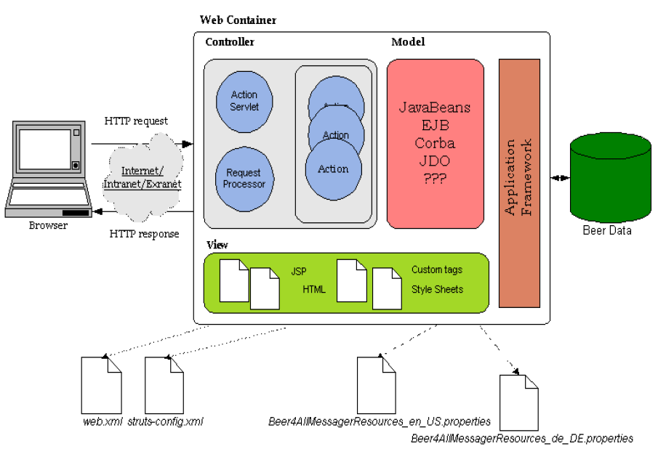
Remember Struts?
Notes:
Some comparisons can be drawn between this Struts architecture diagram an GWT's architecture, but notice how much simpler GWT is.

Slide 13
Feel the Pain!
<!-- ========== Form Bean Definitions ============ -->
<form-beans>
<form-bean name="login" type="test.struts.LoginForm" />
</form-beans>
<!-- ========== Action Mapping Definitions ======== -->
<action-mappings>
<action
path="/login"
type="test.struts.LoginAction" >
<forward name="valid" path="/jsp/MainMenu.jsp" />
<forward name="invalid" path="/jsp/LoginView.jsp" />
</action>
</action-mappings>
Notes:
Not to belay the point too much but an entire gwt application can be configured in less code that one struts action mapping.

Slide 14
Client-side Development
Since you are now developing Java code for the browser, you can now develop OO on the client. True code sharing and re-use!!
GWT is similar to other windowing toolkits (e.g., Swing, SWT)
  Event-driven
  Component-based
Notes:
Then go back to the demo and show the code. Perhaps have two classes that extend or use the same object.

Slide 15
Laying out a page
GWT Pages are layed out with containers rather than layout managers.
A rich set of containers is included. One container for example, FlexLayout, approximates GridBagLayout.
Tools are becoming available to do WYSIWYG layout (e.g., GWT Designer) under commercial licenses.

Slide 16
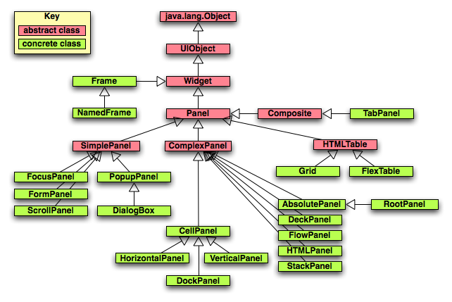
Container (Panel) Library
Notes:
GWT uses containers for layout.
Panels, such as DockPanel, HorizontalPanel, and RootPanel, contain widgets and are used to define how they are laid out in the browser.
Panels in GWT are much like their counterparts in other user interface libraries. The main difference lies in the fact that they use HTML elements such as DIV and TABLE to layout their child widgets.
- There are no layout managers.

Slide 17
Widgets
The basic set of widgets are included. For example:
  Label
  Button
  Listbox
  Textbox
  Textarea
Other (non-Google) widget libraries:
  http://gwt-widget.sourceforge.net/ - the GWT Widget Library. A large collection of widgets including edittable labels, image buttons and Scriptaculous integration amongst others.
  http://www.gwtwindowmanager.org/ GWT Window manager. Very nice looking windows.
  http://gwtpowered.org - not a widget library, but contains a list of widgets, tools, and resources available for GWT

Slide 18
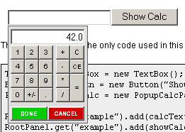
Sample 3rd Party Widgets

Slide 19
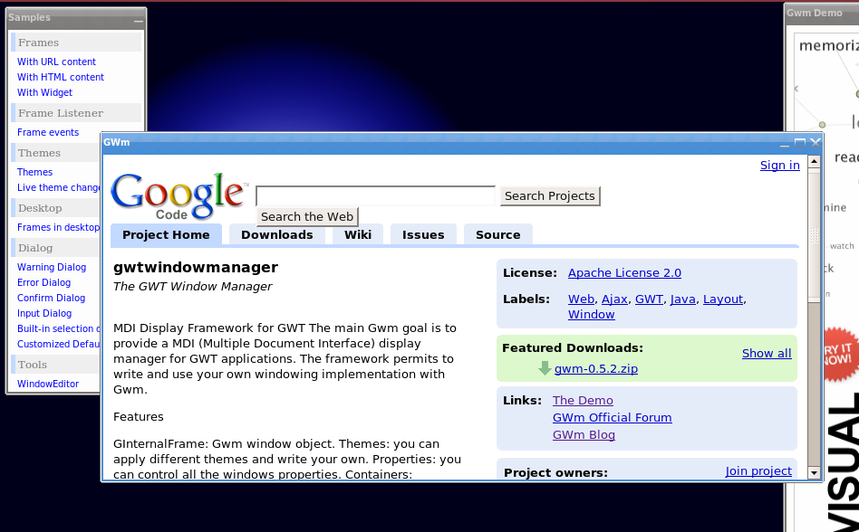
Sample 3rd Party Widgets

Slide 20
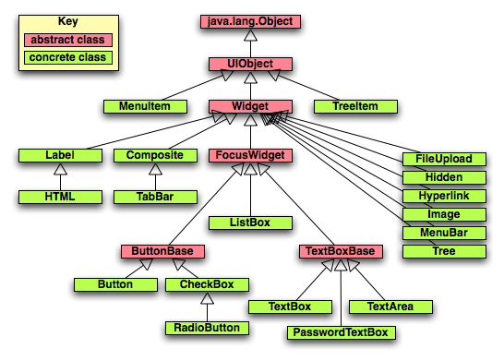
Standard Widget Library
Notes:
Widget is the base class for the majority of user-interface objects. Widget adds support for receiving events from the browser and being added directly to panels.
Create a Widget by extending other Widgets.
Lay out Widgets automatically in Panels.
Widgets are easy to style using cascading style sheets (CSS).
Send your Widget to other developers in a JAR file.

Slide 21
Calling the server
Client calls to the server are made using the GWT RPC mechanism.
Can be confusing at times.
Tools coming of age to hide the complexity (Googlipse, IntelliJ plugin)

Slide 22
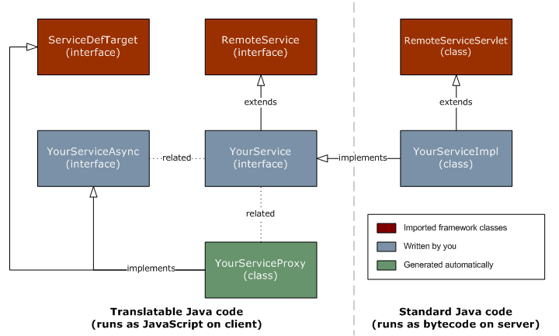
RPC Services

Slide 23
Service Implementation
public interface ChatService extends RemoteService {
public int sendMessage(User user, Friend friend, String message);
}
public class ChatServiceImpl extends RemoteServiceServlet implements ChatService {
public int sendMessage(User user, Friend friend, String message);
//Some code ...
}
}

Slide 24
Service Call
public interface ChatServiceAsync {
void sendMessage(User user, Friend friend, String message, AsyncCallback callback);
}
ChatServiceAsync serviceProxy = (ChatServiceAsync) GWT.create(ChatService.class);
ServiceDefTarget target = (ServiceDefTarget) serviceProxy;
target.setServiceEntryPoint(GWT.getModuleBaseURL()+”/service/Chat”);
AsyncCallback callback = new AsyncCallback() {
public void onFailure(Throwable caught) {
Window.alert("Problem sending message (" + caught.getMessage() + ")");
}
public void onSuccess(Object result) {
//Do something fabulous...
}
};
serviceProxy.sendMessage(_user, _friend, message, callback);

Slide 25
Module Definition
<module>
<!-- Inherit the core Web Toolkit stuff. -->
<inherits name='com.google.gwt.user.User'/>
<!-- Specify the app entry point class. -->
<entry-point class='javasig.stl.demo.client.Chat'/>
<!-- Define chat servlet -->
<servlet path="/service/Chat" class="javasig.stl.demo.server.ChatServiceImpl"/>
</module>

Slide 26
Demo RPC Debugging
Notes:
1. Make a code change
2. Debug it.

Slide 27
Integration
GWT integrates well with other frameworks.
Client-side Integration:
  Largely at the layer of embedded pages via IFrames, although custom Javascript integration is possible via JSNI.
Server-side Integration
  Anything is possible really, as RPC classes are just servlets with some method dispatching from GWT framework.

Slide 28
JSNI
JSNI methods is a powerful technique, but:
  less portable across browsers
  more likely to leak memory
  less amenable to Java tools
  hard for the compiler to optimize.
    public static native void alert(String msg) /*-{
    $wnd.alert(msg);
    }-*/;

Slide 29
Security
Be careful not to put too much on the client side, as you are exposing some inner-workings of your application.
User input must be validated on the server, just as with any framework.
Due to the fine-grained nature of exposed services, there are more points of entry exposed to malicious use.

Slide 30
Security
GWT == Javascript on the client. Consequently, Javascript vulnerabilities effect GWT.
Cross-Site Scripting (XSS)
Request Forging (XSRF)

Slide 31
Unit Testing
Test cases extend GWTTestCase
Two ways to create unit tests:
  junitCreator shell script
  through IDE
Two ways to run unit tests:
  gwt – generated unit test script
  through IDE
Notes:
Describe the unit testing framework
Show a unit testing example
Run it, get a green bar
Tweak the regular code
Run it again, get a red bar
TODO: Put sample junitCreator code in from command line.

Slide 32
Limitations
Java 1.4 compatibility
Only a subset of the base Java classes are supported. (May be less of an issue as Java goes open source).
Server-side objects may not be re-useable on the client if they have references to any code that will not / should not be on the browser. --> Consider using DTO's.

Slide 33
Consequences of GWT Development
Developer required skill-sets can be different depending on the role:
  Greater usage of OO & patterns
  Experience with event-driven programming (e.g., Swing, SWT, even VB)
  Less HTML & Javascript.
UI development may actually go faster
Greater UI consistency

Slide 34
Stuff You might want to know
GWT is completely open-source (Apache 2.0)
GWT development tools are available for Windows, Linux and Mac OS X
Compiled GWT code is cross-platform and supports the following browsers:
  Firefox, IE 5/6/7, Safari, Opera
GWT# for .Net is in development.

Slide 35
GWT Roadmap
Things to come:
  RPC simplification
  Drag and Drop support
  Java 5 language support
  Vector graphics library support: canvas, SVG, VML
See more at:
  http://code.google.com/webtoolkit/makinggwtbetter.html

Slide 36
Resources
http://code.google.com/webtoolkit
http://code.google.com/webtoolkit/makinggwtbetter.html
http://groups.google.com/group/Google-Web-Toolkit/web/security-for-gwt-applications
http://www.ajug.org/meetings/download/struts.pdf
http://www.ociweb.com/mark/programming/GWT.html

