Slide 1
Javelin StampTM
  Andrew Prunicki
  Nov. 8, 2007
Notes:
Theme created by
Sakari Koivunen and Henrik Omma
Released under the LGPL license.

Slide 2
Overview
Hardware
  Microcontrollers
  Robot Demo
  Javelin Stamp Capabilities
Software
  Javelin StampTM – Java differences
  Javelin IDE - debugging
  Source
Notes:
Theme created by
Sakari Koivunen and Henrik Omma
Released under the LGPL license.

Slide 3
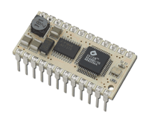
What is the Javelin?
The Javelin is a microcontroller that runs Java.
Can be programmed to perform a variety of tasks.

Slide 4
What is a Microcontroller?
Essentially a small, self-contained computer
Its a single Integrated Circuit (IC) with:
  CPU (anywhere from 4 bits to 64 bits)
  I/O interface(s)
  Volatile RAM for data
  ROM, EPROM, EEPROM or Flash for program storage
  Analog to Digital converter(s)
  Clock Generator

Slide 5
So who cares?
Microcontrollers are everywhere – in our clocks, cars, TVs, etc.
Capable of lots of direct I/O.
With the right programming and devices, microcontrollers have the ability to “sense” the outside world.
Programming them is fun!

Slide 6
Microcontrollers & Robotics
Microcontrollers are an important part of most any robot
Can be the “brain” of an unsophisticated robot
Can serve as “sensory centers” in more sophisticated robots – communicating sensory information to the “brain”.
Notes:
* Be sure to mention the Java car.

Slide 7

Microcontrollers in larger robots
2005 DARPA Grand Challenge - “Tommy”
Microcontrollers (Jstamps) controlled “extremities”
PC “brain”

Slide 8
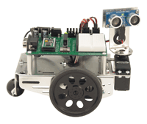
Robot Demo
Simple Javelin-powered Robot
Based on BOE-BOT, plus a PING :))) module
Notes:
Consider bring the video camera on a tri-pod so all can see.

Slide 9
Javelin Stamp Specs
Runs Java (subset) via an on-board JVM
25 Mhz (turbo)
32k of volatile RAM
32k of Flash ROM
16 I/O pins
Voltage regulator: 6 – 24V input, 6V output up to 150mA
Digital - Analog Conversion
Pulse Width Modulation

Slide 10
Virtual Peripherals
The Javelin's way to perform pre-emptive multitasking
The main thread and the VPs share program execution.
Every 8.68 µs, the VPs execute. Normal program flow resumes when VPs are done.
A maximum of 6 VPs may be installed at any given time.
Example VPs: Uart, PWM, timer, ADC

Slide 11
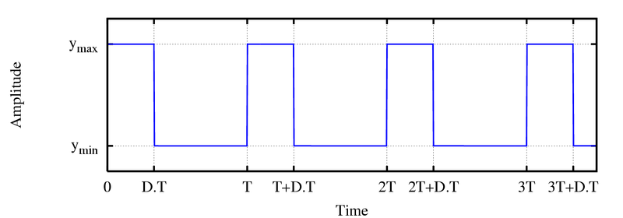
Pulse Width Modulation (PWM)
A square wave with high and low states.
Used for controlling devices, such as:
  Controlling servos
  Generating tones

Slide 12
Power
Power demands can be high.
The Javelin includes a voltage regulator, producing 6V and 150ma. The Javelin consumes 60ma, leaving 90ma available.
Peripherals beyond 90ma will need to have their own power supply.
Vin can be used if the boards power supply is regulated and its voltage meets your needs.
Must be taken into consideration in programming.

Slide 13
Why the Javelin?
Programs are written in a familiar language
You can take a more OO approach to embedded development.
Great documentation from ParallaxTM

Slide 14
Developing for the Javelin
Subset of Java 1.2
No garbage collection
No thread support (although background tasks are supported).
Supports on-board debugging
Simple ability to send/receive discrete pulses (PWM)

Slide 15
Other Notable Differences
Core Java classes are customized.
“main” method has differing method signature – no arguments
No concurrency support. In fact, “notify” has been hijacked.
Must be compiled with Jikes v. 0.47

Slide 16
Javelin Programming & OO
Javelin development allows use of OO concepts, but:
  Be prepared to compromise for memory size and speed.
  Lack of GC requires that you double-think object creation.
  Cooperative multitasking approach is different from dealing with threads

Slide 17
Cooperative multi-tasking
Your main code must perform cooperative multi-tasking
“Task” code is included with the Javelin to help.
Make usage of state machines in your design.
Timers for pre-emptive multi-tasking.
  Useful for quick tasks, such as a watchdog.

Slide 18
Real-Time Progamming
Real-Time Programming does not mean fast.
Predicability – a task can always be completed within a set amount of time
Hard vs. Soft
Garbage collection poses a problem for RTP.
  Javelin Stamp has none
  RTJ (JSR-001) – provides control over GC with a new GC algorithm

Slide 19
Development process
Write your code
Compiling & Linking
  Code must be compiled with Jikes v. 0.47
  All classes (included java.lang) are linked into a jem file.
Uploading
  Jem files are uploaded to the Javelin via serial or usb.
The Javelin IDE handles most of these details

Slide 20
Programming Demo
TestPing
Robot code
Basic Stamp version of robot code

Slide 21
Miscellaneous
Programs are stored in flash memory
At runtime, programs are copied from flash memory to RAM.
Small bits of information can be stored in flash. This information is stored at the “other end”, making it available even after re-programming. This is fairly common feature in embedded programming.

Slide 22
Other Notable Microcontrollers
Other Parallax microcontrollers
  Basic Stamp
  Propeller
  SX
Systronix Java-powered microcontrollers
  Jstamp (Ajile AJ-80)
  JStik (Ajile AJ-100)
Arduino (Atmel ATmega168)
PIC
OOPIC

Slide 23
JavelinTools
Open source project started by me to allow programming the Javelin on non-MS Windows platforms.
Contains a bug that prevents all but the most trivial programs from being uploaded.
Currently only Linux is supported. Mac OS X support may be added once all essential features are implemented.
http://sourceforge.net/projects/javelintools/

Slide 24
References, Links
http://www.parallax.com/javelin/index.asp
http://forums.parallax.com/forums/
http://sourceforge.net/projects/javelintools/
http://www.jstamp.com/
http://www.arduino.cc/
http://www.teamjefferson.com/
http://en.wikipedia.org/wiki/Pulse-width_modulation
http://java.sun.com/javase/technologies/realtime/index.jsp

