Slide 1

High Powered Messaging with
James Carr
Software Engineer
CARFAX, INC

Slide 2

About Your Speaker

Slide 3
A Brief Introduction to Messaging

Slide 4
How can I integrate multiple applications to work together and share data?

Slide 5
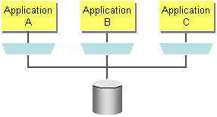
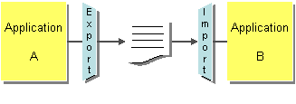
Some Solutions
Shared Database
File Transfer
Might work for your needs. You can ensure data stays consistent between applications and with shared database you have transactions to help manage concurrent updates.

Slide 6
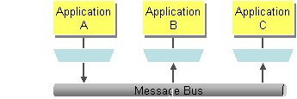
Messaging
Use messaging to integrate operations across various different systems in a way that allows for work to be done asynchronously and independent of each other. If one application goes down it should be able to resume work when it comes back up without slowing down an application publishing to it.

Slide 7
You might need messaging if…
Need to integrate different systems to work together
Need to scale
Need to be able to monitor data feeds
Decoupled Publishers and Subscribers
Queuing and Buffering for later delivery
Transfer data frequently, immediately, and asynchronously.

Slide 8
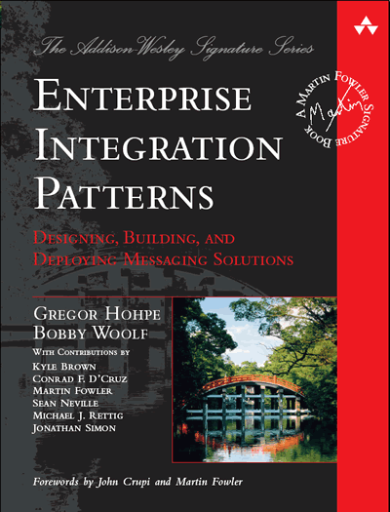
The Bible On Messaging
Ignore all the SOA books, if you really want to dig deep and understand messaging, I suggest

Slide 9
Overview of Messaging Patterns
Before digging into the details of AMQP and RabbitMQ, let's establish some of the terminology and patterns that are common.

Slide 10
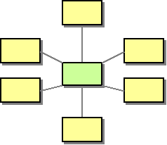
Message Broker
Answers the question “How do we decouple the destination from the sender”?
Manages the routing of messages to intended destinations

Slide 11
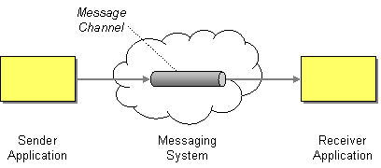
Message Channel
A message channel is what connects two peers
Sender writes to channel, receiver reads from channel

Slide 12
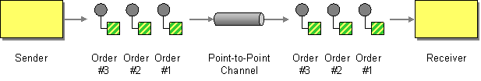
Point-to-Point Channel
A channel that connects one sender with only one receiver

Slide 13
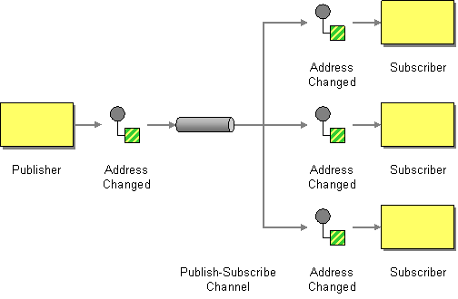
Publish-Subscribe Channel
Delivers a copy of the message to each receiver subscribing to the channel

Slide 14
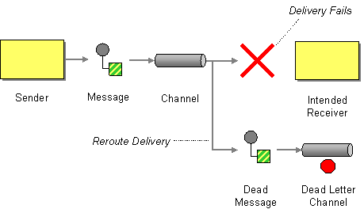
Dead Letter Channel
Where a messaging system sends a message that is undeliverable

Slide 15
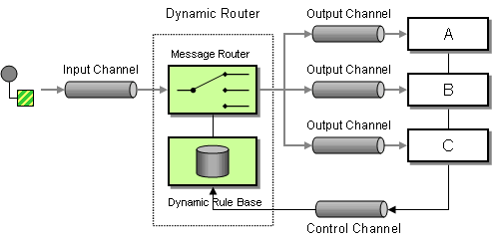
Dynamic Router
Route a message to different receiver based on some property of the message

Slide 16
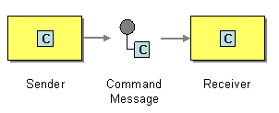
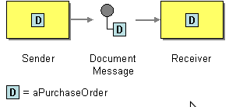
Messages
Command Message – message that causes a command to be invoked on the receiver (think remote procedure invocation)
Document Message – message that is used to transfer data between two applications (e.g. an employee record, stock share information, etc)

Slide 17
The Sad State of Messaging
Most solutions are proprietary and closed
For example, JMS defines the API, not the wire level protocol
    The wire level protocol is different for different brokers.
It's up to the vendor to determine the format, but they're not bound to any standard.

Slide 18
Open Standards to the Rescue!
There are several open formats available for messaging
  These Include
    STOMP
    AMQP
    XMPP
For this presentation I'll be discussing AMQP specifically

Slide 19

AMQP Features

Slide 20








Where? Who?

Slide 21
AMQP
Advanced Message Queuing Protocol
Defines the wire level protocol (whereas JMS defines only an API)
Completely open and specified by the AMQP Working Group
  Includes many companies, such as J.P. Morgan, Bank of America, Cisco, Red Hat, iMatrix, Rabbit Technologies, etc.
Defines the semantics of server and client behavior to ensure interoperability.

Slide 22
Components of AMQP
Broker
Exchanges
Queues
Routing Keys
Messages
Transactions

Slide 23
The Broker
Manages queues, exchanges, channels, etc
Central focal point that allows multiple peers (producers and consumers) to communicate with each other
Could be a stand alone server or an entire cluster with a virtual host name

Slide 24
Exchange
An exchange is where messages are published to. Think of an exchange as a post office that receives incoming mail (but does nothing with it).
The exchange routes messages to specific queues (mailboxes) that have been configured by clients. More on this in a bit.

Slide 25
Queues
Think of it as a mailbox that consumers read from.
  Read only. With AMQP you never publish to a queue, only exchanges
Messages are routed from exchanges to queues based on routing keys
Can be short lived (temporary) or permanent.

Slide 26
How Queues Are Consumed
Synchronously – a consumer could connect to a queue and empty the messages out one by one
Asynchronously – consumer attaches to the queue and is notified of updates
Multiple consumers can listen on a queue, they will get messages in a round robin fashion
  GREAT for load balancing!

Slide 27
Routing Keys and Bindings
How do we route messages from exchanges to queues?
  Each message contains a routing key
  Queues are bound to exchanges by routing keys or routing key patterns
Example (pseudo code)
  Queue.bind('queueA').to('exchange').on('stock.quote');

Slide 28
Back to Queues for a Minute
Multiple queues can bind on the same routing key or routing key pattern
In this case, both queues will get a copy of the message.

Slide 29
Who Creates These?
Traditionally messaging mechanisms are created and administered on the server
AMQP allows clients to create exchanges, bindings, queues and define them as they see fit
However, the option is given to revoke creation capabilities for certain user accounts

Slide 30
More on Binding
AMQP has three core exchange types the enforce specific rules on bindings
  Direct Exchange
  Topic Exchange
  Fanout Exchange

Slide 31
Direct Exchange
Matches on explicit routing keys
  For example, a queue would be bound only on a key like 'stock.quote.IBM'
Even though the name implies it's a one-to-one channel, multiple queues can be bound on the same routing key

Slide 32
Topic Exchange
Allows for binding queues by pattern to receive messages with different keys.
  For example with these routing keys:
    uk.london.order
    uk.liverpool.order
    uk.liverpool.shipment
  We could receive all messages from liverpool with:
    uk.liverpool.*
  Or all messages for uk:
    uk.#

Slide 33
Routing Key Patterns
Routing keys are defined by developers and consist of dot notation
# represents a complete wildcard match
* will only match within one section
  foo.bar.baz
    foo.*.baz (match)
    foo.* (no match)
    #.baz (match)
    #baz (no match)
    # (match anything)

Slide 34
Fanout Exchange
Basically the same as binding a queue to an exchange using only #
All routing keys are ignored, ALL messages are broadcast to ALL queues

Slide 35
Messages
MUST have a routing key
Optional fields
  Expiration
  Priority
  Delivery-mode
  Immediate

Slide 36
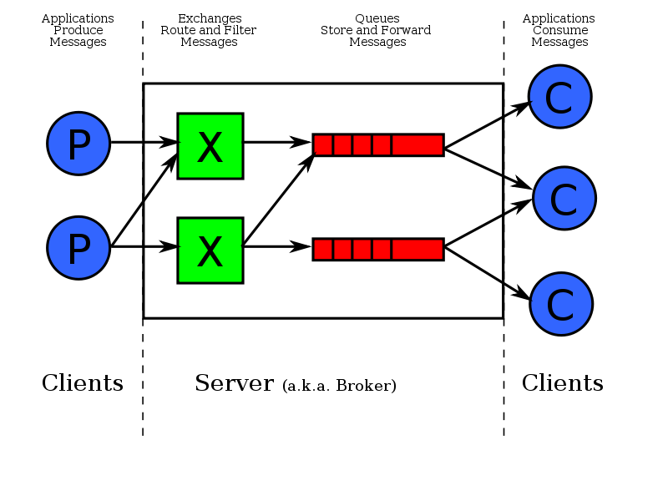
A Quick Overview

Slide 37
Check out http://www.amqp.org if you want to learn more.

Slide 38
AMQP Brokers
ZeroMQ (integrates with) – http://zeromq.org
Apache Qpid - http://qpid.apache.org/
RabbitMQ - http://www.rabbitmq.com/
Despite similarity in names, ActiveMQ does not implement AMQP

Slide 39
Why RabbitMQ?
Built using erlang and the Opent Telecom Platform
  Battle tested, fast and highly reliable
Many libraries exist for a variety of platforms
Includes several plugins that let you use different protocols as well
  STOMP, JSON-RPC, HTTP, XMPP, etc

Slide 40
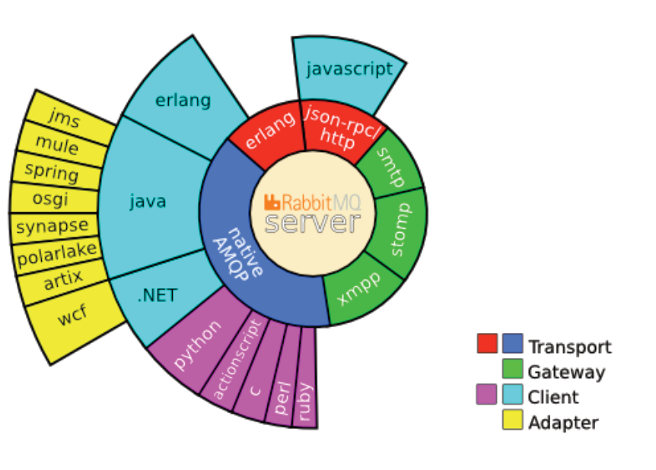

Slide 41
Commandline Control
Start up: rabbitmqctl start_app
Status: rabbitmqctl status
List queues: rabbitmqctl list_queues

Slide 42
Plugins
Has an API that allows extension of functionality
Management Plugin
Auth plugins (ldap, SSL, etc)
Easy to use... just download, drop in the plugins directory and start up the broker

Slide 43
Using RabbitMQ in Java
The client library from the rabbitmq site
Apache Camel amqp component
spring-amqp milestone release
  This means you mavenizers will need to use the alternate repository location
  http://maven.springframework.org/milestone
There’s also a rabbitmq grails plugin.

Slide 44
spring-amqp
Since this is a java user group, let's explore spring-amqp for messaging with rabbitmq
Is currently 1.0.0.M2 release, with a RC1 due this spring
API is subject to change, but works (for the most part)
  Disclaimer: I actually contributed to the project while preparing this presentation. :)

Slide 45
spring-amqp Features
Template style integration
Converters for automatic message marshaling
  Plain java serialization
  JSON
Integrates with spring-integration and spring-batch

Slide 46

Enough Jibber Jabber! Show me some code fool!

Slide 47
Example App: Stock Monitor
A stock service exists that fetches real time quotes for a ticker
A monitor application polls the service at intervals and publishes the results onto an exchange
One consumer will be a java based application
Another consumer will be a node.js based application

Slide 48
More Complex Example
How can we receive messages based on some complex logic? For example, if a stock raises a certain percentage?
Use a command message for the publisher to handle that logic itself and bind to a queue that the publisher will route that message to.

Slide 49
Dirty Details…
Licensed under the Mozilla Public License
Commercial Support Exists
Get it now, be up and running in minutes.
Contribute!

Slide 50
Links
Spring-amqp: http://www.springsource.org/spring-amqp
My Examples from this presentation: https://github.com/jamescarr/stock-amqp-service-sample
Camel AMQP Component: http://camel.apache.org/amqp.html
RabbitMQ website: http://www.rabbitmq.com/

