Slide 1
Play 2 Application Framework
Overview
Stateless High-Performance MVC web framework
Favors convention over configuration ( RoR )
Allows hot code reloading
Displays error messages in the browser
Open source under Apache 2 license
Written in scala but runs java or scala apps

Slide 2
Play 2 Application Framework
Play is NOT standard J2EE
Builds to a self contained zip file instead of war/ear file
No web.xml file etc.
Application zip file contains everything needed to run the app on java SE 6

Slide 3
Play 2 Application Framework
Build Tool
Play uses Simple Build Tool (SBT) internally instead of Maven or Ant
This fact is not very important since the Play console is used for all build related activity
SBT is included with play distribution and does not need to be installed seperately

Slide 4
Play 2 Application Framework
Installation
Download from http://www.playframework.org
Latest version is 2.0.4
Play 2.0.0 was released in March 2012
Extract zip file, add play-2.0.4 folder to path, and make the play and framework/build shell scripts executable ( chmod 744 play )
Play only needs to be installed on developer machines ( not needed on prod machines )

Slide 5
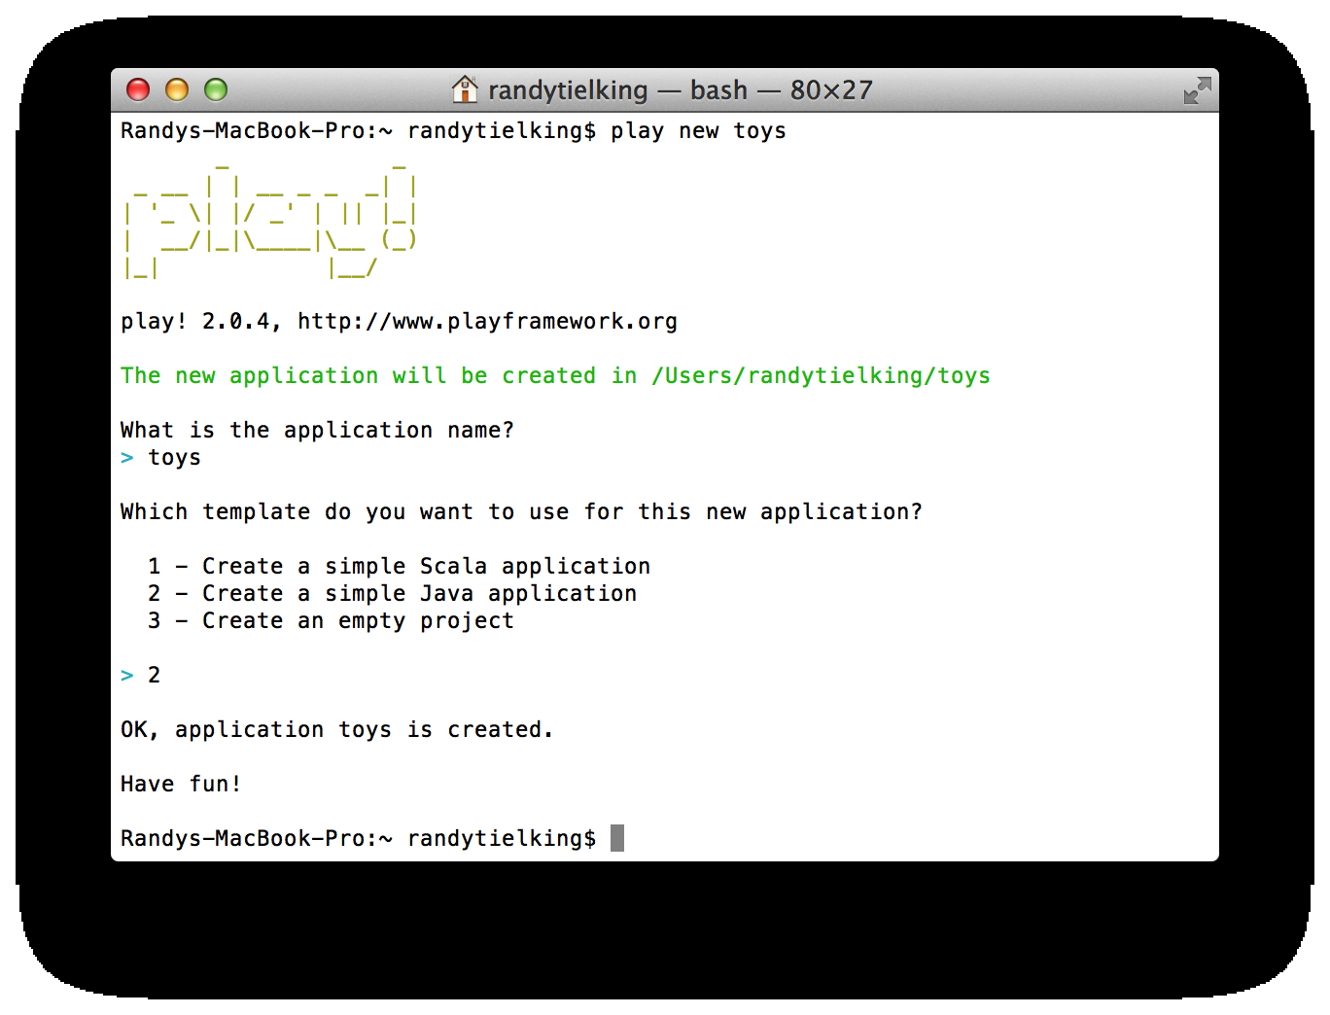
Play 2.0 Application Framework
Installation

Slide 6
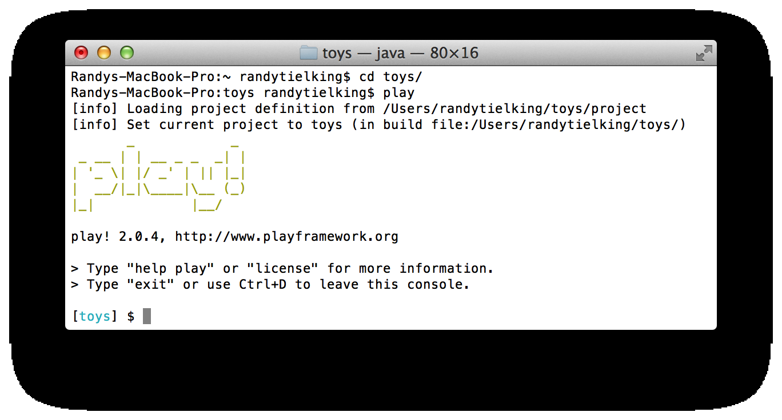
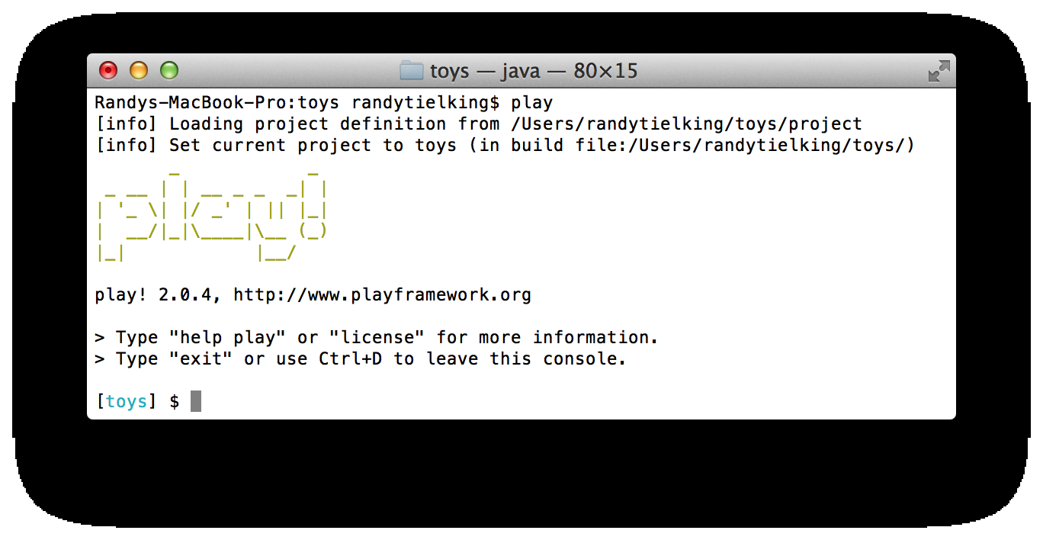

Slide 7
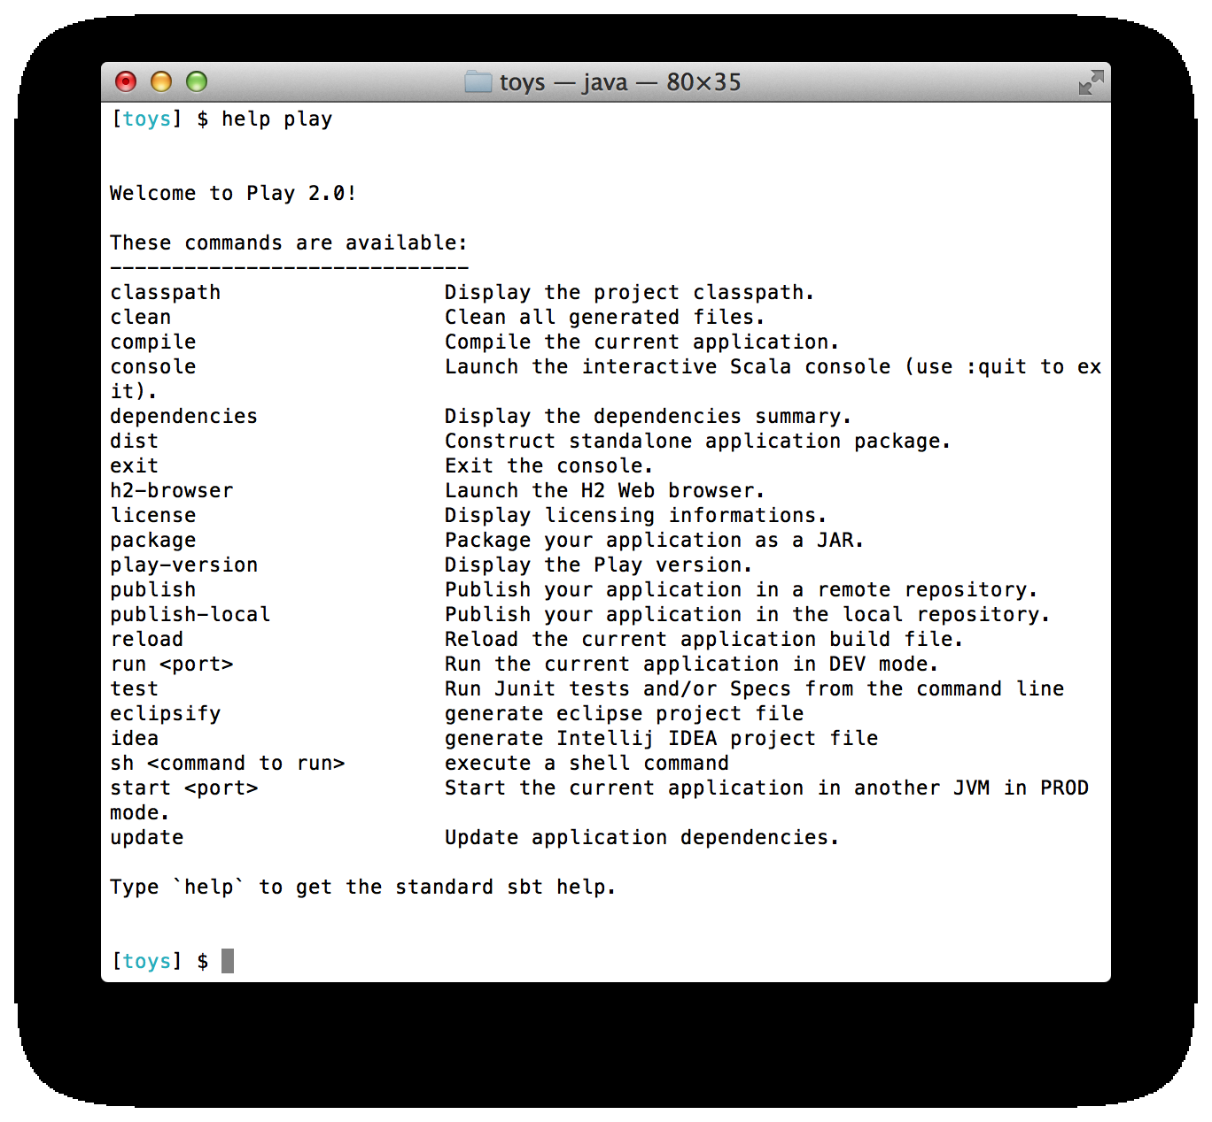

Slide 8
Play 2 Application Framework
Console Commands
eclipsify <with-source=true> – builds .project and .classpath files ( do not check in )
play <debug> run <port> - Starts play in dev mode. Default port is 9000. debug option will allow remote debugging on port 9999.
start <port> - Starts play in prod mode
dist – builds standalone zip file in dist folder
h2-browser – starts a web view to H2 db

Slide 9
app : Application sources
--assets : Compiled asset sources
--stylesheets : Typically LESS CSS sources
--javascripts : Typically CoffeeScript sources
-- controllers : Application controllers
-- models : Application business layer
-- views : Templates
conf : Configurations files and other non-compiled resources (on classpath)
-- application.conf : Main configuration file
-- routes : Routes definition
public : Public assets
-- stylesheets : CSS files
-- javascripts : Javascript files
-- images : Image files
project : SBT configuration files
-- build.properties : Marker for sbt project
-- Build.scala : Application build script
-- plugins.sbt : sbt plugins
lib : Unmanaged libraries dependencies
logs : Standard logs folder
-- application.log : Default log file
target : Generated stuff
-- scala-2.9.1
-- cache
-- classes : Compiled class files
-- classes_managed : Managed class files (templates, ...)
-- resource_managed : Managed resources (less, ...)
-- src_managed : Generated sources (templates, ...)
test : source folder for unit or functional tests

Slide 10
# This is the conf/application.conf file
# which is the main configuration file for the application.
# The application languages
application.langs="en"
# We are using H2 in server mode
db.default.driver=org.h2.Driver
db.default.url="jdbc:h2:tcp://localhost/~/h2database/toys;autocommit=off"
# Ebean scan the models package for JPA annotations
ebean.default="models.*"
# Logging
logger.root=ERROR
logger.play=INFO
logger.toys=DEBUG

Slide 11
# This is the conf/routes file
# which defines all application routes (Higher priority routes first)
# Home page
GET / controllers.Application.index()
# Toy URLs
GET /toys controllers.Application.toys()
POST /toy controllers.Application.newToy()
POST /toy/:id/delete controllers.Application.deleteToy(id: Long)
# Map static resources from the /public folder to the /assets URL path
GET /assets/*file controllers.Assets.at(path="/public", file)

Slide 12
public class Application extends Controller {
private static final Logger log = LoggerFactory.getLogger(Application.class);
private static Form<Toy> toyForm = form(Toy.class);
public static Result index() {
return redirect(routes.Application.toys());
}
public static Result toys ( ) {
return ok(views.html.index.render(Toy.findAll(), toyForm));
}
public static Result deleteToy(Long id) {
log.debug("Delete toy id " + id + " called");
Toy.deleteToy(id);
return redirect(routes.Application.toys());
}
public static Result newToy() {
Form<Toy> filledForm = toyForm.bindFromRequest();
if ( filledForm.hasErrors() ) {
return badRequest(views.html.index.render(Toy.findAll(), toyForm));
} else {
Toy.createToy(filledForm.get());
return redirect(routes.Application.toys());
}
}
}

Slide 13
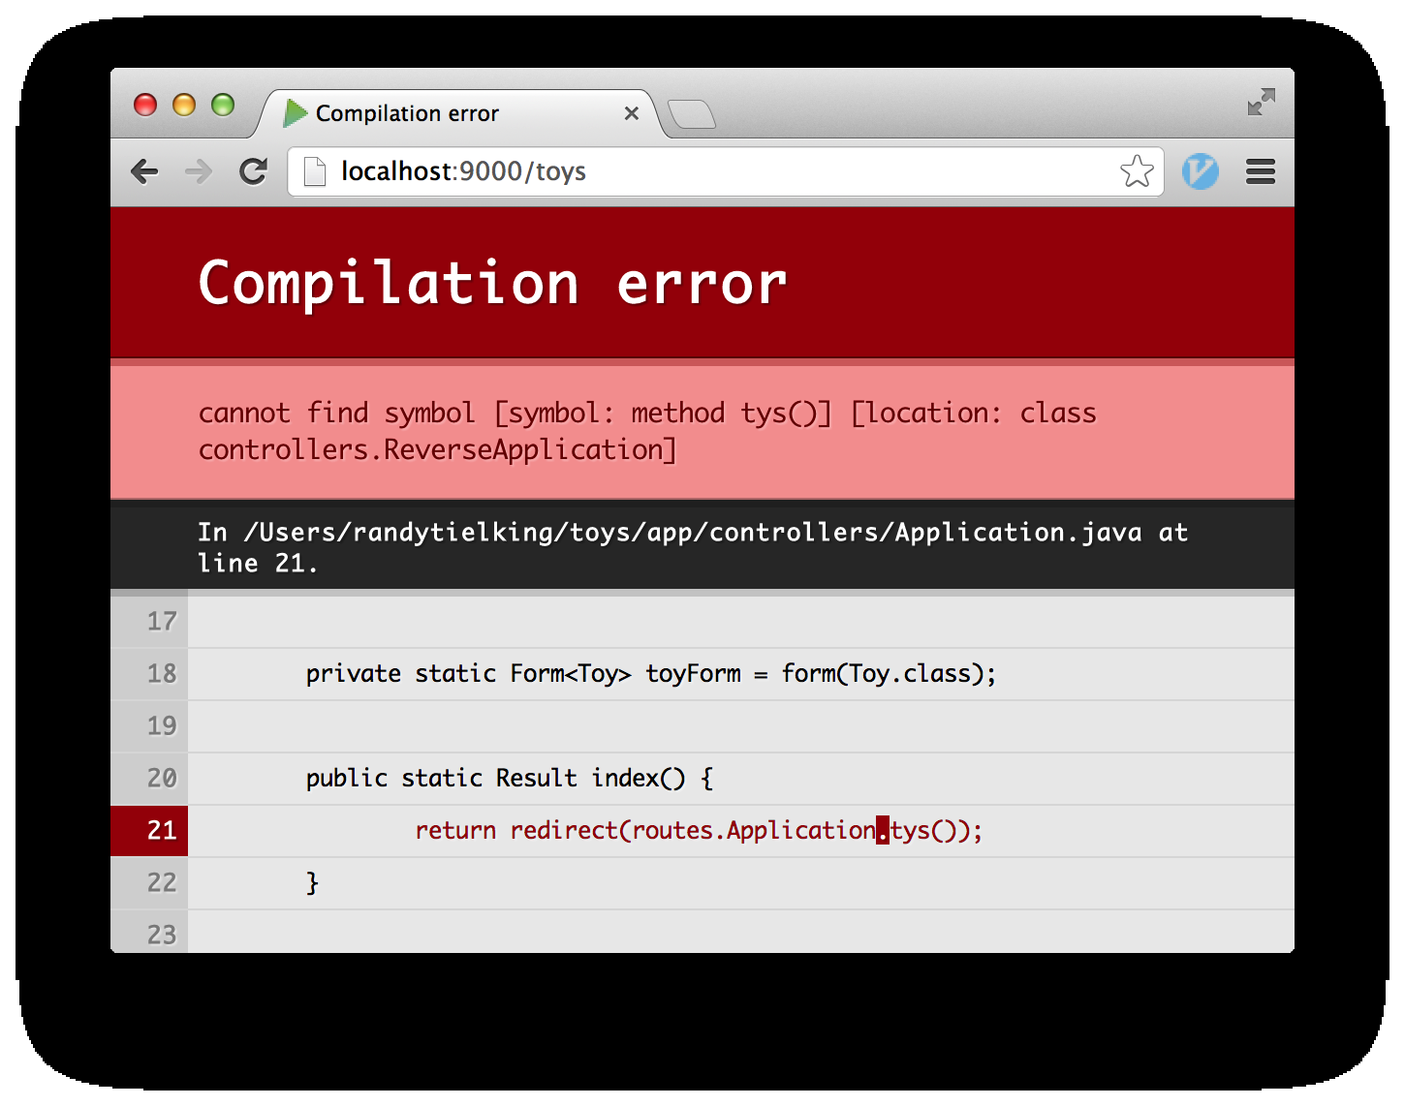

Slide 14
// This is the /views/index.scala.html file
@(toys : List[Toy], toyForm : Form[Toy])
@import helper._
@main("My Toys") {
<h1>My Toy Wish List Has @toys.size Toys</h1>
<table id="toyWishListTable">
<tr>
<th>Name</th>
</tr>
@for( toy <- toys ) {
<tr>
<td>@toy.name</td>
<td>
@form(routes.Application.deleteToy(toy.id)) {
<input type="Submit" value="Delete" />
}
</td>
</tr>
}
</table>
@form(routes.Application.newToy()) {
<table>
<tr>
<td>Name</td>
<td>@inputText(toyForm("name"), '_label -> Nil)</td>
<td><input type="Submit" value="Add" /></td>
</tr>
</table>
}
}

Slide 15
// This is the /views/main.scala.html file
@(title: String)(content: Html)
<!DOCTYPE html>
<html>
<head>
<title>@title</title>
<link rel="stylesheet" media="screen" href="@routes.Assets.at("stylesheets/main.css")">
<link rel="shortcut icon" type="image/png" href="@routes.Assets.at("images/favicon.png")">
<script src="@routes.Assets.at("javascripts/jquery-1.7.1.min.js")" type="text/javascript"></script>
</head>
<body>
@content
</body>
</html>

Slide 16
Play 2 Application Framework
Setting Up ORM Tool
Will use Ebean which uses JPA 2 annotations but is not a JPA implementation ( uses a different query language than JPA )
Enable Ebean scanning of classes in the models java package
Can also use JPA 2 with hibernate implementation but more configuration needed than for Ebean

Slide 17
// This line in the /conf/application.conf file enables Ebean scanning
# Scan models package for JPA annotations
ebean.default="models.*"

Slide 18
// This is the models.Toy.java file
@Entity
public class Toy extends Model {
private static Finder<Long,Toy> toyFinder = new Finder(Long.class,Toy.class);
@Id
public Long id;
@Column(length=100)
public String name;
public static void createToy ( Toy toy ) {
toy.save();
}
public static Toy findToyById ( Long id ) {
return toyFinder.byId(id);
}
public static List<Toy> findAll ( ) {
return toyFinder.all();
}
public static void deleteToy ( Long id ) {
Toy.findToyById(id).delete();
}
}

Slide 19
Play 2 Application Framework
Evolution
Used to manage DDL and DML
Has two sections: Ups section for creating and Downs section for destroying the database
Can consist of multiple files named 1.sql, 2.sql, etc which will be executed in numerical order
Play can automatically detect changes to entity classes and update the 1.sql file if that is the only file

Slide 20
// This is the 1.sql file
# --- !Ups
create table toy (
id bigint not null,
name varchar(100),
constraint pk_toy primary key (id))
;
create sequence toy_seq;
# --- !Downs
SET REFERENTIAL_INTEGRITY FALSE;
drop table if exists toy;
SET REFERENTIAL_INTEGRITY TRUE;
drop sequence if exists toy_seq;

Slide 21
// This is the 2.sql file
# --- !Ups
insert into toy (id,name) values ( next value for toy_seq, 'Scooter');
# --- !Downs
delete from toy;

Slide 22
Play 2 Application Framework
Session Data
Play is stateless and does not store session data on the server
Session data is stored on the client browser as a cookie which is encrypted and signed to detect tampering
Max size of session is max size of cookie - 4kb

Slide 23
Play 2 Application Framework
Unit Testing
Play includes a Helper class with several useful static methods useful for testing to mock out the application framework, create a test H2 database and simulate user interaction with the browser
The evolution scripts will be executed when creating the test H2 database

Slide 24
public class ToyDatabaseTest {
@Test
public void findById ( ) {
running(fakeApplication(inMemoryDatabase()), new Runnable() {
public void run() {
List<Toy> allToys = Toy.findAll();
Assert.assertEquals(1, allToys.size());
Assert.assertEquals("Scooter", allToys.get(0).name);
}
});
}
}

Slide 25
public class AddToyUITest {
@Test
public void testAddToyWithUI ( ) {
running(testServer(3333, fakeApplication(inMemoryDatabase())), HTMLUNIT, new Callback<TestBrowser>() {
public void invoke(TestBrowser browser) {
browser.goTo("http://localhost:3333");
assertThat(browser.$("body h1").
first().getText()).isEqualTo(
"My Toy Wish List Has 1 Toys");
browser.$("#name").text("Firetruck");
browser.$("#newToySubmit").click();
assertThat(browser.$("body h1").first().
getText()).isEqualTo("My Toy Wish List Has 2 Toys");
}
});
}
}

Slide 26
Play 2 Application Framework
Deploying
Deployment file is a zip file which contains a start script and all jar files needed by app
Built using “play dist” command and zip file in the /dist folder
Only dependency is java 6
Can replace the /conf/application.conf using -Dconfig.file setting which can override props

Slide 27
Play 2 Application Framework
Deploying (continued)
Play uses Jboss Netty web server which uses asynchronous I/O ( not 1 thread per request )
Platform as a Service (PaaS) providers supporting play 2 include Heroku, Cloud Foundry, and Openshift

Slide 28
Play 2 Application Framework
Pros include:
  specific error messages shown in browser
  routes and views are compiled into .class files so errors shown/code completion in IDE
  model changes are automatically detected and can be applied to database via browser
  hot code reloading
  built in unit testing helper functionality
Cons include:
  haven't found a good Eclipse editor for views
  short track record

