Slide 1

Agile Transformation
Gint Grabauskas
Presented to STL JUG
9-January-2014
City Place One Auditorium

Slide 2

Agenda
The Triangle
Laws & Theories
Agile Myths
Agile vs Scrum
The Sacred Iteration
The Team
Servant Leadership
Staffing Models
Component vs. Feature Teams
Definitions
Quality & Continuous Improvement
Agile Planning
Agile Story Hierarchy
Q&A

Slide 3





What is This?

Slide 4
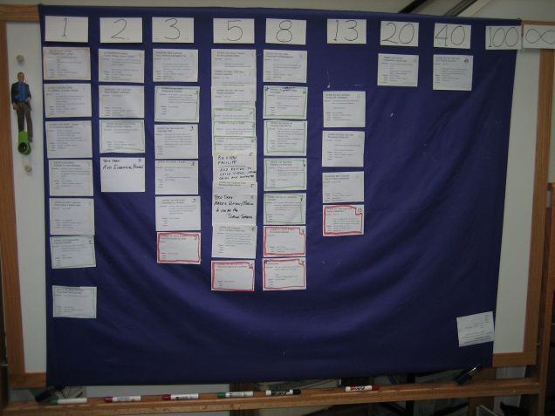
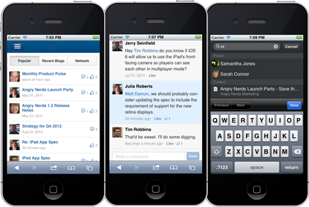
Laws of Development
1) Requirements are Emergent
2) Working Stuff is BEST Measure of Progress

Slide 5


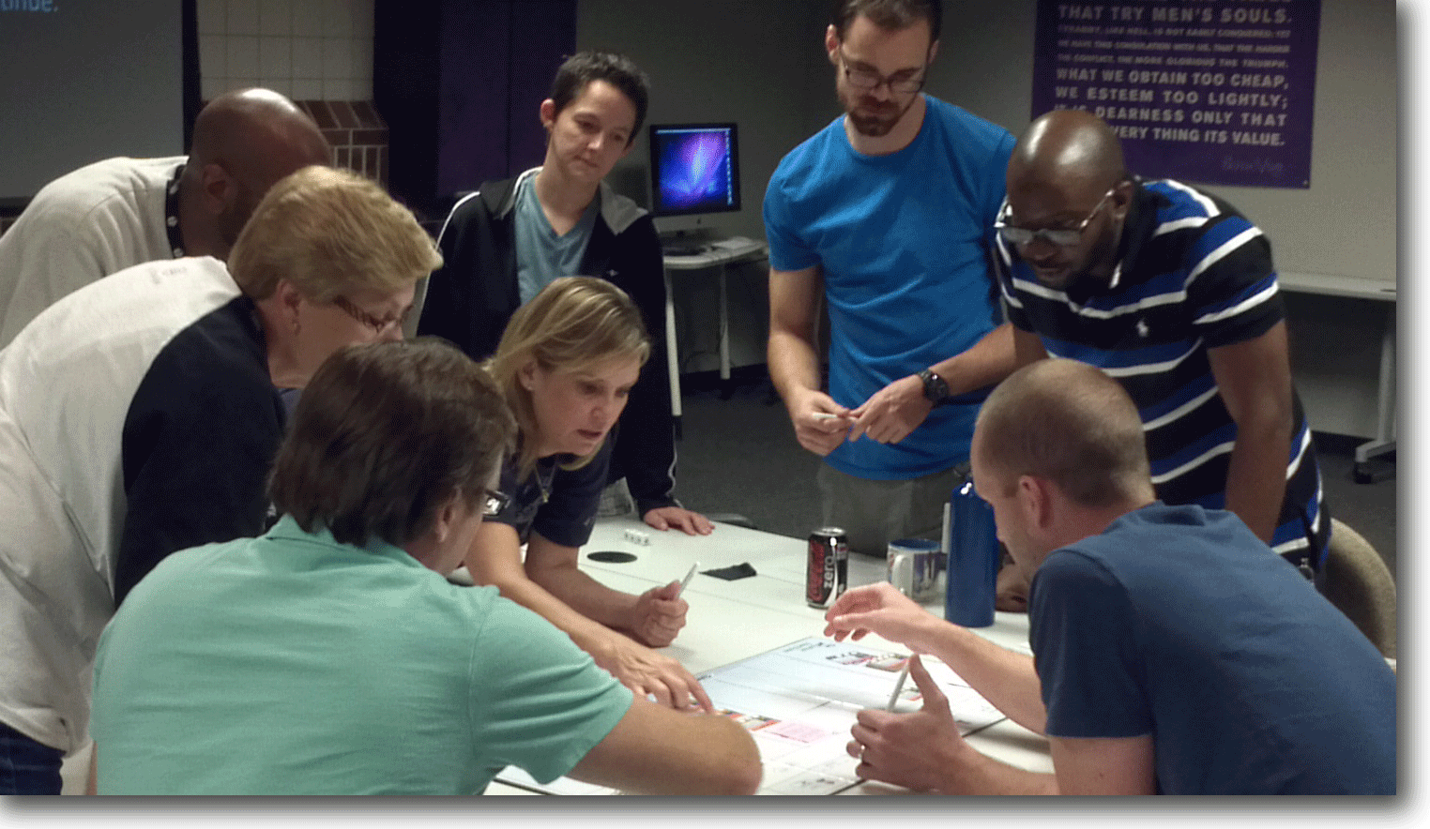
Theories of Development
1) Activity
Outcome
2) Development can be sustainable, humane, and fun
Not This!
But This

Slide 6

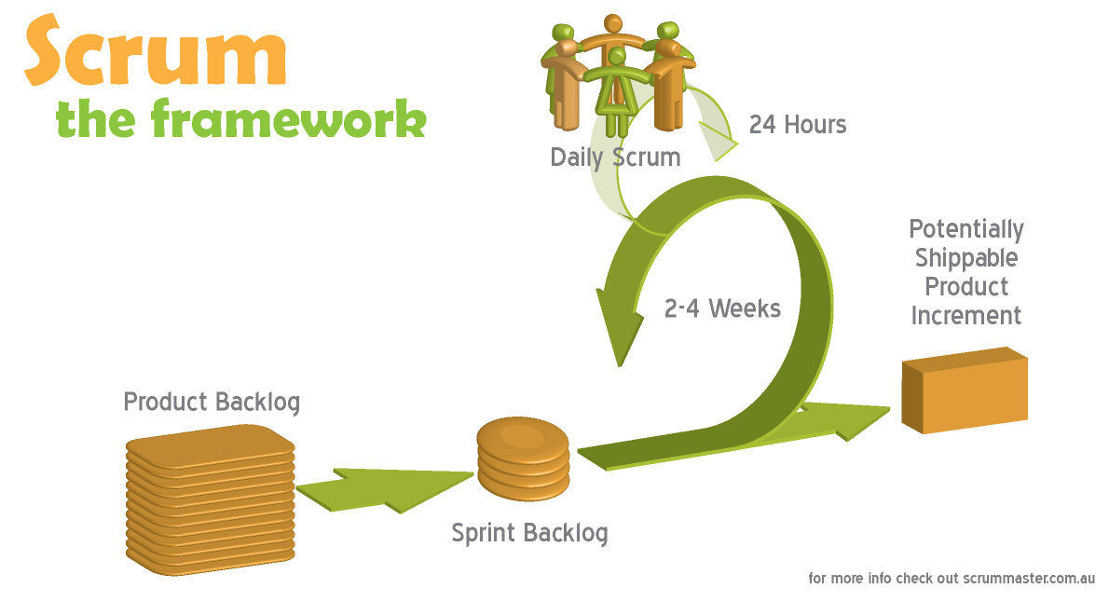
Agile vs. Scrum
Question: What does Agile mean to you?
Our Answer: Agile is a mindset/philosophy that
recognizes that there is a better way
to develop stuff.
Question: What is Scrum?
Our Answer: Scrum is a realization of this mindset…our
development framework.

Slide 7
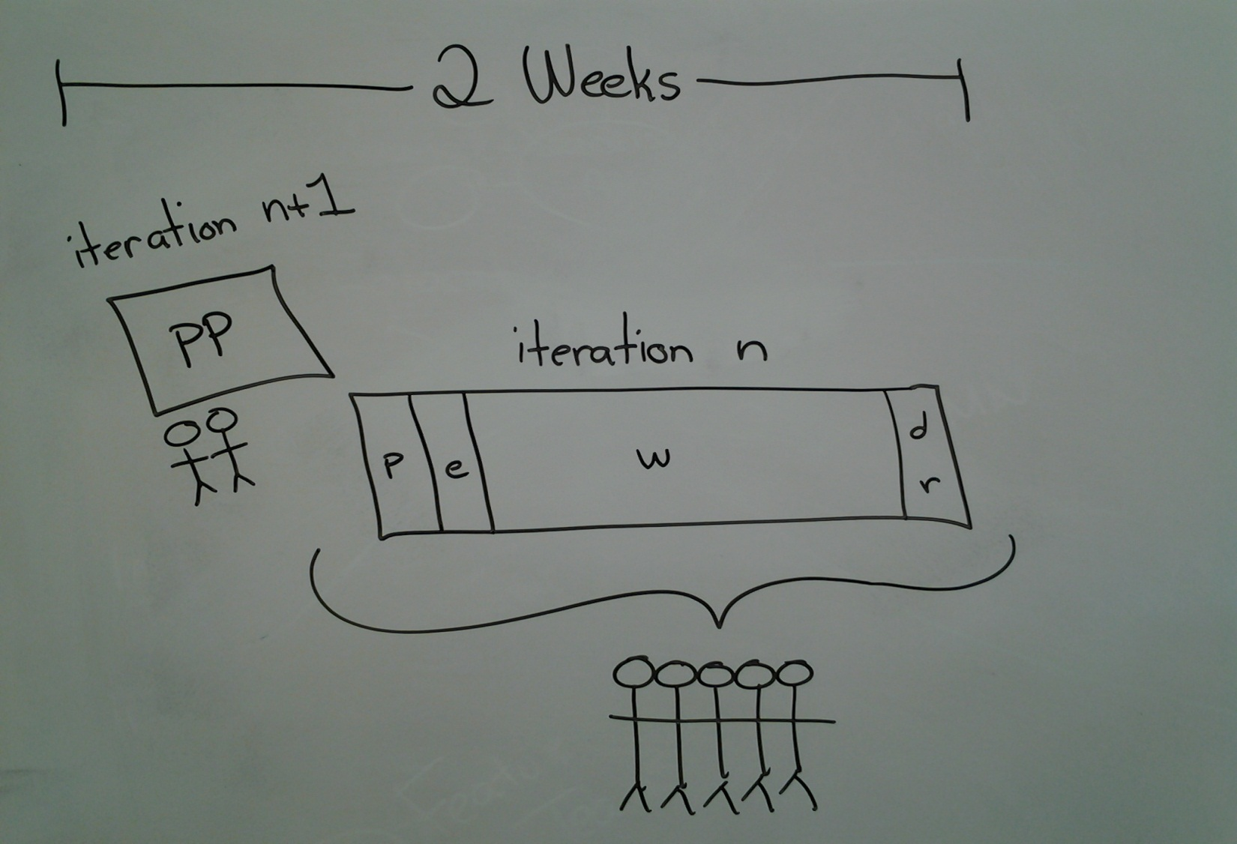
The Sacred Iteration

Slide 8
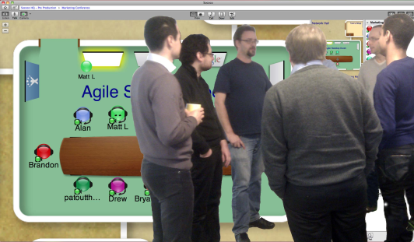
The Team
Product Owner
Arguably the most important role on
an agile team. Overall responsible for:
Product Vision
Product Backlog
Product Release Plan
Scrum Master
Servant leader, un-blocker (not status taker),
facilitates process and all Scrum ceremonies,
leads, guides, coaches.
Team
BA, Dev, QA, Engineering, Infrastructure, Operations, etc.
“Critical mass” team CO-LOCATION very important, especially
early on in your transformation.

Slide 9
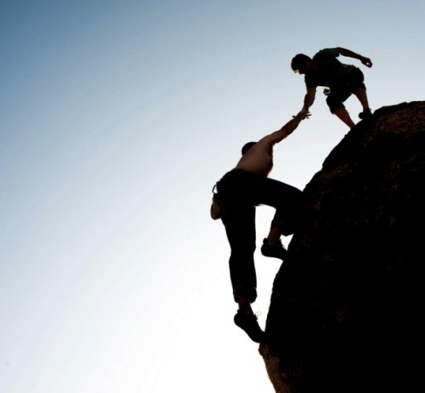
Servant Leadership
Philosophy and set of practices that enrich the lives of others
Focus on growth and well being of people and teams
Shared leadership and power
Needs of others first
Helps others develop and perform to highest levels
Servant leadership is not weakness
For more information:
  http://www.agilealliance.org/files/1913/5525/5359/ServantLeadershipAgileTeams.pdf
  http://en.wikipedia.org/wiki/Servant_leadership

Slide 10
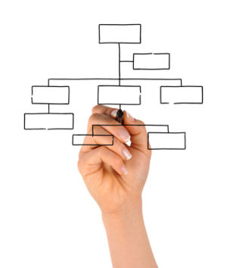
Agile Staffing Models
100% Dedication
50/50
Agile Safari
Emergency

Slide 11
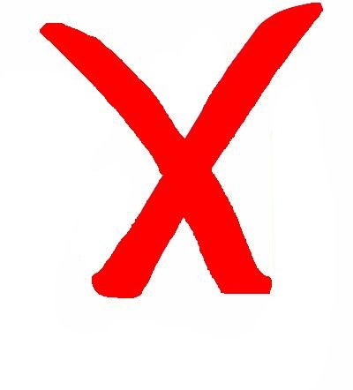

Component vs. Feature Teams
Component Teams – Groups formed around the architectural
modules or components of a system, such as a single-specialty
GUI team or a middle tier team, etc.
Feature Teams – Long-lived, cross-functional team that completes
many end-to-end customer features, one by one.

Slide 12

Definitions
Product Backlog
Prioritized list of user stories.
User Story
A “lightweight”, easily understandable, agile requirement
written from the perspective of a user. Who/What/Why. A
promise that something will be worked.
Story Point
A relative estimate quantified in numerical terms.
Velocity
The “rate” of progress for a team (e.g. SPs completed
per Sprint).
Release Burndown
Rate of progress (velocity) over many sprints,
shown graphically.

Slide 13

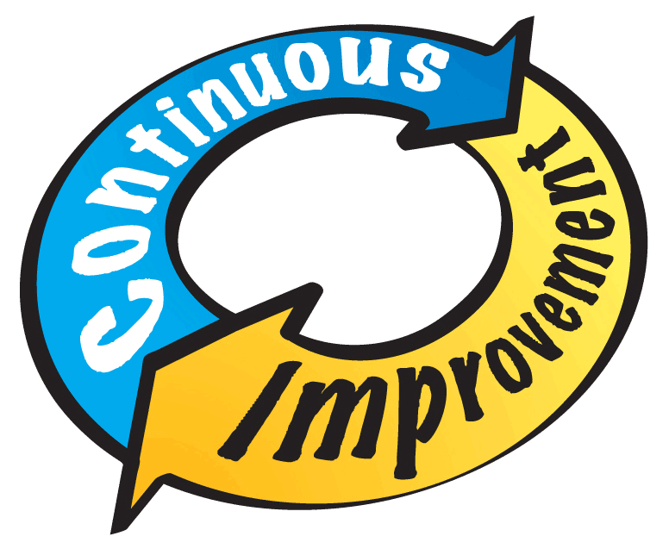
Quality & Continuous Improvement
Everyone’s Responsibility
QA→QE Hiring Practices
QE integral/embedded team members
How to test emergent requirements → Automation
Built into iteration
Start/Stop/Keep
Cumulative Law (vs. Post-Mortem)

Slide 14
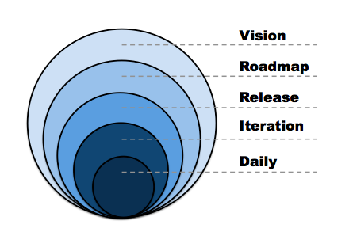
Our 5 Levels of Agile Planning

Slide 15

Our 5 Levels of WIP Hierarchy
Project (1)
Version (1…n)
Feature (1…n)
Story (1…n)
Task (1…n)

Slide 16

Thank You For your Time

Slide 17

Questions???

