Slide 1

Jenkins 2.x
Chris Vogel

Slide 2
Agenda
Jenkins background
Installation
Jenkins 2.x highlights
Build pipelines
Pipeline DSL
Multibranch plugin

Slide 3
Jenkins
An open source continuous integration tool
Extensible with over 1000 plugins
Master/agent architecture
Released weekly (currently 2.17)
Has quarterly LTS releases (2.7.2)

Slide 4

History
Originally released in February 2005 as Hudson
Forked in February 2011 as Jenkins
Released version 2.0 on April 20, 2016

Slide 5

Installation
Download WAR file
Run as executable WAR file
Install in web container (e.g. Tomcat)
Run as Docker container
jenkins – LTS release
jenkinsci/jenkins – weekly release

Slide 6
Installation
Native installations
Debian-based distribution
apt-get
Red Hat-based distribution
yum
Windows
Master and agents as Windows service

Slide 7
Setup Wizard
Initializes security
Requires initial, generated, admin password
Allows creation of admin account
Plugin configuration
Suggested plugins
Manual selection

Slide 8
Setup Wizard Demo

Slide 9

Jenkins 2.x Highlights
Focused more on continuous delivery
Pipeline DSL
Maintains backwards compatibility
Improved job configuration screens
Tab metaphor
Improved “New Item” screen
Same interface

Slide 10
New UI (Blue Ocean)
Re-thinks the Jenkins user experience
A separate UI
Old and new side-by-side
Currently in alpha

Slide 11
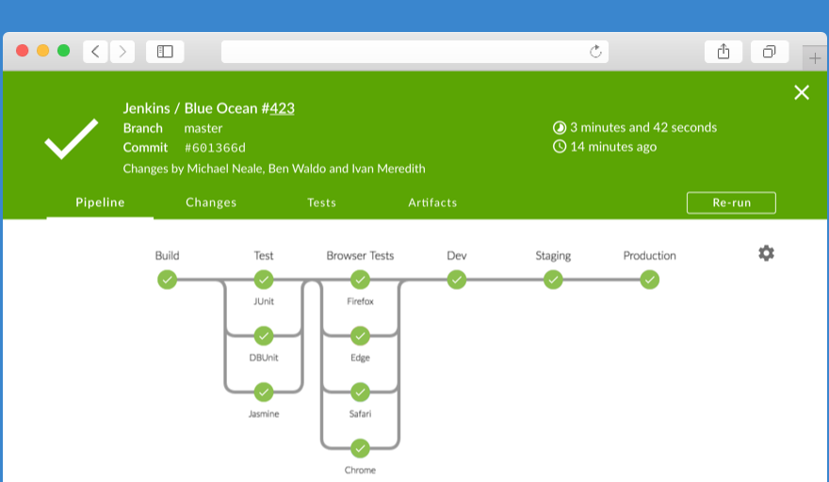

Slide 12

Build Pipeline
“Automated manifestation of your process for getting software from version control into the hands of your users”

Slide 13




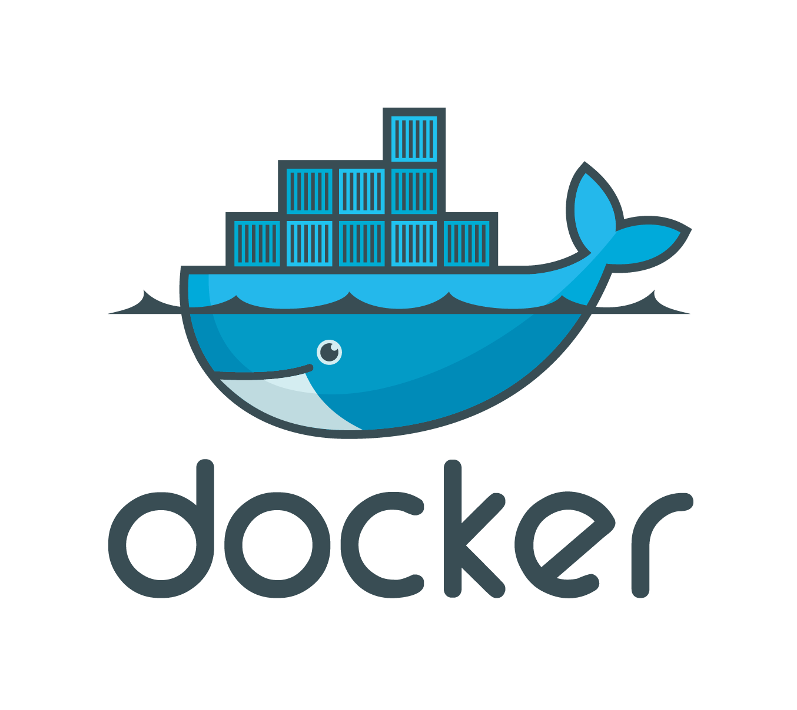
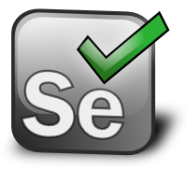

Example Project
Baseball Standings
Spring Boot
Gradle
JUnit
Jacoco
Docker
Selenium
MySQL

Slide 14

Example Pipeline
Checkout
Build/Test
Publish test results & code coverage
Sonar code analysis
Create Docker image
Run system tests

Slide 15
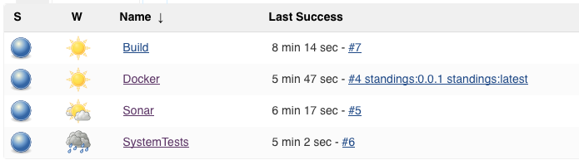
Build Pipeline
Legacy Pipeline (Jenkins 1.x)
Chain individual jobs together
Notes:
Painful process to setup, coordinated configuration to get it to work, difficult to duplicate, easy to break

Slide 16
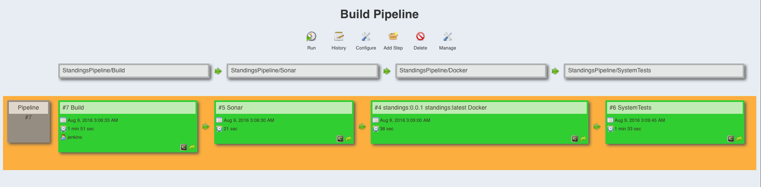
Build Pipeline
Legacy Pipeline (Jenkins 1.x)
Chain individual jobs together
Build Pipeline Plugin View

Slide 17
Legacy Pipeline Demo
Notes:
Tag number – best practice would be to use a variable based on the build number, Selenium

Slide 18
Build Pipeline
New Pipeline (Jenkins 2.x)
Pipeline DSL
Pipeline as code
In job vs in SCM

Slide 19
Pipeline DSL
Groovy-based Domain Specific Language
Extensible by plugins
Extensible by Pipeline Global Library
Web-based snippet generator
IntelliJ IDEA GroovyDSL downloadable script

Slide 20
Pipeline as Code
Design a whole pipeline, not a linear set of tasks
Store the pipeline configuration (Jenkinsfile) in a text file in SCM
Automatically set up new pipelines when configuration files are added
Differentiate multiple branches in the same repository
https://wiki.jenkins-ci.org/display/JENKINS/2.0+Pipeline+as+Code
Notes:
he default interaction model with Jenkins, historically, has been very web UI driven, requiring users to manually create jobs, then manually fill in the details through a web browser. This requires additional effort to create and manage jobs to test and build multiple projects, it also keeps the configuration of a job to build/test/deploy separate from the actual code being built/tested/deployed. This prevents users from applying their existing CI/CD best practices to the job configurations themselves.

Slide 21
Pipeline Goals
Complex requirements - fork/join, loop, parallel
Resilient – survive master restarts
Pausable – pause and wait for human input
Efficient – restart from saved checkpoints (Enterprise)
Visualized – Pipeline StageView dashboard

Slide 22
Pipeline Vocabulary
Step
A single task/build step
Stage
Grouping of logical build steps
Node
Schedules build steps on a build agent
Creates a workspace

Slide 23
Pipeline DSL Steps
build: Build a job
checkout: General SCM
echo: Print message
git: Git
input: Wait for interactive input
mail: Mail
node: Allocate node

Slide 24
Pipeline DSL Steps
sh: Shell script
stage: Stage
step: General build step
tool: Use a tool from a predefined tool installation

Slide 25
DSL Global Variables
env: Environment variables
scm: SCM configuration, multibranch or script from SCM
docker: Docker-related functions
Build images
Manage images
Run containers

Slide 26
Jenkins 2.x Pipeline Demo
Notes:
Replay

Slide 27
Multibranch Job
Enables configuration of jobs for branches of a project
Automatically discovers branches
Requires a Jenkinsfile in the project root

Slide 28
Multibranch Job Demo

Slide 29


Slide 30
Resources
Website - http://jenkins.io
Getting Started with Pipeline - https://jenkins.io/doc/pipeline/
Pipeline Tutorial - https://github.com/jenkinsci/pipeline-plugin/blob/master/TUTORIAL.md
Plugin Compatibility with Pipeline - https://github.com/jenkinsci/pipeline-plugin/blob/master/COMPATIBILITY.md

Slide 31
Resources
Continuous Deliver with Jenkins Workflow and Docker - http://www.coding-stories.com/blog/2015/08/23/continuous-delivery-with-jenkins-workflow-and-docker/
Introducting Blue Ocean - https://jenkins.io/blog/2016/05/26/introducing-blue-ocean/
My Jenkinsfile - https://github.com/captdestrukto/STL-JUG-Jenkins2

