Slide 1
Java Flight Recorder and
Java Mission Control

Slide 2
about the presenter
software engineer at Oracle
middleware products: SOA Suite and Integration Cloud Suite
over 15 years as a java developer including work at BEA Systems, MetaMatrix, and Tripos
I use JFR and JMC to diagnose issues in test and production. (I don‘t work on JFR and JMC internals)
david.difranco@oracle.com
ddif@alum.mit.edu

Slide 3
Java Flight Recorder
command-line tool for collecting profiling data from running JVMs
sampling based, for low overhead
focus on CPU, threads, socket and file usage
originally JRocket Mission Control, part of BEA‘s JRocket JVM
part of the Oracle hotspot JVM since since Java 7

Slide 4
Instrumentation vs Sampling
Instrumentation:
Byte code is instrumented
Accurate invocation counts
Distorted call times (possibly severe)
Sampling:
Byte code is not instrumented
No invocation counts
Fairly accurate call times (depending on frequency)
Infrequently called messages may be missed

Slide 5
Oracle says:
"The Java Flight Recorder (JFR) is a commercial feature. You can use it for free on developer desktops or laptops, and for evaluation purposes in test, development, and production environments. However, to enable JFR on a production server, you must have a commercial license. Using the Java Mission Control (JMC) for other purposes on the JDK does not require a commercial license." *
* The rest of this presentation is my opinion and doesn‘t necessarily represent Oracle

Slide 6
Java Flight Recorder usage
JRE:
command-line parameters to start a java program with JFR enabled
JDK:
also supports attaching JFR to running JVM using the jcmd command

Slide 7
starting a java program with JFR
java -XX:+UnlockCommercialFeatures \
-XX:+FlightRecorder \
-XX:StartFlightRecording=filename=myrecording.jfr,dumponexit=true \
MyApp

Slide 8
attaching JFR to a running program
jcmd <pid> JFR.start filename=myrecording.jfr name=myrecording
jcmd <pid> JFR.dump name=myrecording
jcmd <pid> JFR.stop name=myrecording

Slide 9
other options (for either method of starting)
dumponexit: if true, automatically save file on exit
dumponexitpath: path to save the file
delay: seconds to delay the start
duration: duration after which to stop
maxage: max duration of data to maintain (older data is discarded)
maxsize: max size of data to maintain (older data is discarded)
compress: if true, compress the file using Gzip
stackdepth: maximum depth of call stacks to record
settings: template file created in JMC (see next slide). This has even more granular options than above.

Slide 10
recording template options
two built-in templates (XML files)
default: very low overhead, suitable for production
method sampling only (% counts)
no invocation counts or exact invocation times
no memory allocation recording
profile: approx 2% CPU overhead
same as above, except:
records memory allocations
lower thresholds on thread and I/O event recording

Slide 11
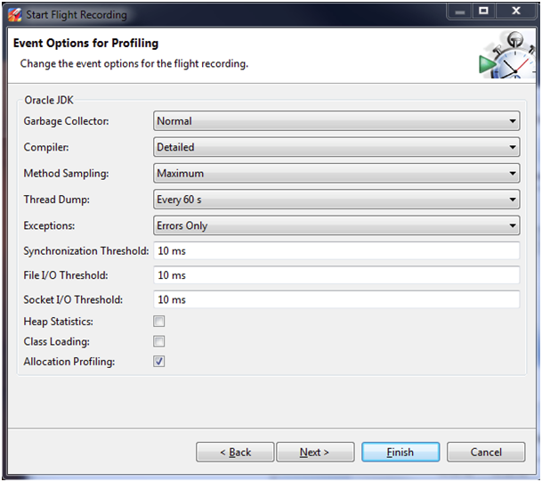
creating your owsn recording template
editable, saveable from JMC
or hand-edit XML: copy the defaults from <jre>/lib/jfr/
<?xml version="1.0" encoding="UTF-8"?>
<!--
Recommended way to edit .jfc files is to use Java Mission Control,
see Window -> Flight Recorder Template Manager.
-->
<configuration version="1.0" name="Continuous" description="Low overhead configuration safe for continuous use in production environments, typically less than 1 % overhead." provider="Oracle">
<producer uri="http://www.oracle.com/hotspot/jvm/" label="Oracle JDK">
<control>
<!--
Contents of the control element is not read by the JVM, it's used
by Java Mission Control to change settings that carry the control attribute.
-->
<selection name="gc-level" default="detailed" label="Garbage Collector">
<option label="Off" name="off">off</option>
<option label="Normal" name="detailed">normal</option>
<option label="All" name="all">all</option>
</selection>
<condition name="gc-enabled-normal" true="true" false="false">
<or>
....

Slide 12
JFR file API
two unsupported APIs
planned to be supported officially in JDK9.
reference parser (SAX-like):
JDK_HOME/jre/lib/jfr.jar
JMC parser (DOM-like):
JDK_HOME/lib/missioncontrol/plugins/com.jrockit.mc.flightrecorder_<version>.jar
blog entry with examples: http://hirt.se/blog/?p=446

Slide 13
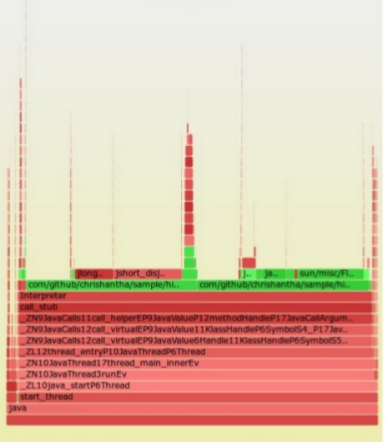
JFR file API example: jfr-flame-graph
https://github.com/chrishantha/jfr-flame-graph
Flame graphs:
height = depth in the stack
width = frequency (#samples)
colors are random
Like a call tree, with width indicating frequency / usage

Slide 14
Java Mission Control
rich application for analyzing performance data
originally JRocket Mission Control, part of BEA‘s JRocket JVM
part of the Oracle JDK since since Java 7
no commercial license required

Slide 15
Java Mission Control: JFR support
supports attaching to running JVM
supports opening .jfr files gathered off-line
visualization of
CPU profiling
memory usage (including object stats and allocation data if collected)
file I/O
socket usage
thread usage

Slide 16
Java Mission Control: other functionality
fully-featured MBean browser
plugins available
heap analysis (JOverflow)
Unix/Linux OS (Dtrace)
Weblogic
Java FX
Coherence
and more

Slide 17
Demo

Slide 18
weaknesses
JFR doesn‘t support bytecode instrumentation to get exact invocation counts
if you need this, look at commercial profilers like YourKit or JProfiler
Hot Methods view not very useful
have to browse call tree which is tedious
Socket and File views can be misleading
show only operations > 20ms by default
JOverflow heap profiler isn‘t user friendly, feature rich
I recommend Eclipse MAT
-XX:+HeapDumpOnOutOfMemoryError and -XX:HeapDumpPath=

Slide 19
resources
JFR and JMC:
www.oracle.com/technetwork/java/javaseproducts/mission-control/java-mission-control-1998576.html
Troubleshooting java (includes JFR/JMC and other tools):
docs.oracle.com/javase/8/docs/technotes/guides/troubleshoot/toc.html
Eclipse MAT:
www.eclipse.org/mat/
blog note on JFR parsers:
hirt.se/blog/?p=446

