Slide 1


Accelerating Java Development with the UML
Greg Schottland
General Manager, Application Development Tools
Embarcadero Technologies,Inc.

Slide 2
Tutorial Outline
Part 1: Quick Overview of the UML
Part 2: Practical UML
Part 3: Demonstration

Slide 3
Part One
UML Overview

Slide 4
What is the UML
Unified Modeling Language
An industry standard design notation for:
    Expressing software architecture
    Expressing software dynamics and behavior
    Documenting software deployment
OMG standard
The de-facto industry standard today
The UML supports both Process and Architecture

Slide 5
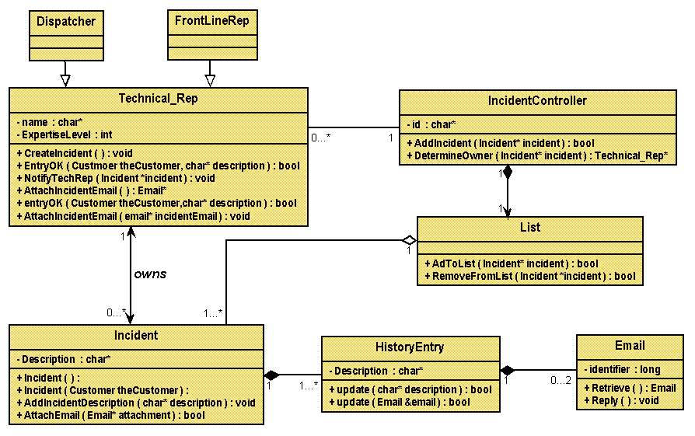
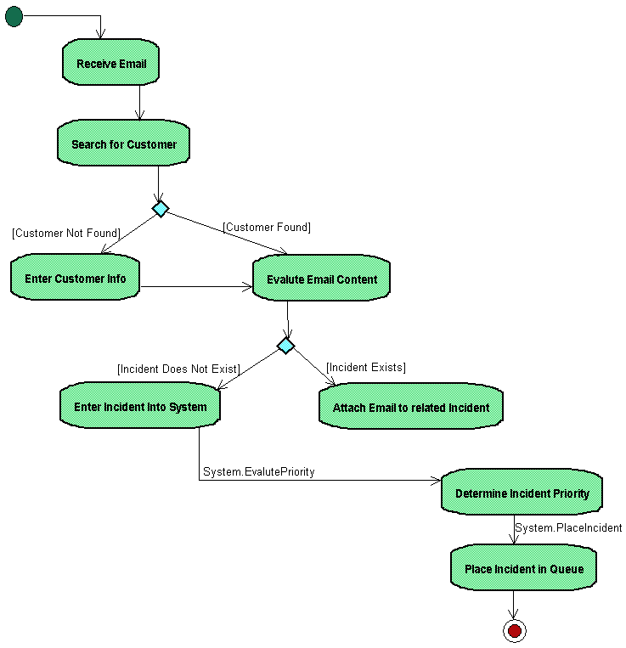
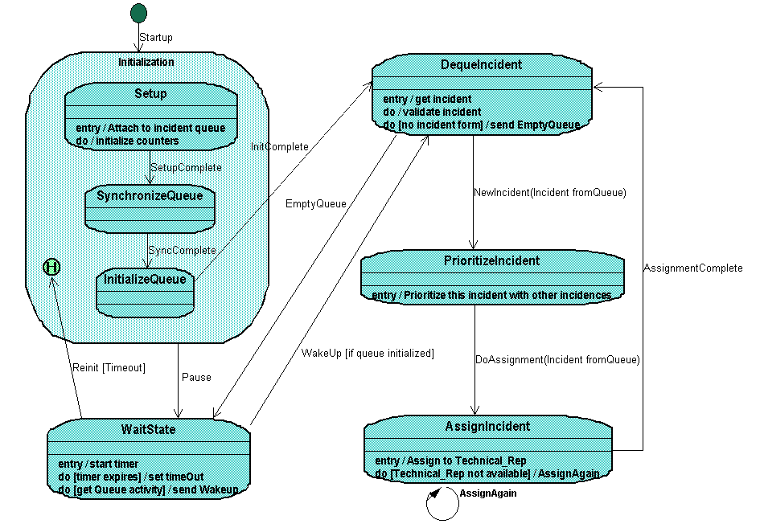
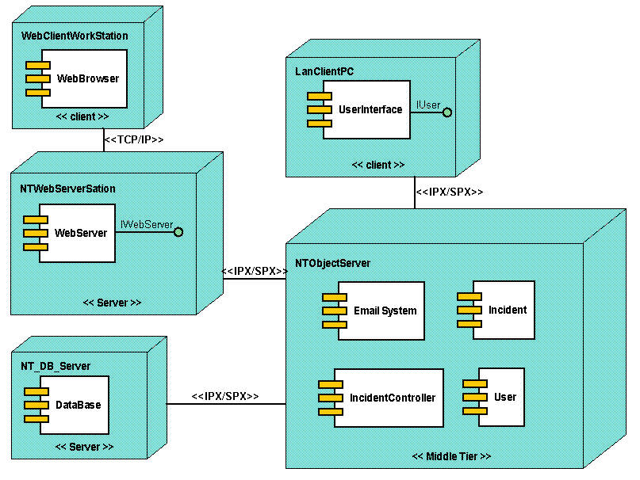
UML Architecture Support
4 + 1 View Model of Architecture
Design View
Implementation View
Class & Object Diagrams
Interaction Diagrams
Statechart Diagram
Activity Diagram
Component Diagram
Interaction Diagrams
Statechart Diagram
Activity Diagram
Use Case View
Use Case Diagram
Interaction Diagrams
Statechart Diagram
Activity Diagram
Class & Object Diagrams
Interaction Diagrams
Statechart Diagram
Activity Diagram
Deployment Diagram
Interaction Diagrams
Statechart Diagram
Activity Diagram
Process View
Deployment View
Reprinted from The Unified Modeling Language Users Guide

Slide 6
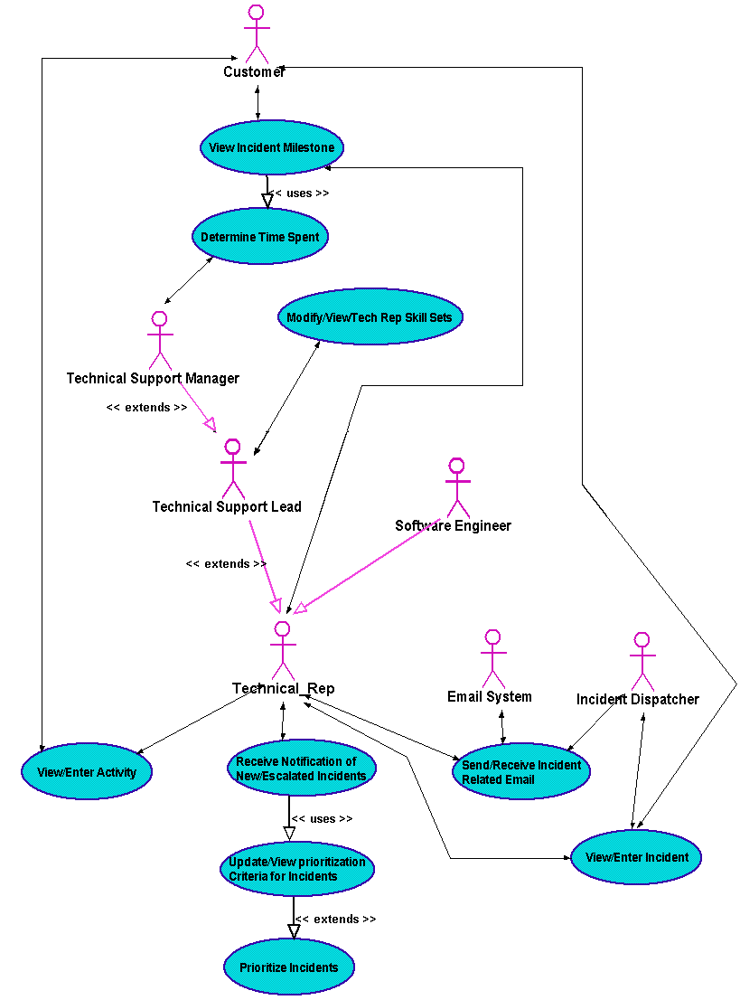
Architecture
Use Case View
  encompasses the use cases that describe the behavior of the system
  does not specify the organization of the software system
  does specify the forces that shape the system’s architecture
  static aspects are captured in Use Case diagrams
  dynamic aspects are captured in Interaction (Sequence and Collaboration), Statechart and Activity diagrams

Slide 7
Architecture
Design View
  classes, interfaces and collaborations that form the vocabulary of the problem and its solution
  supports the functional requirements of the system
  static aspects are captured in Class and Object diagrams
  dynamic aspects are captured in Interaction, Statechart and Activity diagrams

Slide 8
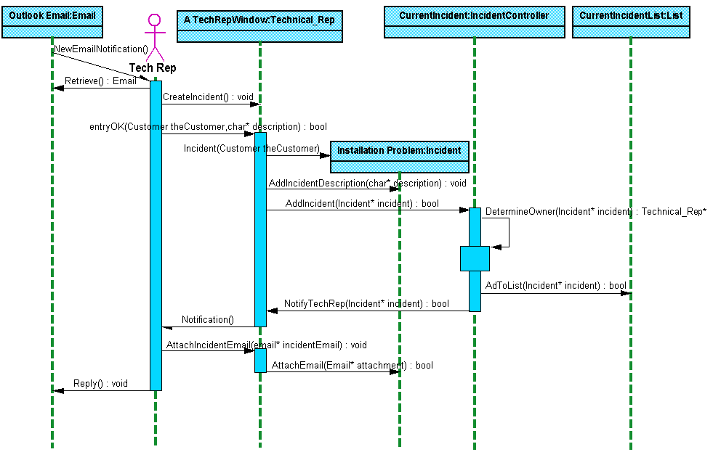
Architecture
Process View
  threads and processes that form the system’s concurrency and synchronization mechanisms
  addresses performance, reliability, scalability and throughput of the system
  static and dynamic aspects are captured as with the Design View with a focus on active classes that represent the processes and threads

Slide 9
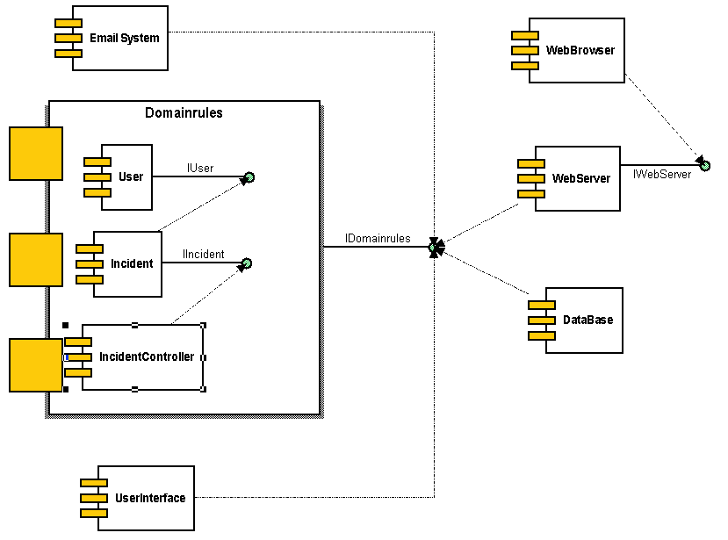
Architecture
Implementation View
  the components and files used to assemble the system
  primarily addresses the configuration management of the system’s releases
  static aspects are captured in Component diagrams
  dynamic aspects are captured in Interaction, Statechart and Activity diagrams

Slide 10
Architecture
Deployment View
  the nodes that form the system’s hardware topology
  addresses the distribution, delivery and installation of the system
  static aspects captured in Deployment diagrams
  dynamic aspects captured in Interaction, Statechart and Activity diagrams

Slide 11
Part Two
Practical UML

Slide 12
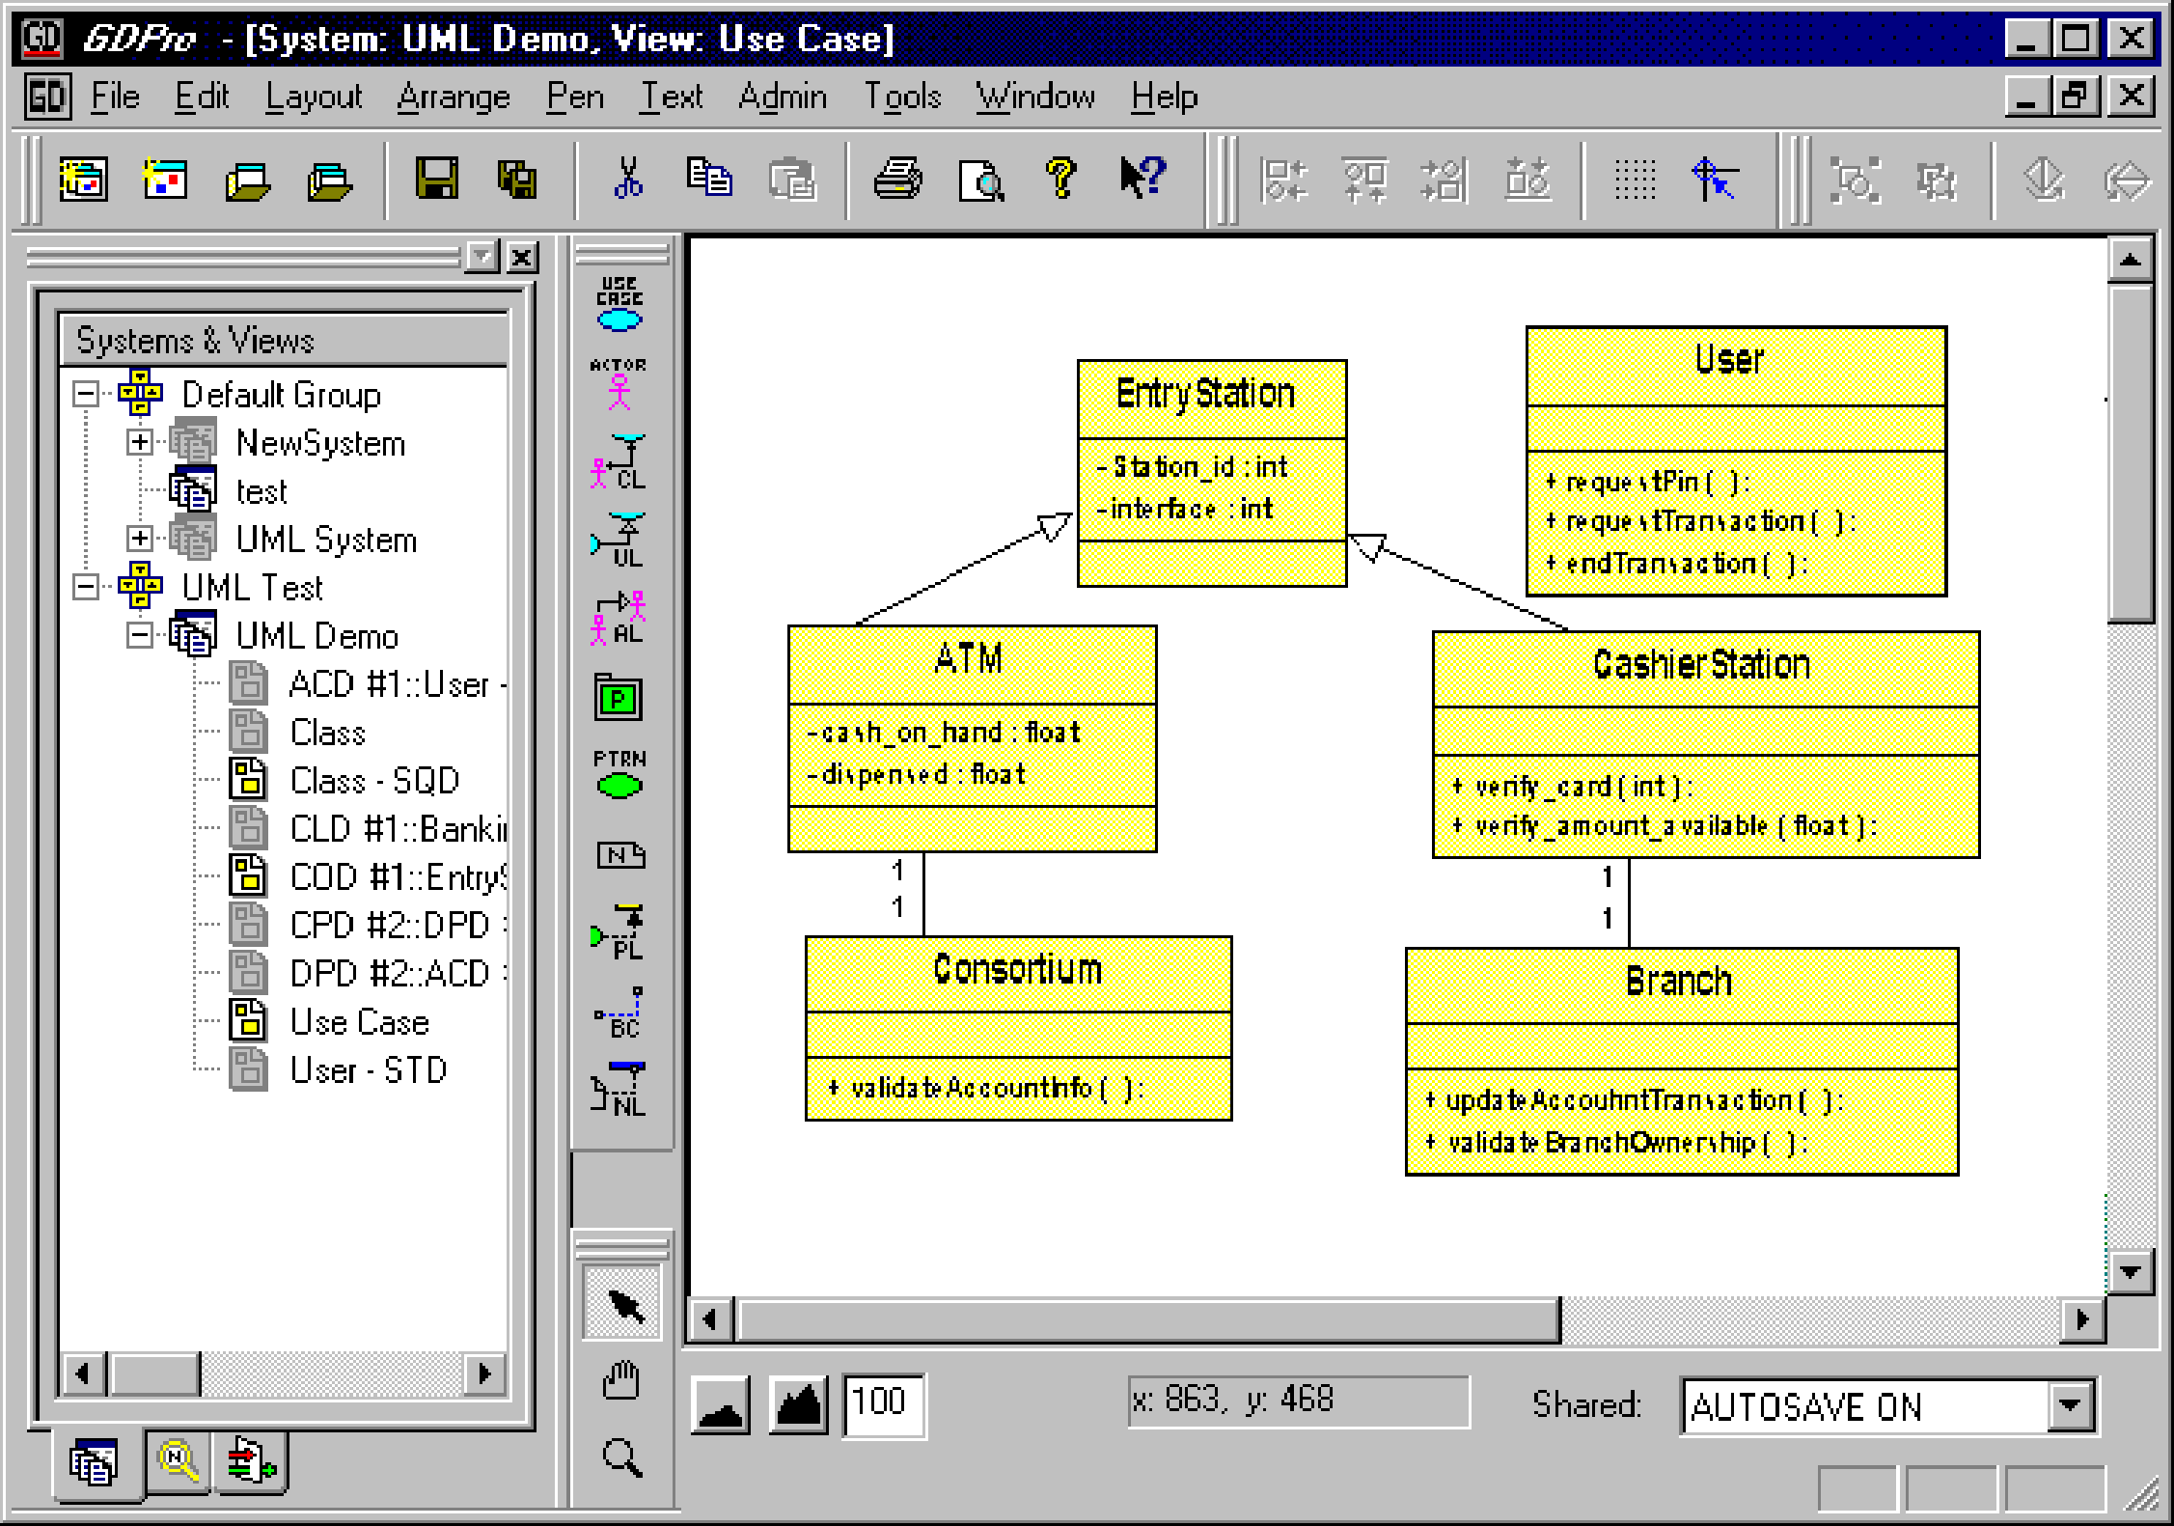
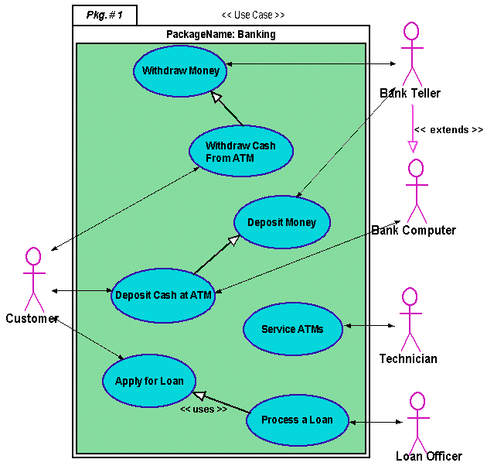
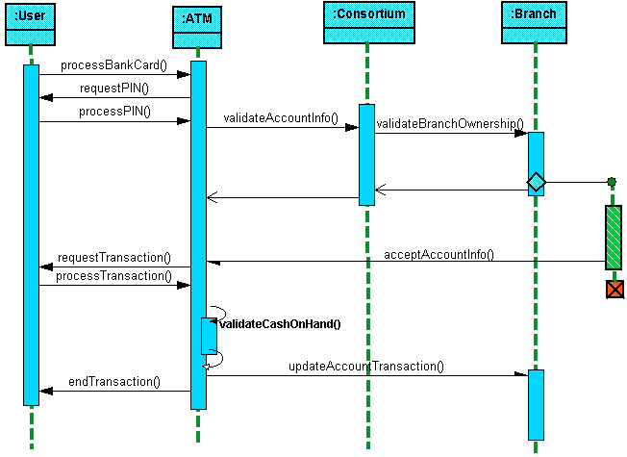
Class Diagram
Most used UML Diagrams:
Use-Case Diagram
Sequence Diagram

Slide 13
Practical UML
Three main approaches to applying UML technology
  Upfront Analysis and Design
  Code exploration / discovery
  Combination of the above two

Slide 14
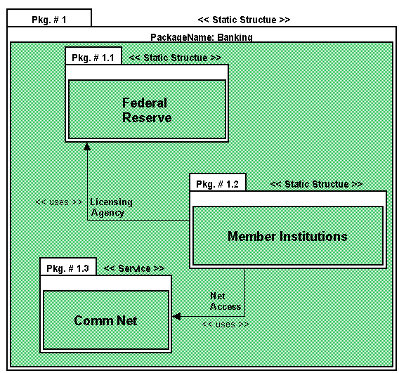

Upfront A & D:
Models Guide Code
Java Source Code

Slide 15
Code Exploration / Discovery:
Code viewed through models
Java Source Code

Slide 16
Combination:
Quick Iteration Between Code and Models
Java Source Code

Slide 17
Part Three
Demonstration

Slide 18
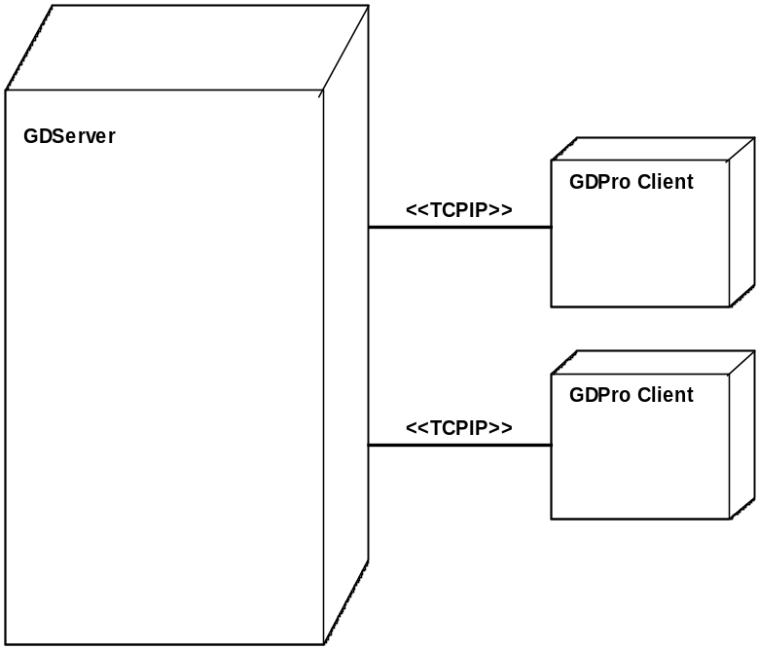
Network Monitor Program
Sample application to monitor network performance of clients connected to a server

Slide 19
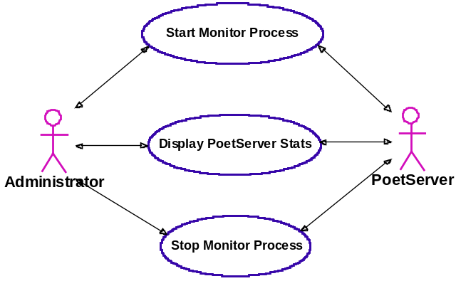
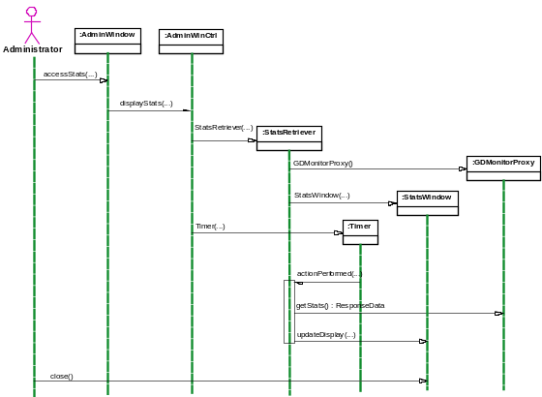
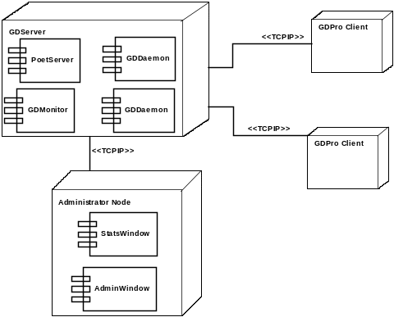
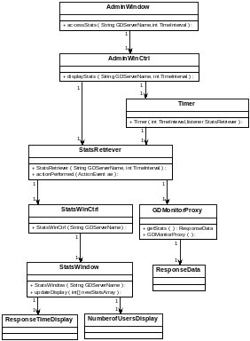
Network Monitor
Model Summary
UML Provides Architecture and Implementation Visibility

Slide 20
Recommended UML Guides
SAMS Teach Yourself UML in 24 Hours
Schmuller, Joseph. 1999.. Indianapolis: SAMS: A Division of Macmillan Computer Publishing.
Instant UML
Miller, Pierre-Alain, 1997. Paris: Wrox Press Ltd.
The Unified Modeling Language User Guide
Booch, Grady, J. Rumbaugh, and I. Jacobson. 1999. Reading: Addison-Wesley.
Use Case Driven Object Modeling with UML
Rosenberg, Doug with Kendall Scott. 1999. Addison-Wesley

Slide 21
Thank You!
Greg Schottland
Email: greg@gdpro.com
Phone: (800) 811 – 2784
Website: http://www.gdpro.com

