Slide 1
Java2 Printing API
Jean-Cédric Desrochers
March 9, 2000

Slide 2
Agenda
Java2 Printing API:
    Printing concepts
    The java.awt.print package
    Examples
Real World Experience
    Projects and Realization
    Issues and Workarounds
What’s new in JDK 1.3

Slide 3
Printing Concepts
Based on a callback model :
    Printing system controls when pages are printed;
    Application provides pages to print;
    Pages requested out of order and more than once;
More flexible :
    Reverse order;
    Print with a series of bands;

Slide 4
Printing Concepts (ii)
Job control entities :
    Initiate and control the printing process;
    Java provides classes like PrinterJob, PageFormat and Paper to manage print jobs;
Document related entities :
    Low-level classes like Printable knows how to render a single kind of page (page painter);
    High-level classes like Pageable and Book represent a collection of pages with different formats;

Slide 5
Printing Concepts (iii)
Page painter :
    Render a page using a graphics context;
    Implements the printable.Print() method;
    Notifies when all pages are rendered;
public int print(Graphics g, PageFormat page, int pageIndex)

Slide 6
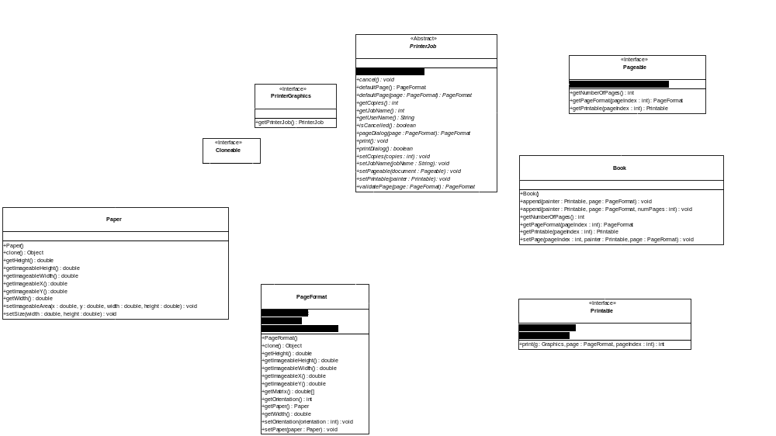
The java.awt.print package

Slide 7
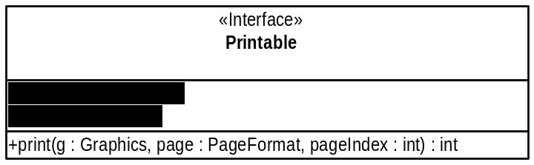
Printable Interface
Simplest way to print:
    Application provides a page painter;
    Printing system calls the print() method;
In a Printable job:
    Only one painter and one PageFormat;
    Job starts with page at index 0 (sequential);
    Page painter notifies when the end of the doc has been reached;
    Single-threaded;

Slide 8
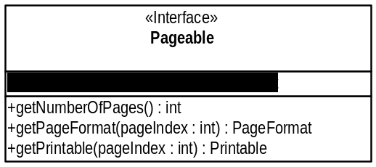
Pageable Interface
More flexible:
    Pages differ in layout and implementation;
    The system knows the number of pages;
In a Pageable job:
    Different page painters and PageFormats;
    Pages printed in an arbitrary order;

Slide 9
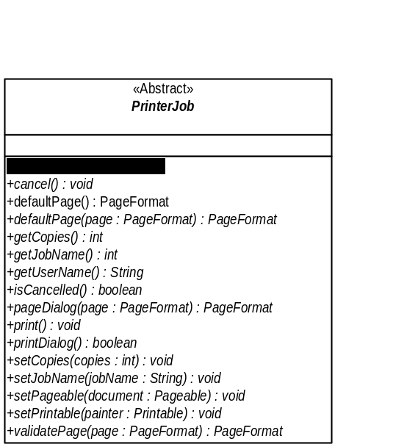
PrinterJob Class
Typical Life-Cycle:
  1) Get a new PrinterJob by calling getPrinterJob()
  2) Determine what PageFormat to use
  3) Set the Printable or the Pageable object to be printed
  4) Additional properties (copies, job name)
  5) Call printDialog() to show a dialog box (optional)
  6) Call print() to print the job

Slide 10
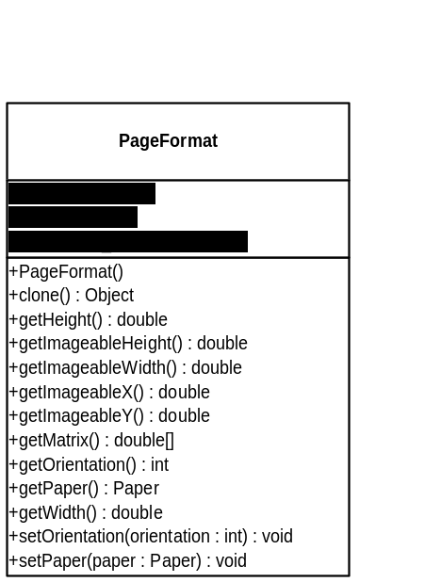
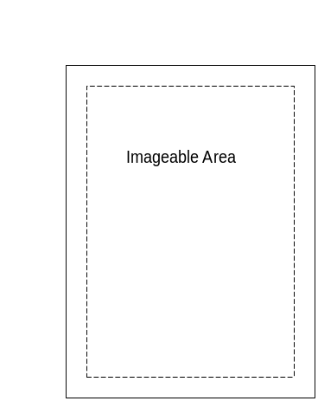
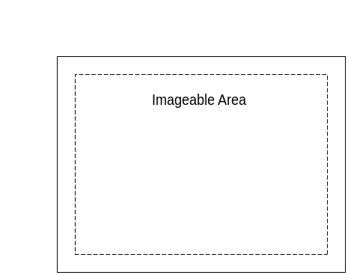
PageFormat Class
Describes the geometry of the page:
    Origin is at the upper left corner of paper;
    Units are in 1/72 inch;
    Specifies the imageable area of the page;

Slide 11
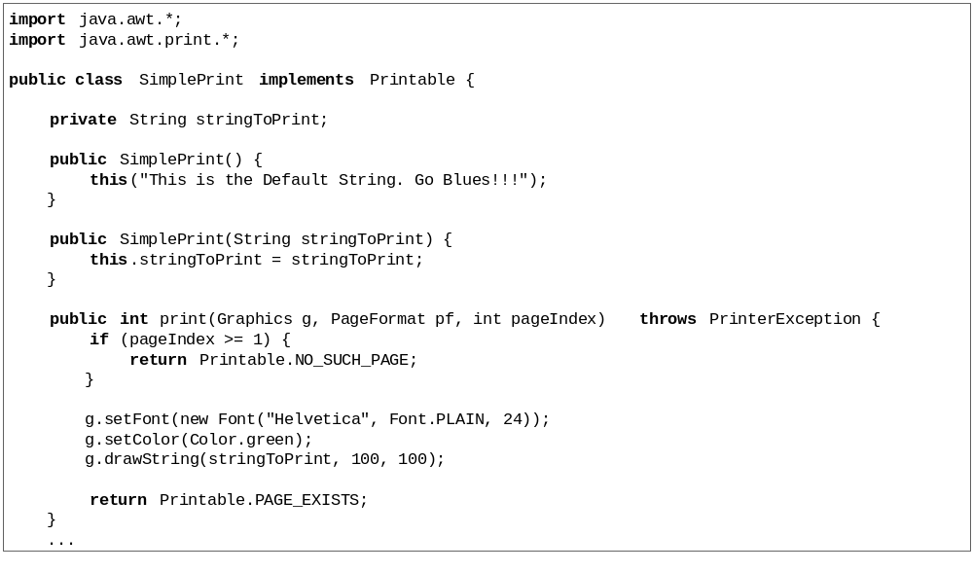
Printing using Printable

Slide 12
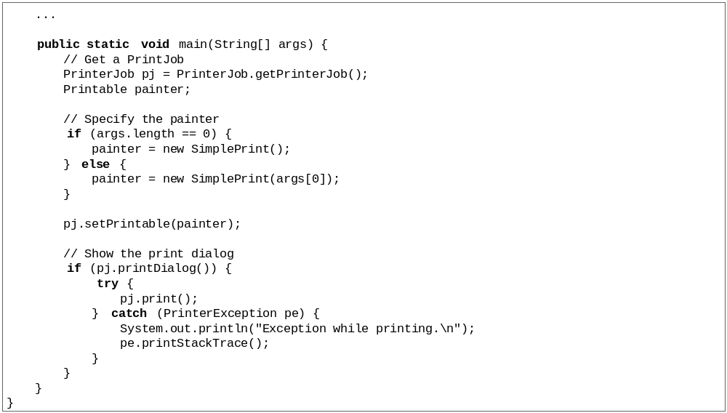
Printing using Printable (ii)

Slide 13
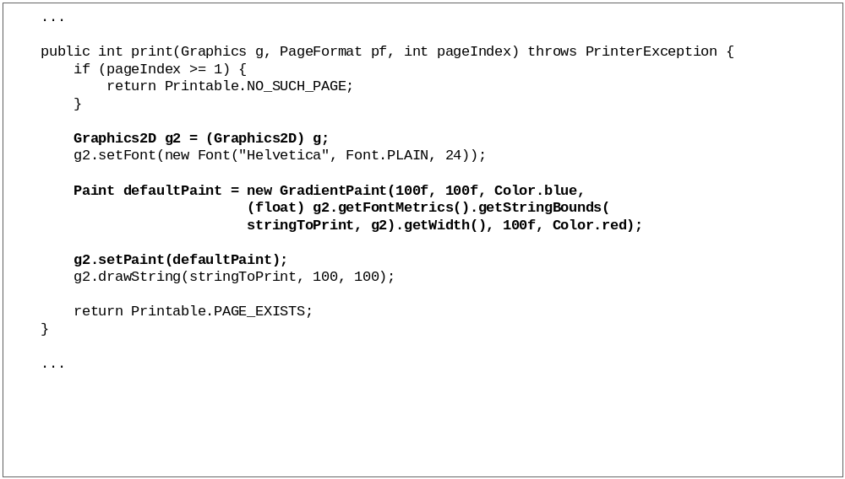
Example with Graphics2D

Slide 14
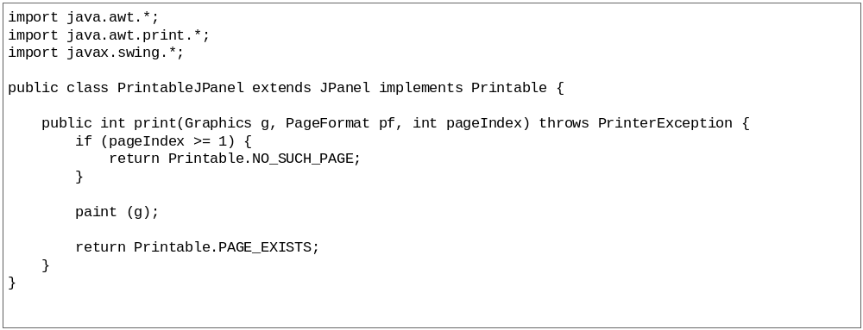
Printing Swing Components

Slide 15
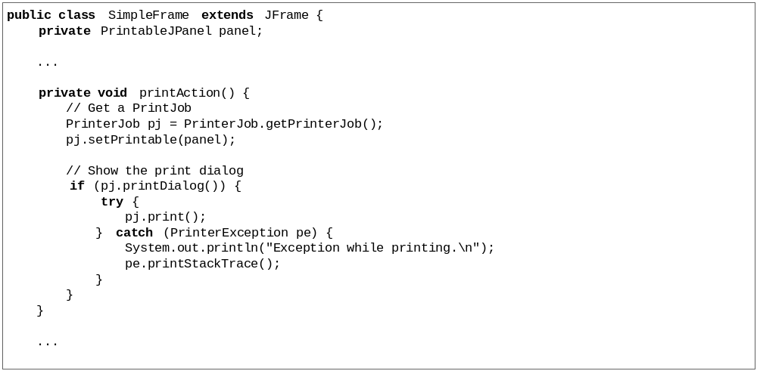
Printing Swing Components (ii)

Slide 16
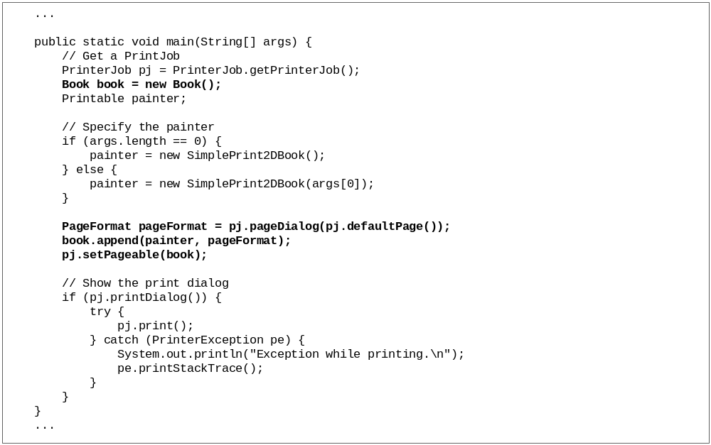
Printing using Pageable

Slide 17
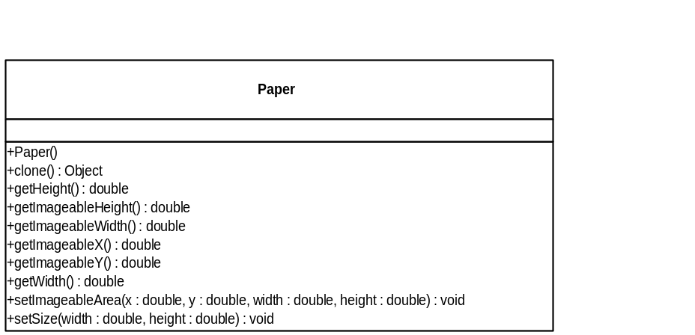
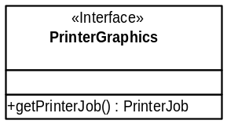
Other Classes
PrinterGraphics Interface:
    Implemented by Graphics objects that are passed to a Printable object;
Paper Class:
    Physical characteristics of a piece of paper;
    Used by the PageFormat;

Slide 18
Exceptions
PrinterException:
    Thrown by the Printable.print() method
PrinterIOException:
    Subclass of PrinterException;
    IO error occured during printing;
PrinterAbortException:
    Subclass of PrinterException;
    User or application cancelled the print job;

Slide 19
Real World Experience
Build and print HTML Reports:
    Generated with Oracle Reports;
    Available through HTTP server;
    Shown in Java GUI with ICEBrowser;
Great Ideas:
    Use the browser’s panel to print;
    Manage multiple pages;

Slide 20
Challenges
Image Quality:
    Resolution was awful;
Turn double buffering off:
    Faster printing;
    Higher resolution and quality;

Slide 21
Challenges (ii)
Formatting of documents:
    Unable to set margins;
    Printing system use default PageFormat;
    Known bug;
Printing very long:
    Generating HUGE spool file;
    Only on Windows with Laser Printers;
    Also, known bug;

Slide 22
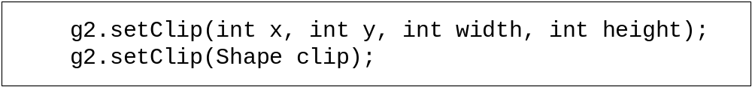
Advance Features
Use of translate():
    Moves an imaginary pen to a next position;
Use of clip areas:
    Restrict the component to only be painted in a given area;

Slide 23
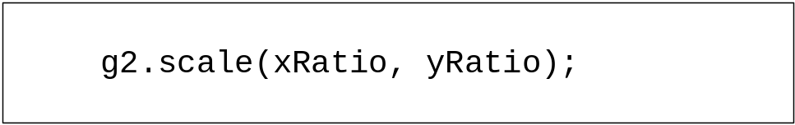
Advance Features (ii)
Use of scaling:
    Scales the 2D graphics context;
    Ratio of one maintains the size;
Other Graphics operations:
    Rotation;
    Transformation;

Slide 24
What’s new in JDK1.3
Same package, same classes;
A lot of bug fixes!!!
New classes for AWT printing model:
    JobAttributes class;
    PageAttributes class;

Slide 25
Conclusion
A good printing model;
Need some tuning;
Based on native resources;
Learn use of Java2D API;

