Slide 1
eBASE Bridge
Conversion to Java
A Story of Hope, Frustration
and Triumph!
James Kinder
Vice President, Internet Technologies
Computrol, Inc.
.

Slide 2
eBASE:
Current Technologies
IBM S/390 Mainframe
IBM VSAM, DB2, IMS, others
IBM COBOL and Assembler
IBM CICS, 3270 terminals
Microsoft Windows NT, IIS
Microsoft Active Server Pages (ASP)
Microsoft Visual Basic and VB Script

Slide 3
eBASE:
Major Part of New Business Plan
CEO: “Sell eBASE as a software product”
CEO: “Upgrade current clients to eBASE at no charge”
Me: “Deliver a portable Web solution - support NT and most Unix platforms - Solaris, AIX, HP-UX, Linux”
Me: “Partner with Sun, IBM and Microsoft”
Me: “Partner with 2 of top consulting firms”

Slide 4
eBASE Bridge
Portability Plan
Convert eBASE Bridge from VB to Java
Also develop Enterprise JavaBeans version
Maintain current Visual Basic version
Phase I - 4Q 1999: create Java Wrappers for MS COM objects, EJB interface
Phase II - 1Q 2000: replace Java Wrappers with 100% Pure Java modules
Phase III - 2Q 2000: other platforms

Slide 5
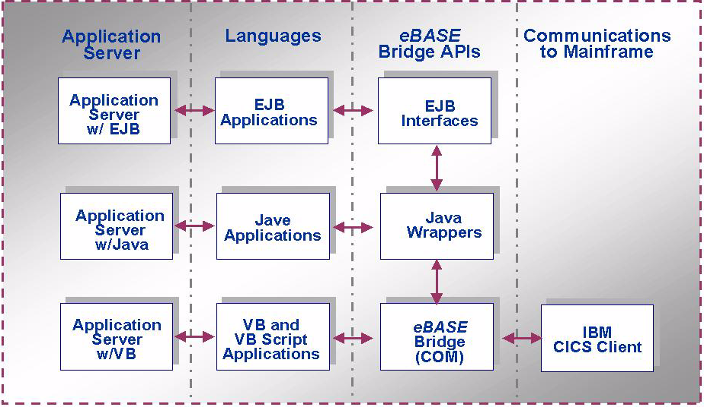
eBASE Bridge
Portability Plan - Phase I

Slide 6
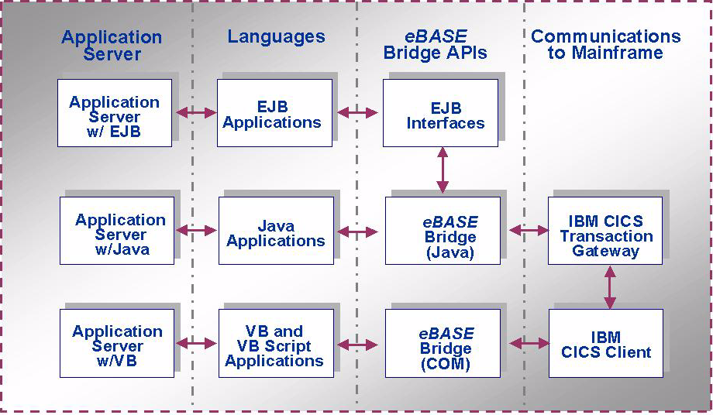
eBASE Bridge
Portability Plan - Phase II

Slide 7
Sun Microsystems:
Hope and Frustration!
Use NetDynamics and COMPAC to create Java Wrappers and COM interface - Hope!
Signed partnership agreement - Hope!
The Sun/Netscape/AOL Alliance created Fear, Uncertainty and Doubt - Frustration!
We did not have the resources required to start the project - Frustration!

Slide 8
Microsoft:
Hope, Frustration and Triumph!
Used Microsoft JActiveX utility - builds a Java interface from VB source - Hope!
JActiveX works, but interface required arrays in arguments - Frustration!
Corrected array problem by changing VB from “by reference” to “by value” - Hope!
Java Wrappers worked in test project - Triumph! (1)

Slide 9
IBM:
Hope and Frustration!
IBM Solutions Marketing gave us Visual Age for Java, WebSphere and a NetFinity server for free - Hope!
Both VA for Java 3.0 Beta and WebSphere 3.0 Beta did not install - Frustration!
Developed the EJB interface to Java Wrappers using Visual Café (without EJB support) - Hope! (2)

Slide 10
IBM:
Hope and Frustration Again!
Installed Visual Age for Java 2.0 and WebSphere 2.0 and they worked - Hope!
IBM rep spent 2 days at Computrol learning eBASE and assisting us - Hope!
IBM rep told us that version 1.0 of both products was “really a beta version”, 2.0 was a “development version”, and 3.0 was the “deployment version” - Frustration!

Slide 11
IBM:
More Frustration!
Because of COM support, the Microsoft JVM (JView) was required
When we tested JView with WebSphere, WebSphere crashed immediately!
IBM marketing claimed support for COM, but the WebSphere guys disavowed any support for JView because of “architectural differences” in JView - Frustration!

Slide 12
Computrol:
We Bite the Bullet!
For IBM partnership to work, eBASE Bridge must work with WebSphere
Other Web application servers may also have problems with JView
So, we decided to “bite the bullet” and go forward with Phase II immediately - convert eBASE Bridge to Java

Slide 13
Computrol:
Project Team
James Kinder - architect, code conversion, test programs, Servlets, Beans, JSP pages
Willy Farrell, IBM rep - VA for Java and WebSphere expertise
Oscar Watts - install NetFinity server and WebSphere, eBASE projects coordinator
Rick Barker - applet and Beans/JSP tests
Mike Lusicic - eBASE Bridge author

Slide 14
Computrol:
Java IDEs
Symantec Visual Café - preferred for Java development and testing
IBM Visual Age for Java - final EJB development, Servlets development
Visual Age IDE is very different, uses huge repository (120 mb), methods in alphabetical order, slower, difficult to use at times, buggy, help links broken!

Slide 15
Computrol:
Conversion to Java - Hope!
Convert syntax - “line by line” (3)
Write get and set routines for 52 public variables - VB programmer is a “bad boy”!
Develop new methods for compatibility with Visual Basic (4,5)
Convert CICS Client interface to CICS Transaction Gateway (6,7)

Slide 16
Computrol:
Conversion to Java - Frustration!
View Processing is complex because of View Caching, tied to VB limitations
View Caching architecture looks like a “Rube Goldberg” solution
Therefore, architectural changes were required to provide View Caching
Converted View Processing, but delayed View Caching support until 1Q 2000

Slide 17
Computrol:
VA & WebSphere - Frustration!
VA for Java bug: when importing a Java source file, it discarded the first and last methods (alphabetically) - Frustration!
WebSphere bug: changes to Servlet required re-cycling WebSphere or even re-booting the server - Frustration!
WebSphere bug: attempting to get a non-existent variable name caused WebSphere to exit the servlet - Frustration!

Slide 18
Computrol:
ICBSearch - Triumph!
Develop Java versions of ICBSearch (3 public methods, 1,000+ lines) with Symantec Café - worked in standalone test - Triumph!
Developed EJB interface to ICBSearch with Visual Age for Java, plus a Java Bean and JSP page - they worked with WebSphere - Triumph!

Slide 19
Computrol:
ICBClient - Frustration!
Developed Java version of ICBClient (48 public methods, 52 properties, 8,000+ lines) with Symantec Café - worked in standalone test - Triumph!
Developed EJB interface to ICBClient with Visual Age for Java, but VA quit on “generate deployed code” (creating the EJB stubs and skeletons) - Frustration!

Slide 20
Computrol:
ICBClient - Triumph!
IBM support said Project and EJB workspaces were “out of sync”, gave me a workaround method - Hope!
EJB version of ICBClient plus a Java Bean and JSP pages - finally worked with WebSphere - Triumph!
Developed generic Servlet and Bean for use with JavaServer Pages (8,9,10) - Triumph!

Slide 21
Computrol:
Next Steps
Certify eBASE Bridge with IBM WebSphere 3.0 and Netscape Application Server 4.0 on NT
Certify eBASE Bridge with selected Web application servers on NT and selected Unix platforms
Develop common caching architecture for Views and selected S/390 control records

Slide 22
Computrol:
Enhancing eBASE
Convert ICBRFS from VB to Java for Data Delivery System
Convert ICBOSS from VB to Java for Online Specification System
Develop common architecture for ASP/VB and JSP/Java environments for eBASE applications development

Slide 23
Computrol:
Advice
Be very careful when developing enterprise Java projects that use Microsoft JView and/or COM - Java is part of their “embrace, extend and extinguish” strategy
If you do, perform a “proof of concept” with JView and/or COM - or VBX, or OLE, or ActiveX, or DCOM, or COM+ or whatever they are calling it this month!

Slide 24
Summary
Computrol is now an IBM Solutions Development Partner
IBM is sponsoring a Web broadcast on eBASE on December 8th - sign up at www.developer.ibm.com, go to “Web broadcast”
eBASE is currently marketed by IBM - THE FINAL TRIUMPH!

Slide 25
More Information
James Kinder - technical
  jameskinder@computrolinc.com
Lucy Kissel - marketing
  lucykissel@computrolinc.com
eBASE information - www.computrolinc.com/ebase
314-576-3412

