Slide 1

Why Do Some Xiaohongshu Recommendation Positions Get Fewer Clicks?
From Commercial Exposure to Candidate Selection
Weiran Hu

Slide 2
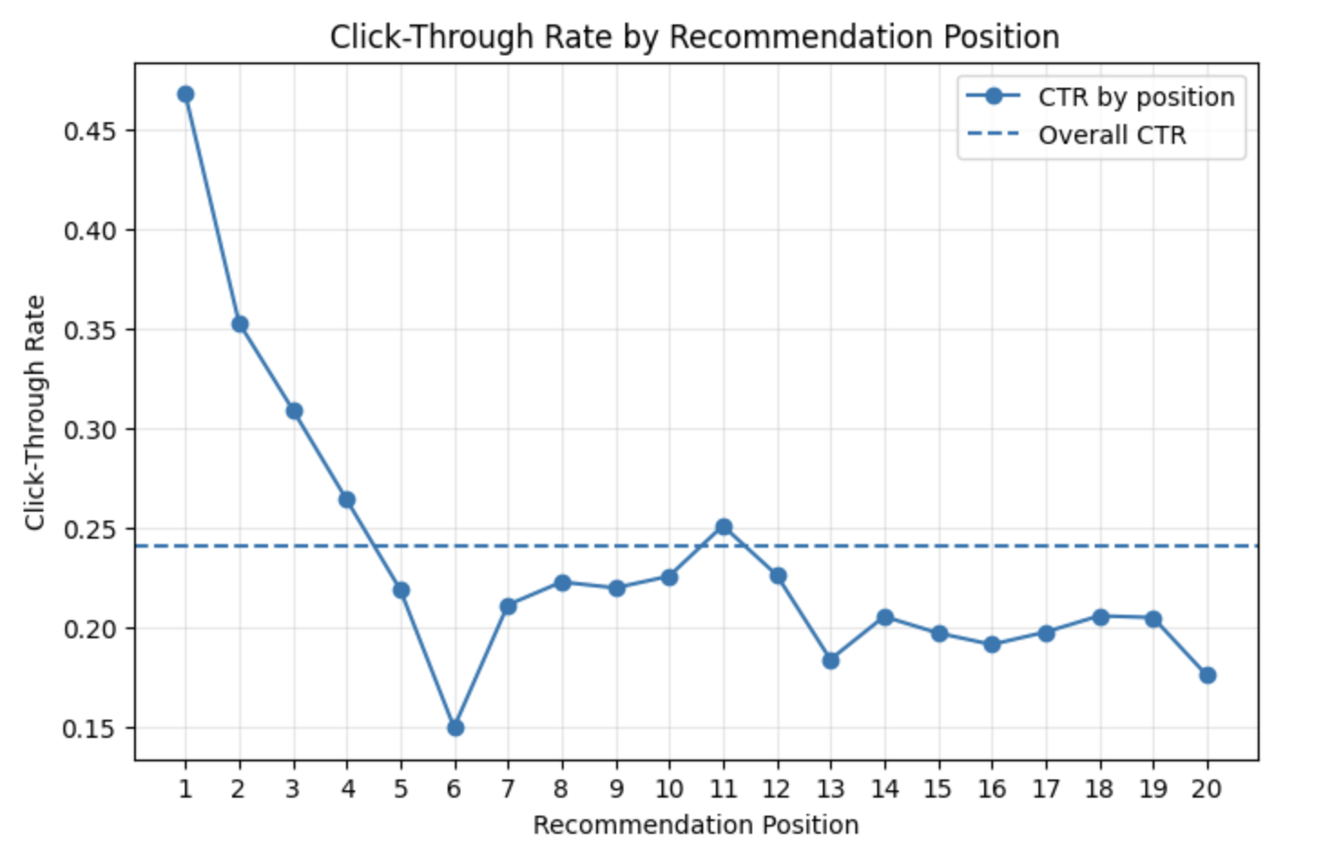
CTR generally declines with rank, but position 6 shows an unusually sharp dip.
"We guess these positions have higher probabilities of exposing commercial notes." (Chen et al., 2025, p. 3675)

Slide 3
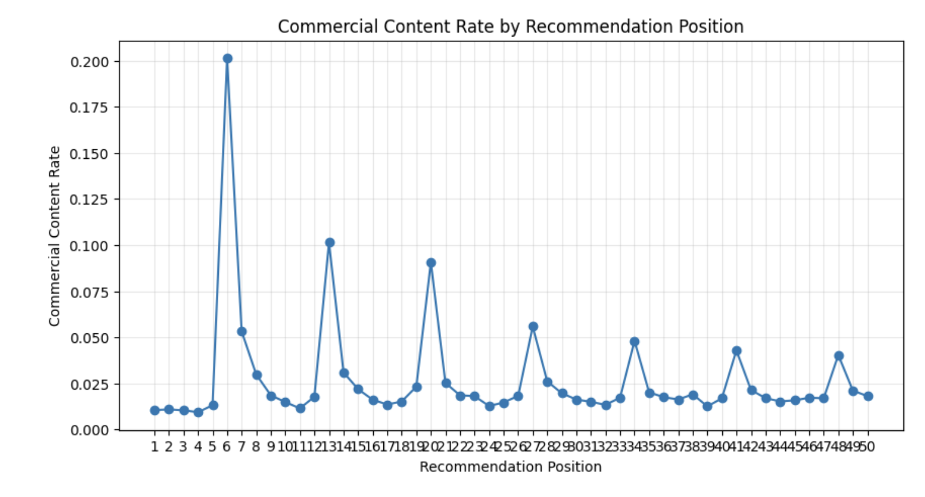
Initial Evidence Supports the Commercial Hypothesis
The Qilin notes metadata includes a commercial_flag field.
I classify notes as:
Commercial content: commercial_flag ≠ 0
Non-commercial content: commercial_flag = 0
Commercial content is strongly concentrated at position 6.
More broadly, commercial-content spikes appear repeatedly at positions 6, 13, 20, 27, …, suggesting a recurring placement pattern.
Source: Qilin dataset / Chen et al., 2025

Slide 4
Recurring Seven Position Structure
Block: which group of seven positions an item belongs to
Within-block position: the item's position within that seven-position group
Positions 6, 13, 20, 27, … all correspond to within-block position 6
Block 1: 1, 2, 3, 4, 5, 6 , 7
Block 2: 8, 9, 10, 11, 12, 13 , 14
Block 3: 15, 16, 17, 18, 19, 20 , 21

Slide 5
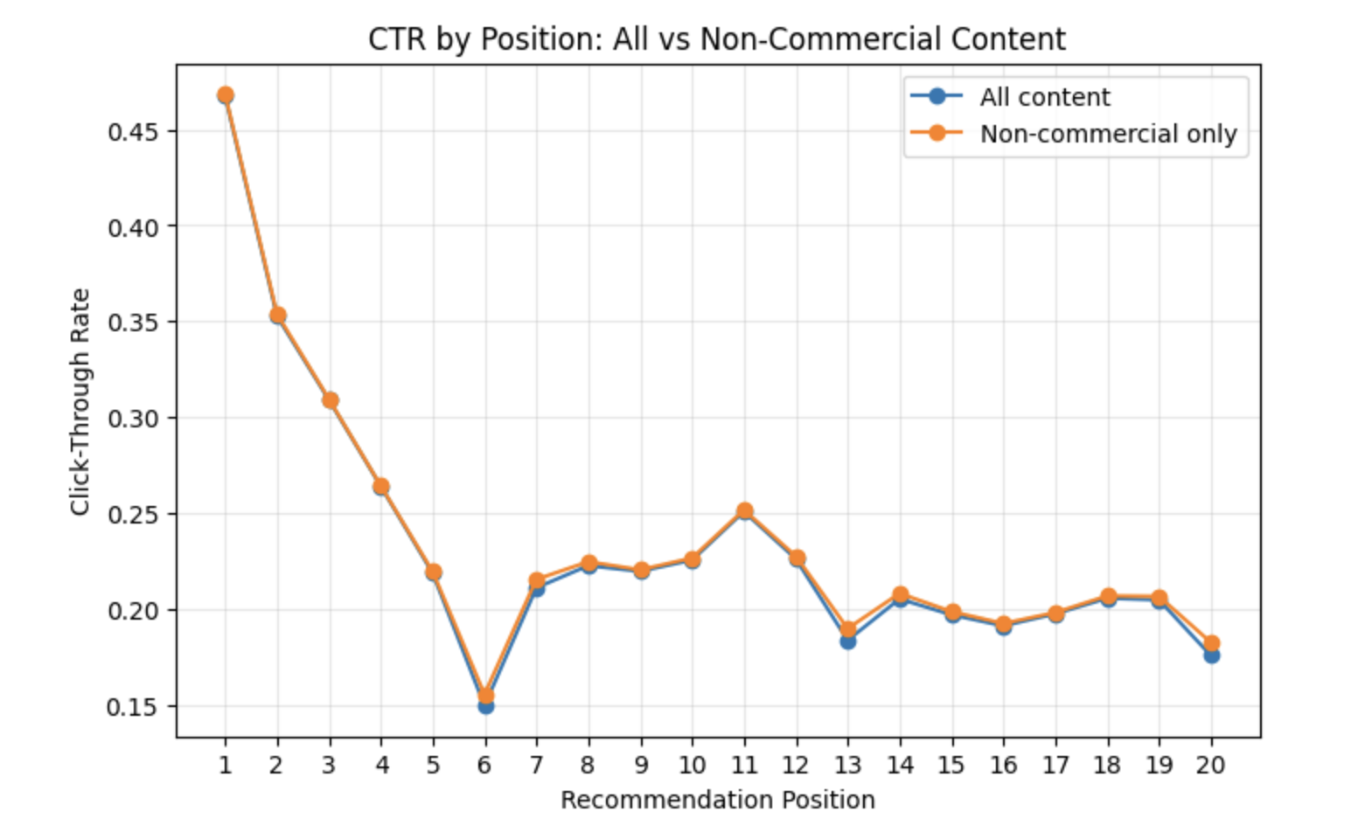
Commercial Content Alone Cannot Explain the CTR Dip
Removing commercial content did not eliminate the CTR dip.
Therefore, commercial exposure alone is not sufficient to explain the recurring engagement penalty.

Slide 6
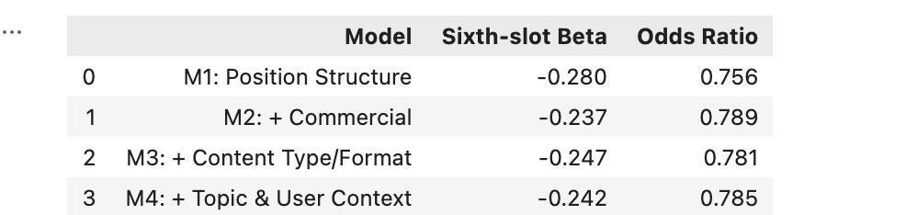
logistic regression
M1: Click∼C(Block)+C(WithinBlockPosition)
Tests whether the sixth position within each seven-item block is associated with lower click probability.
If the added controls fully explained the anomaly:
βslot -> 0
ORslot -> 1

Slide 7
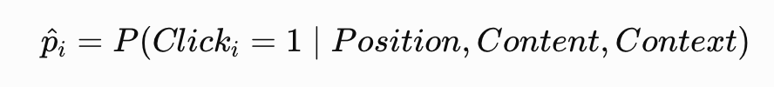
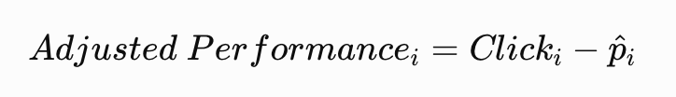
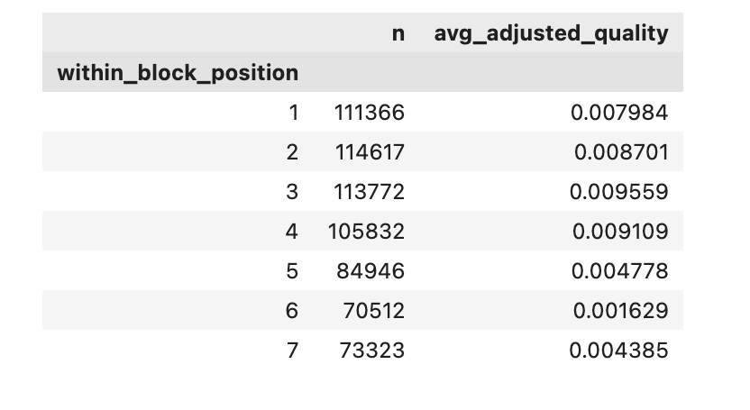
cross-fitted candidate-quality measure
1. Predict expected click probability from position and context
2. Measure performance relative to expectation
3. Use cross-fitting
Each observation is evaluated by a model that was not trained on that observation.
Candidate selection may also contribute to the CTR penalty.
Notes:
11111

Slide 8
Conclusion and Implication
Conclusion
Commercial content partially explains the recurring sixth-slot CTR penalty.
Observable content and user-context factors do not fully explain it.
Candidate selection may also contribute to the CTR penalty.
Implication
The issue may involve the candidate-selection or serving mechanism, not only ad exposure.
Product teams could audit these slots and use A/B tests to evaluate alternative candidate-selection strategies.

Slide 9
Reference
Chen, J., Dong, Q., Li, H., He, X., Gao, Y., Cao, S., Wu, Y., Yang, P., Xu, C., Hu, Y., Ai, Q., & Liu, Y. (2025). Qilin: A multimodal information retrieval dataset with APP-level user sessions. In N. Ferro, M. Maistro, G. Pasi, O. Alonso, A. Trotman, & S. Verberne (Eds.), Proceedings of the 48th International ACM SIGIR Conference on Research and Development in Information Retrieval (pp. 3670–3680). Association for Computing Machinery. https://doi.org/10.1145/3726302.3730279

