Slide 1
Stacked Ensemble of Fine-Tuned DCNNs for
Knee Osteoarthritis Severity Grading
COURSE PROJECT DA221M
Tanvi Doshi Adarsh Gupta Japleen Kaur
220101102 220101003 220106035

Slide 2
CONTEXT
Osteoarthritis is a degenerative joint disease in which the cartilage wears away over time.
Ranked in the top 50 most common diseases, approximately 13% of women and 10% of men aged above 60 years have symptomatic knee osteoarthritis.
The accuracy of detection and classification of KOA into these classes largely depends on the physician’s ability and precision. Since these grades have very minute differences and grading may vary from physician to physician, dependability on manual methods is low.
Currently, the only available treatments for KOA are behavioral interventions such as weight loss, exercise, and strengthening of muscles, which may slow the course of the disease. Thus, the best way to tackle KOA is early detection. This makes the use of machine learning based diagnosis extremely crucial to aid medical professionals make sound decisions.

Slide 3
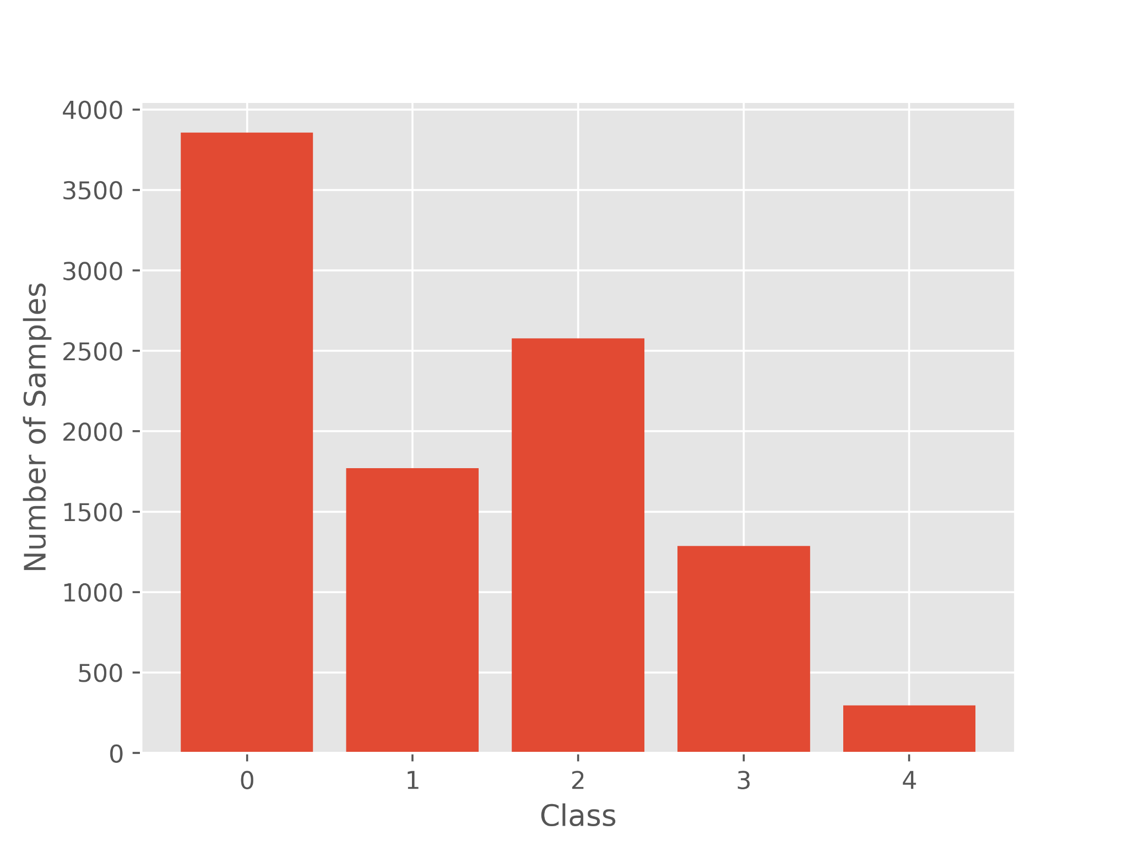
We obtained the knee X-ray images from the OsteoArthritis Initiative(OAI) dataset. This dataset consists of 9786 X-ray images, later partitioned into train, validation and test dataset
The dataset consists of 5 classes of knee osteoarthritis severity based on the KL grading- 0(healthy), 1(doubtful), 2(mild), 3(moderate) and 4(severe).
For multiclass classification, the dataset was used without any modification.
For Binary classification, data from classes 0 and 1 were combined to create class 0 (No disease) and class 2,3 and 4 were combined to create class 1(Disease)
To enhance the images to be used in the CNN architectures, the images were segmented, equalised and augmented.
DATASET AND PRE-PROCESSING

Slide 4
METHODOLOGY
Our proposed methodology is based on the utilization of a stacked ensemble of deep learning models, leveraging transfer learning on a diverse set of pre-trained state-of-the-art architectures including MobileNetV2, You Only Look Once (YOLOv8), DenseNet, EfficientNet, Convolutional Vision Transformer (CvT), and ResNet50.

Slide 5
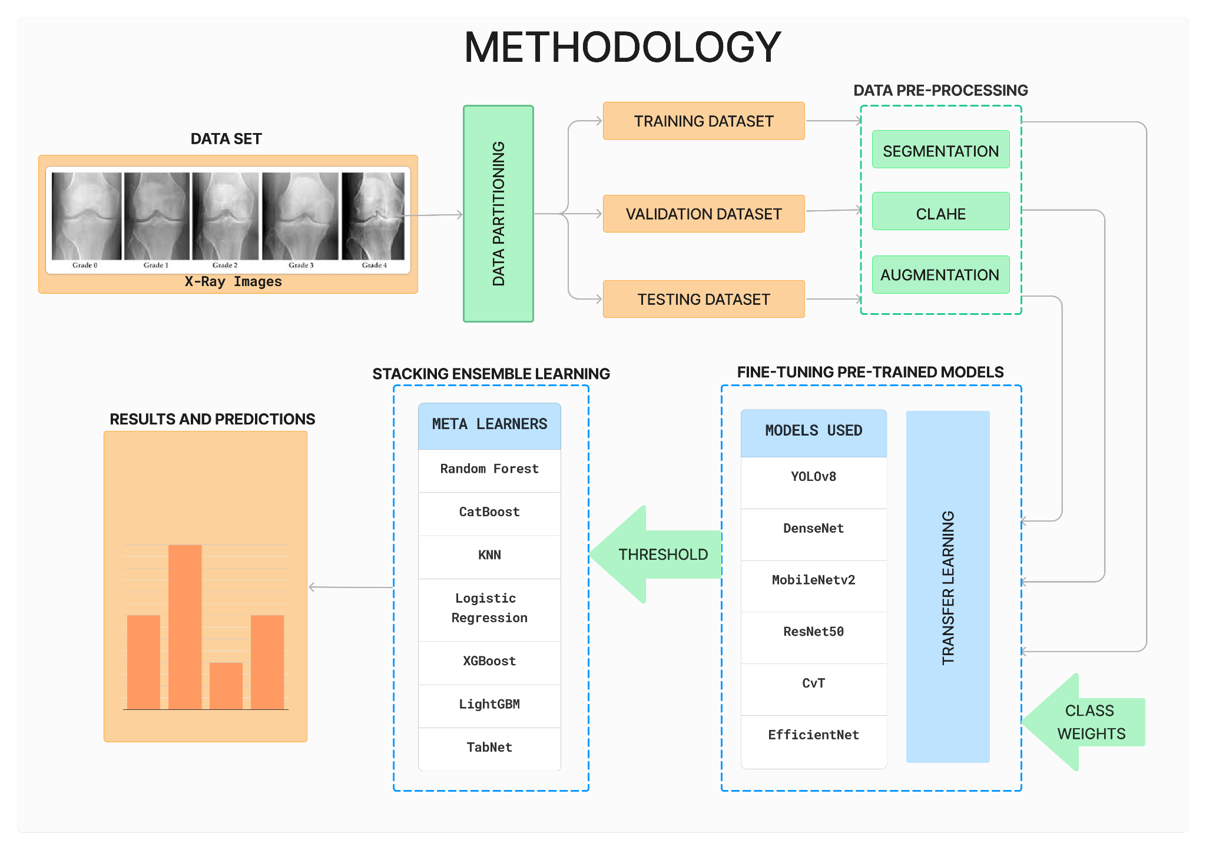

Slide 6
In order to fine-tune the pre-trained models(except) we made the following modifications. First, we introduced a dense layer with 320 neurons with ReLU activation. Further, we added a dropout layer with dropout probability 0.2 which drops 20% of the layers during training to prevent overfitting. Finally, a dense output layer with 5 neurons is added with softmax activation function.
In DenseNet architecture, an additional global average pooling 2D layer was added before the newly added layers to enhance feature extraction.
In multiclass classification, we employed the Categorical Loss Entropy loss function whereas in Binary Classification, Binary Cross Entropy loss function was used. We added class-weights to tackle the imbalance class issue.
The models that gave an accuracy above the chosen threshold, were used as base models for stacked ensemble learning. GridSearchCV and RandomizedSearchCV were used to fine-tune the hyperparameters of the meta-learners used.
After hyperparameter tuning, the best classifier was trained on the train set and used to generate the accuracy score, balanced accuracy score and AUC values on the train, test and val sets.

Slide 7
RESULTS
FOR FINE-TUNED DCNN MODELS
Multiclass | Train acc. | Train AUC | Val acc. | Val AUC | Test acc. | Test AUC
DenseNet | 0.832 | 0.967 | 0.582 | 0.849 | 0.673 | 0.898
YOLOv8 | 0.687 | 0.908 | 0.567 | 0.823 | 0.631 | 0.876
MobileNetv2 | 0.613 | 0.84 | 0.556 | 0.8 | 0.575 | 0.817
In multi-class classification, DenseNet performed the best with a testing accuracy of 67.3% and a 0.898 AUC of the test dataset. The YOLOv8 and MobileNetv2 also performed reasonably well with testing accuracies of 63.1% and 57.5%.

Slide 8
Binary | Train acc. | Train AUC | Val acc. | Val AUC | Test acc. | Test AUC
DenseNet | 0.847 | 0.936 | 0.798 | 0.86 | 0.796 | 0.881
YOLOv8 | 0.813 | 0.899 | 0.781 | 0.841 | 0.793 | 0.876
MobileNetv2 | 0.94 | 0.982 | 0.821 | 0.892 | 0.865 | 0.945
In binary classification MobileNetv2 performed the best with a testing accuracy of 86.5% and a test AUC of 0.945. Followed by DenseNet and YOLOv8 with testing accuracies of 79.6% and 79.3% respectively. In order to obtain the best results a threshold of 50% testing accuracy for multi-class classification and 70% testing accuracy for binary classification was chosen to decide which models to use with the meta learners. Thus, DenseNet, YOLOv8 and MobileNetv2 were used in the ensemble.

Slide 9
FOR STACKED ENSEMBLE
Multiclass Metalearner | Train acc. | Train bal acc. | Train AUC | Val acc. | Val bal acc. | Val AUC | Test acc. | Test bal acc. | Test AUC
Random Forest | 0.941 | 0.948 | 0.997 | 0.738 | 0.731 | 0.964 | 0.707 | 0.724 | 0.909
CatBoost | 0.912 | 0.921 | 0.988 | 0.701 | 0.699 | 0.917 | 0.711 | 0.72 | 0.912
KNN | 0.879 | 0.89 | 0.982 | 0.657 | 0.658 | 0.919 | 0.709 | 0.73 | 0.875
Logistic Regression | 0.852 | 0.859 | 0.972 | 0.632 | 0.637 | 0.854 | 0.71 | 0.714 | 0.91
LightGBM | 0.863 | 0.879 | 0.973 | 0.613 | 0.629 | 0.86 | 0.705 | 0.712 | 0.906
TabNet | 0.873 | 0.891 | 0.978 | 0.607 | 0.626 | 0.811 | 0.708 | 0.723 | 0.889
Binary Classification | Train acc. | Train bal acc. | Train AUC | Val acc. | Val bal acc. | Val AUC | Test acc. | Test bal acc. | Test AUC
Random Forest | 0.991 | 0.99 | 1 | 0.958 | 0.956 | 0.996 | 0.877 | 0.872 | 0.939
CatBoost | 0.959 | 0.955 | 0.986 | 0.828 | 0.819 | 0.904 | 0.879 | 0.875 | 0.945
KNN | 0.959 | 0.954 | 0.995 | 0.855 | 0.843 | 0.953 | 0.879 | 0.871 | 0.913
XGBoost | 0.949 | 0.941 | 0.986 | 0.838 | 0.82 | 0.902 | 0.873 | 0.861 | 0.941
LightGBM | 0.96 | 0.957 | 0.987 | 0.828 | 0.82 | 0.906 | 0.874 | 0.87 | 0.945
TabNet | 0.865 | 0.88 | 0.984 | 0.757 | 0.778 | 0.902 | 0.806 | 0.823 | 0.945

Slide 10

BINARY CLASSIFICATION
Both CatBoost and KNN achieved the highest Test Accuracy of 87.9% showcasing strong performance.
CatBoost also achieved the highest balanced accuracy on the test set of 87.5%.
TabNet got the lowest Test Accuracy of 80.6%.
Notably, all the meta learners performed exceptionally well by attaining Test Accuracies greater than 80% and Test AUCs greater than 0.91.
MULTI-CLASS CLASSIFICATION
CatBoost yielded the highest testing accuracy of 71.1% and the highest testing AUC of 0.912.
CatBoost achieved a balanced accuracy of 72% on the test set. However, the KNN classifier surpassed this with a Balanced Accuracy of 73% on the test set.
All the meta-learners performed reasonably well, attaining test accuracies greater than 70% and Test AUC greater than 0.87.

