Slide 1
Sales CRM Analysis
Sales Cycle
Summary
Cities to Focus on
What-if Scenarios…

Slide 2
Sales Cycle at UrbanPiper
1
2
3
4
5
New Deal
Contact Made
Product Demo
Proposal
Negotiation
9
9
8
7
6
Product Development
Onboarding Merchants
Signed up for Integration
Won
Agreement Sent
10
10
9
8
7
Development Complete
POS Churned
POS Integration Deferred
Deferred
Lost
11
Contact Again
Open
Won
Deferred/Lost

Slide 3
Data Exploration
Snapshot time period 2018 - YTD 2021
5k deals pan India
14 Sales Reps
17.8% Deals Won since 2018
24% (out of?) Deals won in 2020 (Best Year)
34% Open Deals in 2021 (out of deals handled)
Including deals updated prior to 2021, there are 18.7% open deals out of 5k as of Mar 2021

Slide 4
17.8% Conversion Rate over ~5k deals in 4 years
# Sales Rep: 1 (+2 for 2 months)
# Deals Handled: 36
Conversion Rate: 30.6%
Open Deals: 2.8%
Avg. Deal Age: 612 days
# Sales Reps: 13
# Deals Handled: 2,470
Conversion Rate: 8.5%
Open Deals: 34.1%
Avg. Deal Age: 1170 days
Dec 2018
2019
2020
Q1 2021
# Sales Rep: 1
# Deals Handled: 148
Conversion Rate: 36.5%
Open Deals: 0%
Avg. Deal Age: 351 days
# Sales Reps: 8
# Deals Handled: 3,160
Conversion Rate: 24%
Open Deals: 7.7%
# Avg. Deal Age: 1,062 days

Slide 5
17.8% Conversion Rate over ~5k deals in 4 years
# Sales Rep: 1 (+2 for 2 months)
# Deals Handled: 36
Conversion Rate: 30.6%
Open Deals: 2.8%
Avg. Deal Age: 612 days
# Sales Reps: 13
# Deals Handled: 2,470
Conversion Rate: 8.5%
Open Deals: 34.1%
Avg. Deal Age: 1170 days
Dec 2018
2019
2020
Q1 2021
# Sales Rep: 1
# Deals Handled: 148
Conversion Rate: 36.5%
Open Deals: 0%
Avg. Deal Age: 351 days
# Sales Reps: 8
# Deals Handled: 3,160
Conversion Rate: 24%
Open Deals: 7.7%
# Avg. Deal Age: 1,062 days

Slide 6
Data Exploration
# Sales Rep: 1 (+2 for 2 months)
# Deals Handled: 36
Conversion Rate: 30.6%
Open Deals: 2.8%
Avg. Deal Age: 612 days
# Sales Reps: 13
# Deals Handled: 2,470
Conversion Rate: 8.5%
Open Deals: 34.1%
Avg. Deal Age: 1170 days
Dec 2018
2019
2020
Q1 2021
# Sales Rep: 1
# Deals Handled: 148
Conversion Rate: 36.5%
Open Deals: 0%
Avg. Deal Age: 351 days
# Sales Reps: 8
# Deals Handled: 3,160
Conversion Rate: 24%
Open Deals: 7.7%
# Avg. Deal Age: 1,062 days

Slide 7
Top 10 Cities by Potential Outlets (YTD 2021)
YTD 2021 Potential Outlets
Volume of Open Deals
97th Percentile of Outlets per Deals Handled in 2020
Past Conversion Rate
Outlets per Deal: 97th percentile is chosen as the cut-off for each city as we notice a knee-shaped curve shooting at that percentile for almost all major cities

Slide 8
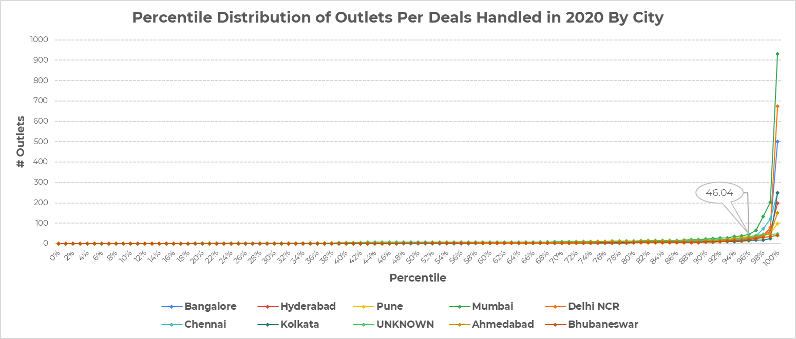
Distribution of Outlets Per Deal (2020)
# Outlets = 46
97th %ile
Note: Only top 10 cities from the previous slide are filtered in this chart

Slide 9
Q2: How many deals to assign to a Sales Rep?
Steps:
- # Sales Rep: 13
Check the MoM distribution of conversion rate per sales rep
1 Extremely high performer (outlier AIB)
2 Extremely poor performers (outlier DJ, MPS)
6 with not enough data points to draw a conclusion
4 with normal variance
finding: DJ should be given lower volume of deals to be handled to increase performance

Slide 10
What-if Scenarios…
Show 2-3 scenarios which help in hitting the 10000 outlets a year target
Focus should be on why a particular parameter was selected for simulation
Show the approach used to create the simulator

Slide 11
Question/Next Steps
How competitive is the [technological] problem solving space within hyperlocal delivery market?
Does it warrant a competitor analysis to understand if and why are we losing sales to competitors
Time Series forecasting:
Overall Sales
Sales by Region/City
Sales by Sales Rep

