Slide 1
Sales CRM Analysis
Sales Cycle
Summary
Cities to Focus on
What-if Scenarios

Slide 2
Sales Cycle at UrbanPiper
1
2
3
4
5
New Deal
Contact Made
Product Demo
Proposal
Negotiation
9
9
8
7
6
Product Development
Onboarding Merchants
Signed up for Integration
Won
Agreement Sent
10
10
9
8
7
Development Complete
POS Churned
POS Integration Deferred
Deferred
Lost
11
Contact Again
Open
Won
Deferred/Lost

Slide 3
17.8% Conversion Rate over ~5k deals since Dec 2018
# Sales Rep: 1 (+2 for 2 months)
# Deals Handled: 36
Conversion Rate: 30.6%
Open Deals: 2.8%
Avg. Deal Age: 612 days
# Sales Reps: 13
# Deals Handled: 2,470
Conversion Rate: 8.5%
Open Deals: 34.1%
Avg. Deal Age: 1,170 days
Dec 2018
2019
2020
Q1 2021
# Sales Rep: 1
# Deals Handled: 148
Conversion Rate: 36.5%
Open Deals: 0%
Avg. Deal Age: 351 days
# Sales Reps: 8
# Deals Handled: 3,160
Conversion Rate: 24%
Open Deals: 7.7%
# Avg. Deal Age: 1,062 days

Slide 4
Which cities should we be focusing more on and why?

Slide 5
Top 10 focus cities out of 60 based on Potential Outlets (YTD 2021) that could be acquired assuming performance remains consistent from last year
YTD 2021 Potential Outlets that could be acquired
Volume of Open Deals
Outlets per Deals Handled in 2020*
Past Conversion Rate
Priority
High
Medium
Low
*Outlets per Deal handled in 2020: 97th percentile is chosen as the cut-off for each city (refer next slide)

Slide 6
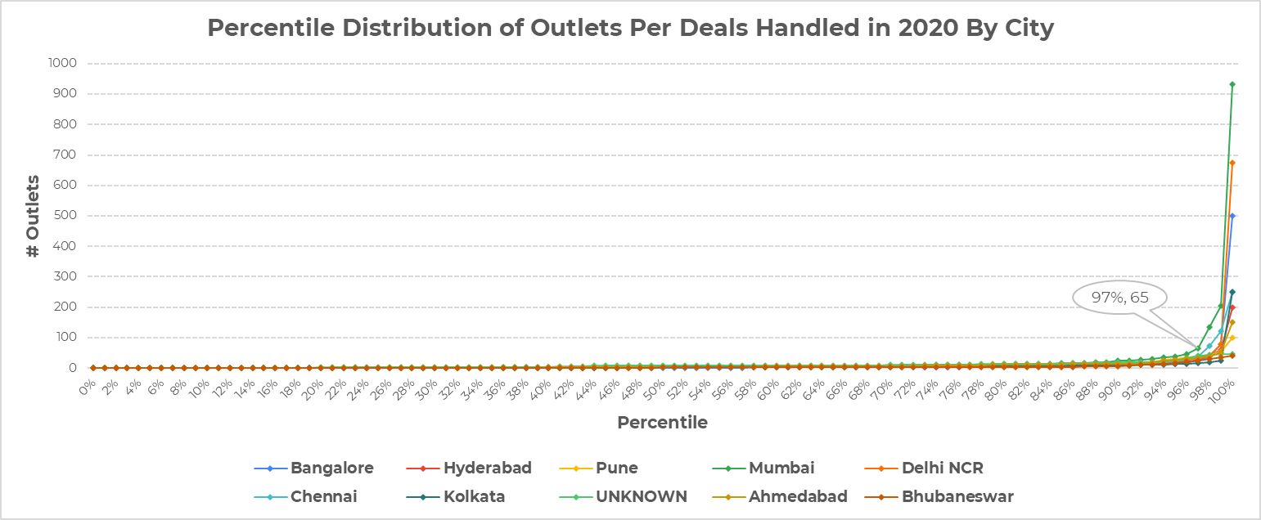
97th percentile provides a balanced assumption on outlets handled per deal considering the outliers present in the data
# Outlets = 65
97th %ile
%ile cut-off or median provides a better representation of outlets per deal handled considering the average would be skewed by the few deals with very high outlets ( right tailed distribution)
Note: Only top 10 cities from the previous slide are filtered in this chart

Slide 7
How many deals should be assigned to a sales rep to close 10-15 deals in a month?

Slide 8
Monthly Performance of sales reps show that some have very few datapoints captured to be analysed and few variation amongst the rest
Deals handled per month is fairly consistent for DS and MJ hence their average deals handled per month is close to the 50th percentile
Everyone else handles exceptionally greater volume of deals in a few odd months than their usual monthly performance skewing their overall performance
Most reps meet their monthly target <25% of the time, with the exception of DS (60%) and SS (90%)
Insufficient Data Points

Slide 9
By excluding the sales reps with insufficient data, we have a sample set that can be further analysed
Step 1/3: Highlight cells with Conversion Rate greater than 18%
# Deals Handled (% Conversion Rate)
Setting the Overall Conversion Rate (18%) as the benchmark to compare individual sales reps’ monthly performance leaves us with the above highlighted datapoints

Slide 10
By excluding the sales reps with insufficient data, we have a sample set that can be further analysed
Step 2/3: Highlight cells with Conversion Rate greater than 10%
# Deals Handled (% Conversion Rate)
Relaxing the Conversion Rate to 10% helps include instances where a Sales Rep handled an extremely large volume of Deals which seems to impact the quality of Monthly Conversion Rate but still meets the monthly target of 10 Deals

Slide 11
By excluding the sales reps with insufficient data, we have a sample set that can be further analysed
Step 3/3: Highlight cells with Conversion Rate between 10% and 18% with at least 10 deals won
# Deals Handled (% Conversion Rate)
Recommendation: Assuming 10-18% conversion rate, every sales rep should aim to handle at least 90-130 Deals in a month to hit their monthly targets

Slide 12
Assuming one person can close up to 10-15 deals in a month, how many salespeople will you need to close 10,000 outlets in a year? to perform this job efficiently. From a company point of view, it is desirable to have the least amount of salespeople

Slide 13
To determine this we need to identify the factors that influence the number of outlets acquired in a given month/year
The following factors could be considered:
Deals Per Rep per Month
Outlets per Deal
Proportion of Restaurant Segments Won
Avg. Deal Handling Time
City
Seasonality (Monthly/Quarterly)
Objective: The objective is to optimize the above mentioned parameters to achieve the target of 10,000 deals in a year by minimizing the estimation of number of sales reps required
Constraints:
# Deals Won per Rep: 10 to 15 per month (Given Assumption)
Outlets per Deal: Upper and Lower bounds for simulation to be determined (To be calculated using outlets distribution)
# Large, Medium, Small Segment Deals: To be determined based on what is the proportion of Large Segment Deals in 2020
# Outlets per Restaurant Segment: To be determined based on the distribution of Outlets per deal in 2020 split by Restaurant Segment

Slide 14
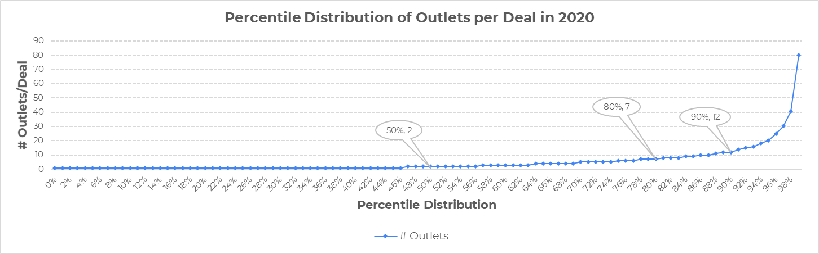
Sample Estimation using 2 Parameters: # Outlets per deal & # Deals won in month
As a simple simulation we can use the below graph to determine the aggregate outlets per deal to consider while calculating minimum number of sales reps required to acquire 10,000 outlets in a year
This estimate can be improved by adding additional granularity like:
Restaurant Segment
City
Seasonality (Monthly/Quarterly)
Avg Deal Handling Time… etc,.

Slide 16
Appendix

Slide 17
By excluding the sales reps with very little data, we have a sample set that can be further analysed
Step x/y: Highlight cells with Conversion Rate greater than 18% and at least 10 deals won
Assuming 10-15% conversion rate, every sales rep should aim to handle at least 90-130 Deals in a month to hit their monthly targets
Cells highlighted in green = At least 10 deals won with at least 10% conversion rate

Slide 18
By excluding the sales reps with very little data, we have a sample set that can be further analysed
Step x/y: Highlight cells with Conversion Rate greater than 10% and at least 10 deals won
Assuming 10-15% conversion rate, every sales rep should aim to handle at least 90-130 Deals in a month to hit their monthly targets
Cells highlighted in green = At least 10 deals won with at least 10% conversion rate

Slide 19
By excluding the sales reps with very little data, we have a sample set that can be further analysed
Step x/y: Highlight cells with Conversion Rate greater than 18% and at least 15 deals won
Assuming 10-15% conversion rate, every sales rep should aim to handle at least 90-130 Deals in a month to hit their monthly targets
Cells highlighted in green = At least 10 deals won with at least 10% conversion rate

Slide 20
By excluding the sales reps with very little data, we have a sample set that can be further analysed
15 Deals, 10% cut-off
Cells highlighted in green = At least 10 deals won with at least 10% conversion rate

Slide 21
Q2: How many deals to assign to a Sales Rep?
Steps:
- # Sales Rep: 13
Check the MoM distribution of conversion rate per sales rep
1 Extremely high performer (outlier AIB)
2 Extremely poor performers (outlier DJ, MPS)
6 with not enough data points to draw a conclusion
4 with normal variance
finding: DJ should be given lower volume of deals to be handled to increase performance

Slide 22
Question/Next Steps
How competitive is the [technological] problem solving space within hyperlocal delivery market?
Does it warrant a competitor analysis to understand if and why are we losing sales to competitors
Time Series forecasting:
Overall Sales
Sales by Region/City
Sales by Sales Rep

Slide 23
Data Exploration
Snapshot time period 2018 - YTD 2021
5k deals pan India
14 Sales Reps
17.8% Deals Won since 2018
24% (out of?) Deals won in 2020 (Best Year)
34% Open Deals in 2021 (out of deals handled)
Including deals updated prior to 2021, there are 18.7% open deals out of 5k as of Mar 2021

Slide 24
17.8% Conversion Rate over ~5k deals in 4 years
# Sales Rep: 1 (+2 for 2 months)
# Deals Handled: 36
Conversion Rate: 30.6%
Open Deals: 2.8%
Avg. Deal Age: 612 days
# Sales Reps: 13
# Deals Handled: 2,470
Conversion Rate: 8.5%
Open Deals: 34.1%
Avg. Deal Age: 1170 days
Dec 2018
2019
2020
Q1 2021
# Sales Rep: 1
# Deals Handled: 148
Conversion Rate: 36.5%
Open Deals: 0%
Avg. Deal Age: 351 days
# Sales Reps: 8
# Deals Handled: 3,160
Conversion Rate: 24%
Open Deals: 7.7%
# Avg. Deal Age: 1,062 days

Slide 25
By excluding the sales reps with very little data, we have a sample set that can be further analysed
10% cut-off
Recommendation
Assuming 10-15% conversion rate, every sales rep should aim to handle at least 90-130 Deals in a month to hit their monthly targets
Cells highlighted in green = At least 10 deals won with at least 10% conversion rate

Slide 26
By excluding the sales reps with very little data, we have a sample set that can be further analysed
18% cut-off
Recommendation
Assuming 10-15% conversion rate, every sales rep should aim to handle at least 90-130 Deals in a month to hit their monthly targets
Cells highlighted in green = At least 10 deals won with at least 10% conversion rate

Slide 27
By excluding the sales reps with very little data, we have a sample set that can be further analysed
10 Deals, 10% cut-off
Recommendation
Assuming 10-15% conversion rate, every sales rep should aim to handle at least 90-130 Deals in a month to hit their monthly targets
Cells highlighted in green = At least 10 deals won with at least 10% conversion rate

Slide 28
By excluding the sales reps with very little data, we have a sample set that can be further analysed
10 Deals, 18% cut-off
Recommendation
Assuming 10-15% conversion rate, every sales rep should aim to handle at least 90-130 Deals in a month to hit their monthly targets
Cells highlighted in green = At least 10 deals won with at least 10% conversion rate

Slide 29
By excluding the sales reps with very little data, we have a sample set that can be further analysed
15 Deals, 10% cut-off
Recommendation
Assuming 10-15% conversion rate, every sales rep should aim to handle at least 90-130 Deals in a month to hit their monthly targets
Cells highlighted in green = At least 10 deals won with at least 10% conversion rate

Slide 30
By excluding the sales reps with very little data, we have a sample set that can be further analysed
15 Deals, 18% cut-off
Recommendation
Assuming 10-15% conversion rate, every sales rep should aim to handle at least 90-130 Deals in a month to hit their monthly targets
Cells highlighted in green = At least 10 deals won with at least 10% conversion rate

Slide 31
By excluding the sales reps with very little data, we have a sample set that can be further analysed
10 Deals, 10%-18% cut-off
Recommendation
Assuming 10-15% conversion rate, every sales rep should aim to handle at least 90-130 Deals in a month to hit their monthly targets
Cells highlighted in green = At least 10 deals won with at least 10% conversion rate

Slide 32
17.8% Conversion Rate over ~5k deals since Dec 2018
# Sales Rep: 1 (+2 for 2 months)
# Deals Handled: 36
Conversion Rate: 30.6%
Open Deals: 2.8%
Avg. Deal Age: 612 days
# Sales Reps: 13
# Deals Handled: 2,470
Conversion Rate: 8.5%
Open Deals: 34.1%
Avg. Deal Age: 1170 days
Dec 2018
2019
2020
Q1 2021
# Sales Rep: 1
# Deals Handled: 148
Conversion Rate: 36.5%
Open Deals: 0%
Avg. Deal Age: 351 days
# Sales Reps: 8
# Deals Handled: 3,160
Conversion Rate: 24%
Open Deals: 7.7%
# Avg. Deal Age: 1,062 days

Slide 33
Top 10 Cities by Potential Outlets (YTD 2021)
YTD 2021 Potential Outlets
Volume of Open Deals
97th Percentile of Outlets per Deals Handled in 2020
Past Conversion Rate
Outlets per Deal: 97th percentile is chosen as the cut-off for each city as we notice a knee-shaped curve shooting at that percentile for almost all major cities

Slide 34
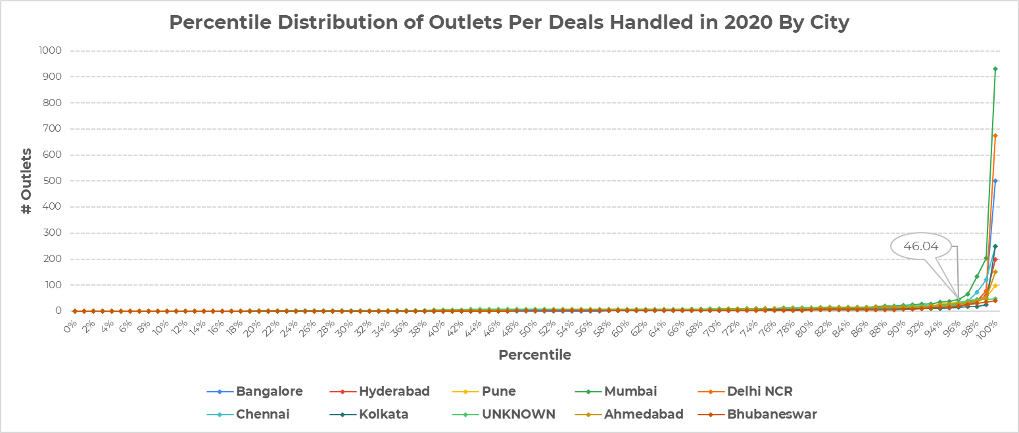
Distribution of Outlets Per Deal (2020)
# Outlets = 46
97th %ile
Note: Only top 10 cities from the previous slide are filtered in this chart

Slide 35
Monthly Performance of Sales Reps
Observations
DS and MJ are the closest to a normal distribution for deals handled every month
DS has a few outliers on the upper end
MJ has a few outliers on the lower end
Everyone else have big outliers on the upper end. Implying that they tend to handle exceptionally greater volume of deals in a few odd months than their usual monthly performance
Observations:
SS has achieved the monthly target 9 out of 10 months
MPS has never achieved monthly target in 8 months

Slide 36
Monthly Goal = 10 Deals
# Deals Handled (% Conversion Rate) By Sales Rep
Recommendation
Assuming 10-15% conversion rate, every sales rep should aim to handle at least 90-130 Deals in a month to hit their monthly targets
Cells highlighted in green = At least 10 deals won with at least 10% conversion rate

