Slide 1

CAPSTONE ANALYTICS | EXECUTIVE BOARD BRIEFING
Banking Transactions & Regulatory Insights
Credit risk, customer behavior, liquidity, regional performance and payment cards across 4,500 accounts
4,500
$103.3M
682
11.14%
Active accounts
Loan principal
Loan contracts
Volume default rate
Three executive actions: cross-sell payment cards as risk mitigants, set regional LTV caps, and deploy a liquidity early-warning system.
[Presenter name] | [Date]
Notes:
[00:00 - 01:00]
"Good morning, members of the Executive Board. Today I am presenting our capstone analytics findings on banking transactions, customer segment behavior, and regulatory credit risk exposure across our 4,500 active accounts and $103.3M loan portfolio. Over the next 14 minutes, we will cover five research dimensions: credit default risk, machine-learning customer personas, cash-flow liquidity coverage, regional branch economics, and payment card risk mitigation. Our goal is to translate these insights into three immediate executive actions to optimize capital allocation and strengthen risk-adjusted margins."

Slide 2
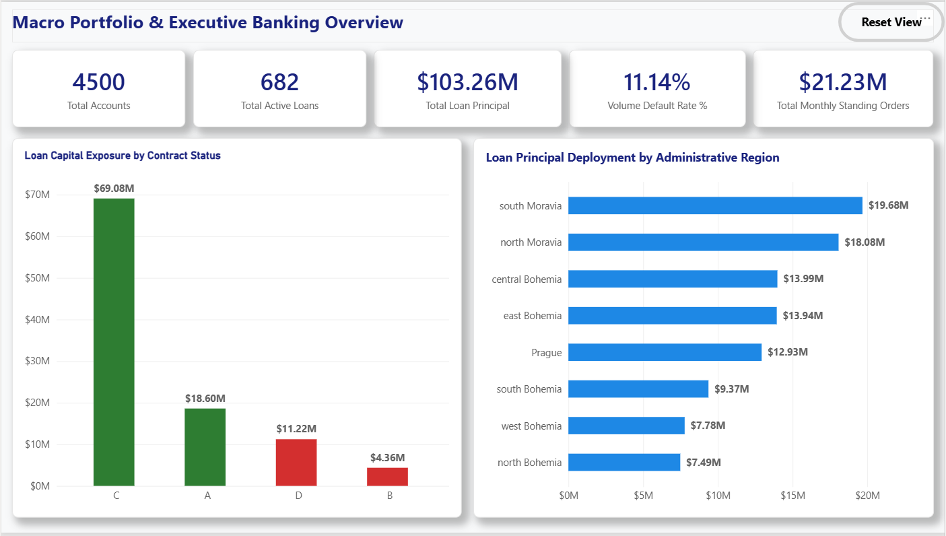
$103.3M deployed across 4,500 accounts
UNIFIED PORTFOLIO OVERVIEW
KEY INSIGHTS
Scale: 682 loan contracts totalling $103.26M across 4,500 accounts.
Default: 76 loans in default (Status B + D): 11.14% by volume, $15.58M or 15.09% by dollars.
Flows: $21.23M monthly standing orders; South and North Moravia hold 36.6% of principal.
LAUNCH POWER BI DASHBOARD
Source: Power BI, Master Executive View | Analytics type: Descriptive
Notes:
[01:00 - 02:30]
"Looking at our macro portfolio view, our core banking operations manage 4,500 client accounts with a total deployed loan balance of $103.26 million across 682 loan contracts. Of these, 76 loans have entered default status (Status B and D), a baseline volume default rate of 11.14%. By dollars, defaulted exposure is $15.58 million (Status B $4.36M plus Status D $11.22M), or 15.09% of principal. Monthly standing payment obligations total $21.23 million, a substantial recurring liquidity flow. This baseline dashboard is our single source of truth as we drill into each research domain."
Power BI: insert link on the button, then present live in Full Screen (F11). Use 'Reset View' to restore baseline filters.

Slide 3
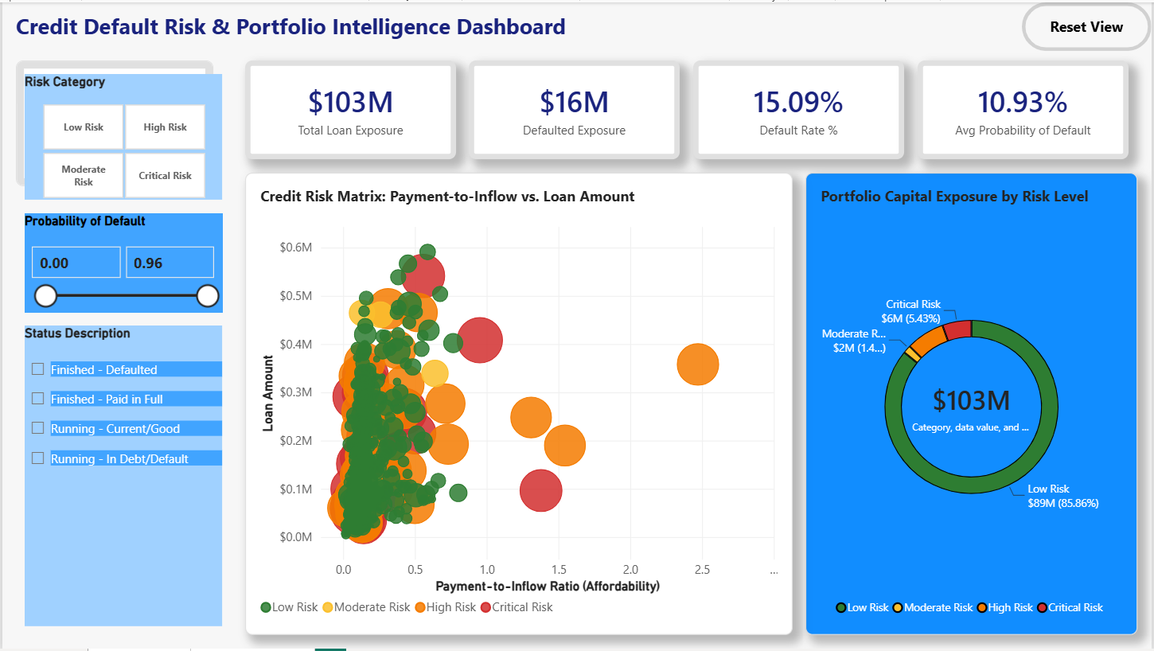
Default risk is not uniform across the portfolio
RESEARCH POINT 1 | CREDIT DEFAULT RISK
KEY INSIGHTS
Mix: 203 paid in full, 403 current, 31 defaulted, 45 in debt: 76 of 682 loans (11.1%).
Exposure: $16M defaulted of $103M; average probability of default is 10.93%.
Term effect: Default rises from 8.4% on 12-month loans to 11.5% to 12.3% on 24 to 60 months.
LAUNCH POWER BI DASHBOARD
Source: Power BI, Research_PBI_1 | Analytics type: General & Predictive
Notes:
[02:30 - 05:00]
"Drilling into Research Point 1, we scored every loan with a probability of default using only information available before origination. The class mix is 203 loans paid in full, 403 running in good standing, 31 finished in default and 45 running in debt: 76 defaults out of 682 loans. The dashboard shows average probability of default at 10.93%, with roughly $16M of the $103M exposure already defaulted. Duration matters: 12-month loans default at 8.4%, while 24 to 60 month loans run between 11.5% and 12.3%. The takeaway is that default risk is not uniform; larger, longer-duration commitments need tighter Debt Service Ratio underwriting prior to origination."
Live demo: use the Risk Category and Probability of Default slicers to isolate Critical Risk loans.

Slide 4
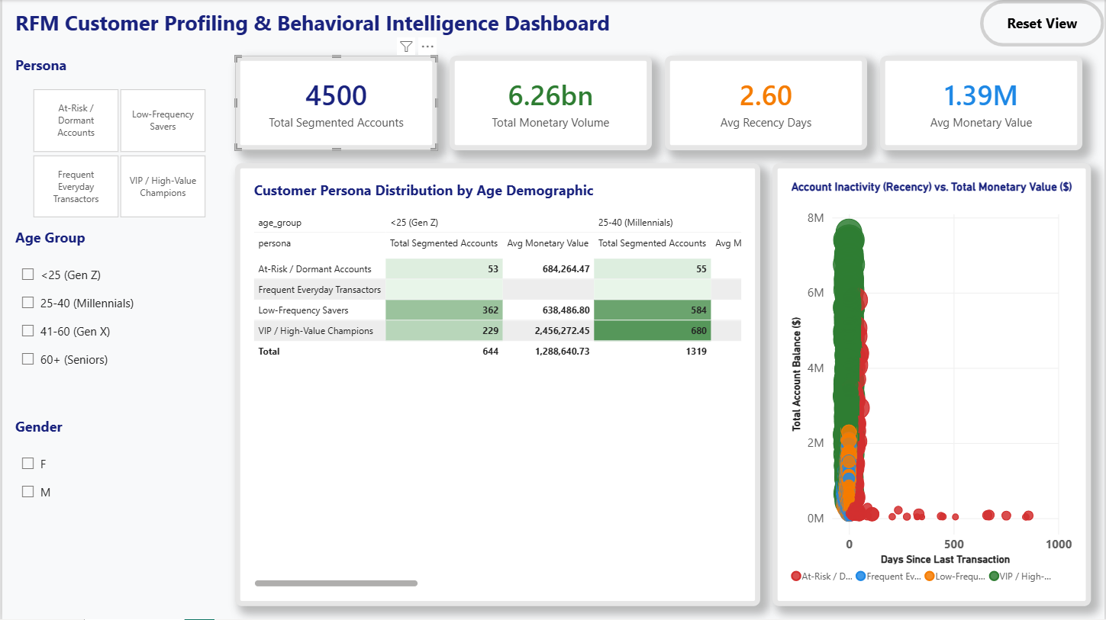
VIP Champions carry the value; At-Risk is small
RESEARCH POINT 2 | RFM CUSTOMER PERSONAS
KEY INSIGHTS
Personas: K-Means on log-scaled RFM splits 4,500 accounts into four behavioral personas.
Value gap: VIPs average $2.46M vs $0.64M for Low-Frequency Savers in the under-25 cohort.
Action: Retain At-Risk accounts early; upsell premium credit lines to VIPs.
LAUNCH POWER BI DASHBOARD
Source: Power BI, Research_PBI_2 | Analytics type: General & Predictive
Notes:
[05:00 - 07:30]
"Turning to Research Point 2, we applied K-Means clustering across Recency, Frequency and Monetary metrics to segment our 4,500 accounts into four personas: VIP / High-Value Champions, Frequent Everyday Transactors, Low-Frequency Savers and At-Risk / Dormant Accounts. In the demographic matrix, VIP Champions are our highest-value segment: in the under-25 cohort they average about $2.46M against roughly $0.64M for Low-Frequency Savers, and the 25-40 cohort holds 680 VIP accounts. At-Risk accounts are few (53 and 55 in the two youngest cohorts) but show long inactivity. Marketing can deploy automated retention offers before closure and upsell premium credit lines to VIP Champions."
Live demo: tick the 41-60 and 60+ age groups to show the remaining cohorts.

Slide 5
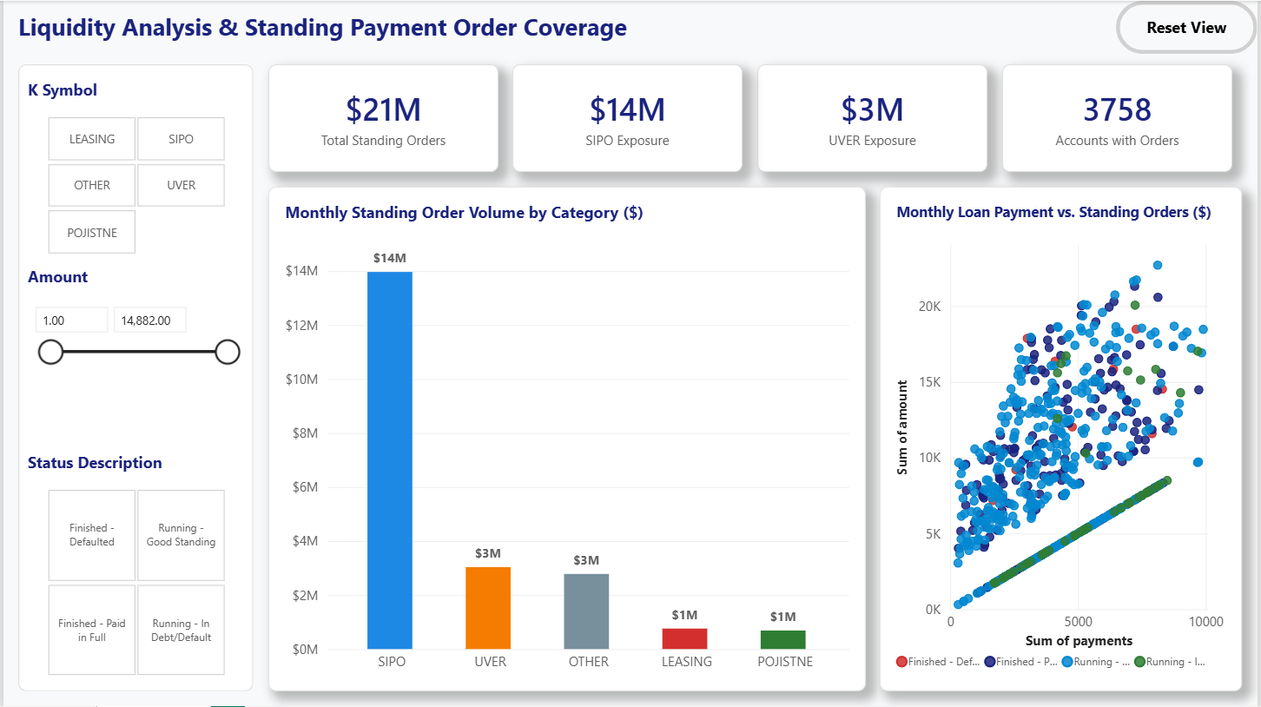
Household payments dominate recurring outflows
RESEARCH POINT 3 | LIQUIDITY & STANDING ORDERS
KEY INSIGHTS
Scale: 3,758 accounts carry $21M of monthly standing orders.
Mix: SIPO household payments lead (~$14M); UVER loan repayments and other transfers follow (~$3M each).
Stress signal: High loan payments plus high standing orders mark the early-warning group.
LAUNCH POWER BI DASHBOARD
Source: Power BI, Research_PBI_3 | Analytics type: General & Predictive
Notes:
[07:30 - 09:30]
"In Research Point 3 we evaluate recurring cash outflows across 3,758 accounts carrying active standing orders. Total monthly commitment is about $21.2M. Household payments (SIPO) account for the largest share at roughly $14M on this dashboard, followed by external loan repayments (UVER) and other transfers at about $3M each. In the scatter on the right, loan installment size is plotted against standing orders: accounts in the upper-right carry a heavy combined fixed-obligation burden. This view lets our credit monitoring team detect distress weeks before a missed payment occurs."
Reconcile before presenting: Research_Point_3.docx reports SIPO at $11.12M (52.4%); the dashboard KPI shows $14M.

Slide 6
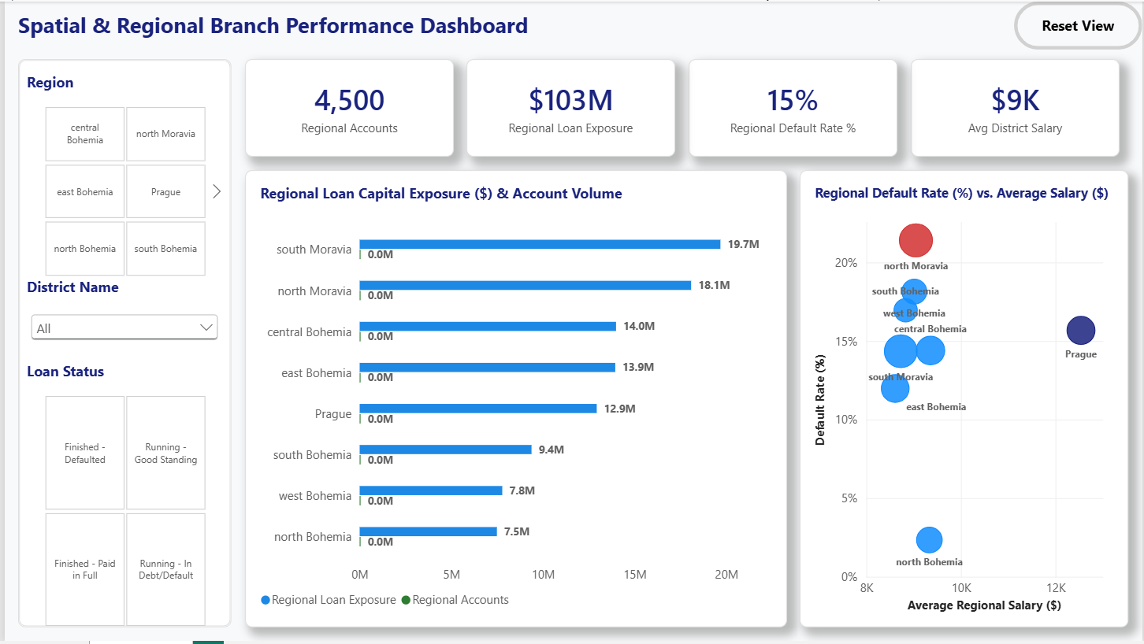
North Moravia carries the highest default rate
RESEARCH POINT 4 | REGIONAL BRANCH PERFORMANCE
KEY INSIGHTS
Concentration: South and North Moravia hold $37.76M, or 36.6% of total principal.
Hot spot: North Moravia shows ~21% default by dollars; North Bohemia is lowest at ~2%.
Not just salary: Prague has the top salary ($12.5K) yet ~16% default, so local limits beat one rule.
LAUNCH POWER BI DASHBOARD
Source: Power BI, Research_PBI_4 | Analytics type: General & Predictive
Notes:
[09:30 - 11:50]
"In Research Point 4 we map portfolio performance across our eight administrative regions. South and North Moravia are our largest hubs, combining for $37.76M or 36.6% of total loan exposure. Default rates differ sharply by region: by dollar exposure North Moravia is the highest at roughly 21% and North Bohemia the lowest at about 2%. Prague has the highest average salary, about $12.5K, yet its dollar default rate is still around 16%, so salary alone does not explain default. By loan count, North Moravia (15.38%), West Bohemia (15.79%) and South Bohemia (15.00%) run nearly double Prague's 8.33%. We recommend localized LTV caps in the high-default regions."
Live demo: click the North Moravia tile (793 accounts, $18.1M), then District slicer 'Ostrava-mesto', then Reset View.
Note: dashboard rates are dollar-weighted; the figures quoted from the research doc are by loan count.

Slide 7
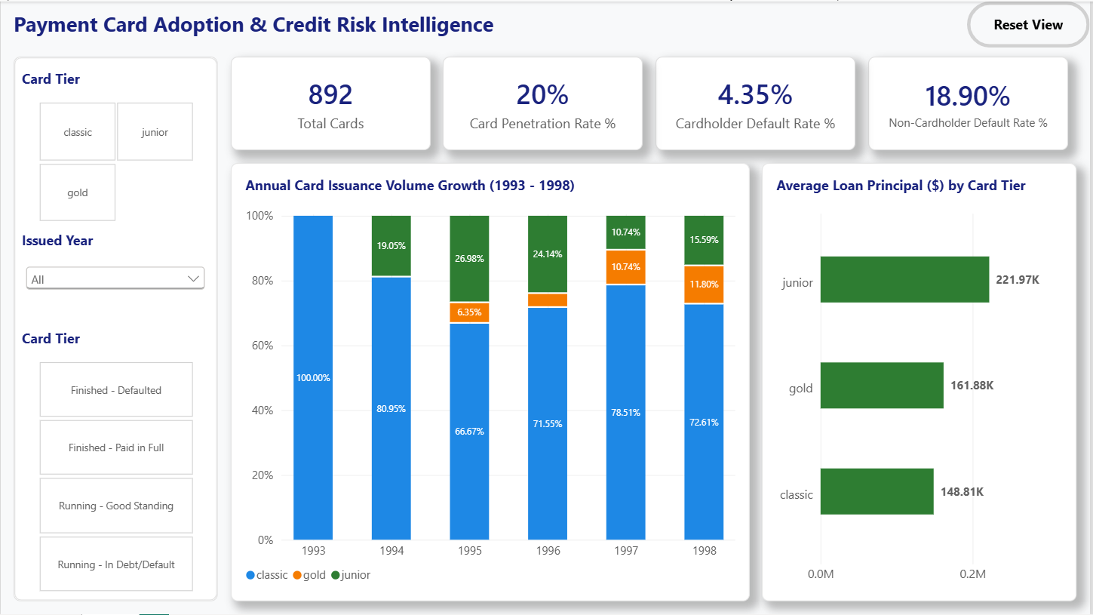
Cardholders default about 4× less often
RESEARCH POINT 5 | PAYMENT CARD RISK SYNERGY
KEY INSIGHTS
4.35%
18.90%
Cardholder default rate
Non-cardholder default rate
Reach: 892 cards, 20% penetration; Classic is ~73% of 1998 issuance.
Loan size: Junior cardholders borrow most ($222K avg), then Gold ($162K), Classic ($149K).
LAUNCH POWER BI DASHBOARD
Source: Power BI, Research_PBI_5 | Analytics type: General & Predictive
Notes:
[11:50 - 13:40]
"Our final technical area uncovers one of our most striking strategic findings: the impact of payment card adoption on credit risk. We hold 892 issued cards across Classic, Junior and Gold tiers, a 20% account penetration rate, with issuance accelerating from one card in 1993 to 449 in 1998. Accounts holding a card show a default rate of 4.35% by dollar exposure (2.94% by volume), whereas non-cardholders show 18.90% by dollars (13.87% by volume): roughly 4.3 times lower by dollars. Card ownership is a powerful proxy for active engagement and financial discipline. Junior cardholders carry the largest average loan at $221.97K."
Live demo: click the 'gold' tile (88 cards, $161.9K average principal), then 'Running - In Debt/Default'.

Slide 8
From describing the past to predicting risk
EXAMINER BRIEFING | GENERAL VS. PREDICTIVE
Descriptive visuals answer "what happened". Predictive visuals answer "what will happen".
Research dimension | General analysis (descriptive) | Predictive analysis (diagnostic) | Primary purpose
RP1 Credit default risk | Loan contract status chart: A, B, C, D counts and $ exposure | Default rate by contract term and probability-of-default risk matrix | Underwriting policy
RP2 RFM personas | Demographic age matrix and baseline RFM distributions | K-Means persona scatter: lifetime value, churn risk, upsell propensity | Targeted marketing
RP3 Liquidity coverage | Standing order outflow by category (SIPO, UVER, other) | Loan payment vs standing orders scatter: cash-flow stress quadrant | Early-warning system
RP4 Regional performance | Regional account volume and loan exposure bars | Default rate vs average salary scatter: district risk from macro factors | Regional LTV caps
RP5 Payment card synergy | Card tier mix and annual issuance trend, 1993 to 1998 | Cardholder vs non-cardholder default comparison (~4.3× lower by $) | Credit-risk proxy
Notes:
[13:40 - 14:30]
"For our academic examiners and risk committees, this slide synthesizes our visualization methodology into general descriptive analytics versus predictive diagnostic analytics. Descriptive visuals, such as raw loan status distributions, baseline RFM demographic matrices and regional account volume maps, answer what happened historically. Our predictive visuals, such as default-by-term curves, K-Means persona scatter plots, standing order stress quadrants, regional default-versus-salary views and card-tier risk proxies, answer what will happen. This dual framework shows our Power BI solution goes beyond static reporting to deliver forward-looking credit risk forecasting and automated early-warning capabilities."

Slide 9
Three priorities for the coming fiscal year
STRATEGIC ROADMAP & EXECUTIVE ACTION PLAN
1
Cross-sell payment cards as risk mitigants
2
Macro-adjusted regional credit limits
3
Automated liquidity early-warning
Bundle a card with every new loan, issued within 30 days of account opening.
Cap LTV at 70% in North Moravia, West Bohemia and South Bohemia; grow wealth and gold-card offers in Prague.
Alert daily when standing orders (SIPO + UVER) exceed 50% of monthly deposit inflows.
4.35% vs 18.90%
70% LTV cap
30 to 60 days
default by $: cardholders vs non-cardholders (~4.3×)
in the high-default regions
earlier intervention before formal default
LAUNCH POWER BI DASHBOARD
[ insert Power BI link here: select button, Ctrl+K ]
Thank you. Questions welcome.
Notes:
[14:30 - 15:00]
"To conclude, we translate these findings into three strategic priorities for the coming fiscal year. First, cross-sell payment cards as risk mitigants by bundling cards with new loan originations. Second, implement macro-adjusted regional credit limits, with a 70% LTV cap in North Moravia, West Bohemia and South Bohemia. Third, configure an automated liquidity early-warning system that alerts when standing orders exceed 50% of monthly deposit inflows. Thank you for your time. I am now open to questions, and we can launch live Power BI filters as needed."
Q&A: open the master .pbix in Full Screen (F11); use 'Reset View' between test cases.

