Slide 1



















$$1×1$$
$$1×1$$
$${ x}_{1}$$
$${ x}_{2}$$
$${ x}_{3}$$
$${ x}_{4}$$
$$K_{2}$$
$$3×3$$
$$3×3$$
$$K_{3}$$
$$3×3$$
$$K_{4}$$
$$3×3$$
$${ y}_{1}$$
$${ y}_{2}$$
$${ y}_{3}$$
$${ y}_{4}$$
$$1×1$$
$$1×1$$
（a）残差模块
（b）Res2Net模块

Slide 2




















$$F_{ex}(∙,W)$$
$$F_{sq}(∙)$$
$$1×1×C$$
$$X$$
$$U$$
$$1×1×C$$
$$\tilde{X}$$
$$H$$
$$H^{′}$$
$$F_{tr}$$
$$H$$
$$F_{scale}(∙,∙)$$
$$W^{′}$$
$$W$$
$$W$$
$$C^{′}$$
$$C$$
(a)
$$C$$
Addition
$$f_{1}$$
$$f_{2}$$
Squeeze
Excite
Squeeze
Excite
$$s_{1}$$
$$s_{2}$$
Addition
(b)

Slide 3
Conv
Kernel:$3×3$
Rate: 6
Conv
Kernel:$3×3$
Rate: 12
Conv
Kernel:$3×3$
Rate: 18
rate=12
rate=18
rate=6
空洞空间金字塔池化
输入特征图

Slide 4






Output
Concatenate
Multiple
$$x_{1}$$
Multiple
$$x_{2}$$
$$x_{3}$$
ReLU+BN
ReLU+BN
ReLU+BN
Conv
($3×3$,Rate=6)
Conv
($3×3$,Rate=12)
Conv
($3×3$,Rate=18)
Input

Slide 5







$$f_{4}$$
$$f_{5}$$
Up-sample
C
Up-sample
C
$$S_{g}$$
Up-sample
$$f_{4}$$
Up-sample
$$3×3$$
Conv+BN
$$1×1$$
Conv+BN
Multiple
C
Concatenate
$$f_{3}$$

Slide 6
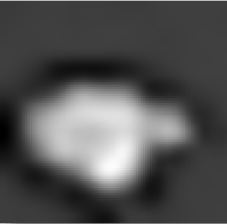
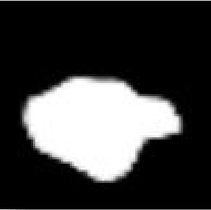
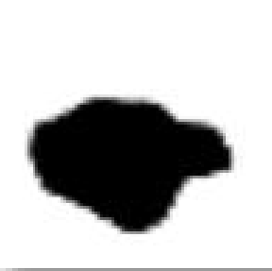




$$f_{i}$$
$$f_{i}^{′}$$
Conv+BN
Multiple
$$R_{i}$$
$$S_{i}$$
Sigmoid
Reverse
Up-sample

Slide 7
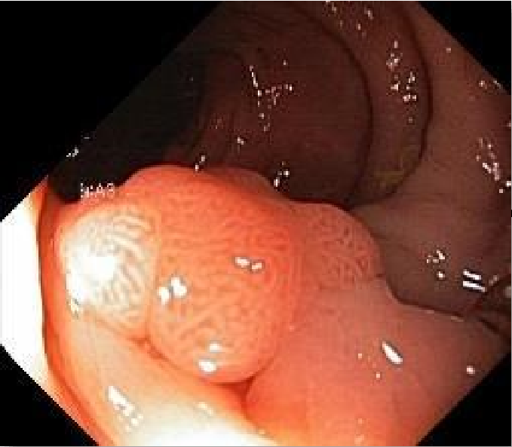

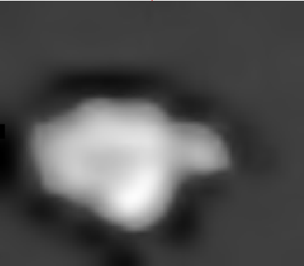
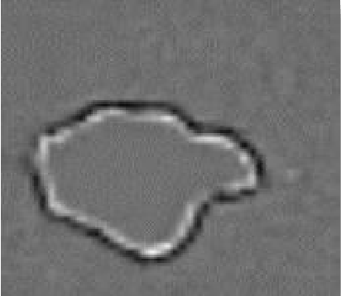
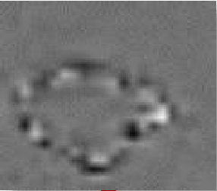

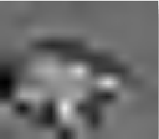
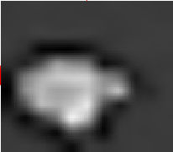
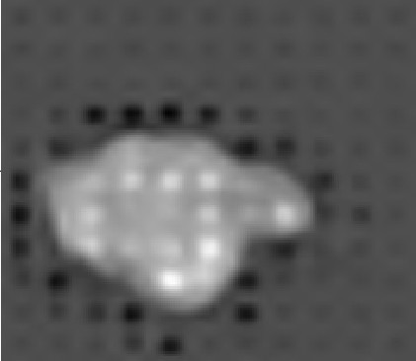













Input
Prediction
Sigmoid
Conv+DSE
$$f_{1}$$
Res2Net+DSE
$$S_{3}$$
$$f_{2}$$
Res2Net+DSE
$$f_{3}$$
RA
Addition
$$f_{3}$$
$$R_{3}$$
Up-sample
Res2Net+DSE
$$f_{4}$$
RA
Addition
$$R_{4}$$
$$S_{4}$$
$$f_{4}$$
Up-sample
Skip-Connection
Addition
Res2Net+DSE
$$f_{5}$$
RA
$$f_{5}$$
$$R_{5}$$
$$S_{5}$$
MASPP
PD
Down-sample
$$S_{g}$$

Slide 8
Dice
本发明
PraNet
U-Net++
Attention U-Net
U-Net
Dice
本发明
PraNet
U-Net++
Attention U-Net
U-Net
Step
Step

Slide 9
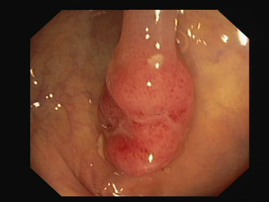
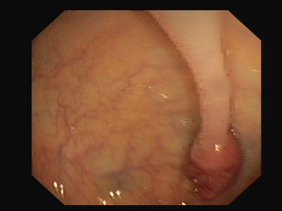
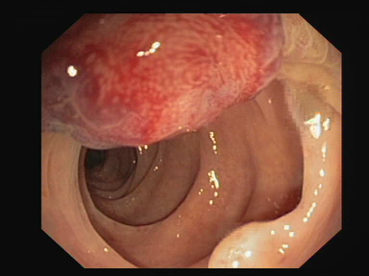
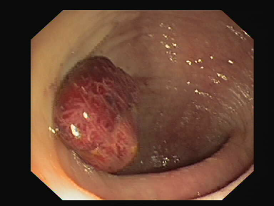
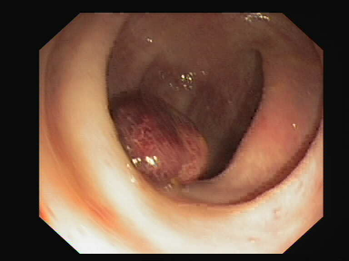
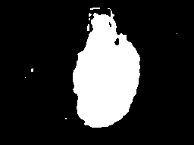
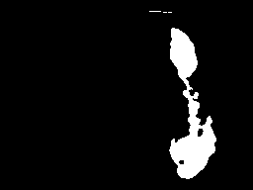
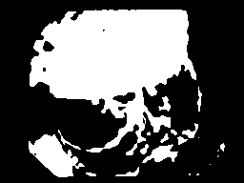


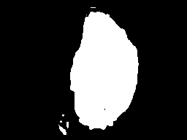
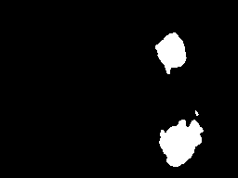
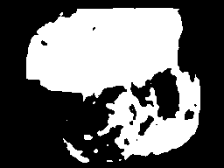
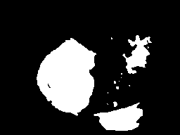

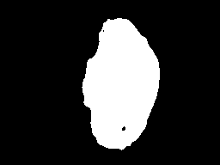
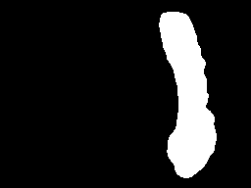

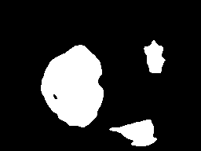

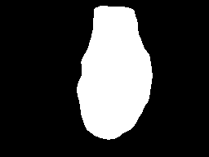
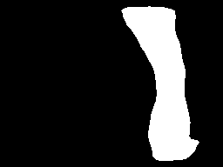
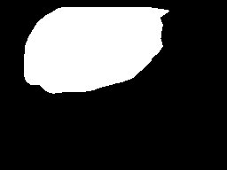

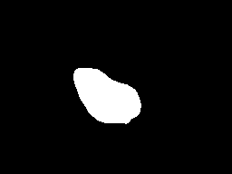

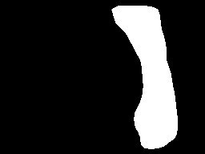


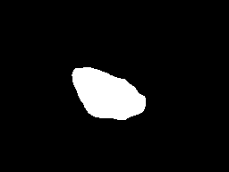
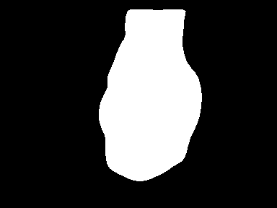
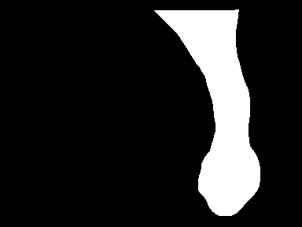
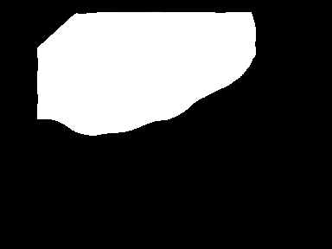
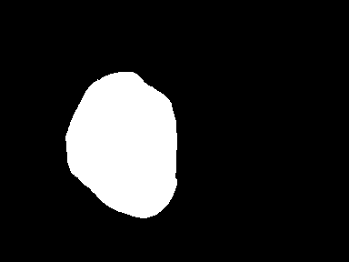

原图
U-Net
Attention U-Net
U-Net++
PraNet
本发明
GT

