Slide 1

Wireless Networking
Ambuj Varshney
ambujv@nus.edu.sg
Notes:
++ Thank you for inviting me to give this talk
++ In this talk, I will present a pathway that can enable us to make wireless embedded systems ubiquitous. I will describe my previous research efforts that tackle the critical challenges that limit the growth of wireless embedded systems. These are related to the growing energy asymmetry that exists between sensing, computation and communication blocks on these platforms.
++ Finally, I will conclude my talk by covering the research agenda that I would like to work on as a faculty member.

Slide 2
Backscatter Like Transmission Mechanisms
Notes:
++ Over the past few years, I have designed several backscatter and beyond backscatter systems that precisely overcome these critical challenges that have limited the widespread deployment of backscatter on IoT devices.
++ The research vision that I have pursued and would like to pursue as a faculty member is to enable a massive deployment of IoT devices by bridging the energy asymmetry between sensing, computation and communication blocks by designing novel platforms and communication mechanisms. I am going to describe some of my research contributions next.

Slide 3
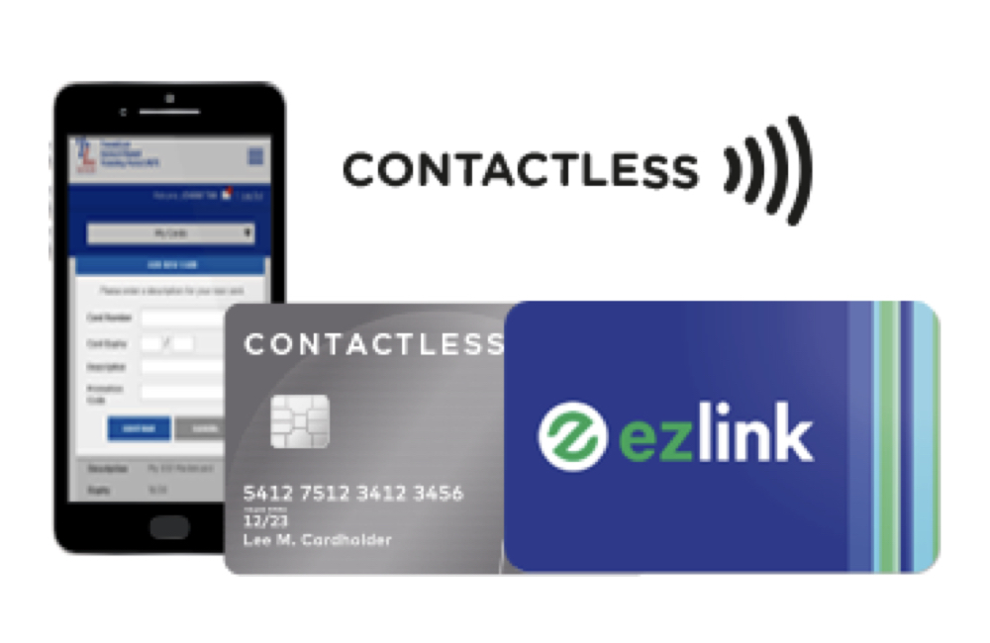
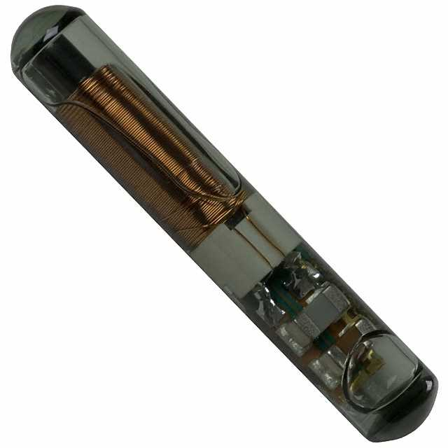
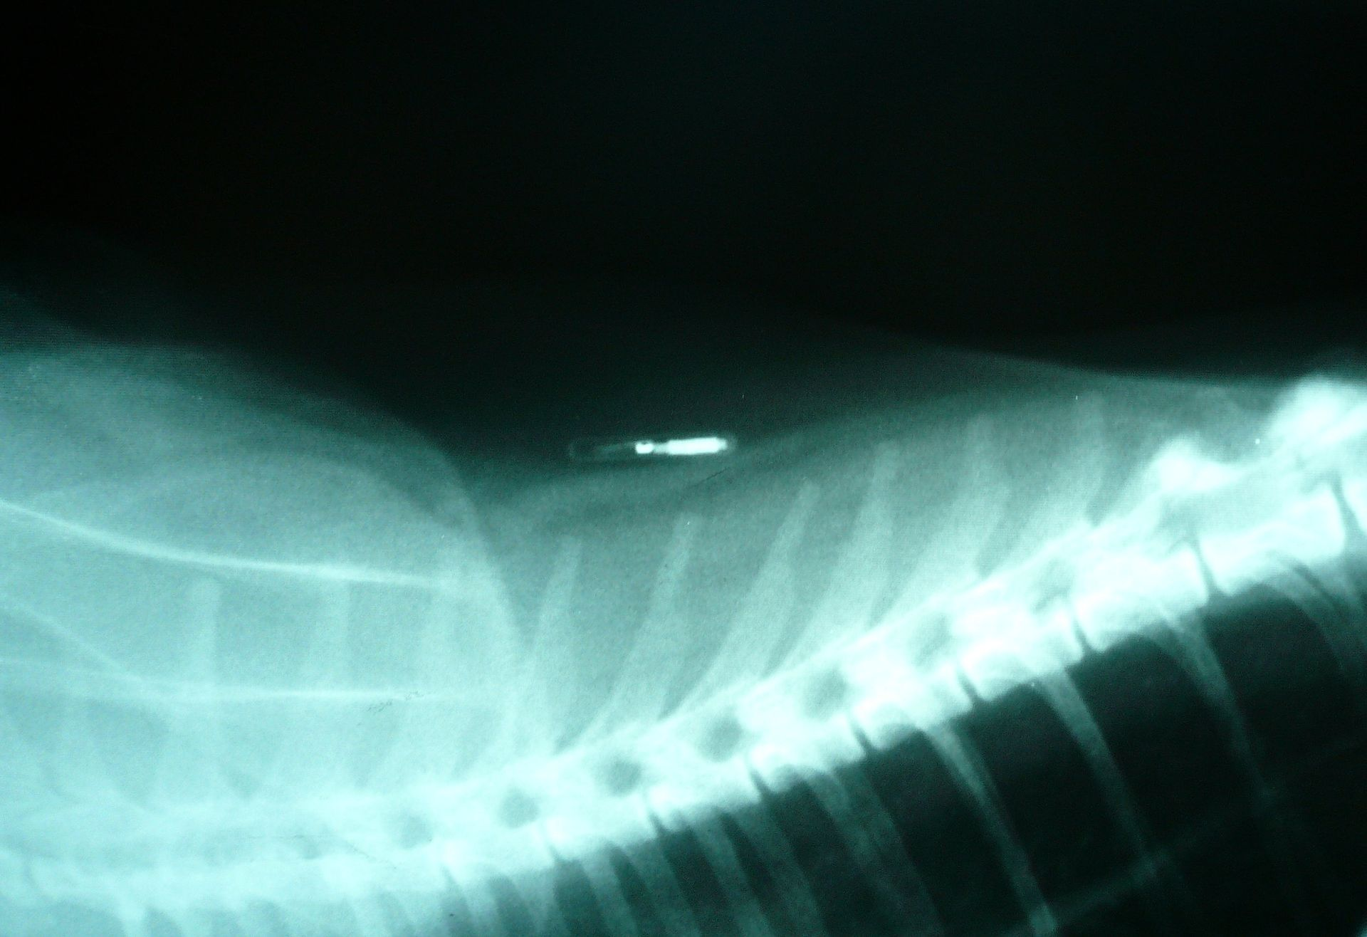
What communication modality do these use?

Slide 4
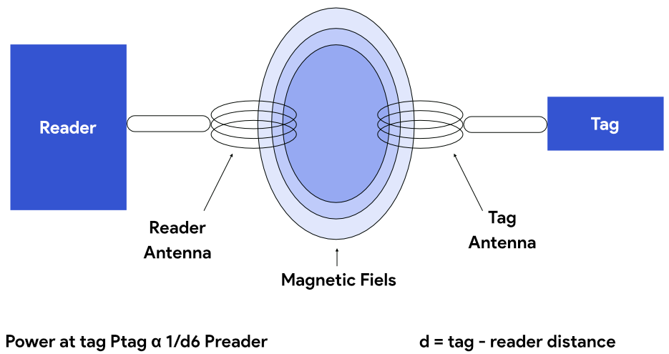
Communication using inductive coupling
A shared magnetic field is created between the two devices
Change in current through one device induces current change through the other
Device can vary load to transmit data
Very low frequency bands (135 KHz, 13.56 MHz)
Transmit through materials including skin
Sensitive to metal

Slide 5
Near Field Communication (NFC)
Inductive Coupling concept (13.56 MHz)
But attached to a powered and capable device (smartphone)
10-20 cm range max (usually <10)
Can act as a tag or as a reader
Allows smartphone to power a tag if needed
Alternatively, smartphone could act like a card and respond to a reader
Two smartphones can communicate without power transfer
Data rate 100-400 kbps!
nRF52840 capable of 100 kbps communication with attached antenna

Slide 6
Wireless communication using Light?
Notes:
++ Over the past few years, I have designed several backscatter and beyond backscatter systems that precisely overcome these critical challenges that have limited the widespread deployment of backscatter on IoT devices.
++ The research vision that I have pursued and would like to pursue as a faculty member is to enable a massive deployment of IoT devices by bridging the energy asymmetry between sensing, computation and communication blocks by designing novel platforms and communication mechanisms. I am going to describe some of my research contributions next.

Slide 7
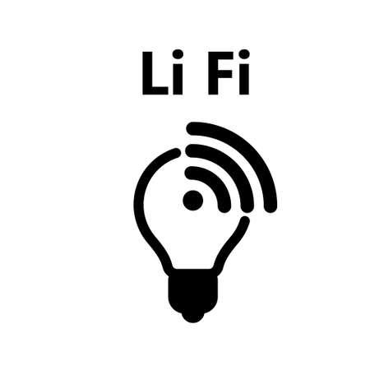

Light Fidelity (LiFi) for Internet of Things
00100111
0
0
1
1
0
0
1
Light-fidelity
1
Advantages:
Illumination
Energy
Communication
Notes:
Let’s start the background story from LiFi
Light fidelity is a wireless technology that uses visible light for data transmission. The information is modulated on the light signal according to the baseband signal.
LiFi offers advantages, such as using a different part of the specturm other than crowded RF electromagnetic signal
In addtion, it simultaneously provide, illumination, energy and communication
Which makes it a good candidate for IoT connectivity.

Slide 8

LiFi communication suffers from coverage challenges
Light cannot propagate through walls or other such physical boundaries
Great from privacy perspective, but limits deployable location of IoT devices
Many IoT devices are located in places with very poor light propagation
IoT devices that are located in the air vents
Inside the wall, floor and other surfaces
IoT devices that are embedded inside the human body
Notes:
Light signal can not propagate through physical spaces. Things like walls, floors, metals block light signal.
When considering privacy, this is an advantage. However for IoT applications, it limits the scenarios where sensors located in places with poor light propagation.

Slide 9
Question
A wireless IoT network uses a TDMA-based medium access protocol. The network has the following configuration:
6 sensor nodes
Each node periodically transmits a packet lasting exactly 5 ms
Each node transmit every 100 ms (i.e., one packet per node every 100 ms).
Synchronization requires adding a guard interval of 1 ms between adjacent time slots to prevent collisions due to timing inaccuracies.

Slide 10
Question
Consider a battery-powered IoT sensor node that periodically transmits environmental data to a gateway. Its radio operates in four different states with distinct current consumptions:
Transmit (Tx) 25 mA
Receive (Rx) 20 mA
Idle Listening 2 mA
Sleep 0.01 mA (10 µA)

Slide 11
Question
Transmission cycle (occurs every 60 seconds):
Transmit data packet: 100 ms
Immediately after transmission, wait in Receive state for ACK: 50 ms
The node periodically checks the channel (Idle Listening) every 5 seconds for a duration of 20 ms.
For the rest of the cycle time, the node remains in Sleep mode.
Battery:
• Capacity clearly stated as 600 mAh (typical CR2450 coin cell).

Slide 12
Question
1. Calculate average current of the node over one full 60-second cycle
2. Estimate battery life in days, given the average current you calculate
3. Clearly evaluate how reducing the Idle Listening interval frequency (e.g., sampling every 10 s instead of every 5 s) affects battery life

Slide 13
Communication Layers
Notes:
++ Over the past few years, I have designed several backscatter and beyond backscatter systems that precisely overcome these critical challenges that have limited the widespread deployment of backscatter on IoT devices.
++ The research vision that I have pursued and would like to pursue as a faculty member is to enable a massive deployment of IoT devices by bridging the energy asymmetry between sensing, computation and communication blocks by designing novel platforms and communication mechanisms. I am going to describe some of my research contributions next.

Slide 14
Introduction to communication layers
Communication between computing devices involves a structured set of procedures known as communication layers. These layers define how data travels from one system to another across networks. A standardized approach to networking ensures interoperability, efficiency, and reliability
A commonly used model is OSI or Open System Interconnection which divides the communication procedures into various different layers

Slide 15
Why have a layered approach to communication?
• Simplifies complexity: Each layer focuses on specific functions
• Facilitates interoperability: Layers are standardized and interoperable between different systems
• Allows easier troubleshooting: Issues are isolated within a specific layer
• Promotes modularity: Layers can evolve independently without impacting the entire system

Slide 16
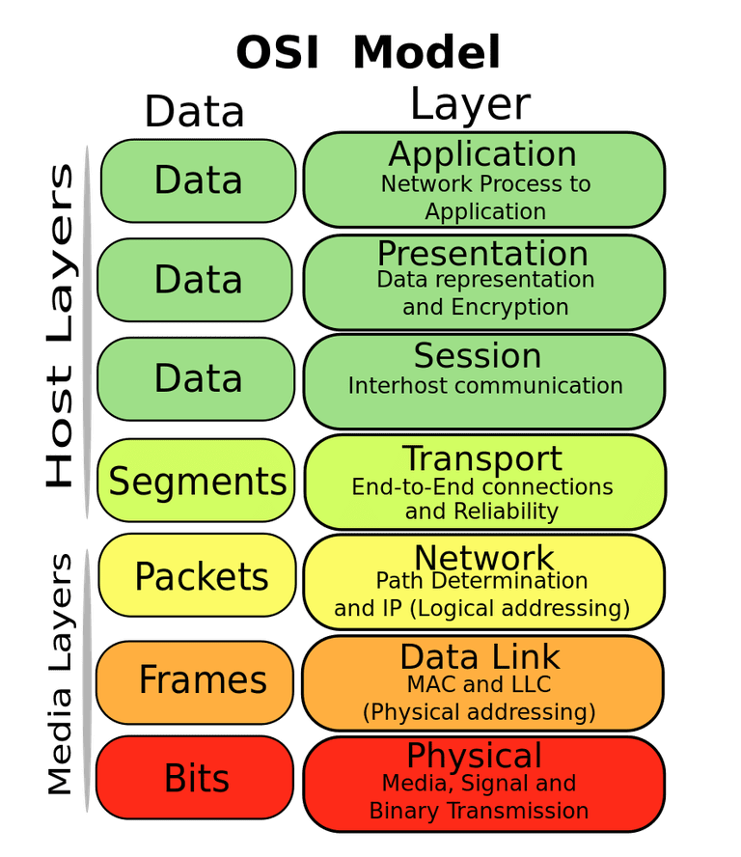
Open System Interconnection Model
OSI model divides communication tasks into seven different layers

Slide 17
Open System Interconnection Model
1. Application Layer: Interacts with user applications (e.g., HTTP, FTP, email protocols)
2. Presentation Layer: Formats or translates data into an appropriate form (e.g., encryption/decryption, data compression)
3. Session Layer: Manages communication sessions between applications (establishes, maintains, and terminates sessions)

Slide 18
Open System Interconnection Model
The Transport Layer ensures efficient communication between endpoints:

Slide 19
Open System Interconnection Model
The Transport Layer ensures efficient communication between endpoints:
TCP (Transmission Control Protocol):
• Connection-oriented
• Guarantees data integrity through acknowledgments and retransmission
• Ideal for email, file transfers, web browsing
UDP (User Datagram Protocol):
• Connectionless, fast delivery without guaranteed delivery or order
• Ideal for streaming media or gaming applications

Slide 20
Open System Interconnection Model
The Transport Layer ensures efficient communication between endpoints:
TCP (Transmission Control Protocol):
• Connection-oriented
• Guarantees data integrity through acknowledgments and retransmission
• Ideal for email, file transfers, web browsing
UDP (User Datagram Protocol):
• Connectionless, fast delivery without guaranteed delivery or order
• Ideal for streaming media or gaming applications

Slide 21
Open System Interconnection Model
Network Layer determines how data moves through interconnected networks:

Slide 22
Open System Interconnection Model
Network Layer determines how data moves through interconnected networks:
IP (Internet Protocol):
• Assigns unique addresses (IP addresses) to devices
• Routes packets efficiently from source to destination
• Supports both IPv4 (32-bit addresses) and IPv6 (128-bit addresses)

Slide 23
Open System Interconnection Model
Data Link Layer is responsible for packaging data into frames, managing direct communication between adjacent network devices, handling error detection and correction, and coordinating access to shared media (e.g., Ethernet, WiFi)
Core functions of data link layer are as follows:
Framing:
• Groups bits into structured “frames”.
• Adds headers and trailers for addressing and error-checking
Logical Link Control (LLC):
• Manages communication flow between sender and receiver
• Handles error detection, correction, and acknowledgments
Media Access Control (MAC):
• Regulates device access to shared media (wired or wireless)
• Ensures orderly transmission of data

Slide 24
Open System Interconnection Model
Data Link Layer is responsible for packaging data into frames, managing direct communication between adjacent network devices, handling error detection and correction, and coordinating access to shared media (e.g., Ethernet, WiFi)
What are some examples of Data-link protocols?

Slide 25
Open System Interconnection Model
Data Link Layer is responsible for packaging data into frames, managing direct communication between adjacent network devices, handling error detection and correction, and coordinating access to shared media (e.g., Ethernet, WiFi)
What are some examples of Data-link protocols?
• Ethernet defines how devices format data into frames for wired local networks, managing frame structure, addressing, and media access (MAC).
• WiFi (IEEE 802.11) protocols similarly manage framing, addressing, error detection, and media access for wireless communication.

Slide 26
Data Link Layer – Framing Data
Converts arbitrary streams of data bits into structured frames
• Frame includes headers with addressing, control, error-checking information
• Ensures data integrity through checksums (CRC - Cyclic Redundancy Check)
Typical Ethernet Frame Structure:
Preamble | Destination Address | Source Address | Type/Length | Data | CRC

Slide 27
Data Link Layer - Wireless Considerations
Wireless communication introduces unique challenges:
• Robustness:
• Frames require additional control data to handle physical layer variations (e.g., varying signal strength and interference)
• Different modulation rates might be used for different packet segments (headers might be transmitted at lower rates to enhance reliability)
• Explicit Routing Information:
• Supports multi-hop wireless networks (e.g., mesh networks)
• Ensures packets follow a defined route for optimal reliability

Slide 28
Data Link Layer - Error Detection and Recovery
Effective communication requires identifying, managing transmission errors:
Error Detection:
• Techniques such as CRC and checksums
• Quickly identifies corrupted data for retransmission
• Error Recovery:
• Automatic Repeat Request (ARQ) mechanisms
• Retransmits corrupted data or missing packets
• Significance for Wireless:
• Wireless communication experiences higher error rates due to environmental factors
• Efficient recovery strategies are essential to reduce costly retransmissions

Slide 29
Data Link Layer – Medium Access Control
MAC protocols handle device access to shared communication channels to prevent collisions and ensure efficient utilization:
Why MAC is essential:
• In wired Ethernet, MAC ensures orderly data transmission on a shared cable
• In wireless, MAC protocols coordinate transmissions to avoid interference and collisions

Slide 30
Need for Medium Access Control
Notes:
++ Over the past few years, I have designed several backscatter and beyond backscatter systems that precisely overcome these critical challenges that have limited the widespread deployment of backscatter on IoT devices.
++ The research vision that I have pursued and would like to pursue as a faculty member is to enable a massive deployment of IoT devices by bridging the energy asymmetry between sensing, computation and communication blocks by designing novel platforms and communication mechanisms. I am going to describe some of my research contributions next.

Slide 31
Medium access control for wireless is hard
Wired networks are constant, reliable, and physically isolated
Ethernet has the same throughput minute-to-minute
Bits sent through Ethernet or USB are (usually) received
Lack of wires introduces variability, unreliability, and vulnerability to interference compared to wired communication
Wireless networks are variable, error-prone, and shared
WiFi throughput changes based on location and walls
Signals from nearby devices interfere with your signals
Individual bits might flip or never be heard at all
Wireless signals degrade with distance, obstacles, and interferences

Slide 32
Wireless is a shared medium
Wired communication has signals confined to a conductor
Copper or fiber
Guides energy to destination
Protects signal from interference
Wireless communication is inherently broadcast in nature
Energy is distributed in space
Because signals are broadcast, interference and collisions are significant issues
Signals also must compete with other signals in same frequency band
Broadcast nature also raises privacy and security considerations

Slide 33
Increasing network capacity is challenging
Wired networks just add more wires
Buses are many signals in parallel to send more data
Wireless networks are harder
Adding more links increases interference
Need to expand to different frequencies

Slide 34
Analogy: wireless medium as acoustic
How do we determine who gets to speak?
If two or more devices transmit simultaneously, their signals overlap, and the communication fails
Eye contact (or raise hand) -> out-of-band communication
Waiting for silence before speaking -> carrier sense multiple access
Having pre-scheduled speaker turns -> time division multiple access
Just speak and hope it works -> ALOHA
Everybody sing at different tones -> frequency division multiple access (stretching the metaphor)

Slide 35
Wireless: Medium and multiple access challenge
Problem: Multiple radio transmitters want to access a common channel
How to coordinate access for these radio transmitters ?
MAC protocols ensure orderly, efficient sharing of limited wireless bandwidth

Slide 36
Channelization Protocols

Slide 37
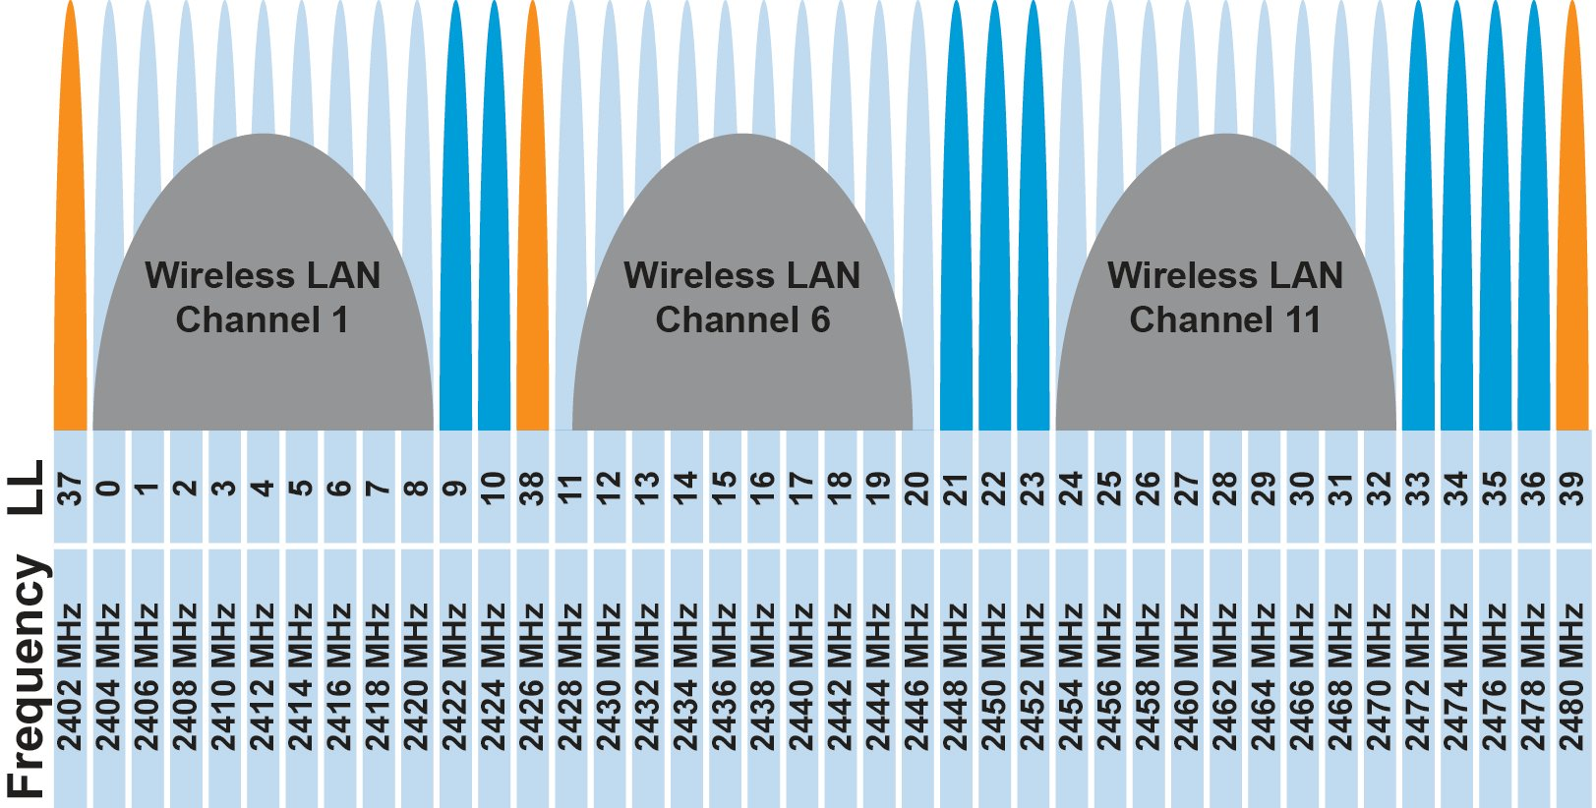
FDMA – Frequency Division Multiple Access
Separate transmissions by placing them at different frequencies
Channel:
Technically, each device can use a separate, fixed frequency
One example can be walkie-talkies
What are disadvantages of giving every device own frequency?
Conceptually, how RF channels work
WiFi networks pick different bands
802.15.4 picks a channel to communicate on

Slide 38
FDMA – Frequency Division Multiple Access
Separate wireless transmissions by placing them at different frequencies
Channel:
Technically, each device can use a separate, fixed frequency
One example can be walkie-talkies (mostly separate)
What are disadvantages of giving every device own frequency?

Slide 39
Wireless communication over multiple channels
Why do we need multiple channel for wireless communication?
Increase throughput
spatial diversity
Increase reliability

Slide 40
Multi Channel MAC Protocols
Use a control channel:
Use of a default channel and time synchronization for control message exchange
Nodes switch to a different channel for data communication
All channels are used for data communication:
Nodes switches to another channel when link quality is bad
How do we find a “good” channel to switch to?

Slide 41
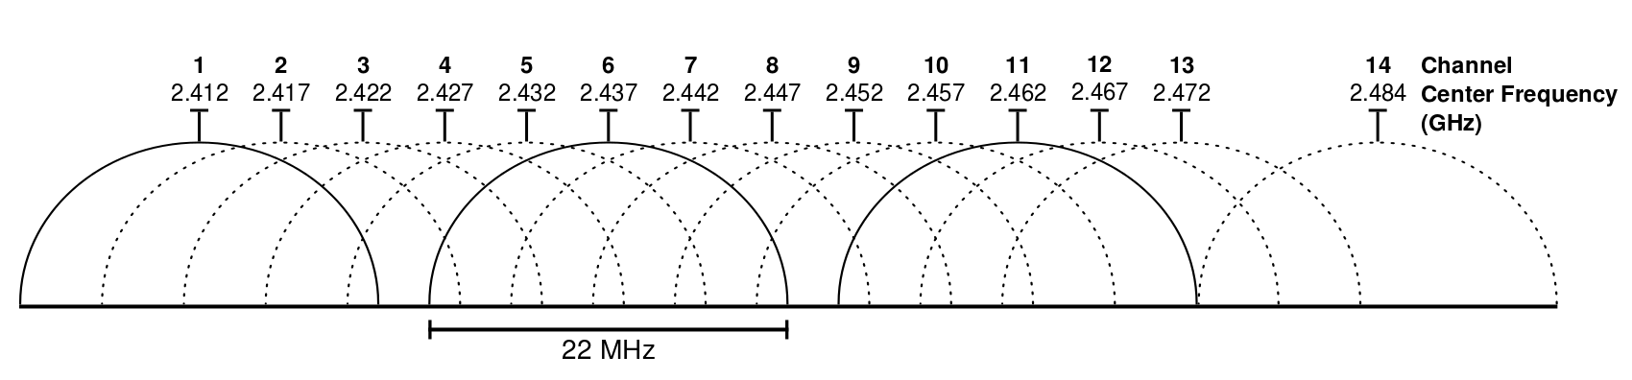
Wifi Channels
14 channels designated in the 2.4 GHz range spaced 5 MHz apart (with the exception of a 12 MHz spacing before channel 14)
https://en.wikipedia.org/wiki/List_of_WLAN_channels

Slide 42
ZigBee Channels

Slide 43
TDMA – Time Division Multiple Access
Split transmissions in time
Devices share the same channel
Splits time into fixed-length windows
Each device is assigned one or more windows
Can build a priority system here with uneven split among devices
Requires synchronization between devices
Often devices must listen periodically to resynchronize
Less efficient use of slots reduce synchronization
Large guard windows. E.g. 1.5 second slot for a 1 second transmission

Slide 44
TDMA: Time Division Multiple Access‏
Consider a 1Mbps channel (1,000,000bits/sec)
Divide channel into 1000 (equal) times slots
Each slot is 1ms, and can transmit 1,000 bits
Assign slots to 50 users
Each user transmits every 50 slots/ms and transmit 20 times/slots per second
On average, each user can transmit 20kbps
Buffering is needed on both sender and receiver to match the differences in data rates
sender-side: 20kbps -> 1 Mbps
Receiver-side: 1Mbps -> 20kbps
Notes:
44
44

Slide 45
TDMA vs. FDMA
FDMA
TDMA
Frequency
Frequency
Time
Time
In practical systems, TDMA is often combined with FDMA
Frequency
Time
Notes:
45
45

Slide 46
Orthogonal Frequency Division Multiplexing :OFDM
In FDM, the entire frequency spectrum is dedicated to carry data from a single source
Example: transmit at 40Mbps over a 20 MHz spectrum
In OFDM, data is divided into many (slower) bit streams and multiple subcarriers (each with smaller spectrum) is used
Example: divide data source into 40 sources, each 1Mbps

Slide 47
WiFi Channel Usage

Slide 48
Cross Channel Interference (CTI)
A. Hithnawi, et.al.,TIIM: Technology-Independent Interference Mitigation for Low-power Wireless Networks, IPSN 2015

Slide 49
Frequency and Time leads to Spread Spectrum (SS)
Spread-spectrum techniques are methods by which a signal is deliberately spread in the frequency domain, resulting in a signal with a wider bandwidth
Such techniques can be used to establish secure communications, increase resistance to natural interference, jamming and to prevent detection
Concept has been alluded to in 1900s, and applied in some form during WWII
Resistant to narrowband interference
Signals are difficult to interpret – appears as if increase in background noise
Can share frequency band with others with minimal interference

Slide 50
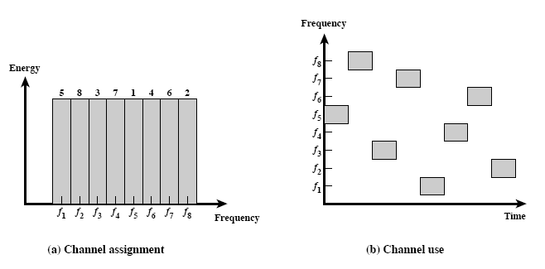
Spread spectrum: Frequency Hopping (FH)
FHSS increase resistance to a) natural interference b) jamming c) detection

Slide 51
Spread spectrum: Frequency Hopping (FH)
A protocol that we use everyday uses Frequency hopping spread spectrum technique?

Slide 52
Spread spectrum: Frequency Hopping (FH)
A protocol that we use everyday uses Frequency hopping spread spectrum technique?
Bluetooth hops between 79 different 1 MHz channels in the band.

Slide 53
Spectral efficiency
Spectral efficiency (in bits/s/Hz) determines how efficiently devices utilize allocated bandwidth, depending on the modulation scheme
Different modulation schemes provide different spectral efficiency:
Simple modulation (e.g., FSK) ≈ 1 bit/s/Hz.
Advanced modulation (e.g., QPSK, QAM) higher bits/s/Hz (2–8 bps/Hz).

Slide 54
Question
Total available bandwidth: 500 kHz
4 IoT nodes:
• Node A and B each need 50 kbps
• Node C needs 100 kbps
• Node D needs 200 kbps
The chosen modulation scheme supports a maximum spectral efficiency of 1 bit/s/Hz (for simplicity), meaning each 1 Hz of bandwidth can carry 1 bit per second.

Slide 55
Question
Calculate how much frequency bandwidth each node must be allocated based on the given spectral efficiency (1 bps/Hz)
Verify if the allocated bandwidth fits within available 500 kHz channel
If an additional node (Node E) joins later and requires 200 kbps, clearly evaluate if it’s feasible to accommodate this node

Slide 56
Question
A wireless IoT network uses a TDMA-based medium access protocol. The network has the following configuration:
6 sensor nodes
Each node periodically transmits a packet lasting exactly 5 ms
Each node transmit every 100 ms (i.e., one packet per node every 100 ms).
Synchronization requires adding a guard interval of 1 ms between adjacent time slots to prevent collisions due to timing inaccuracies.

Slide 57
Question
1. Calculate the total TDMA frame duration clearly, including guard intervals.
2. Clearly evaluate channel utilization efficiency (actual data transmission time vs. total frame time, including guard intervals).
3. Determine clearly the worst-case latency a node experiences from packet generation to successful transmission.
4. Suppose the synchronization overhead (guard interval) can be reduced from 1 ms to 0.2 ms by using a more accurate synchronization mechanism:
• Clearly recalculate channel utilization and latency.
• Clearly discuss the trade-offs involved (complexity, cost, energy).

Slide 58
Random Access Protocols

Slide 59
Why Do We Need Random Access Protocols (RAP)?
• Networks are increasingly wireless and dynamic:
• Rapid proliferation of mobile devices, sensors, and IoT nodes
• Devices join or leave networks unpredictably; traffic patterns not always regular/ predictable
• Fixed scheduling is challenging or impractical:
• Pre-allocating transmission slots becomes inefficient when traffic is bursty/unpredictable
• Scheduled transmissions waste resources if nothing to send during allocated slots
• RAPs provide an efficient, lightweight solution for managing sporadic, unscheduled, low-rate data transmissions
• Examples of scenarios benefiting from Random Access:
• Smart-home IoT sensors sending occasional status updates
• Low-power wide-area networks (LPWANs) in environmental monitoring (e.g., LoRaWAN)

Slide 60
Analogy to understand Random Access Protocols
Imagine a conversation in a crowded room:
Scenario: Several people want to speak occasionally, but unpredictably
• Scheduled speaking (like TDMA): Each person has a fixed speaking slot
Issue: Wastes time if some people have nothing to say
• Random speaking (like ALOHA): Speak when needed, and if there’s a collision,
pause and retry after a random interval
Benefit: Low overhead, simple, easy to manage with minimal coordination

Slide 61
Random access protocol: Aloha
• Origin & Historical Context:
• Developed in 1971 at the University of Hawaii by Norman Abramson
• Designed originally to connect computers across islands using radio links (ALOHAnet)
• Core Idea (simplicity first):
• Devices transmit whenever data is available, without explicit coordination
• No prior scheduling or channel sensing; purely random transmissions
• Why ALOHA matters historically:
• First practical implementation of random access wireless networking
• Inspired modern random-access protocols, foundational for today’s wireless systems (BLE, LoRaWAN, satellite networks)

Slide 62
Random access protocol: Aloha
Protocol Rules:
1. If you have data, transmit immediately
2. After transmission, wait a certain time to receive acknowledgment (ACK)
3. If ACK is received, transmission successful; if no ACK, wait a random time interval and retransmit (exponential backoff recommended)
• Collision Problem:
• If two or more nodes transmit simultaneously, collision occurs, resulting in lost data
• Nodes do not listen before transmitting (no channel sensing)

Slide 63
Packet collisions are bad, we need to avoid them
Each packet transmission has a window of vulnerability
If two nodes transmit within one packet-duration interval, collision occurs
The time duration is the the on-air duration of a packet
Competing transmissions during the packet are bad
Competing transmissions before packet can also be bad

Slide 64
Solution to this problem? Dividing time in slots
Slotted ALOHA reduces collision windows by aligning transmissions to predefined slots
Requires synchronization: Every device must know slot boundaries, adding complexity to the implementation and device
Real world Analogy: Speaking during predefined time slots in a conference
time

Slide 65
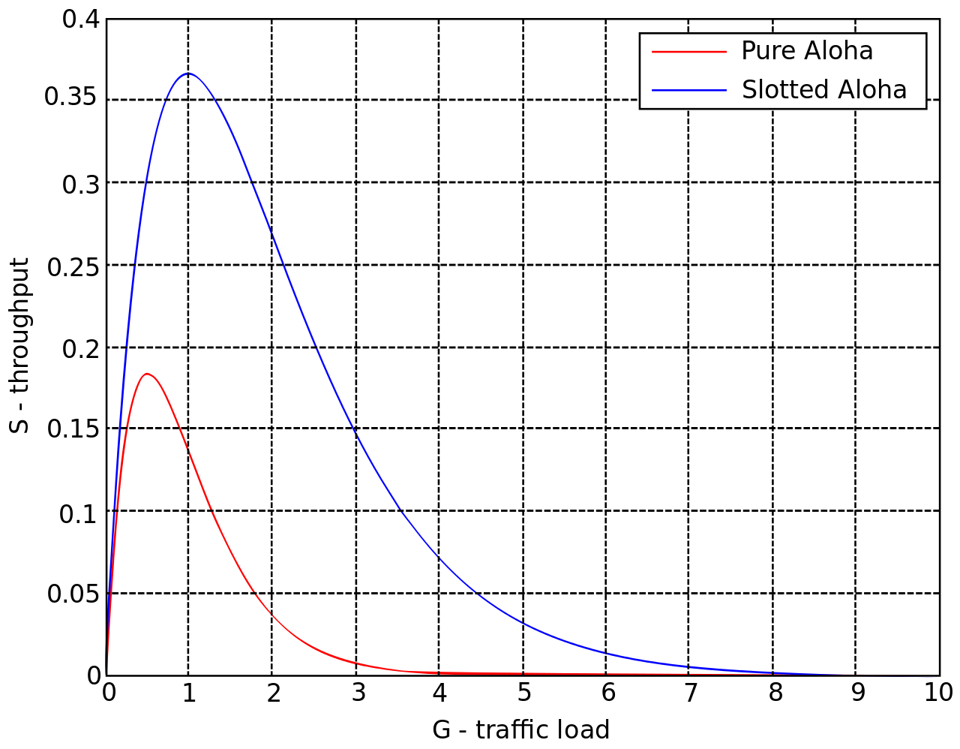
ALOHA throughput
It can be shown that traffic maxes out at
ALOHA: 18.4%
Slotted ALOHA: 36.8%
Assuming Poisson distribution of transmission attempts
Slotted throughput is double because the “before” collisions can no longer occur

Slide 66
Why Use Random Access if Efficiency is Limited?
Simplicity and low overhead:
• RAPs do not need complex synchronization or scheduling mechanisms
• Suitable for resource-constrained IoT or sensor networks
• Efficiency in low-load scenarios:
• Collisions are rare when network load is low
• Random access can achieve low latency for intermittent or bursty transmissions
• Real-world usage examples:
• BLE beaconing: Short, random broadcasts to discover devices
• LoRaWAN: Simplicity and battery efficiency preferred over maximizing throughput
• Satellite and RFID networks: Sporadic data transmission scenarios

Slide 67
Why Use Random Access if Efficiency is Limited?
Simplicity and low overhead:
• RAPs do not need complex synchronization or scheduling mechanisms
• Suitable for resource-constrained IoT or sensor networks
• Efficiency in low-load scenarios:
• Collisions are rare when network load is low
• Random access can achieve low latency for intermittent or bursty transmissions
• Real-world usage examples:
• BLE beaconing: Short, random broadcasts to discover devices
• LoRaWAN: Simplicity and battery efficiency preferred over maximizing throughput
• Satellite and RFID networks: Sporadic data transmission scenarios

Slide 68
CSMA/CA: Introduction and Motivation
What is CSMA/CA?
• Carrier Sense Multiple Access with Collision Avoidance is a medium access control protocol widely used in wireless networks (especially WiFi)
• Nodes sense the medium to check if it’s busy before attempting transmission, but collisions are actively avoided rather than detected after occurrence
Why is Collision Avoidance Necessary?
• Wireless networks have difficulty reliably detecting collisions directly due to signal fading, interference, and hidden nodes.
• Collision Avoidance proactively reduces the probability of collisions occurring

Slide 69
How CSMA/CA Works (Step-by-Step)
1. Listen first (Carrier Sensing):
Nodes listen (sense) the channel before transmission. If the channel is busy, the node waits.
2. Random Backoff (Collision Avoidance):
Once the channel becomes idle, nodes don’t transmit immediately. Instead, they wait for a random time interval (random backoff period) before transmitting
3. Transmit Data:
After the random wait, if the medium remains idle, the node transmits its data
4. Acknowledgment (ACK):
Successful reception is confirmed through an ACK from the receiving node. Lack of ACK implies potential collision or error, triggering retransmission

Slide 70
CSMA/CA: Choosing W_{max}
Should W_{max} be constant?
Intuitively, W_{max} should be small when there is lower chance of collision and vice versa
W_{max} varies according to the Binary Exponential Backoff (BEB) algorithm.
Set “slot time” to 2 times the max. propagation delay on the channel
If this is the first transmission, sends immediately
If there is a collision, after i-th collision, pick W_{max} randomly between 0 and 2^{i}-1 time slots.

Slide 71
Binary Exponential Backoff (BEB) in CSMA/CA
Why Exponential Backoff?
• If collisions occur, waiting intervals adaptively increase to further reduce future collision probability
• Each successive collision indicates higher channel contention
BEB Mechanism clearly explained:
1. Initial attempt: Small waiting period (randomized within a small range).
2. After each collision:
The range (window size) for the random backoff doubles (exponential increase), reducing collisions progressively:
• 1st collision: Wait between 0 - (2^1-1) slots
• 2nd collision: Wait between 0 - (2^2-1) slots
• After i-th collision: Wait between 0 - (2^i-1) slots.

Slide 72
CSMA/CA: Trade-off
What are the Trade-off:
More aggressive (smaller W_{max}) – more likely to achieve higher channel utilization, but also more likely to collide
Less aggressive – lower channel utilization, less likely to collide
Utilization vs. delay
Overly aggressive or conservative can increase delay
Optimal point depends on
Number of stations/nodes contenting
Traffic load

Slide 73
Hidden terminal problem
Device C
Device A
Device B

Slide 74
CSMA with RTS/CTS
Occurs when two transmitters cannot sense each other’s transmissions but interfere at a common receiver
RTS/CTS Mechanism:
• Request to Send (RTS): Short control frame sent by transmitter requesting access
• Clear to Send (CTS): Receiver replies if it’s ready, informing nearby nodes to remain silent temporarily
A partial solution
When channel is idle, transmitter sends a short Request To Send (RTS)
Receiver will send a Clear To Send (CTS) to only one node at a time
RTS collisions are faster and less wasteful than hidden terminal collisions
Downside: overhead is high for waiting for CTS when contention is low

Slide 75
Solving Hidden Terminal Problem
B
RTS
CTS
CTS
A
C
OK, I’ll wait …

Slide 76
Real-world protocol access control
ALOHA
BLE advertisements
Unlicensed LPWANs: Sigfox, LoRaWAN
CSMA
WiFi (slotted, CSMA/CA)
TDMA
BLE connections
Cellular LPWANs: LTE-M and NB-IoT

Slide 77
Medium Access Control for Internet of Things

Slide 78
Medium access control for Internet of Things
• General wireless MAC protocols typically optimize for:
Low Latency
High Channel Utilization
Fairness (all nodes have equal chance to communicate)
However, IoT has unique requirements:
Extremely low power consumption
Typically, low and intermittent channel utilization
Priority shift for IoT MAC protocols:
Energy conservation becomes the primary design goal
MAC protocols must minimize power usage to prolong battery life

Slide 79
Energy consumption of medium access control
Sources of energy consumption in contention-based protocols:
1. Overhearing (receiving unintended transmissions)
2. Control packet overhead (RTS, CTS, ACK, etc.)
3. Data transmission/reception
4. Idle listening (listening to channel when nothing is being transmitted)
(1) – (3) occurs only when there is an active transmission
(4) (Idle listening) happens even without any transmissions and can dominate energy use

Slide 80
“Life Cycle” of MAC Protocols
(4)
(1) – (3)
(4)
(1) – (3)
(4)
(1) – (3)
Less Traffic
(4)
(1 – (3)
(4)
(1) – (3)
Less Traffic
(4)
(4)
As traffic load decreases, the proportion of energy consumed by idle listening increases significantly. This makes idle listening the dominant source of wasted energy in low-load IoT networks.

Slide 81
Idle listening is energy expensive
Idle listening consumes significant energy, especially at low load:
• Measurements show idle listening can consume between 50% to 100% of the energy needed for actual receiving
• Dilemma clearly presented:
• If nodes turn off their radios to save power, how will they detect incoming transmissions?
Solution Needed:
Duty cycling—periodically waking up briefly to sense transmissions, then returning to sleep mode

Slide 82
Duty cycled medium access control protocols
Core Concept:
Nodes sleep when inactive, drastically reducing idle listening time
Periodically “wake up” to sense channel activity
Main advantage:
Minimizes idle energy consumption
• Key challenge:
Determining the optimal wake-up schedule is critical
Coordination required to ensure nodes wake at the right time to detect transmissions

Slide 83
ALOHA with Preamble Sampling
Vanilla Aloha: Works when a) There is no contention (usually true when utilization is low) b) Receiver is listening (may not be true duty cycling)
How to convert ALOHA to work with duty cycle?

Slide 84
ALOHA with Preamble Sampling
Vanilla Aloha: Works when a) There is no contention (usually true when utilization is low) b) Receiver is listening (may not be true duty cycling)
How to convert ALOHA to work with duty cycle?
Nodes periodically wake and sample the channel to check for activity
Transmitters send an extended preamble (long duration) before data, ensuring receivers detect transmissions
• How it works step-by-step:
• Sender transmits a long preamble to “wake up” receiver
• Receiver periodically wakes briefly to sense for preambles
• Once a preamble is detected, receiver stays awake, receives the actual data, and acknowledges

Slide 85
Aloha with Preamble Sampling
Sensing
Sensing
Sensing
Sensing
Receiver
Sender
Preamble
Data
Sensing
Sensing
Sensing
Recv
ACK
Receiver 1
Sensing
Sensing
Receiver 2

Slide 86
Aloha with Preamble Sampling
Tp
Sender
Preamble
Data
Sensing
Sensing
Sensing
Recv
ACK
Receiver 1
Ts
T_{D}
• Advantages:
• Reduces idle listening significantly, saving power
• Simple to implement, asynchronous, no synchronization required
• Limitations:
• Preamble wastes energy at sender and slightly increases latency

Slide 87
B-MAC: Asynchronous Medium Access Control
Implements preamble sampling concept.
Nodes independently choose wake-up intervals (asynchronous).
Operational Steps:
1. Sender transmits a long preamble
2. Receivers periodically sample the channel
3. If a preamble is detected, the receiver stays awake for data transmission
Key Parameters:
Channel sampling interval: Determines energy usage
Long preamble: Duration matches sampling interval to ensure detection
Pros and Cons:
Pros: Energy-efficient, simple, asynchronous operation
Cons: Long preamble introduces latency and unnecessary overhead

Slide 88
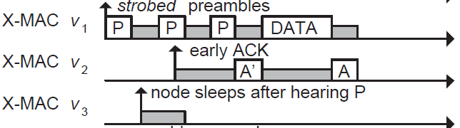
Improving B-MAC with X-MAC
X-MAC improves over B-MAC
Sender transmits many “probes” with gaps between probes. Each probe contains address of intended receiver
Receiver checks address embedded in probe, sends acks if it is the destination during the gap period between probes
Sender transmits DATA, receive replies with Ack to complete data transfer

Slide 89
ContikiMAC
ContikiMAC is the MAC protocol implemented in Contiki OS

Slide 90
Synchronous MAC
Nodes agree to wake up simultaneously at predetermined intervals
Each interval split into active (listen period) and inactive (sleep period)
Example Scenario (clearly illustrated):
10% duty cycle: 10% of the time nodes listen; 90% sleep.
For example: nodes listen for 100 ms, then sleep for 900 ms.
Advantages:
Predictable and coordinated
Easier to manage communication during listening periods
Disadvantages:
Requires synchronization overhead.
Less flexible compared to asynchronous schemes (X-MAC, B-MAC)

Slide 91
Synchronous MAC (SMAC)
Example: 10% duty cycle
Each node listens for 100ms and sleep for 0.9s
Each node listens for 1s and sleeps for 9s

Slide 92
Question
Consider a wireless sensor network with the following characteristics:
• Nodes follow a synchronized S-MAC schedule with a 10% duty cycle.
• Total frame duration (Listening + Sleeping) = 1 second (1000 ms).
• Therefore, nodes stay awake 100 ms and sleep for 900 ms per cycle.
Assume:
• Each node has a fixed battery (1000 mAh) with radio current consumption of:
Active listening/transmission: 20 mA
Sleep mode: 0.05 mA
When active, the network sends data packets of duration 10 ms each.

Slide 93
Question
1. Energy Calculation: Compute the average current consumption per node over one complete cycle (active + sleep) using the given parameters.
2. Battery Life Estimation: Given a sensor powered by a battery rated at 1000 mAh, estimate the node’s lifetime under these conditions (ignore battery inefficiencies).
3. Latency Considerations: If a critical event occurs immediately after the active listening period, what’s the maximum latency until the event is detected and reported?
4. Trade-offs clearly discussed: If you increase the duty cycle from 10% to 20%, how does this change your energy consumption and latency?

Slide 94
Collisions are always bad?

Slide 95
Receiving transmissions with collisions
• Occurs when multiple nodes transmit simultaneously, yet the receiver successfully decodes the strongest signal
• In some scenarios, collisions do not always cause complete failures
Receiver receives the strongest signal, ignoring weaker interfering signals
Enhances performance in certain scenarios (dense IoT deployments)

Slide 96
Receiving transmissions with collisions
99%
15%
35%
100%
R
-70.89dB
T4
-80.93dB
-83.02dB
-84.09dB
T3
T2
T1

Slide 97
Flooding

Slide 98
Flooding is a recreation of broadcasts
Goal: get information to all nodes
This is the problem of “data dissemination”
Problem: difficult in Mesh topologies
Packet loss, retransmission delays
Really, data dissemination is just to broadcast to all nodes
But broadcast transmissions don’t reach far enough to cover entire mesh

Slide 99
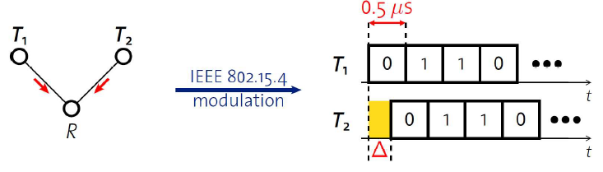
Synchronous transmissions
Multiple nodes transmit same packet at same time
R can receive packet with high probability if Δ is small
May even improve probability of reception (more energy at receiver)
500 ns is 1/32 of a symbol for 802.15.4 (chip duration)

Slide 100
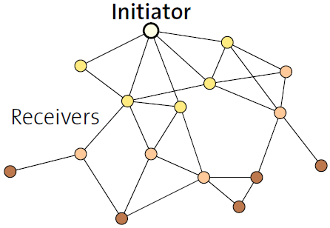
Fast packet propagation in Glossy

Slide 101
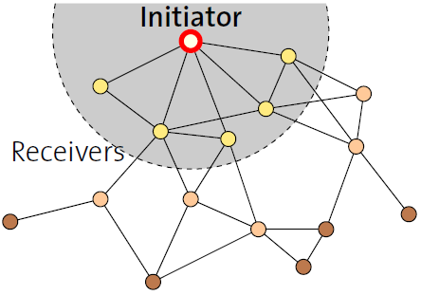
Fast packet propagation in Glossy

Slide 102
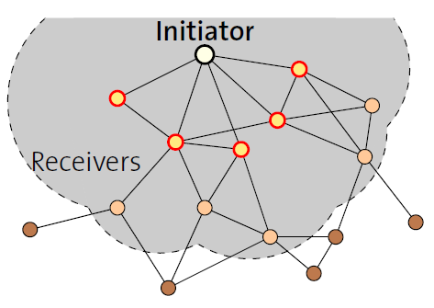
Fast packet propagation in Glossy

Slide 103
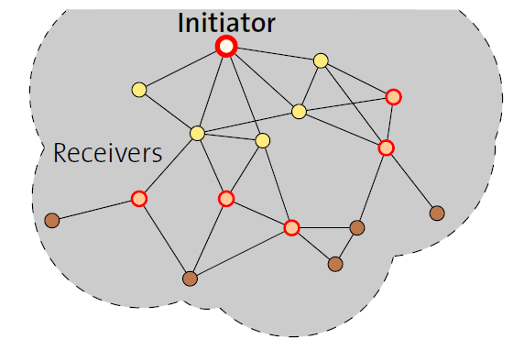
Fast packet propagation in Glossy

Slide 104
Wireless Networking
Ambuj Varshney
ambujv@nus.edu.sg
Notes:
++ Thank you for inviting me to give this talk
++ In this talk, I will present a pathway that can enable us to make wireless embedded systems ubiquitous. I will describe my previous research efforts that tackle the critical challenges that limit the growth of wireless embedded systems. These are related to the growing energy asymmetry that exists between sensing, computation and communication blocks on these platforms.
++ Finally, I will conclude my talk by covering the research agenda that I would like to work on as a faculty member.

