Slide 1
LORA+raspberry
DNN controller
BC controller
package
LORAWAN
data
iCloud
LORA+raspberry
package
LORA+raspberry
Port1
LORAWAN
Port2
Port3
LORA+raspberry
package
LORAWAN
Smart meter
Gateway

Slide 2
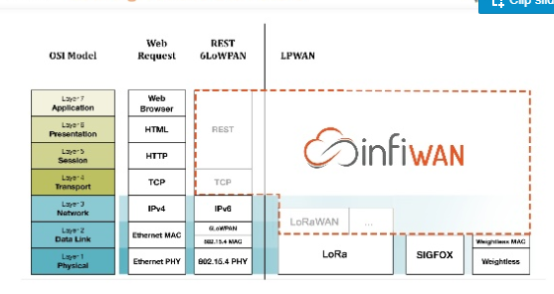
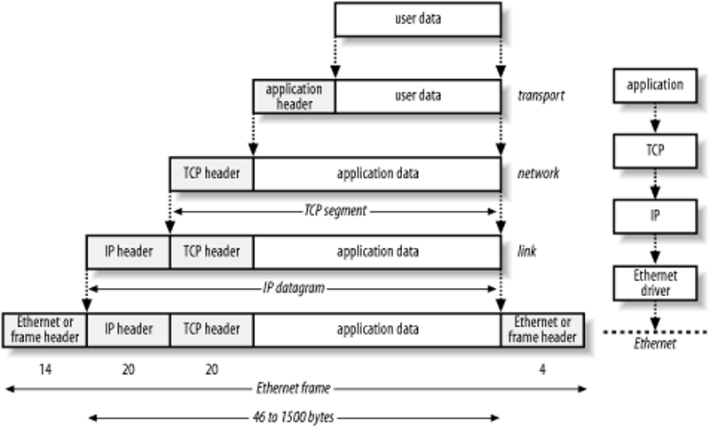
LORA package to Http pachage
http header
LORAWAN VS. OSI-7 Layer
Notes:
LPWAN: https://www.slideshare.net/infiswift/lpwan-for-iot-62591541?fbclid=IwAR0ELIXQ9wohciEskKSvZg9rdE-wBlUy8qSDeyYW0TzKV85WsQJV5p5rKT0
LORA: https://www.eebreakdown.com/2016/08/lora-i.html?fbclid=IwAR1IfAFoTrkfjv4xLusgfOkjFFoHKOkRfrefZYPbAQgpbp8oMjSzMVqZX6Y

Slide 3
使用 web api 的 Gateway
參考有使用的gateway:
* Amazon API Gateway
* Microservices
所以…
流程:
1.解析LORA package
2.Get Data
3.Add http header(restful api)
Notes:
Microservices :https://docs.microsoft.com/zh-tw/dotnet/standard/microservices-architecture/architect-microservice-container-applications/direct-client-to-microservice-communication-versus-the-api-gateway-pattern
Amazon API Gateway: https://aws.amazon.com/tw/api-gateway/faqs/?fbclid=IwAR2lXCcu1pWHUl7PARy3v4n8wakKKubbZaPTwnMCZ4PtJKolPtKVyzLtv4w

Slide 4
未來要做的…
&同步與不同步問題
iCloud
thread1
LORA+Raspberry
port
thread2
port
thread3
port
Notes:
https://ithelp.ithome.com.tw/articles/10193116

