Slide 1
PC LUT Fix
EMTF Working Meeting
Sep 2018

Slide 2

SingleMu30 (2018 SingleMu modes)
1.25 < $|Eta|$ < 1.55

Slide 3
SingleMu30 (2018 SingleMu modes)
1.55 < $|Eta|$ < 1.85

Slide 4
SingleMu30 (2018 SingleMu modes)
1.85 < $|Eta|$ < 2.10

Slide 5
SingleMu30 (2018 SingleMu modes)
2.10 < $|Eta|$ < 2.40

Slide 6
Normalized Rate (SingleMu Modes)
1.25 < $|Eta|$ < 2.40

Slide 7
Normalized Rate (DoubleMu Inclusive Modes)
1.25 < $|Eta|$ < 2.40

Slide 8
Normalized Rate (MuOpen Inclusive Modes)
1.25 < $|Eta|$ < 2.40

Slide 9
Back Up

Slide 10
Rate (SingleMu Modes)
1.25 < $|Eta|$ < 2.40

Slide 11
Rate (DoubleMu Inclusive Modes)
1.25 < $|Eta|$ < 2.40

Slide 12
Rate (MuOpen Inclusive Modes)
1.25 < $|Eta|$ < 2.40

Slide 13
SingleMu22 (2018 SingleMu modes)
1.25 < $|Eta|$ < 1.55

Slide 14
SingleMu22 (2018 SingleMu modes)
1.55 < $|Eta|$ < 1.85

Slide 15
SingleMu22 (2018 SingleMu modes)
1.85 < $|Eta|$ < 2.10

Slide 16
SingleMu22 (2018 SingleMu modes)
2.10 < $|Eta|$ < 2.40

Slide 17
Data Files
root://eoscms.cern.ch//store/user/abrinke1/EMTF/Emulator/ntuples/HADD/
Default
NTuple_SingleMuon_FlatNtuple_Run_2018D_v1_2018_09_19_SingleMuon_2018_emul_102X_ReReco_v1_321988_coord.root
Bug Fix
NTuple_SingleMuon_FlatNtuple_Run_2018D_v1_2018_09_19_SingleMuon_2018_emul_102X_ReReco_v1_321988_bugFix.root

Slide 18
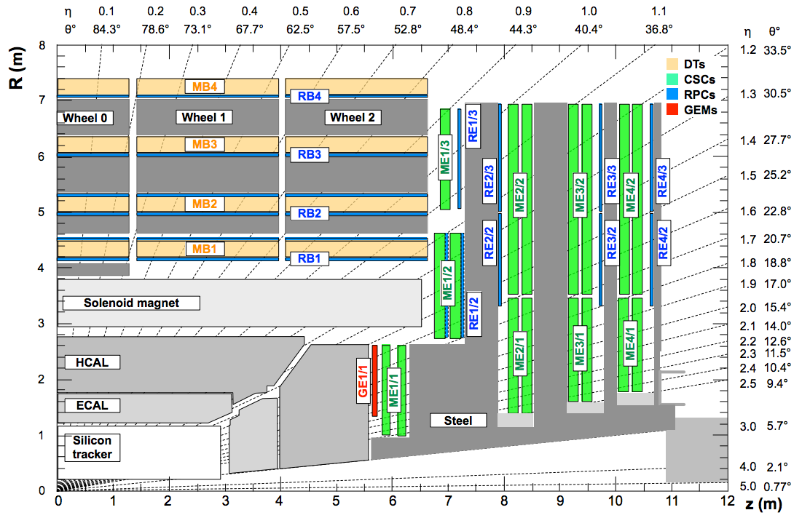
Geometry
Barrel Muon Track Finder (BMTF)
Overlap Muon Track Finder (OMTF)
Endcap Muon Track Finder (EMTF)

Slide 19
EMTF track modes vs Stations
Mode # | Definition | Stations
15 | 1+2+4+8 | 1,2,3,4
14 | 2+4+8 | 1,2,3
13 | 1+4+8 | 1,2,4
12 | 4+8 | 1,2
11 | 1+2+8 | 1,3,4
10 | 2+8 | 1,3
9 | 1+8 | 1,4
7 | 1+2+4 | 2,3,4
6 | 2+4 | 2,3
5 | 1+4 | 2,4
3 | 1+2 | 3,4

Slide 20
Muon Quality
SingleMu (Q>=12)
EMTF mode 15, 14, 13, 11
DoubleMu (Q>=8)
EMTF mode 12, 10, 7
EMTF mode 15, 14, 13, 11
MuOpen (Q>=4)
EMTF mode 9, 6, 5, 3
EMTF mode 9, 10, 7
EMTF mode 15, 14, 13, 11
SingleMu Quality (Q>=12)
EMTF mode 15, 14, 13, 11
DoubleMu Quality (Q>=8)
EMTF mode 9, 10, 7
EMTF mode 15, 14, 13, 11
MuOpen Quality (Q>=4)
EMTF mode 12, 6, 5, 3
EMTF mode 9, 10, 7
EMTF mode 15, 14, 13, 11
2017
2018

Slide 21
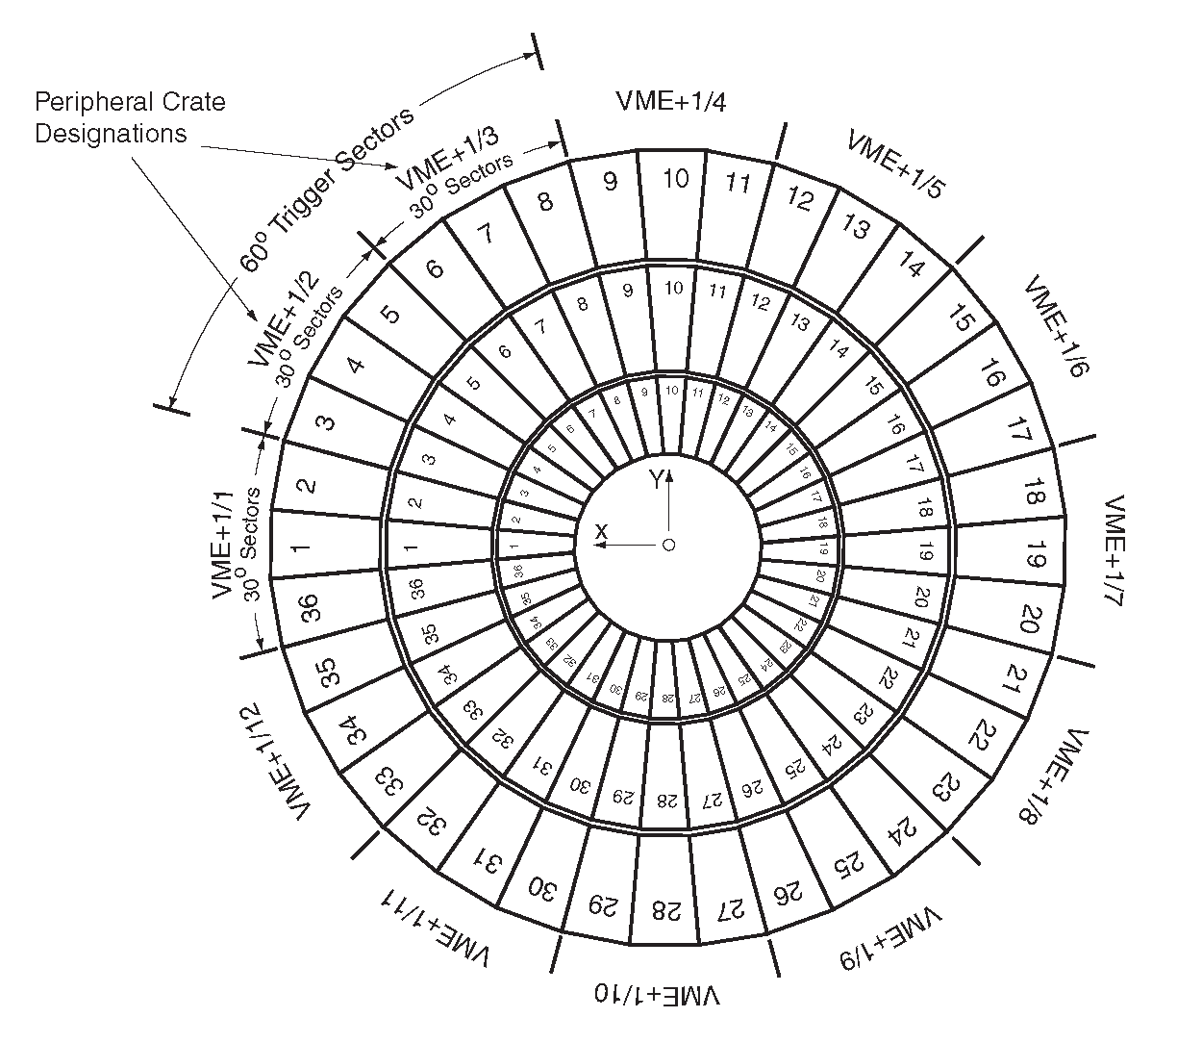
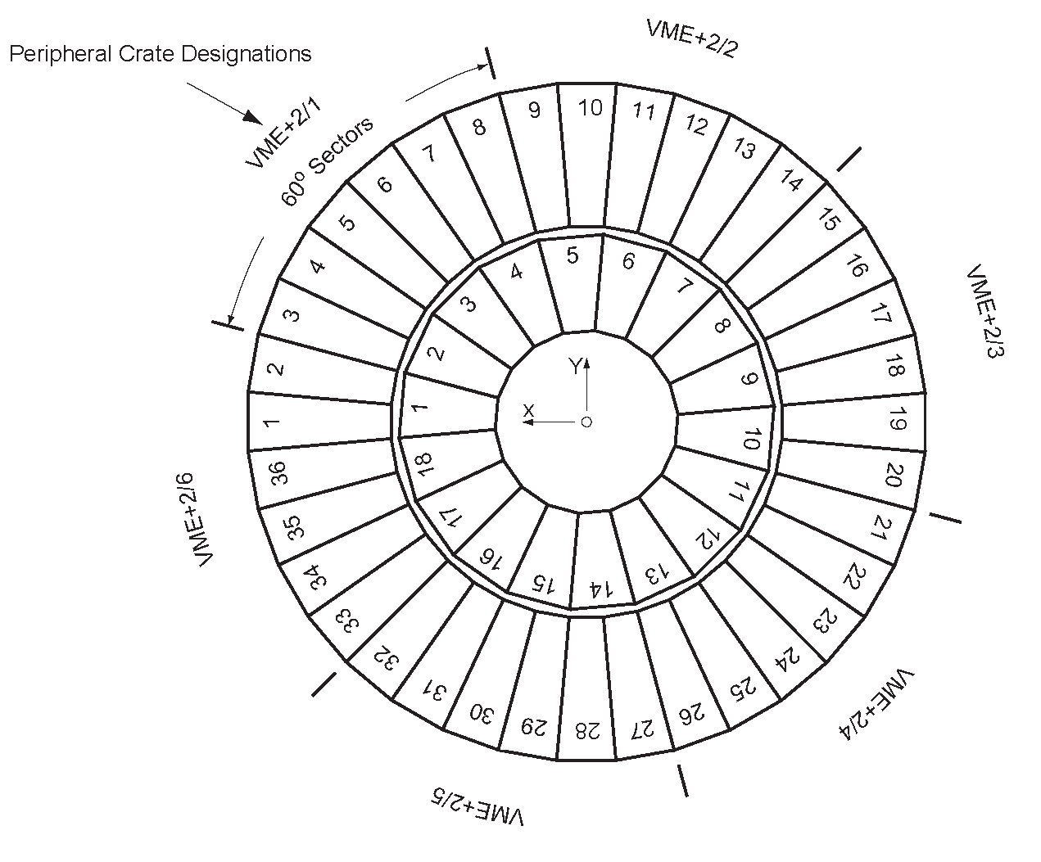
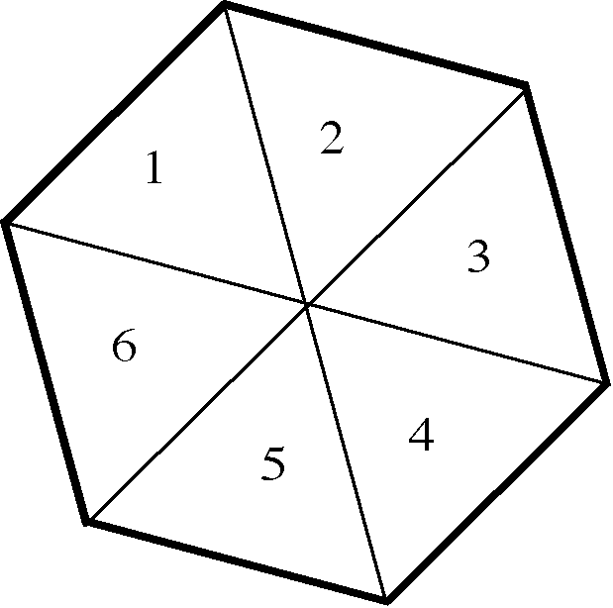
CSC Geometry
Station 1
Station 2, 3, 4

Slide 22
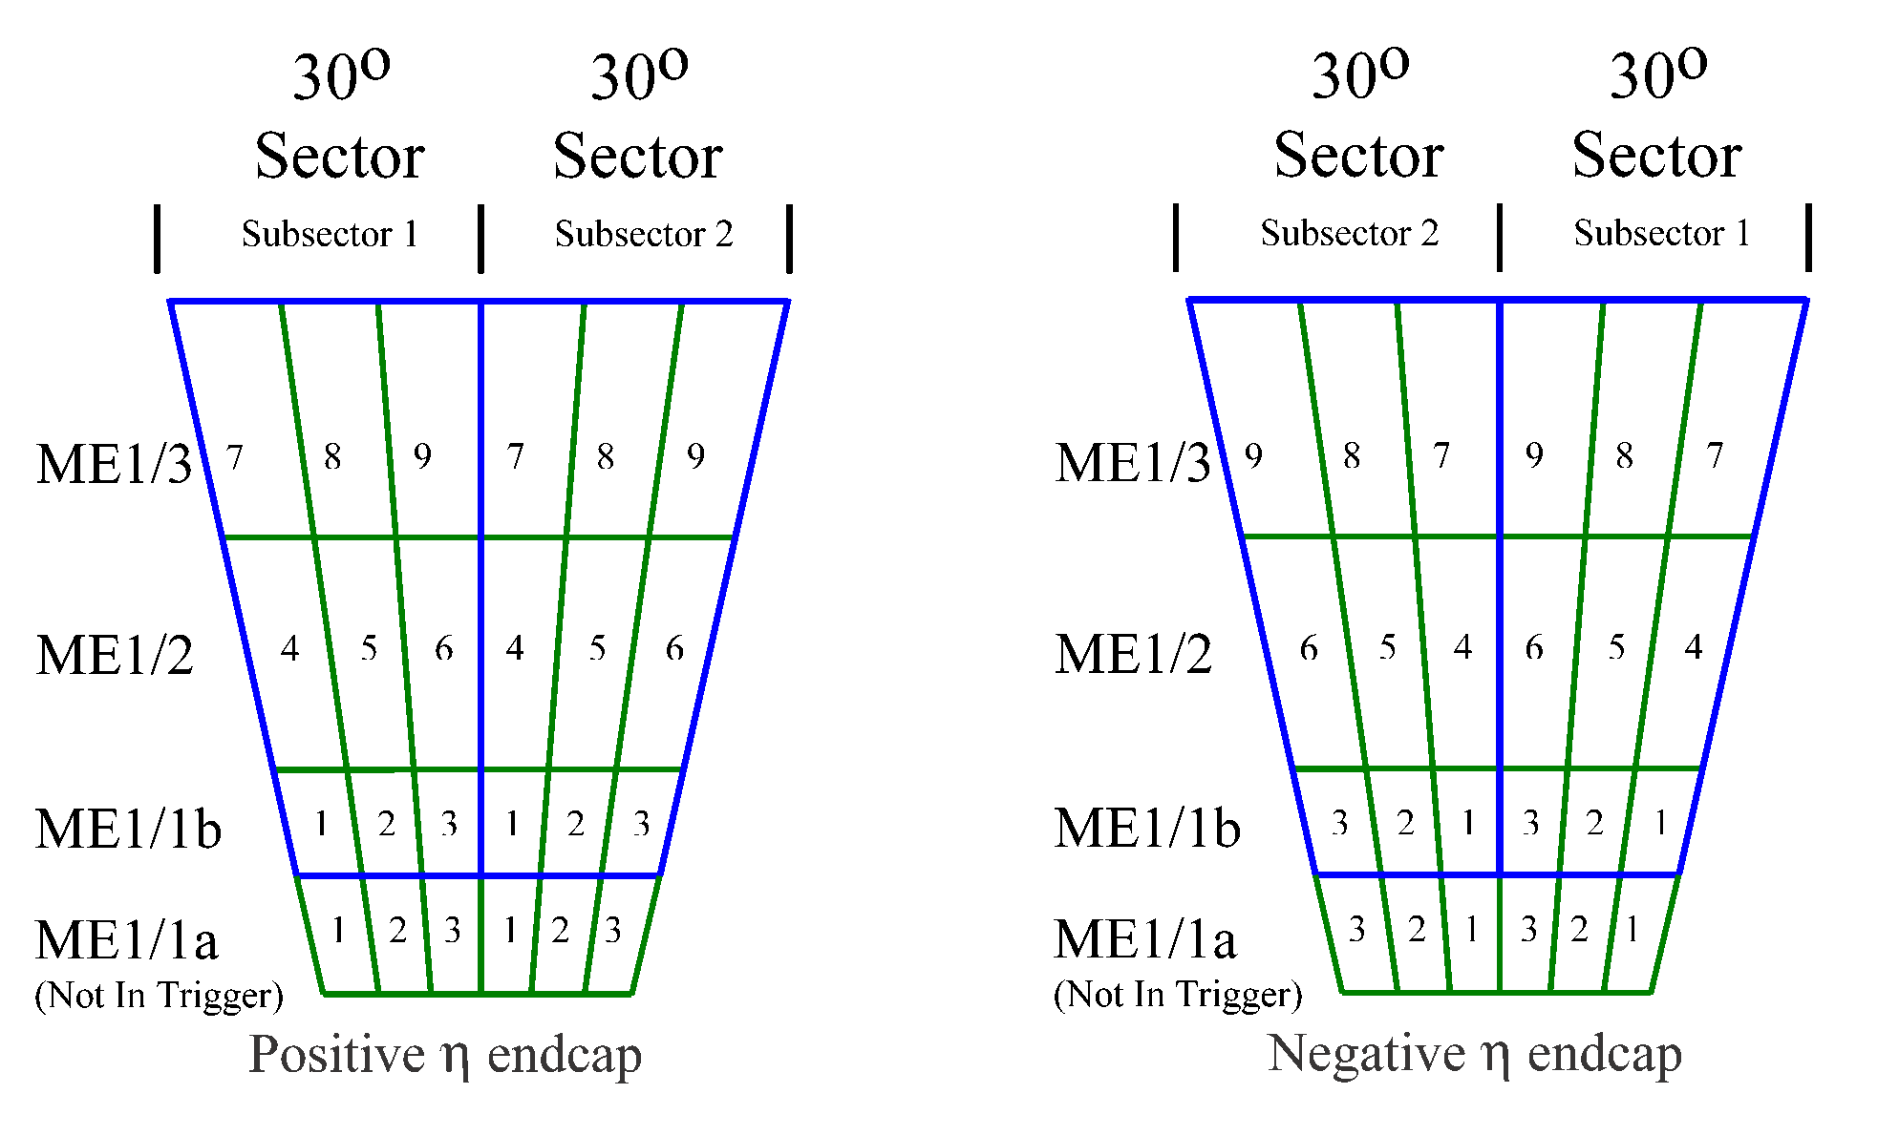
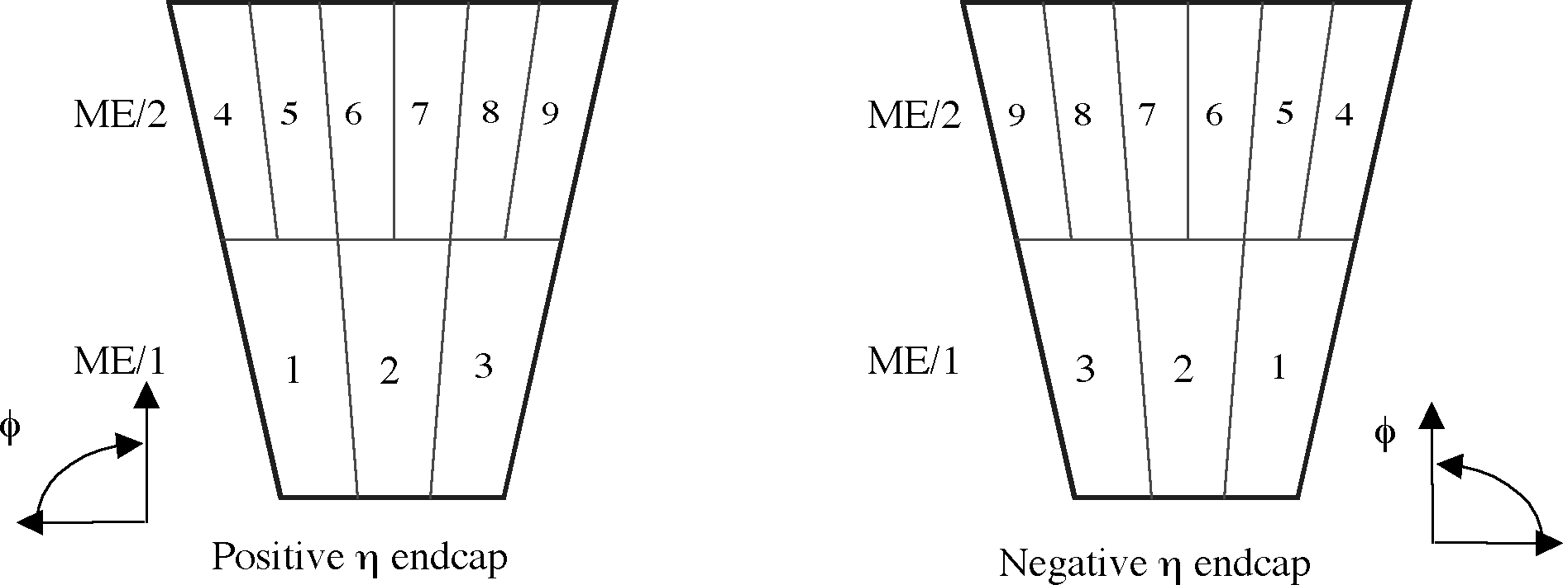
CSCs in a trigger sector
Station 1
Station 2, 3, 4

