Slide 1

2017 EMTF pT Resolution
Wei Shi
EMTF Working Meeting

Slide 2
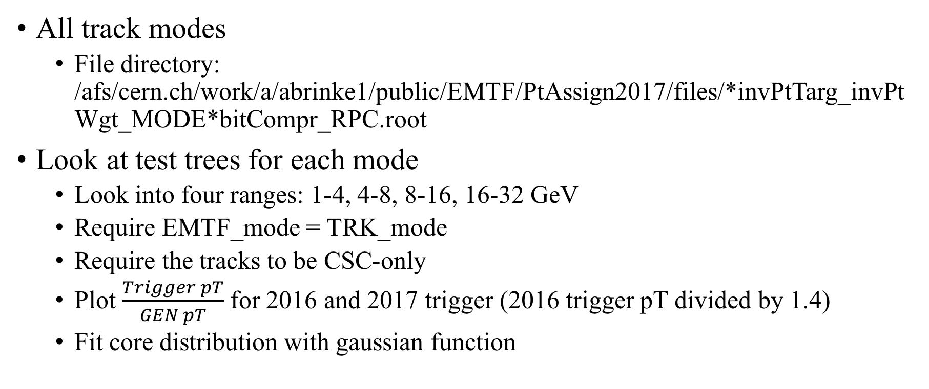
Selections
All track modes
File directory: /afs/cern.ch/work/a/abrinke1/public/EMTF/PtAssign2017/files/*invPtTarg_invPtWgt_MODE*bitCompr_RPC.root
Look at test trees for each mode
Look into four ranges: 1-4, 4-8, 8-16, 16-32 GeV
Require EMTF_mode = TRK_mode
Require the tracks to be CSC-only
Plot $\frac{Trigger pT}{GEN pT}$ for 2016 and 2017 trigger (2016 trigger pT divided by 1.4)
Fit core distribution with gaussian function

Slide 3
Four station track

Slide 4
Mode 15 (station 1,2,3,4)

Slide 5
Mode 15 (station 1,2,3,4)

Slide 6
Mode 15 (station 1,2,3,4)

Slide 7
Mode 15 (station 1,2,3,4)

Slide 8
Three station track

Slide 9
Mode 14 (station 1,2,3)

Slide 10
Mode 14 (station 1,2,3)

Slide 11
Mode 14 (station 1,2,3)

Slide 12
Mode 14 (station 1,2,3)

Slide 13
Mode 13 (station 1,2,4)

Slide 14
Mode 13 (station 1,2,4)

Slide 15
Mode 13 (station 1,2,4)

Slide 16
Mode 13 (station 1,2,4)

Slide 17
Mode 11 (station 1,3,4)

Slide 18
Mode 11 (station 1,3,4)

Slide 19
Mode 11 (station 1,3,4)

Slide 20
Mode 11 (station 1,3,4)

Slide 21
Mode 7 (station 2,3,4)

Slide 22
Mode 7 (station 2,3,4)

Slide 23
Mode 7 (station 2,3,4)

Slide 24
Mode 7 (station 2,3,4)

Slide 25
Two station track

Slide 26
Mode 12 (station 1,2)

Slide 27
Mode 12 (station 1,2)

Slide 28
Mode 12 (station 1,2)

Slide 29
Mode 12 (station 1,2)

Slide 30
Mode 10 (station 1,3)

Slide 31
Mode 10 (station 1,3)

Slide 32
Mode 10 (station 1,3)

Slide 33
Mode 10 (station 1,3)
Other two station track find in back up

Slide 34
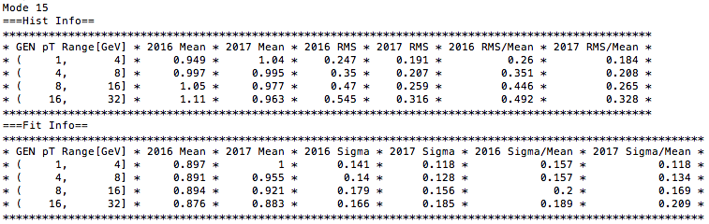
Summary Table
Summary table
Histogram information: mean, RMS, RMS/mean (2016 and 2017)
Gaussian Fit parameter: mean, sigma, sigma/mean (2016 and 2017)

Slide 35
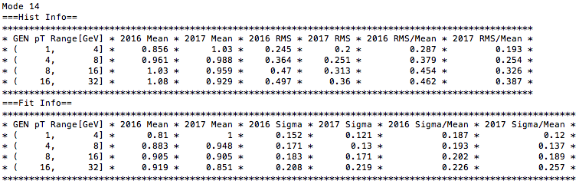
Summary Table

Slide 36
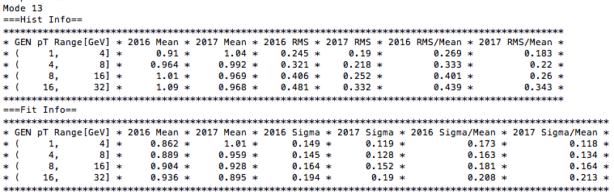
Summary Table

Slide 37
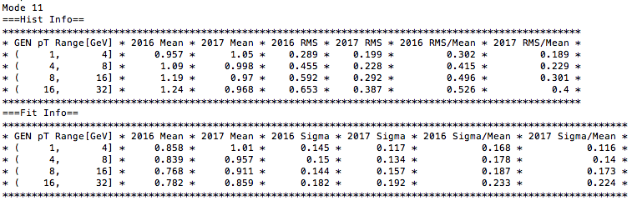
Summary Table

Slide 38
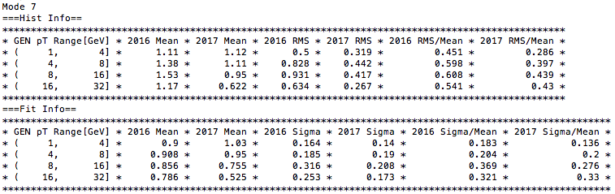
Summary Table

Slide 39
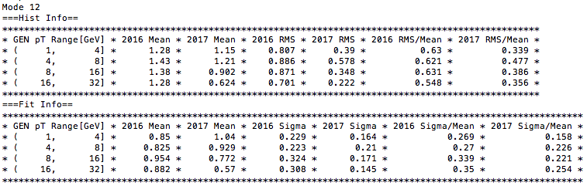
Summary Table

Slide 40
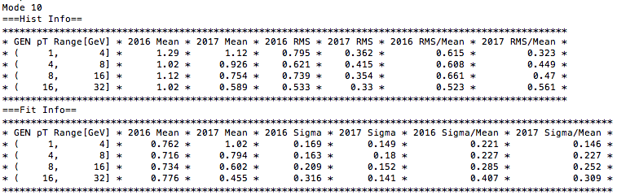
Summary Table
Other two station track summary table find in back up

Slide 41
Conclusion
2017 EMTF pT resolution is better than 2016 in pT (1, 32] GeV
Use fit sigma/mean as the pT resolution evaluation metric
2017 pT resolution is ~2% - 11% better than 2016, depending on modes and pT
2017 pT resolution is between 10% and 20% in pT (1, 32] GeV

Slide 42
BACK UP

Slide 43
Other two station track

Slide 44
Mode 9 (station 1,4)

Slide 45
Mode 9 (station 1,4)

Slide 46
Mode 9 (station 1,4)

Slide 47
Mode 9 (station 1,4)

Slide 48
Mode 6 (station 2,3)

Slide 49
Mode 6 (station 2,3)

Slide 50
Mode 6 (station 2,3)

Slide 51
Mode 6 (station 2,3)

Slide 52
Mode 5 (station 2,4)

Slide 53
Mode 5 (station 2,4)

Slide 54
Mode 5 (station 2,4)

Slide 55
Mode 5 (station 2,4)

Slide 56
Mode 3 (station 3,4)

Slide 57
Mode 3 (station 3,4)

Slide 58
Mode 3 (station 3,4)

Slide 59
Mode 3 (station 3,4)

Slide 60
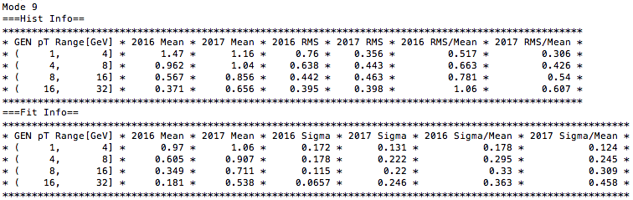
Summary Table

Slide 61
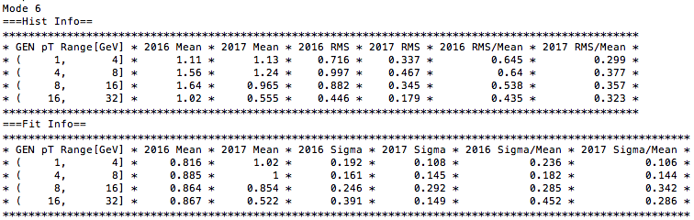
Summary Table

Slide 62
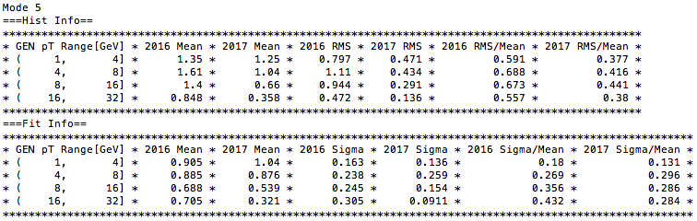
Summary Table

Slide 63
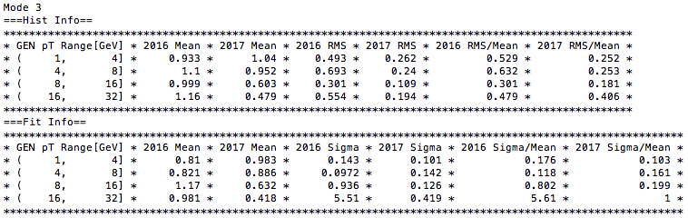
Summary Table

