Slide 1
CMP_SC 8170 · PROJECT 2
Template-Based Modeling vs AlphaFold3 on CASP15 Targets
An AI-assisted MODELLER pipeline coordinated by Claude, evaluated against experimental structures
Parthaw Goswami · Vinaya Santhosh Kumar · Weisi Liu · Arwa Mashaqbeh
Targets: T1124 (TBM-easy) · T1127 (TBM-hard) · T1151s2 (FM/TBM)
Notes:
We compare classical template-based modeling with MODELLER against AlphaFold3 on three CASP15 targets of increasing difficulty. Claude coordinates the MODELLER side and the evaluation.

Slide 2
RESEARCH QUESTION
Where does template-based modeling fail?
• Compare MODELLER (template-based) with AlphaFold3 (deep learning) on three CASP15 targets of increasing difficulty.
• Score both against the experimental structure over the CASP evaluation unit: TM-score, GDT-TS, lDDT, Cα RMSD.
• Relate MODELLER's accuracy to template identity, coverage and alignment quality.
• Test whether a Claude agent choosing templates changes the outcome versus a fixed-rule baseline.
Target | CASP class | Length | PDB | Evaluation unit
T1124 | TBM-easy | 384 | 7UX8 | 7–384
T1127 | TBM-hard | 211 | 8XBP | 6–210
T1151s2 | FM/TBM | 116 | 8D5V (chain A) | 28–111
T1151s2 replaces the original FM/TBM target T1123, for which the profile search finds no template in the pre-2022 PDB (best E = 0.5).
CMP_SC 8170 · Project 2 · Template-based modeling vs AlphaFold3
2
Notes:
CASP classes: TBM-easy has a clear template, TBM-hard a weak one, FM/TBM is borderline free modeling. Scores are computed over the CASP evaluation unit (EU) only. T1151s2 replaced T1123, for which the profile search finds no template.

Slide 3
METHOD
Pipeline: Claude coordinates, tools compute
Agent 1 · Claude
profile search → templates → MODELLER → pick model
Target FASTA
CASP15 sequence
Agent 2 · Claude
TM, GDT-TS, lDDT, RMSD vs experimental structure
Report
tables, figures, interpretation
AlphaFold3 Server
default settings, top-ranked model
Claude decides
Code enforces
Baseline (no AI)
search settings · which templates to build (≤ 4) · which model to keep · error analysis
no templates released after 2022-05-01 or from the target entry · Agent 1 never sees the answer · metrics by code
same tools, fixed rules: top-ranked template, lowest-DOPE model
CMP_SC 8170 · Project 2 · Template-based modeling vs AlphaFold3
3
Notes:
Agent 1 and Agent 2 are Claude tool-use loops. Claude decides search settings, which templates to build and which model to keep; the tools run HMMER, MODELLER and the metrics and enforce the rules. AlphaFold3 is run by hand on the AlphaFold Server with default settings. The baseline runs the same tools with fixed rules: top-ranked template, lowest-DOPE model.

Slide 4
METHOD · AGENT 1
Template search: iterative profile HMM
Target sequence
expression tags masked
Target | Hits | Templates built | Kept | Identity | Coverage | GA341
T1124 | 250 | 5I2H, 1QZZ, 3GWZ | 5I2H:A | 27% | 81% | 1.00
T1127 | 250 | 4HNY, 2FE7, 2BEI | 2FE7:B | 36% | 75% | 0.93
T1151s2 | 8 | 7KUG, 6ONO, 7F7N | 7KUG:A | 38% | 47% | 0.60
Round 1
sequence vs pre-2022 PDB chains
Rounds 2–3
profile HMM from hits (E ≤ 1e-3)
• T1124, T1127: hundreds of family members (methyltransferases, acetyltransferases).
• T1151s2 (FM/TBM): only 8 hits, all WhiB-family regulators, at ~38% identity over 55 residues — a remote template the profile still finds.
• Claude built 3 templates per target and named the risky region before evaluation: T1124 domain orientation, T1127 insertion 60–104, T1151s2 tail 85–111.
MODELLER
profile alignment → 5 models
CMP_SC 8170 · Project 2 · Template-based modeling vs AlphaFold3
4
Notes:
jackhmmer round 1 compares the sequence itself; each further round builds a profile HMM from the confident hits (E ≤ 1e-3) and searches again. The profile knows which positions are conserved in the family, so it finds remote homologues such as the WhiB family for T1151s2. The same profile aligns target and template for MODELLER. GA341 near 1 means a reliable fold; lower z-DOPE is better.

Slide 5
RESULTS
AlphaFold3 is more accurate on every target
Target | Method | TM ↑ | GDT-TS ↑ | lDDT ↑ | RMSD (Å) ↓
T1124 (TBM-easy) | MODELLER | 0.537 | 41.3 | 0.542 | 21.3
 | AlphaFold3 | 0.940 | 90.8 | 0.870 | 6.6
T1127 (TBM-hard) | MODELLER | 0.722 | 65.5 | 0.529 | 11.5
 | AlphaFold3 | 0.973 | 95.5 | 0.882 | 0.9
T1151s2 (FM/TBM) | MODELLER | 0.524 | 52.7 | 0.407 | 17.3
 | AlphaFold3 | 0.916 | 92.9 | 0.817 | 1.5
• MODELLER is best on the TBM-hard target (0.72), not the TBM-easy one (0.54).
• AlphaFold3: TM 0.92–0.97 everywhere; its RMSD is raised only by floppy termini.
CMP_SC 8170 · Project 2 · Template-based modeling vs AlphaFold3
5
Notes:
Scores over the CASP evaluation unit. Our TM-score matches the TMscore program on all six models. MODELLER does best on the TBM-hard target, so CASP difficulty labels did not predict its accuracy. The chart is a native PowerPoint chart: right-click → Edit Data.

Slide 6
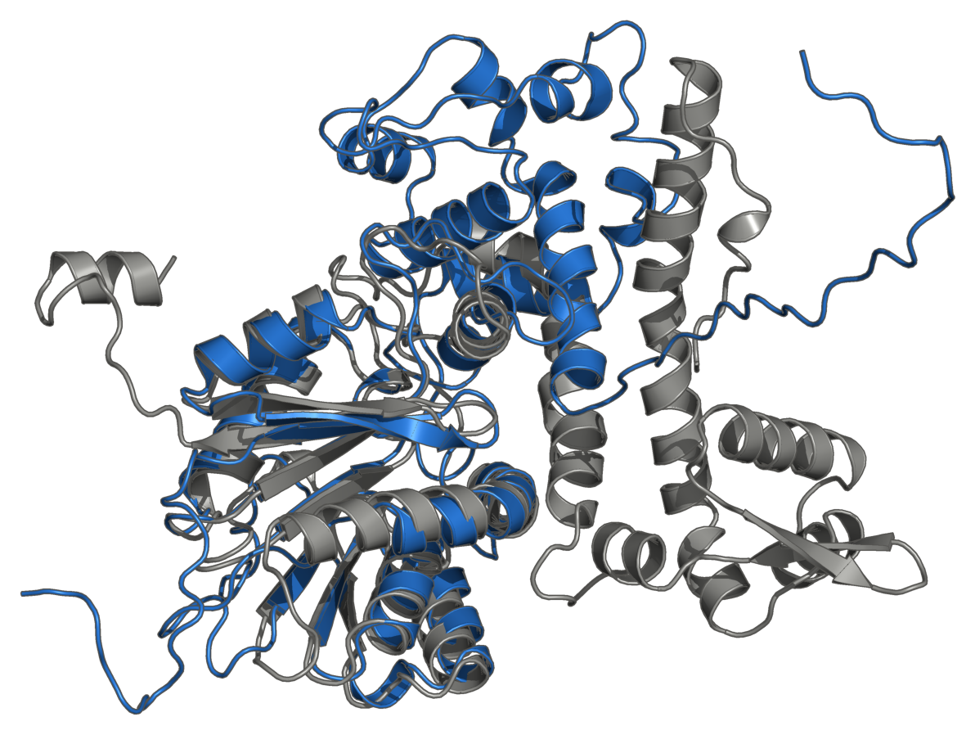
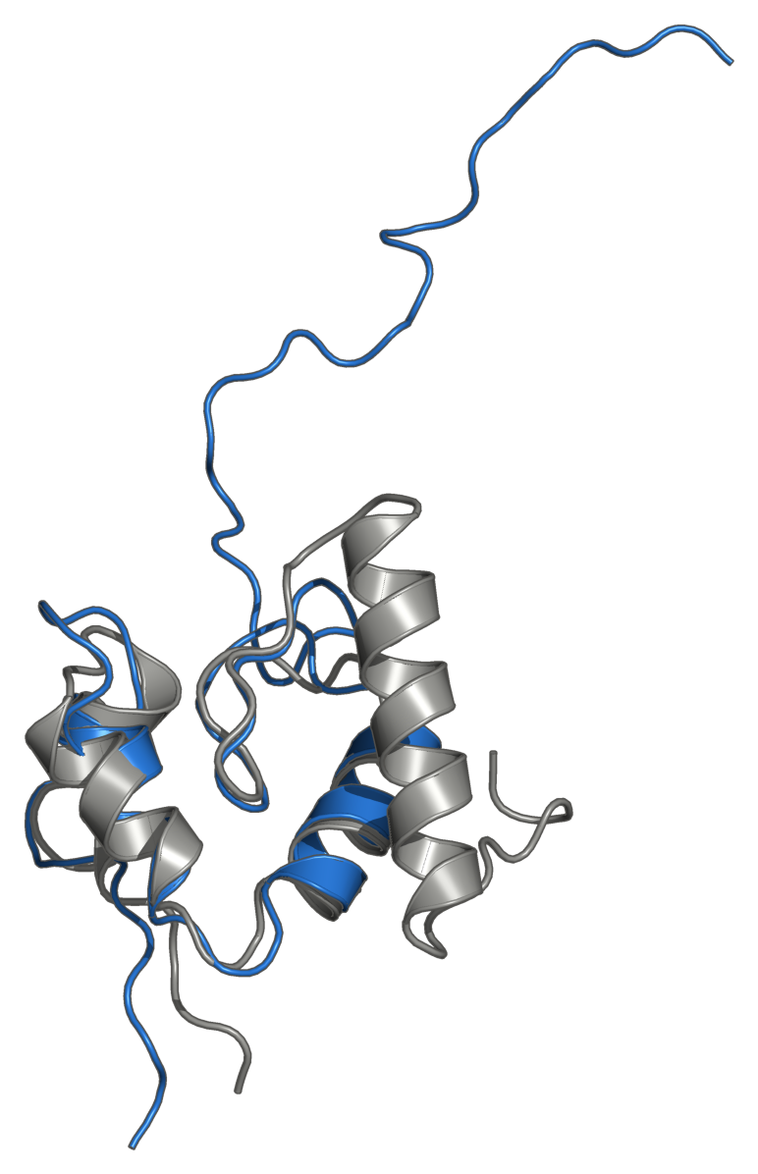
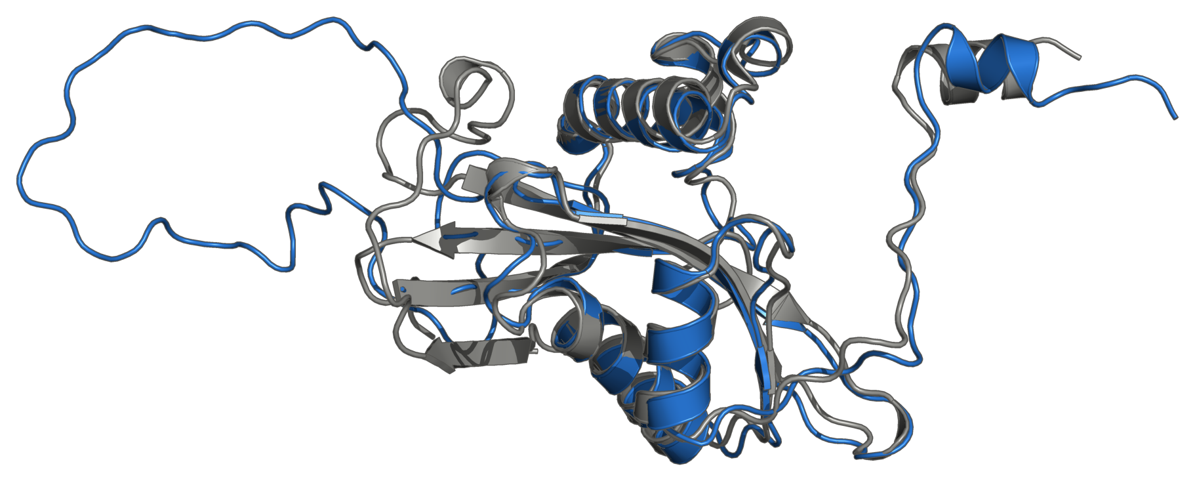
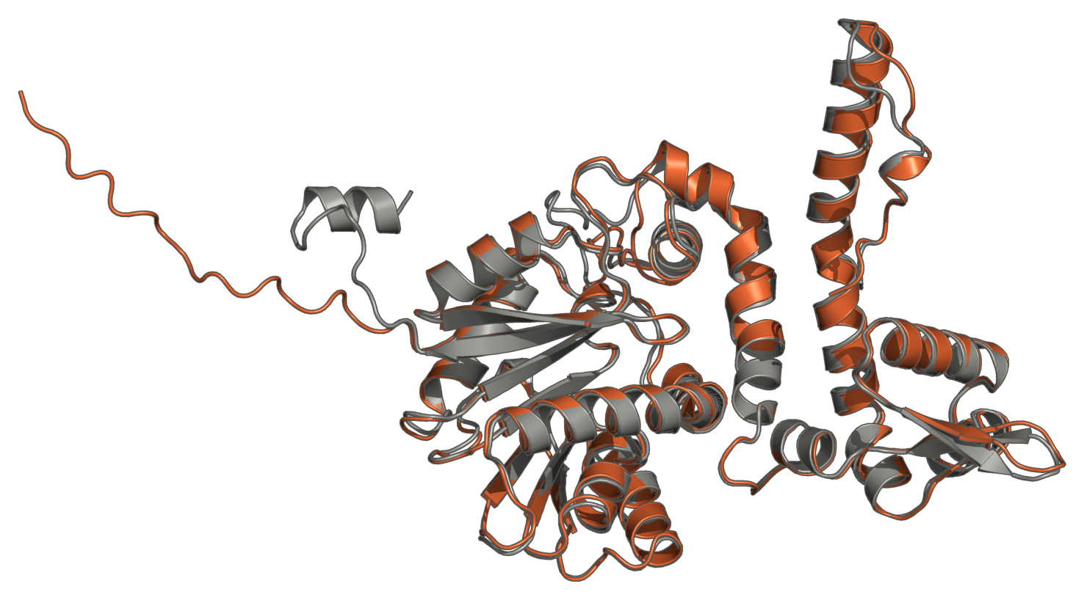
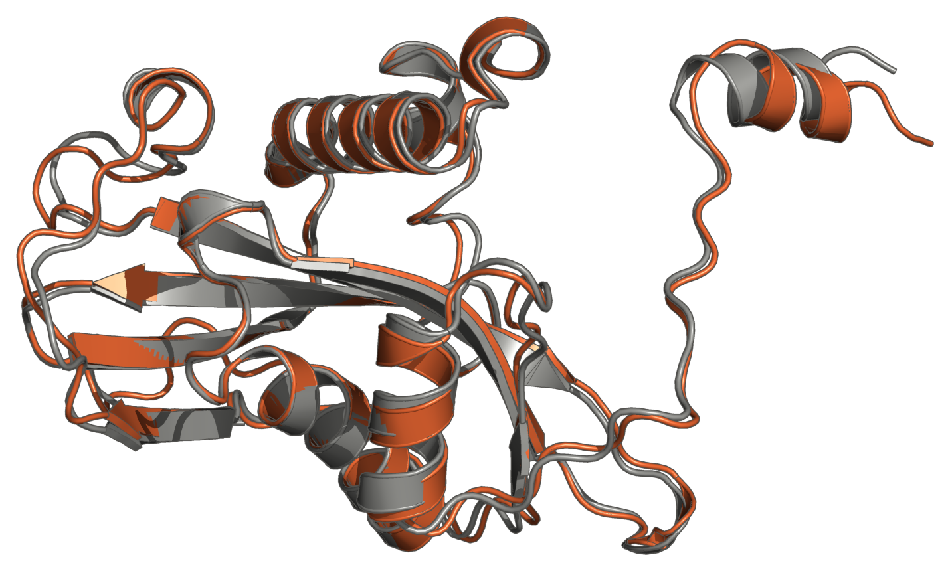
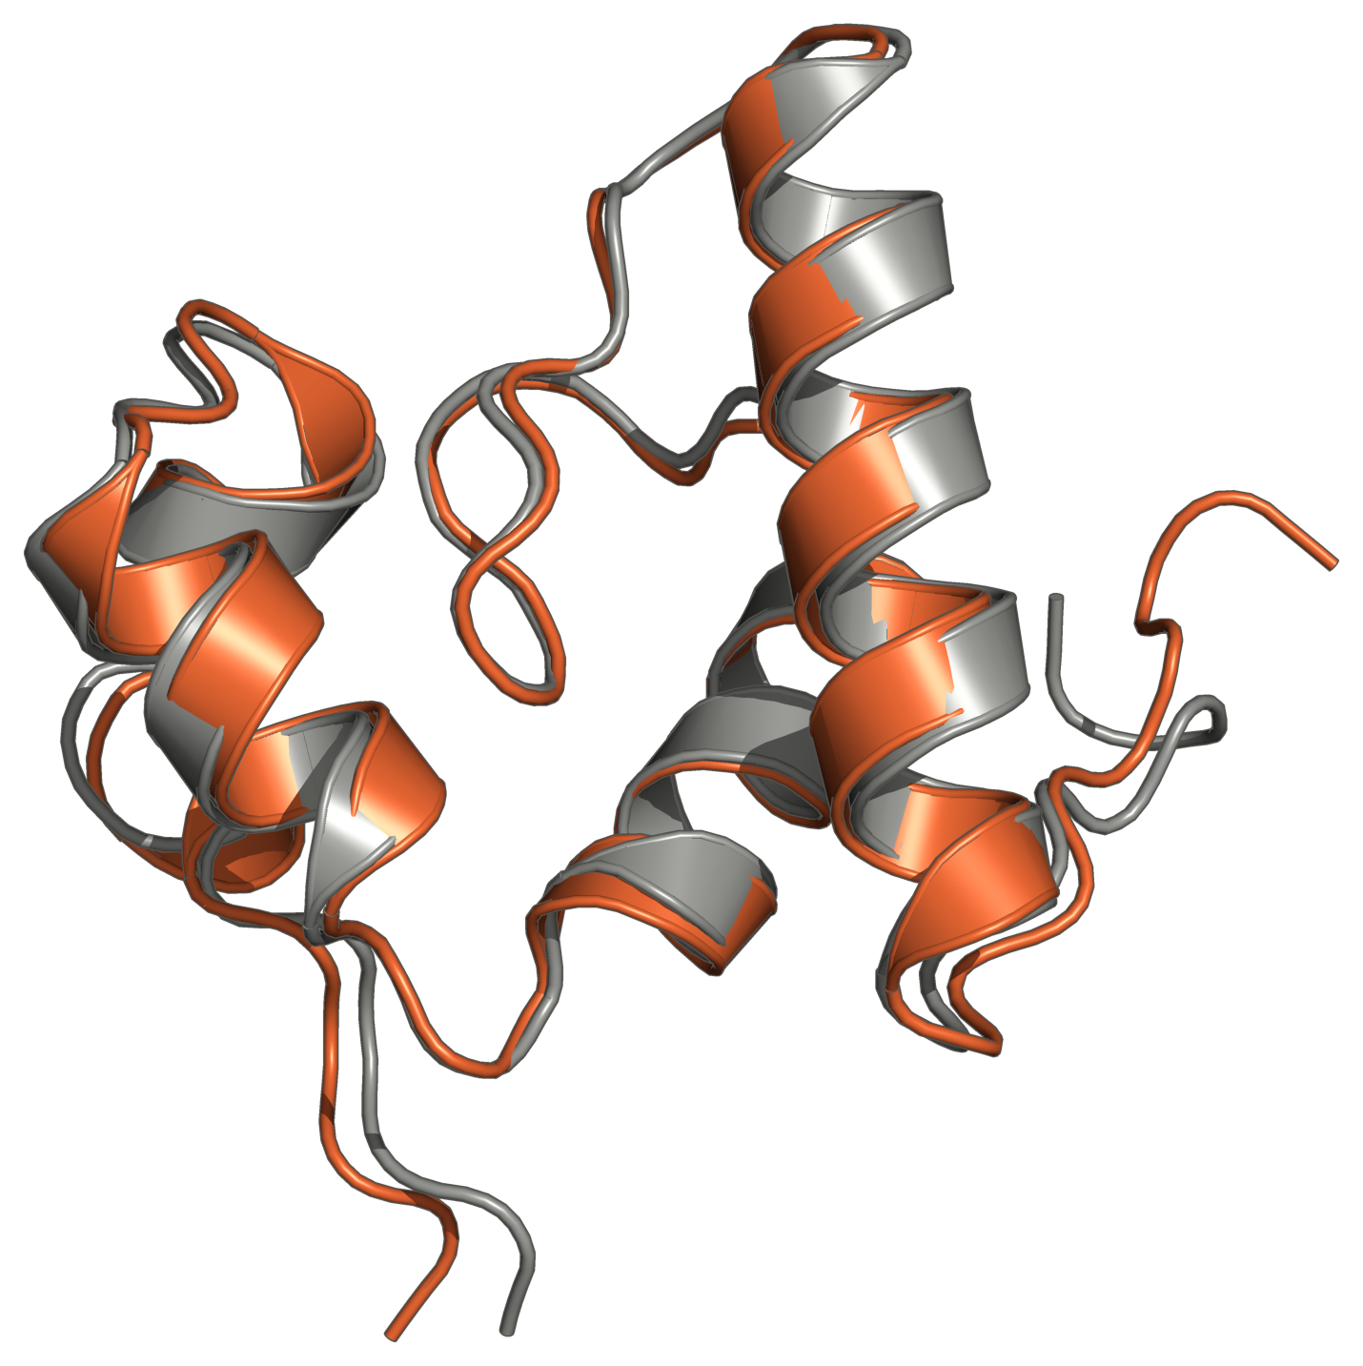
RESULTS
Where MODELLER goes wrong
experimental
MODELLER
AlphaFold3
T1124 (TBM-easy)
T1127 (TBM-hard)
T1151s2 (FM/TBM)
MODELLER · TM 0.537
MODELLER · TM 0.722
MODELLER · TM 0.524
AlphaFold3 · TM 0.940
AlphaFold3 · TM 0.973
AlphaFold3 · TM 0.916
N-terminal domain (7–135) misplaced by 38 Å
core 1.9 Å; insertion 60–104 has no template
WhiB core 1.7 Å; tail 85–111 has no template
CMP_SC 8170 · Project 2 · Template-based modeling vs AlphaFold3
6
Notes:
Grey is the experimental structure; each model is superposed with the TM-score superposition. T1124: the catalytic domain fits, the N-terminal domain is in a different place (Claude flagged this risk). T1127: the template-covered GNAT core fits; the insertion with no template does not. T1151s2: the WhiB core fits; the C-terminal tail beyond the template is placed ~35 Å away. AlphaFold3 matches the native in all three.

Slide 7
DISCUSSION
Why is AlphaFold3 so much better?
Target | EU covered | TM gap | in covered residues | in uncovered residues
T1124 | 83% | +0.40 | +0.29 | +0.11
T1127 | 79% | +0.25 | +0.08 | +0.17
T1151s2 | 65% | +0.39 | +0.11 | +0.28
Why AlphaFold3 avoids this
Learned from the whole PDB: it predicts this sequence's own structure instead of copying one relative's coordinates.
Co-evolution from deep sequence alignments: positions that mutate together are in contact, which constrains regions no template covers.
Templates are hints, not scaffolds: several are combined and adjusted to the target, so domain arrangement is not inherited from one homologue.
Result: accurate even where MODELLER had nothing (T1127 insertion 0.9 Å, T1151s2 tail 1.5 Å).
Where MODELLER loses (larger share in orange):
No template, no structure: the T1127 insertion and the T1151s2 tail exist in no template, so MODELLER guesses them (22–35 Å off).
Covered but misplaced: T1124's N-terminal domain is template-covered (27% identity) yet lands 38 Å from the native; the domain arrangement is wrong.
Copying a relative caps accuracy: covered core 3.2 Å (T1127) and 2.2 Å (T1151s2) Cα RMSD vs 0.8 / 0.7 Å for AlphaFold3 on the same residues.
CMP_SC 8170 · Project 2 · Template-based modeling vs AlphaFold3
7
Notes:
The TM-score gap is split by template coverage: each model's TM-score is recomputed over template-covered residues only (normalised by the full EU); the rest of the gap is in uncovered residues. The two parts use separate superpositions, so the split is approximate. Homologues at 30–40% identity typically differ by 1.5–2.5 Å, which caps how close a copied template can be.

Slide 8
AGENT VS BASELINE
Did the Claude agent change the outcome?
Target | Baseline (fixed rules) | Claude agent | TM (agent / baseline)
T1124 | top-ranked 5I2H:A | 1 search, 3 builds → kept 5I2H:A | 0.537 / 0.537
T1127 | top-ranked 2FE7:B | 1 search, 3 builds → kept 2FE7:B | 0.722 / 0.722
T1151s2 | top-ranked 7KUG:A | 2 searches, 3 builds → kept 7KUG:A | 0.524 / 0.524
• Same final template on all three targets → identical scores. Claude's 6 alternative builds confirmed the top-ranked choice rather than beating it.
• With a good search and ranking, the fixed rule is already strong; the agent did not improve accuracy here.
• Where the agent helped: a written, checkable rationale for every choice, and risk predictions (domain orientation, insertion, uncovered tail) that Agent 2 confirmed.
CMP_SC 8170 · Project 2 · Template-based modeling vs AlphaFold3
8
Notes:
Same tools, same leakage rules; only the decisions differ. Claude built alternatives on every target but ended up with the fixed rule's template each time. Its value was the explicit, checkable reasoning and correct risk predictions.

Slide 9
SUMMARY
Conclusions
• MODELLER is only as good as its template: accurate where the template covers (core ~2 Å), wrong where it does not.
• A profile search makes template-based modeling possible even for the FM/TBM target (T1151s2, TM 0.52).
• AlphaFold3 outperforms MODELLER on all three targets (TM +0.25 to +0.40), mostly in regions templates do not cover or place correctly.
• The Claude agent matched the fixed rule's choices and predicted each failure region: it added transparency, not accuracy.
Limitations
Three targets, one model per method: case studies, not trends.
Single-template models only.
Claude's rejected builds were not scored against the native.
CASP evaluation units only; T1151s2 scored as a monomer.
AlphaFold Server also uses PDB templates: method vs method, not template vs none.
CMP_SC 8170 · Project 2 · Template-based modeling vs AlphaFold3
9
Notes:
Limitations: three targets, one model per method; single-template models; Claude's rejected builds were not scored; scores cover the CASP evaluation units only, and T1151s2 is one chain of a complex. Reproduce: conda env create -f environment.yml; tbm run-all; tbm --baseline run-all; python scripts/make_slides.py

