Slide 1

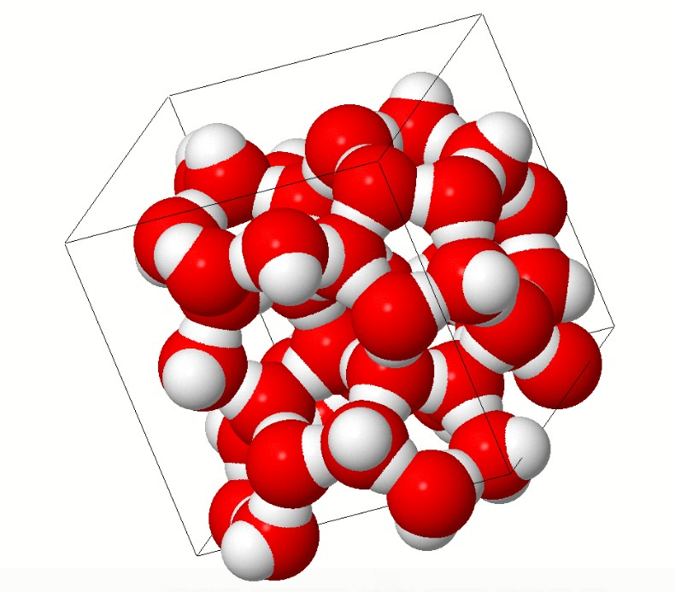
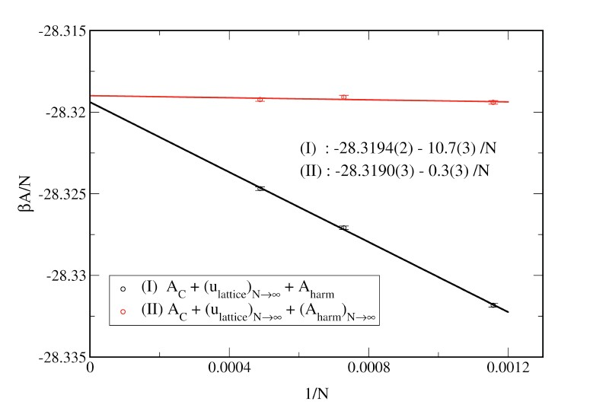
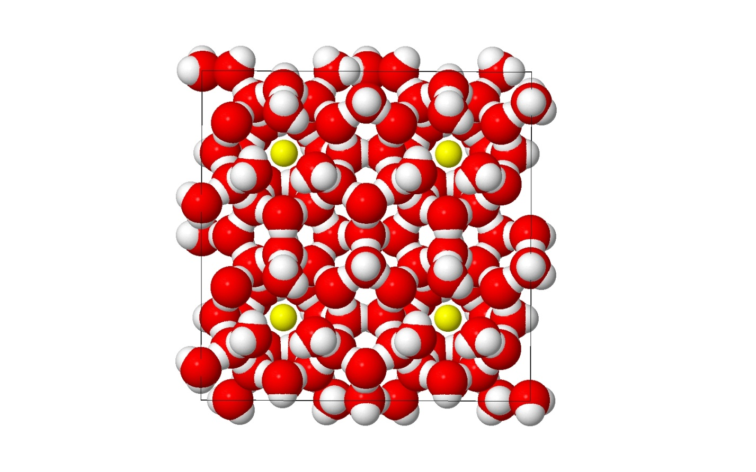
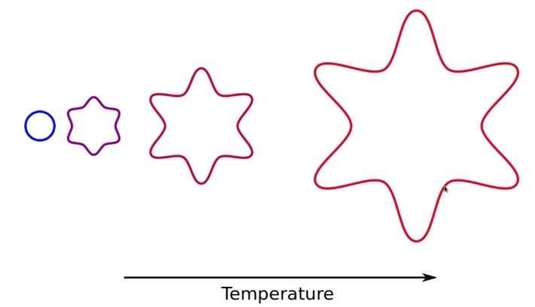
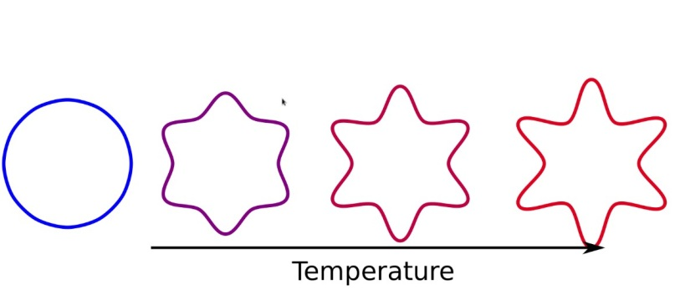
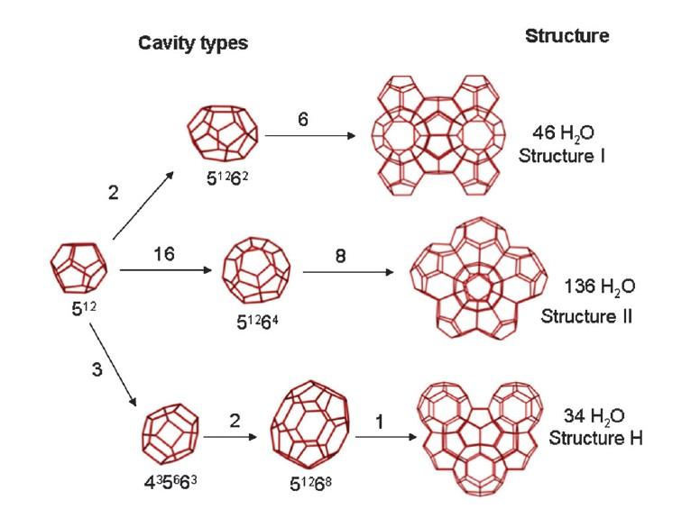
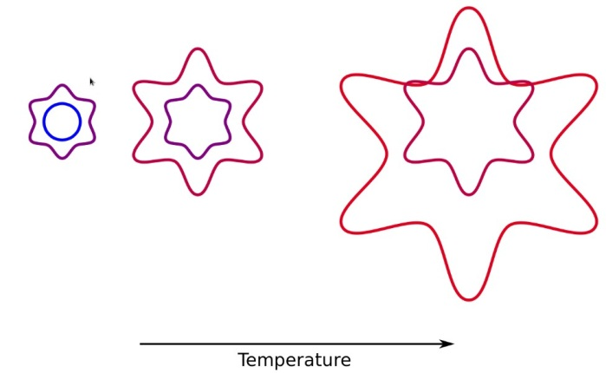
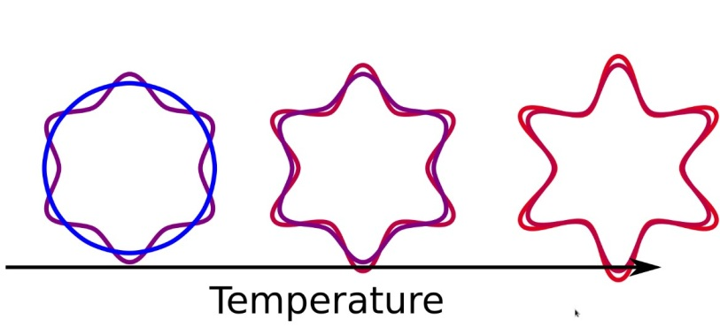
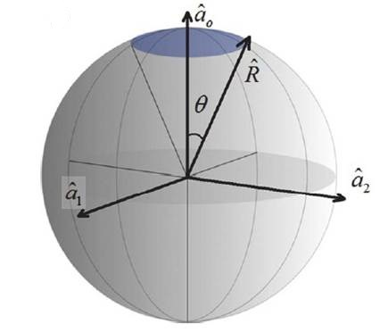
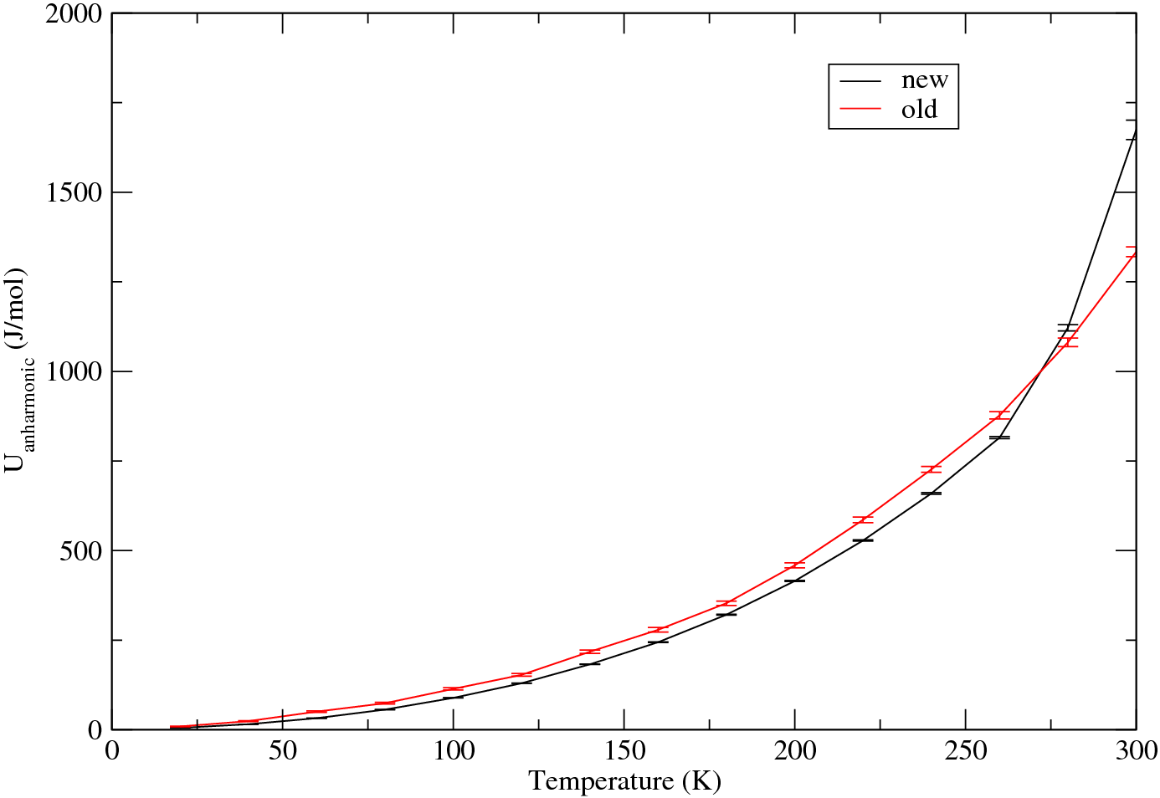
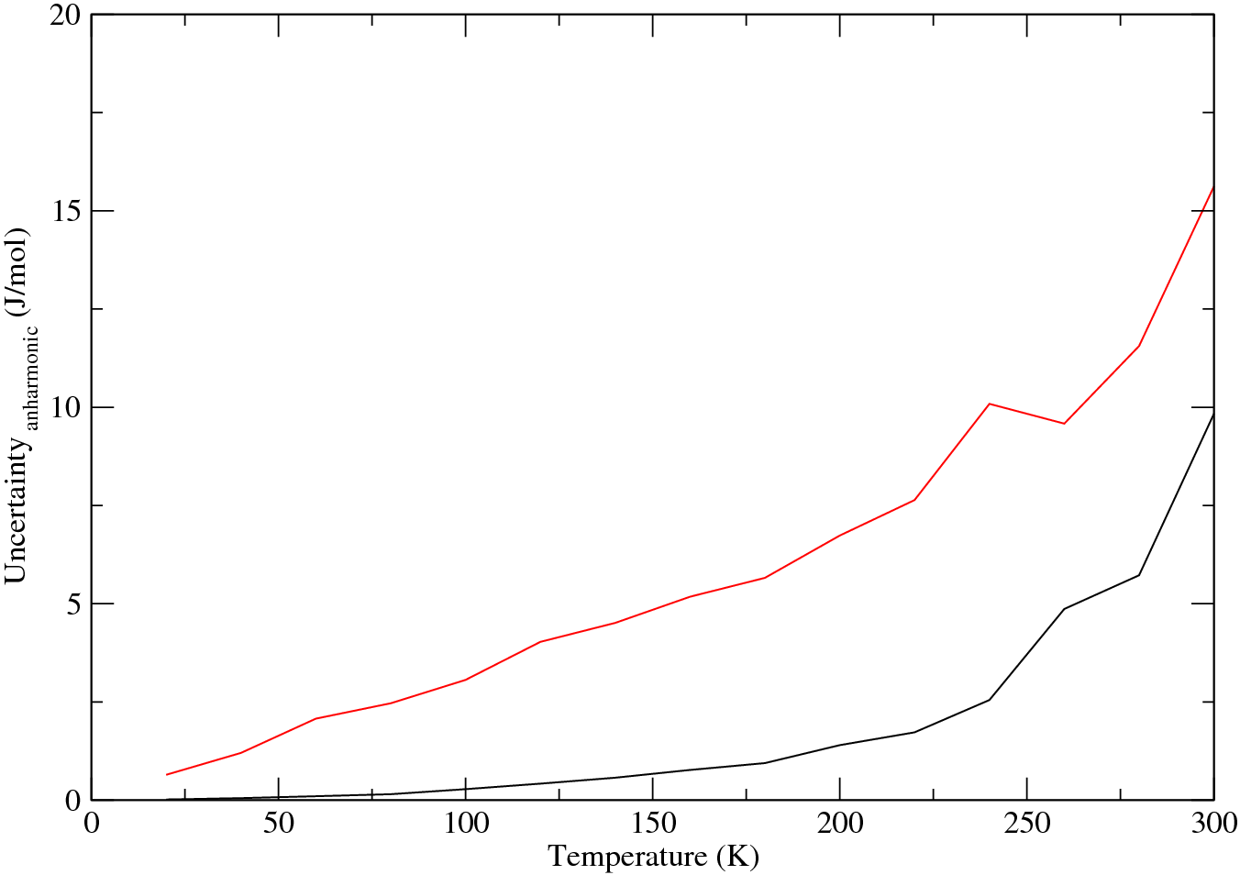
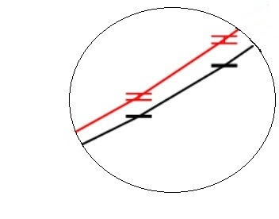

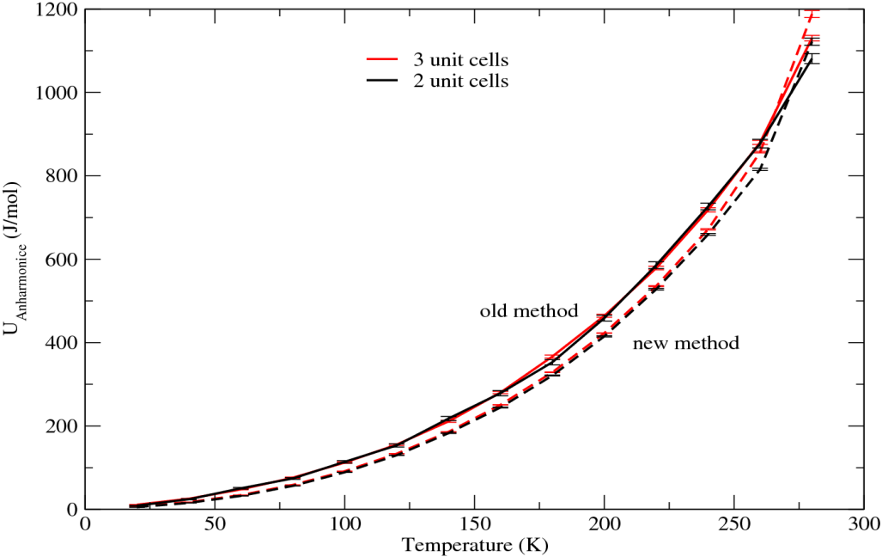
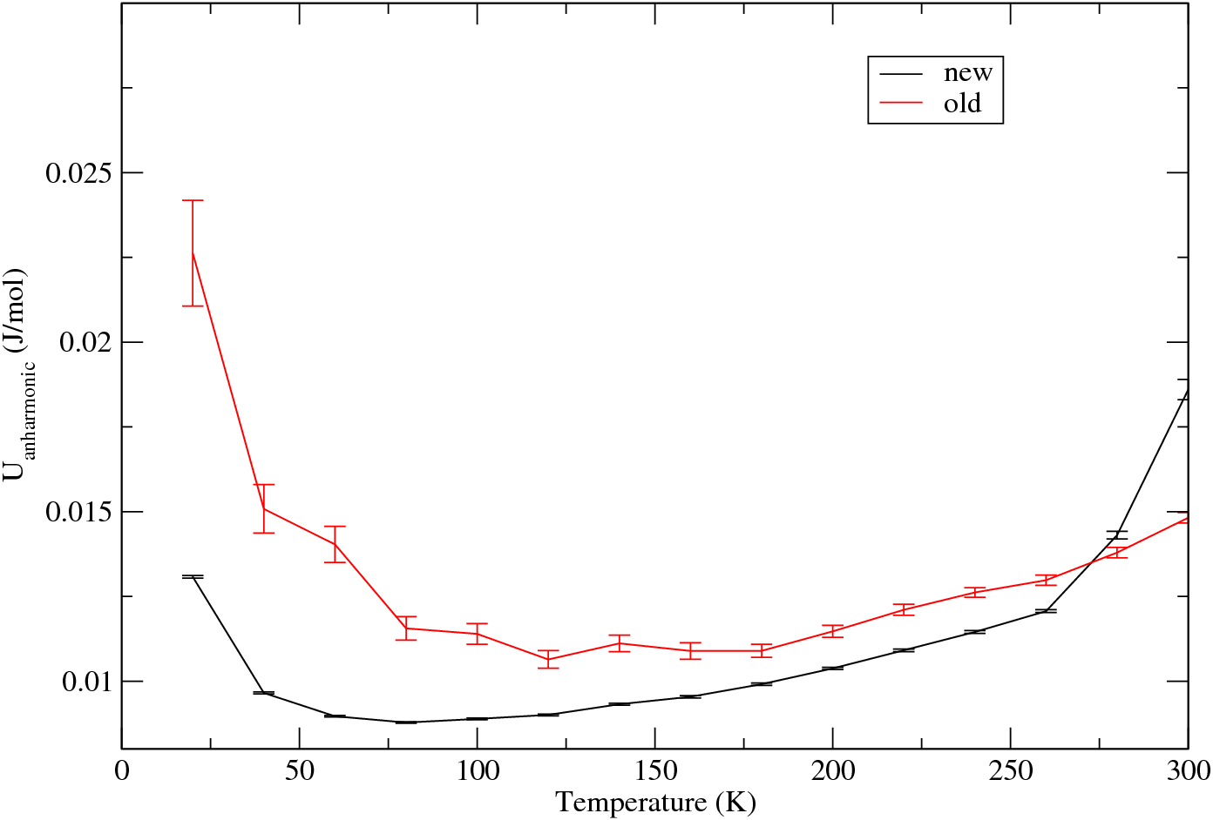
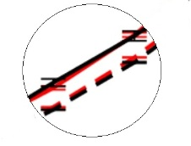
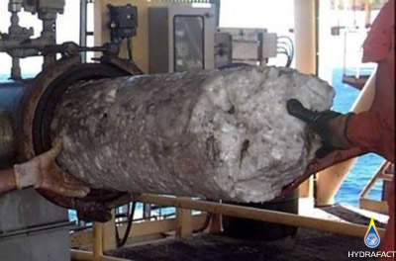
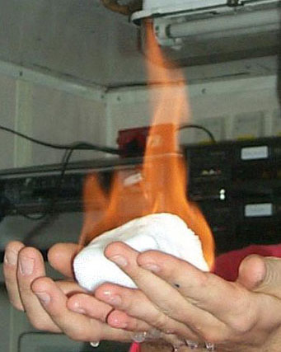


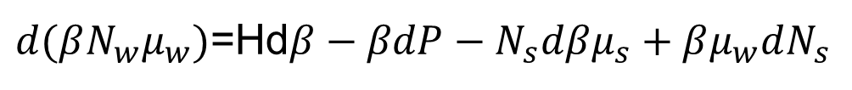

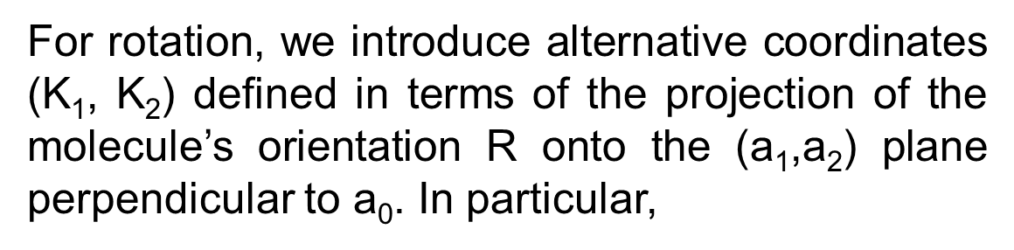


A Comprehensive Molecular-Based Study of the Stability of clathrate Hydrates
Weisong Lin , Andrew J. Schultz, David A. Kofke
Department of Chemical and Biological Engineering, University at Buffalo, The State University of New York, Buffalo, NY 14260
Introduction
Method
Advantages
Definition
Clathrate hydrates are crystalline structures that consist of water molecules forming cages via a hydrogen-bonding network enclosing small guest molecules. Such structures normally form at a condition of high pressure and low temperature.
1. Use harmonic analysis to find the free energy of clathrate hydrate with all cages vacant when temperature→ 0.
1. few system size dependence
Dependence of free-energy contributions on the size of the simulated
Tan, T. B.; Schultz, A. J.; Kofke, D. A.,. J. Chem. Phys. 2011, 135
(4), 044125.
2. Introduce harmonically targeted temperature perturbation (HTTP) method to evaluate the free energy with increasing temperature.
The basic perturbation theory working equation:
2. Much more precise than FEP theory
When temperature is 0, we could do the harmonic analysis (configuration space is circle). But when temperature get higher, system become enharmonic(not circle) and configuration space increases rapidly with temperature. If we do the scaling, difference would be smaller.
Yellow sphere represents the guest molecule and molecule with one red and two white spheres is represent the water.
2. Structure
Gas hydrates usually form three crystallographic cubic structures: structure I and structure II and Structure H. Each type are formed of two or three small cages:
For translation
For translation,
however
For rotation, we introduce alternative coordinates ($\text{Κ}$₁, Κ₂) defined in terms of the projection of the molecule’s orientation R onto the (a₁,a₂) plane perpendicular to a₀. In particular,
Temperature perturbation method. Measuring ΔβA with perturbation fails
http://rheneas/~andrew/http/HTTP.xhtml
HTTP method. Scale out the change in size we expect
http://rheneas/~andrew/http/HTTP.xhtml
where
Preliminary Result
So that
Better accuracy
Uncertainty
Former case is only for linear and for nonlinear molecules like water, we need to project the hyperspherical cap in 4-D quaternion space, which can’t be pictured. I have a question for you: As we see the projection in the 3-D is a circle then what would the projection be like in the 4-D?
The three common clathrate hydrate structures, including the constituent cavities. Nomenclature: 5¹²6⁸indicates 12 pentagonal and 8 hexagonal sides in a cavity; numbers along lines indicate the number of cavities in each unit crystal structure. The rightmost numbers indicate the water molecules per crystal structure
http://www.globalspec.com/reference/55602/203279/2-what-are-natural-gas-clathrate-hydrates
Motivation
$$or$$
Few size effect
Divided by T square
1.Solve the blockage in the oil pipelines.
The formation of clathrate hydrate becomes the main reason of blockage in the pipelines which could result in the suspension of gas and oil production.
2. Recovery of huge potential energy
The global resource of methane in gas hydrate deposits in commonly cited as 20,000 trillion m³ making gas hydrates itself contain more energy than any other forms of energies we exploit today.
$in which θ$ is half of the overall rotation angle $α (θ=α/2)$
$$similarly$$
$$where$$
After a long calculation, we have the expression of how anharmonic energy changes with temperature:
References
3. Conduct additional molecular simulations to gauge the dependence on composition and/or pressure by integration along μ_{S}
1. Tan Tai Boon, A. J. Schultz, and D. A. Kofke, 'Efficient Calculation of - and -Nitrogen Free Energies and Coexistence Conditions Via Overlap Sampling with Targeted Perturbation', Journal of Chemical Physics, 135 (2011), 044125 (13 pp.).
2. T. B. Tan, A. J. Schultz, and D. A. Kofke, 'Efficient Calculation of Temperature Dependence of Solid-Phase Free Energies by Overlap Sampling Coupled with Harmonically Targeted Perturbation', Journal of Chemical Physics, 133 (2010).
4. With the knowledge of free energy we can identify the stable crystalline form and locate the conditions where phase transitions occur.
www.radhanathswamionline.com/event
www.chem.ntnu.nononequilibrium-thermodynamicsindex522b.html
Acknowledgements
3. Clathrate hydrate also has other applications in refrigeration, desalination and transportation.
Solid-fluid secondary refrigerants have higher energy efficiency in refrigeration. Advances are reported in several aspects of clathrate hydrate desalination fundamentals necessary to develop an economical means to produce municipal quantities of potable water from seawater. Using clathrate transport gas like H₂ would be safer and more efficient by reducing pressure and increasing temperature.
$d(βN_{w}μ_{w})$=Hd$β−βdP−N_{s}dβμ_{s}+βμ_{w}dN_{s}$
Notes:
Backgroun keep the same
Advantages keep the same
Motivation could be shorter
Method could have more equations (see sabry’s poster )
Move more things in the last group meeting shows
I think it won’t be so difficult
Results: shows more pics

