Slide 1



Laboratory 2:
Inertial Navigation and PDR
Dr. Weisong Wen, Assistant Professor
Trustworthy AI and Autonomous Systems Laboratory (TAS Lab)
The Hong Kong Polytechnic University Nov. 3, 2025
1 / 10

Slide 2




Objective
Core Learning Goals
Gain hands-on experience with IMU-based pedestrian positioning
Learn smartphone sensor data collection techniques
Implement Pedestrian Dead-Reckoning (PDR) algorithms
Master adaptive step detection for robust navigation
Understand parameter tuning effects on positioning accuracy
Key Focus Areas
Step-based navigation principles
Dynamic threshold adaptation
Sensor fusion for heading estimation
Real-world positioning challenges
Goal: Accurate trajectory estimation
using smartphone IMU data
2 / 10

Slide 3





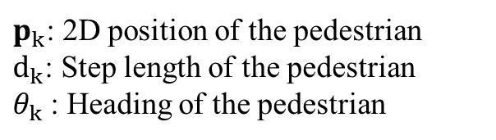








Pedestrian Dead-Reckoning: Fundamentals & Challenges
What is PDR?
Step-based navigation technique
Estimates position by tracking:
Step detection: when steps occur
Step length: distance per step
Heading: direction of movement
Uses IMU sensors:
Accelerometer: Motion detection
Gyroscope: Orientation tracking
Key Advantages
More robust than continuous integration
Discrete event-driven approach
Better suited for low-quality mobile sensors
No infrastructure requirements
N
$$θ_{3}$$
$$d_{3}$$
$$θ_{4}$$
E
$$d_{2}$$
$$p_{2}$$
$$p_{3}$$
$$d_{4}$$
N
$$θ_{2}$$
$$d_{1}$$
$$p_{4}$$
$$θ_{1}$$
$$p_{1}$$
E
$p_{k}$: 2D position of the pedestrian
$d_{k}$: Step length of the pedestrian
$θ_{k}$: Heading of the pedestrian
3 / 10

Slide 4
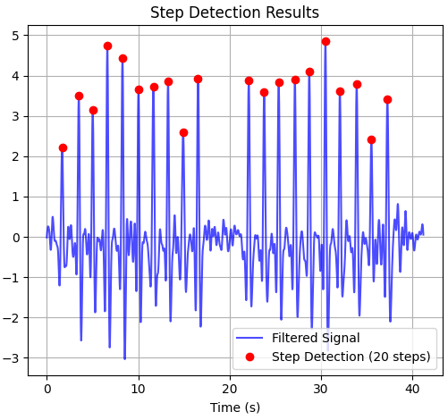
Adaptive Step Detection Algorithm
Mathematical Framework
Signal Processing:
Band-pass filtering (0.5-3Hz human gait range)
Vertical acceleration extraction: a_{z}(t)
Dynamic Threshold Calculation:
threshold(i) = σ(window_{i}) × 0.5
Step Detection Criteria:
a_{filtered}[i] > threshold(i)
a_{filtered}[i] > min peak height
Local maximum condition
Minimum time interval constraint
Adaptive Features:
Dynamic thresholding based on local variance
Robust to different walking styles
Handles varying phone orientations
Filters false positives/negatives
4 / 10

Slide 5


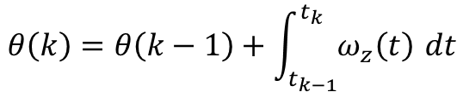

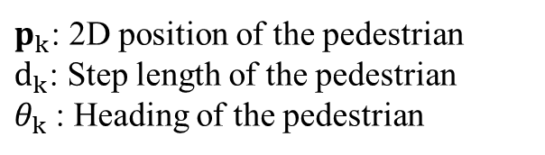
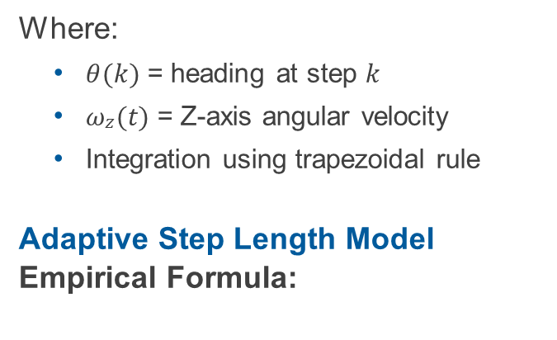





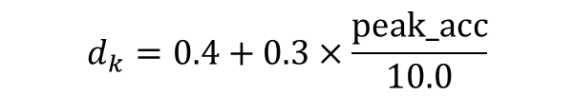


Heading & Step Length Estimation
Heading Estimation from Gyroscope Trajectory Calculation
Integration Method:
$$θ\left(k\right)=θ\left(k−1\right)+\int_{t_{k−1}}^{t_{k}}{ω_{z}\left(t\right)} dt$$
$$θ_{3}$$
Where:
$θ(k)$ = heading at step $k$
$ωz(t)$ = Z-axis angular velocity
Integration using trapezoidal rule
Adaptive Step Length Model
Empirical Formula:
$$d_{2}$$
$$p_{2}$$
N
$$θ_{2}$$
$$d_{1}$$
$$θ_{1}$$
$$p_{1}$$
E
$$p_{0}$$
$$p_{k}=p_{k−1}+d_{k}\left[\cos{θ_{k}},\sin{θ_{k}}\right]$$
$p_{k}$: 2D position of the pedestrian
$d_{k}$: Step length of the pedestrian
$θ_{k}$: Heading of the pedestrian
$$d_{k}=0.4+0.3×\frac{\text{peak}\text{_}\text{acc}}{10.0}$$
Constraints:
$$d_{k}∈\left[0.3,1.2\right] \text{meters}$$
5 / 10

Slide 6
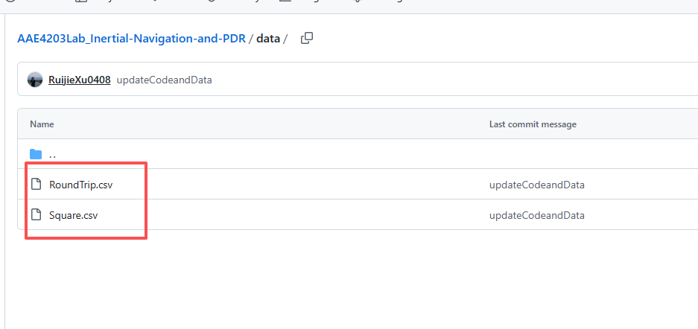
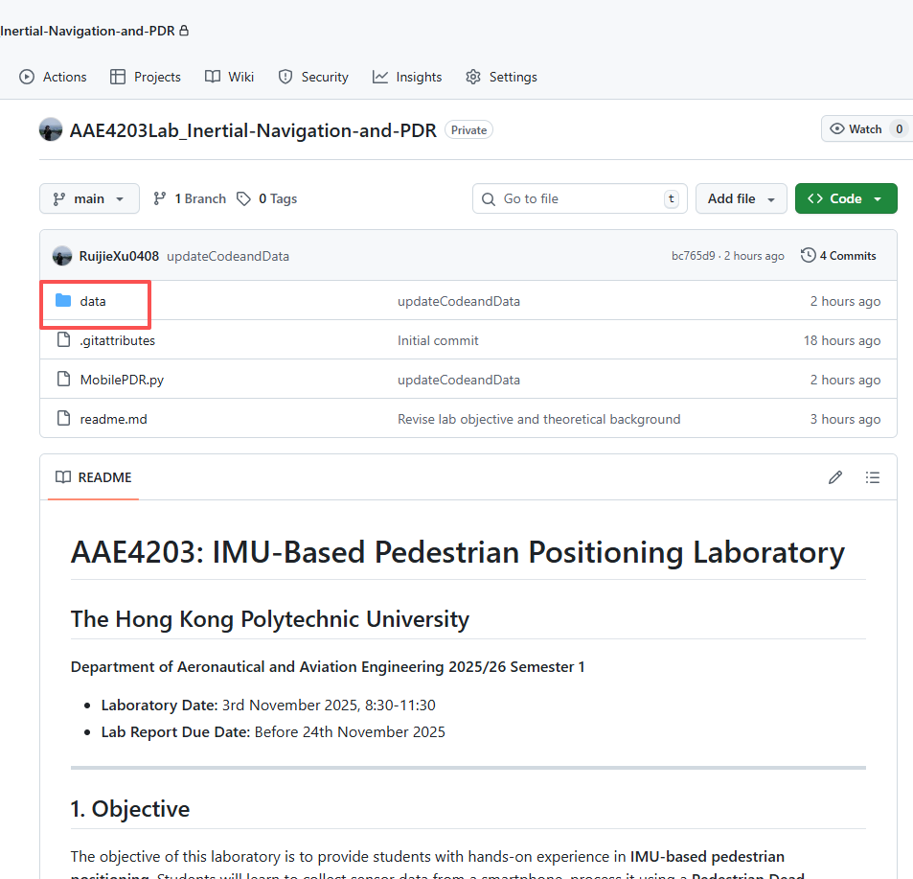
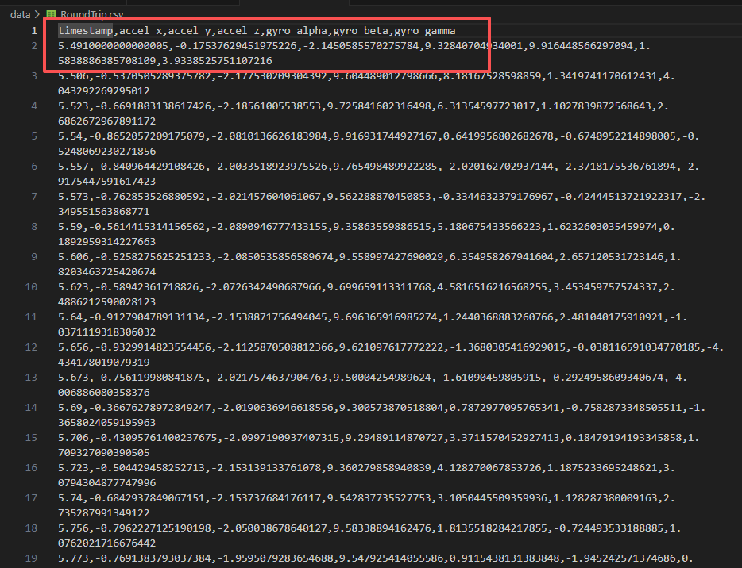
Laboratory Procedure: Data Collection & Setup
Chosen 1: Demo data from lab repository
Choose one of it
6 / 10

Slide 7
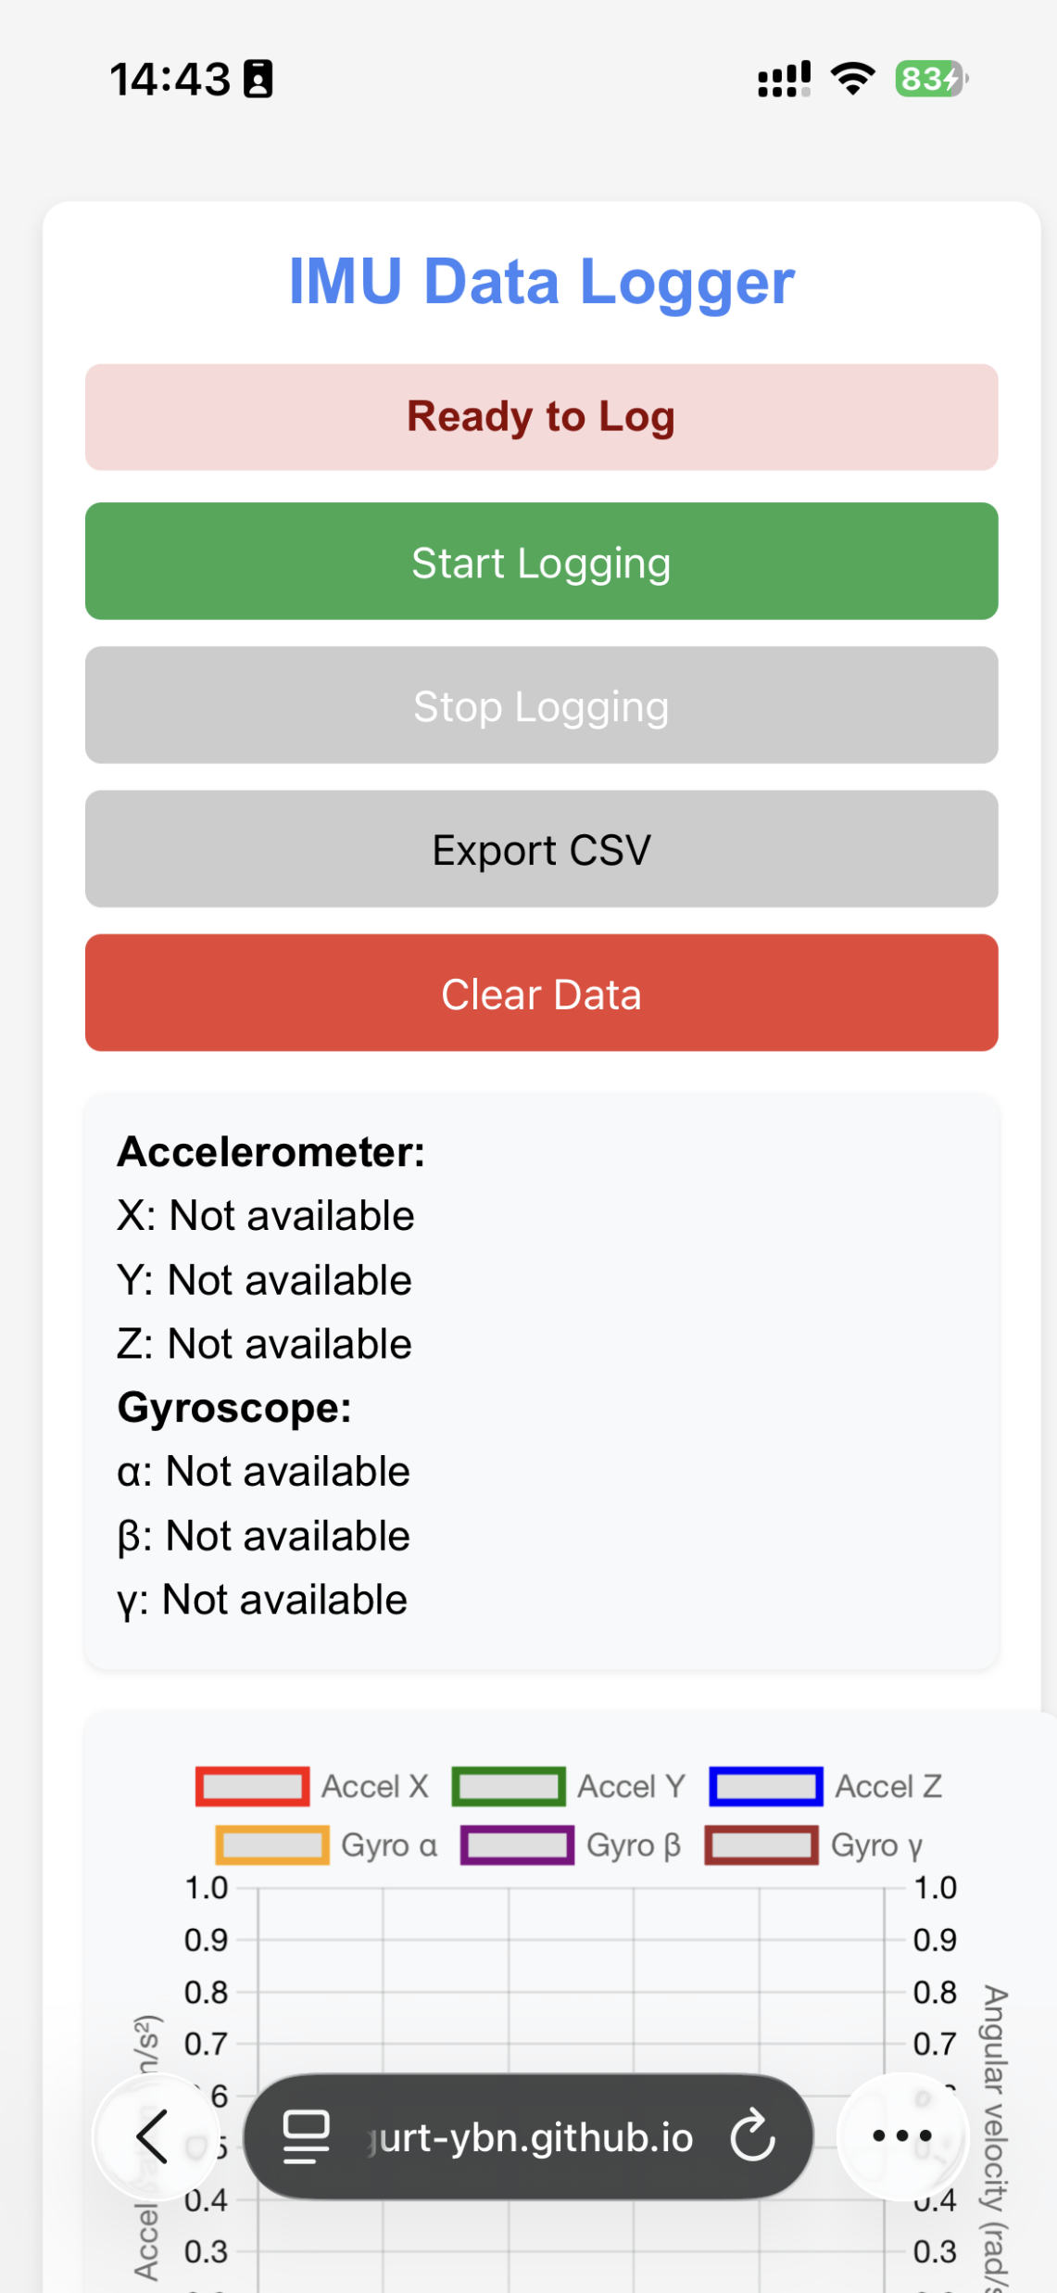
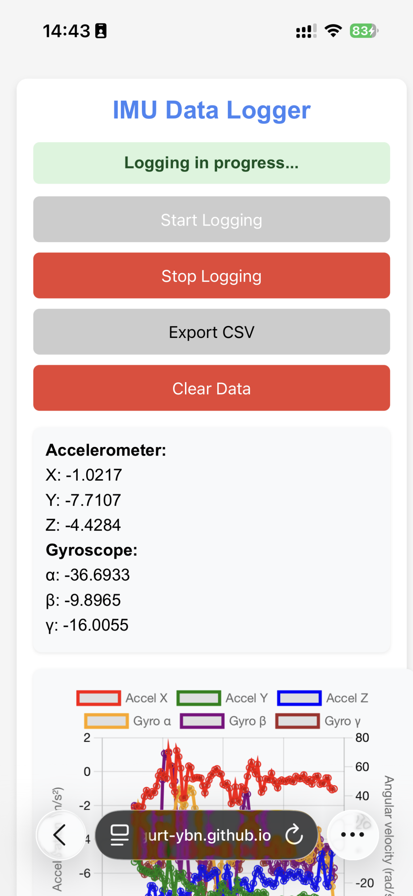
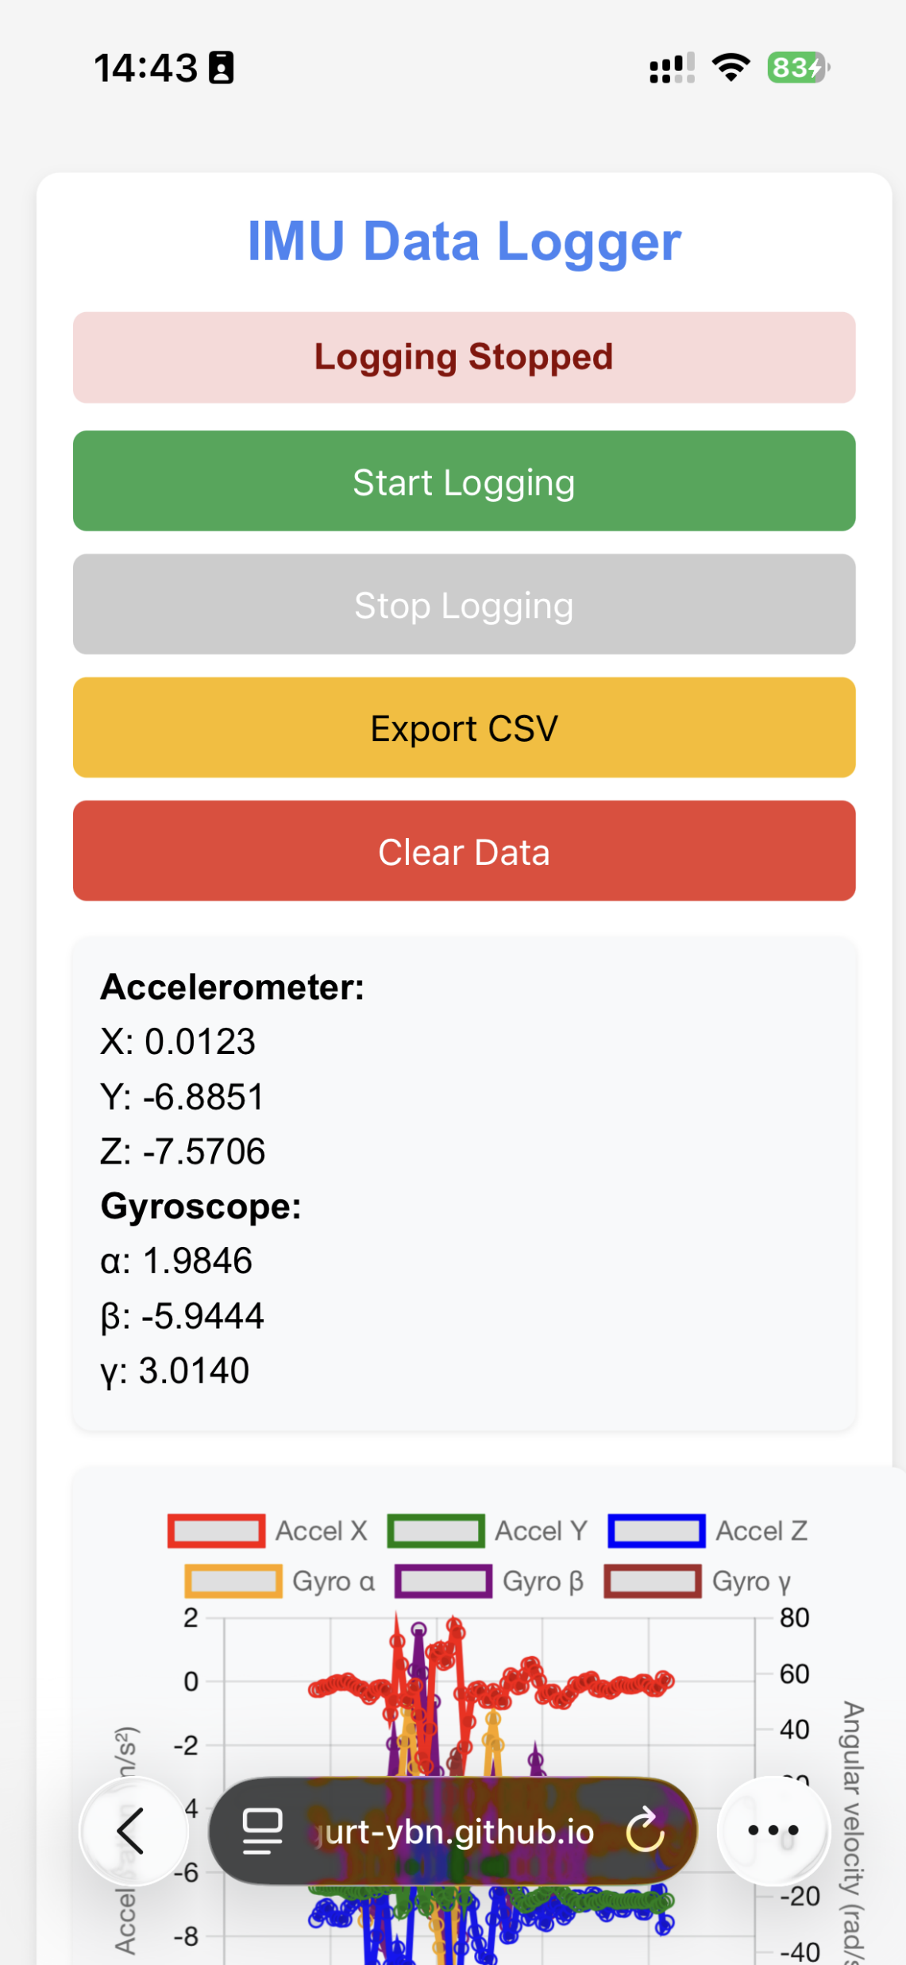
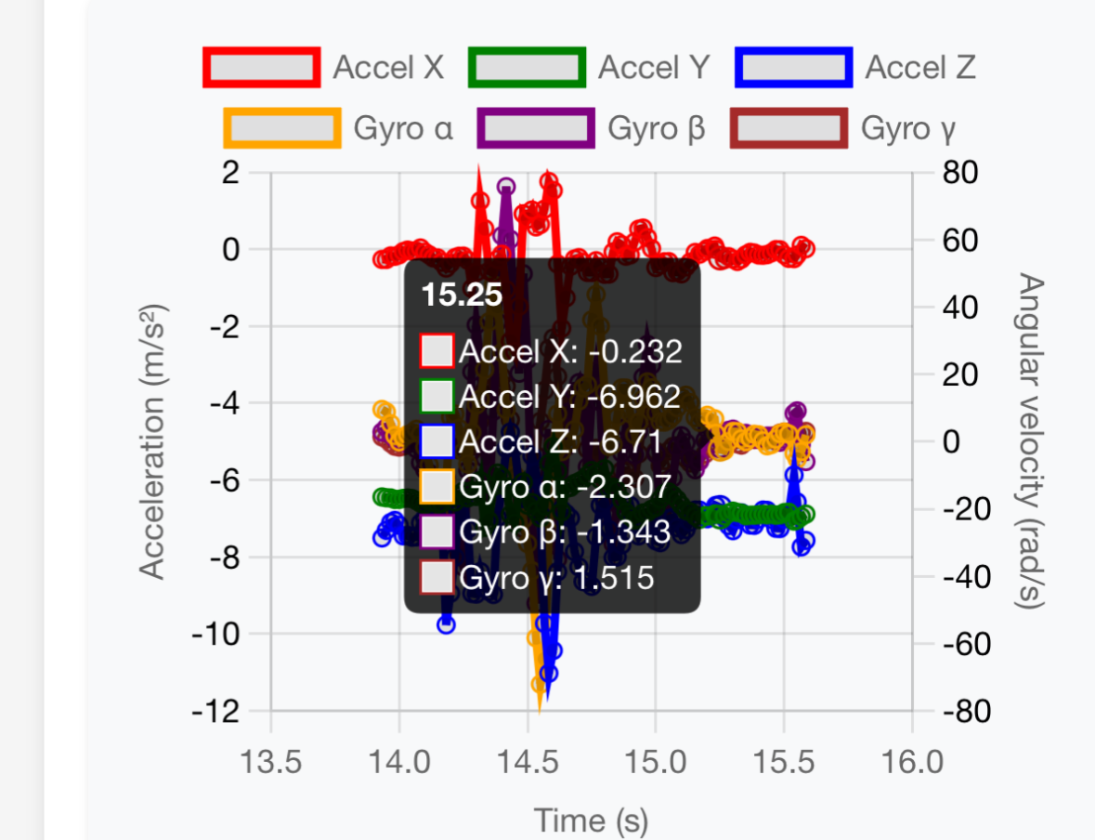
Laboratory Procedure: Data Collection & Setup
Chosen 2: Collect data on your own through HTML
4. Export the data to your laptop
3. Click to stop when finishing
Chosen 1: demo data
• Design simple, repeatable paths: — 5×5 meters square
— 10m straight line (return to start) — L-shaped or rectangular patterns
Consider ground truth measurement (Simple method: just return to the starting point or linear interpolation
Plan for consistent phone holding
Step 2: Data Collection
Use provided HTML IMU collection tool
Maintain consistent phone orientation
Record at stable sampling rate
Export as CSV with format
1. Click to start
2. Collect the data and view it
7 / 10

Slide 8
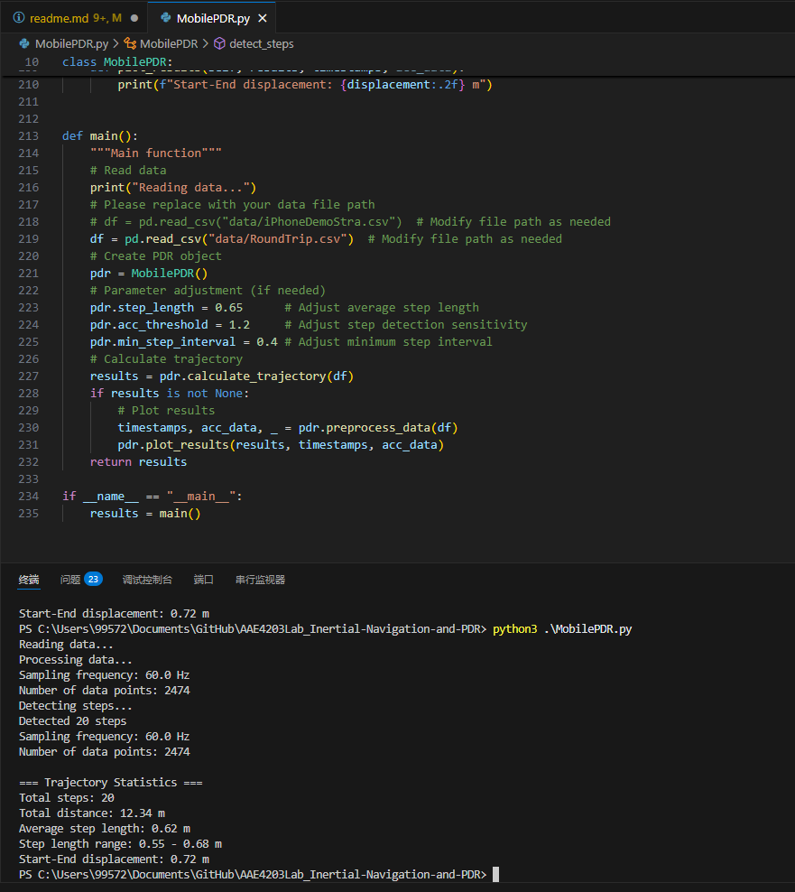
Parameter Tuning & Performance Optimization
Key Tunable Parameters
Step Detection Sensitivity:
1. Replace it by your own data path
1
2
3
pdr. acc_threshold = 1.2
# Peak detection threshold
pdr. min_step_interval = 0.4
# Min time between steps
Step Length Parameters:
pdr. step_length = 0.65
# Average step baseline
min_peak_height = 1.0
# Absolute minimum threshold
1
2
3
Signal Processing:
1
2. Run the python code
window_size = int (0.5 * fs)
3. View the results and plot
# Dynamic threshold window
8 / 10

Slide 9
Thinking Question:
Research Question
Does the orientation of the smart-phone during data collection affect PDR algorithm performance? Why or why not?
How does heading estimation affect the performance of the PDR algorithm? What methods can be used to improve the accuracy of heading estimation?
9 / 10

Slide 10
Q&A
Thank you for your attention
Let’s Q&A!
Dr. Weisong Wen, Assistant Professor
Trustworthy AI and Autonomous Systems Laboratory (TAS Lab)
The Hong Kong Polytechnic University Nov. 3, 2025
10 / 10

