Slide 1
5280 Running

Slide 2
Purpose
Show all 5k, 10k, and half marathons within the Denver, CO area.
Users who create an account will be able to post ads for running buddies for a specific race.

Slide 3



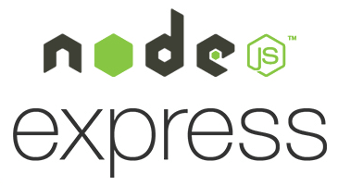


Coding requirements
API – Active API
Frontend – Angular5 / Material
Backend – NodeJS / Express
Login – Passport JS
Host – Google Cloud Platform
NoSql DB – MongoDB / Atlas

