Slide 1
rLP-Treated LD Subiculum Analysis
1/13/25

Slide 2
Experiment Details
3x Tg APOE4 mice injected with {dose} of rLP (reconstructed lipoprotein particles) at 12 mo, analyzed after 24 hrs for amyloid, lipid droplet clearance

Slide 3
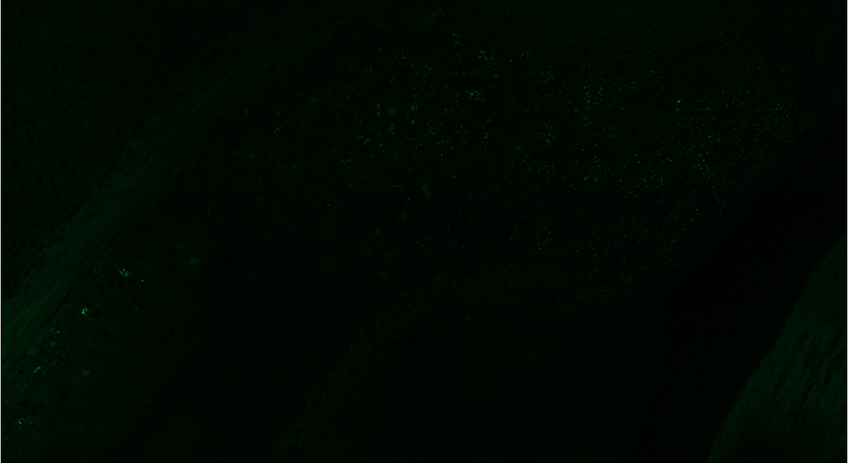
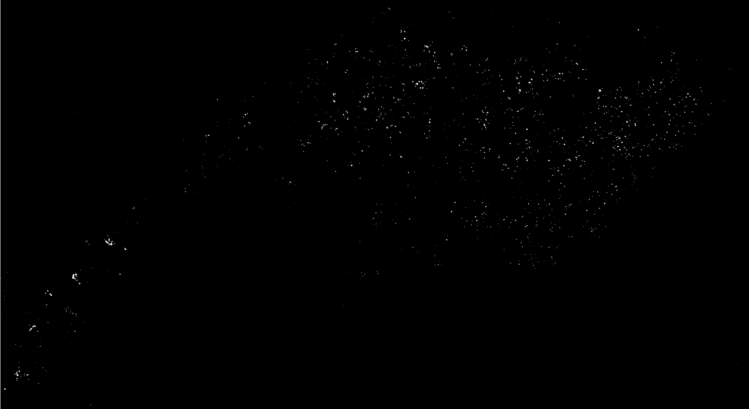
2024-11-12_ICinject241010_rLP10l_sliceB2__F_mouse 3_SBC_20Xtile_350-Hoechst_488-BODIPY_647-D54D2

Slide 4
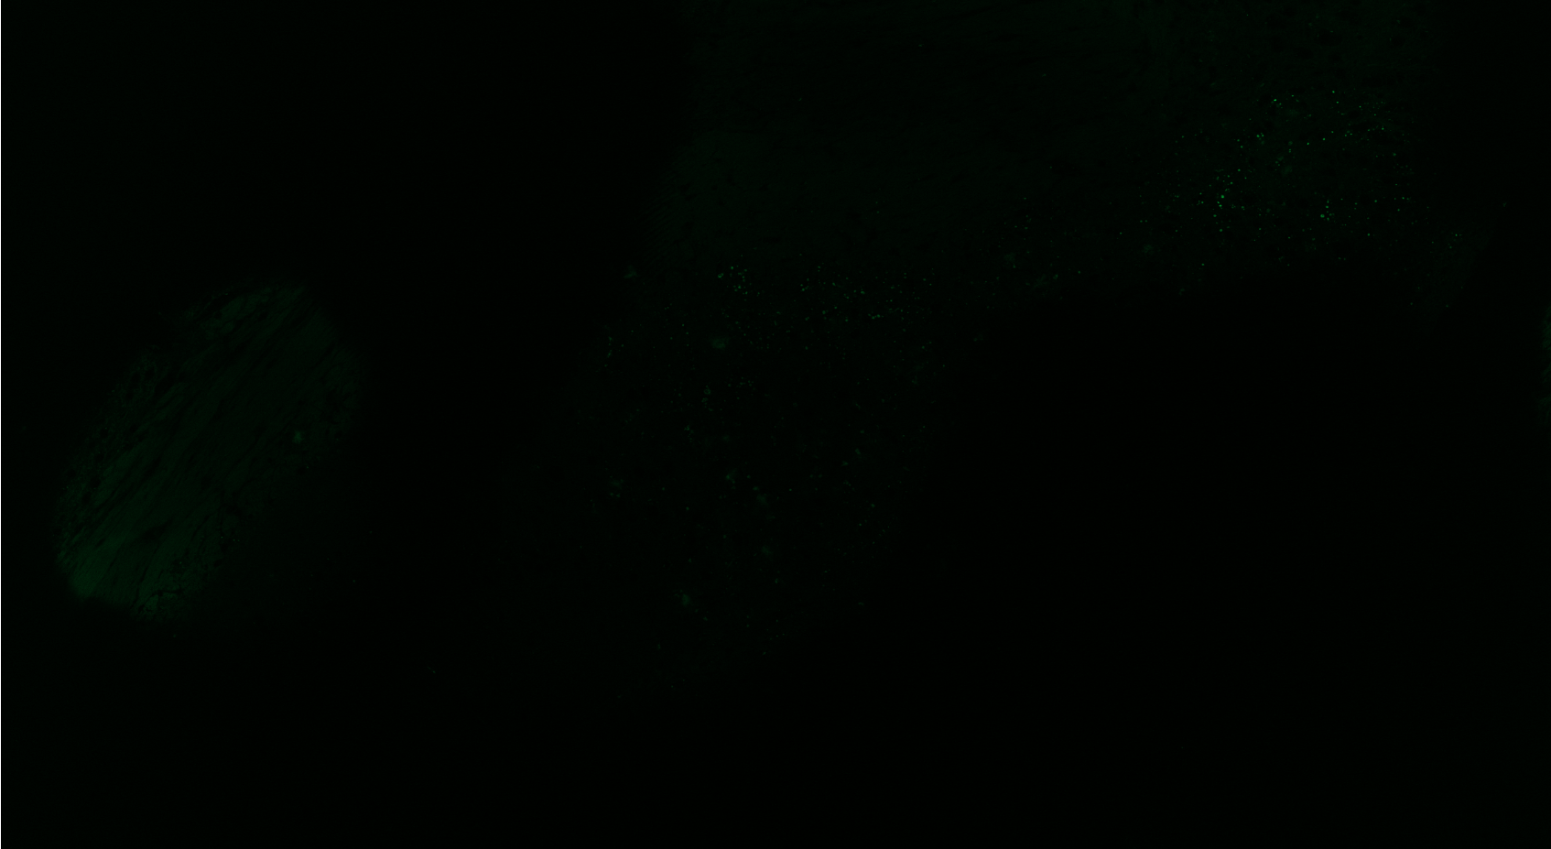
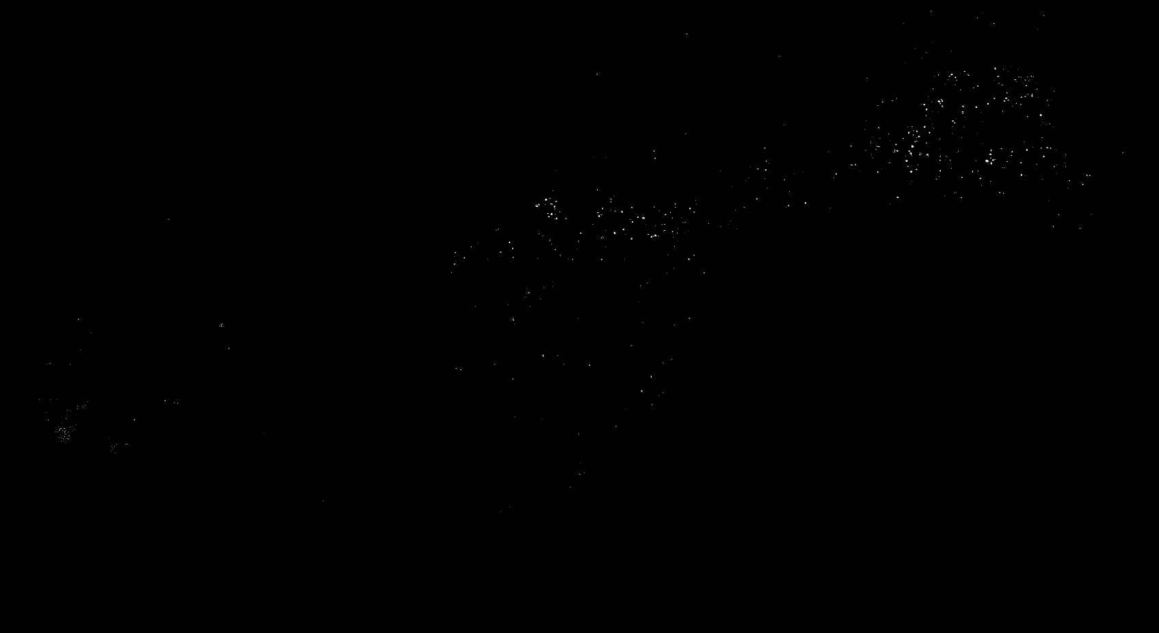
2024-11-12_ICinject241010_rLP10l_sliceB2__M_mouse 2_SBC_20Xtile_350-Hoechst_488-BODIPY_647-D54D2

Slide 5
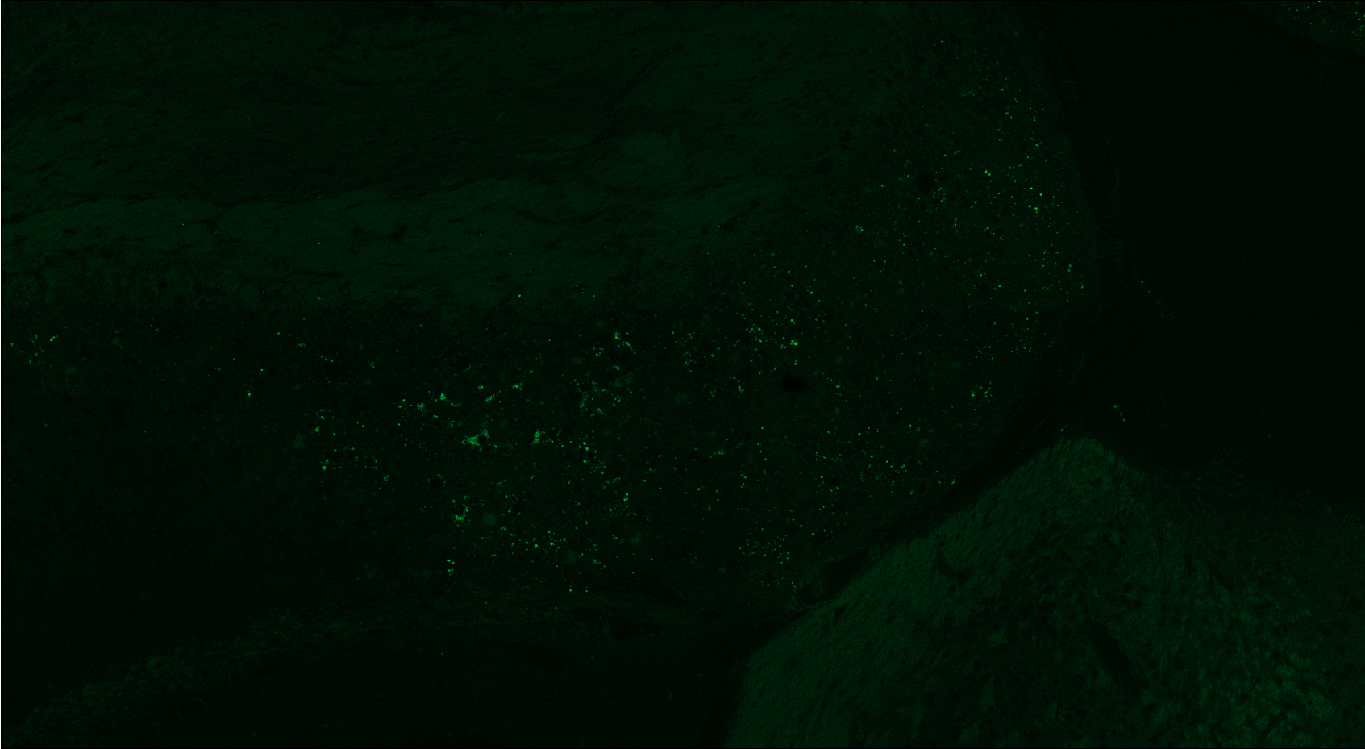
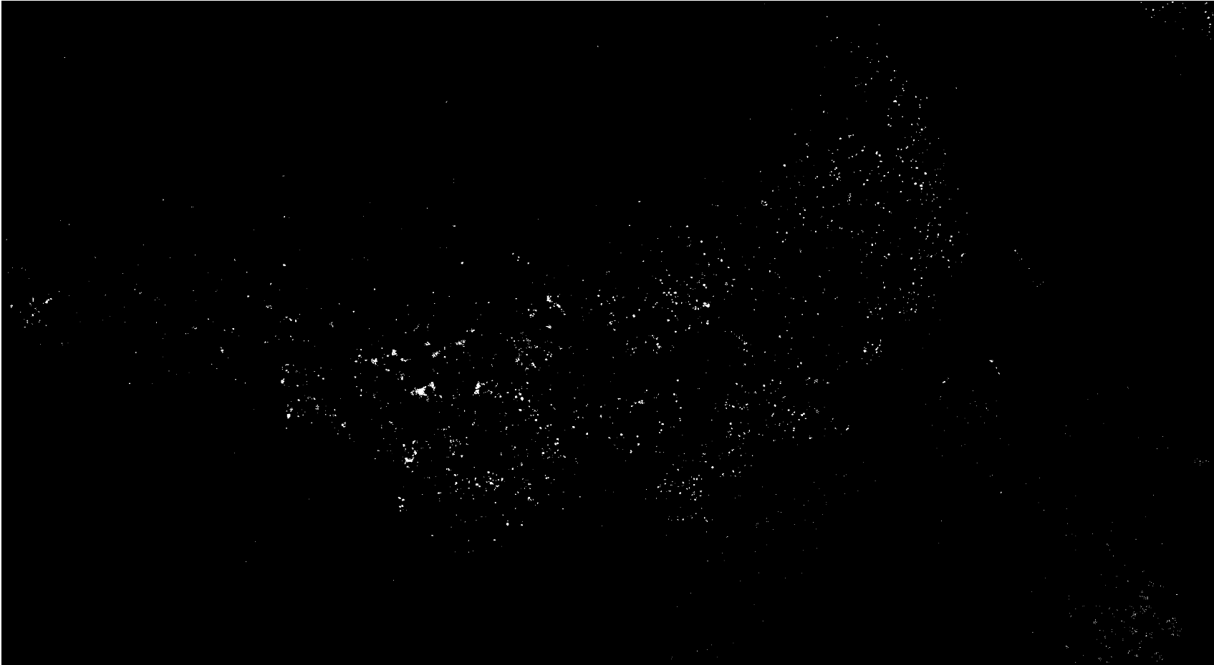
2024-11-15_ICinject240912_saline_F_mouse1_SBC_20Xtile_350-Hoechst_488-BODIPY_647-D54D2

Slide 6
2024-11-22_ICinject241010_saline_slice3BR__M_mouse 1_SBC_20Xtile_350-Hoechst_488-BODIPY_647-D54D2

