Slide 2
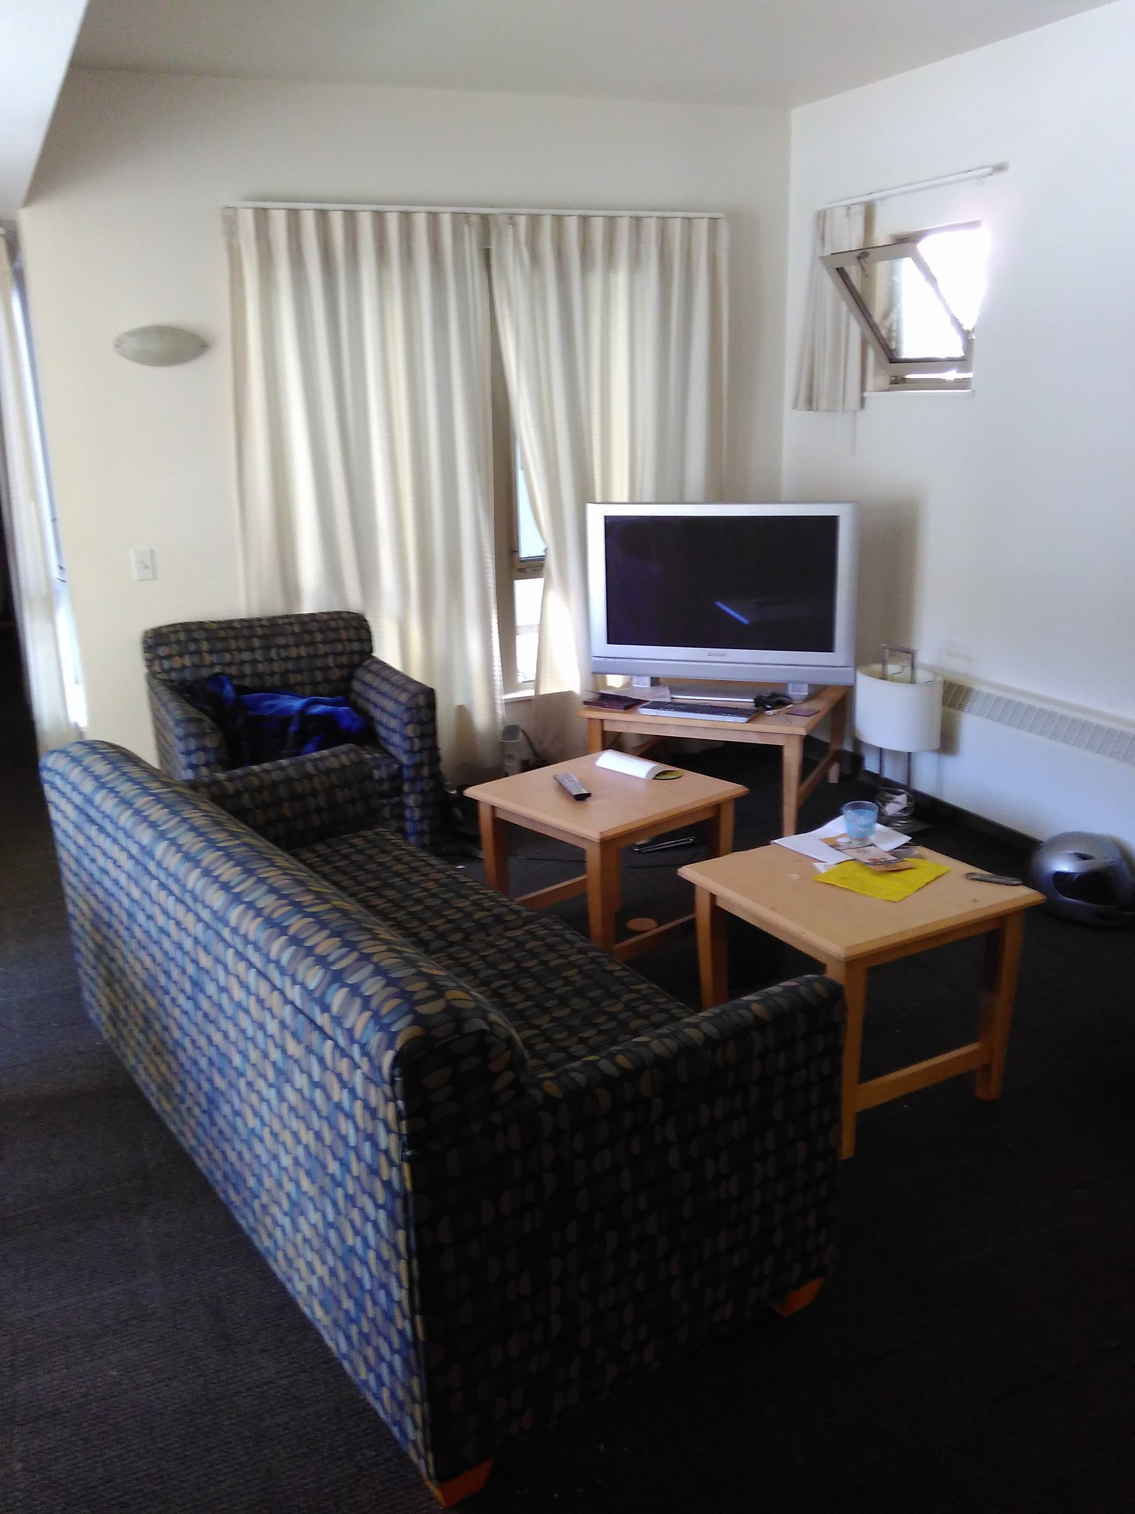
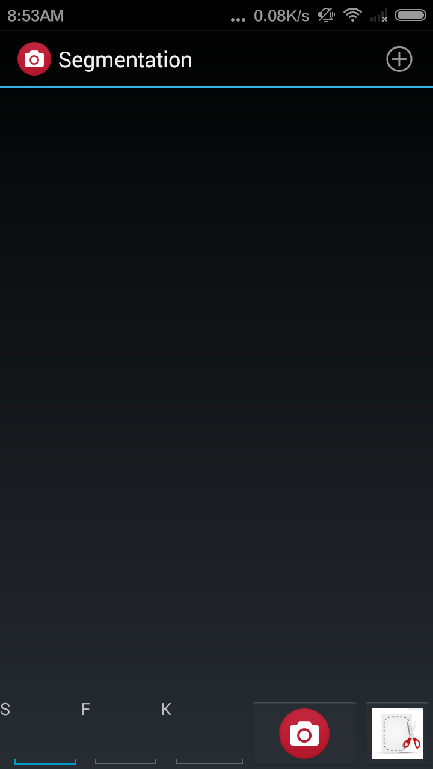
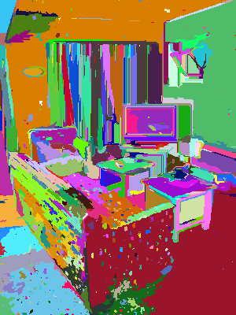
Android application – snap shot
Save picture
Parameters of Gaussian filter
Segmentation
Parameter of segmentation

