Slide 1
Efficient Graph-Based Image Segmentation
Weiting Lin, Tianchen Jin, and Steven Munn
ECE 278
Winter 2015
Graph-Based Segmentation

Slide 2
Content
Method Overview
Core Implementation in C/C++
Matlab Mex wrapper
Java Implementation (Android)
C/C++ Implementation
Conclusion
ECE 278
Winter 2015
Graph-Based Segmentation

Slide 3
Method Overview
Build graph with edge weight proportional to pixel “difference”
Perform graph cut (merge pixels)
MInt(C1, C2) = min(Int(C1) + τ (C1), Int(C2) + τ (C2))
Visualize results
ECE 278
Winter 2015
Graph-Based Segmentation

Slide 4
C/C++ implementation
Our method imposes a minimum component size right at the beginning, unlike their method which imposes it as post processing. Essentially, we merge more than they do, the segmentation is less noisy and looks better.
ECE 278
Winter 2015
Graph-Based Segmentation

Slide 5

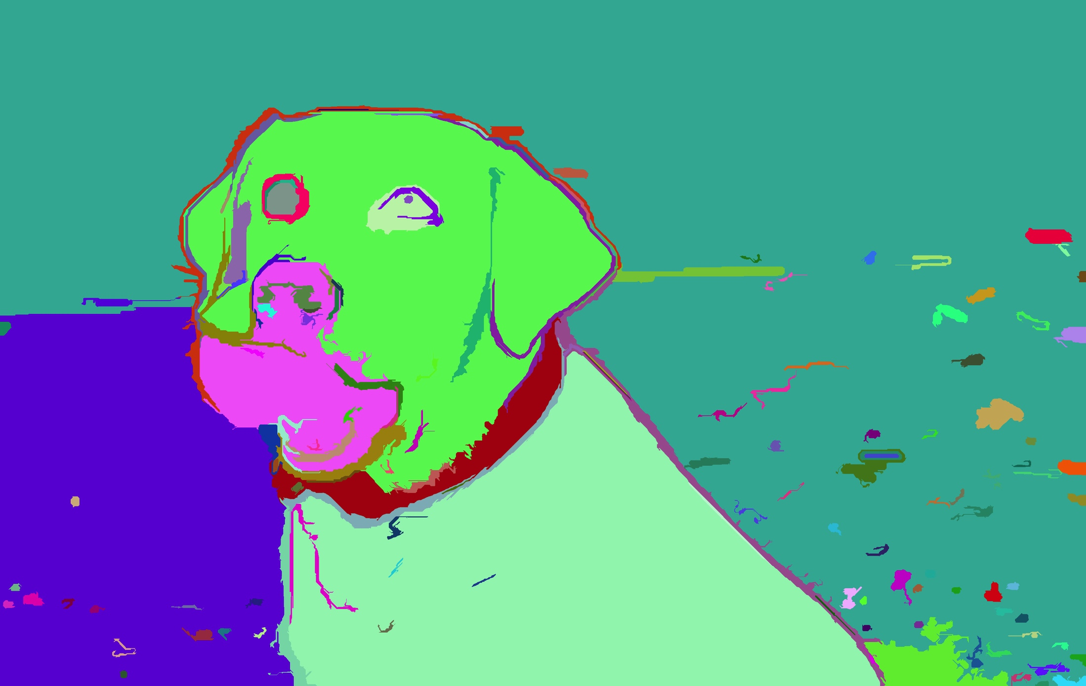

Mex results
Original dog
Their Result
Our Result
ECE 278
Winter 2015
Graph-Based Segmentation

Slide 6
Android Implementation
Hardware limitations, especially regarding memory require us to down sample the original input image.
Interface and some function rewritten in Java, but the core code is still in C/C++.
Need about 5 seconds to segment the image on an average $100 phone.
ECE 278
Winter 2015
Graph-Based Segmentation

Slide 7

Multidimensional graph construct
Original Lena
x,y,Y,Cr,Cb space Lena
ECE 278
Winter 2015
Graph-Based Segmentation

Slide 8


Multidimensional graph construct
x,y,H,S,V space Lena
x,y,L,A,B space Lena
ECE 278
Winter 2015
Graph-Based Segmentation

Slide 9
MultiDim. Implementation
Distance between pixels is measured by L2 distance in 5-D space.
Exact k-nearest neighbor for every pixel runs too slowly (~30 minutes for 512x512 image).
Approximate k-nearest neighbor runs in 2 or 3 minutes for image of the same size.
ECE 278
Winter 2015
Graph-Based Segmentation

Slide 10
Performance
MATLAB scripts
ECE 278
Winter 2015
Graph-Based Segmentation

Slide 11
References
David I Shuman, Sunil K. Narang, Pascal Frossard, Antonio Ortega, and Pierre Vandergheynst. IEEE Signal Processing Magazine. May 2013. The Emerging Field of Signal Processing on Graphs. http://ieeexplore.ieee.org/stamp/stamp.jsp?arnumber=6494675
Pengfei Lui, Xiaohan Wang, Yuantao Gu. IEEE International Conference on Acoustic, Speech and Signal Processing. 2014. Coarsening Graph Signal with Spectral Invariance
Jianbo Shi and Jitendra Malik. IEEE TRANSACTIONS ON PATTERN ANALYSIS AND MACHINE INTELLIGENCE. Aug 2000. Normalized Cuts and Image Segmentation
Ha Q. Nguyen and Minh N. Do. IEEE Transactions on Signal Processing. Jan 2015. Downsampling of Signals on Graphs Via Maximum Spanning Trees
ECE 278
Winter 2015
Graph-Based Segmentation

