Slide 1
Efficient Graph-Based Image Segmentation
Weiting Lin, Tianchen Jin, and Steven Munn
ECE 278
Winter 2015
Graph-Based Segmentation

Slide 2
Contents
Method Overview
Core Implementation in C/C++
Matlab Mex wrapper
Android Implementation
C/C++ Implementation
Best segmentation (Multi-Dim. Graph Construction)
Fastest segmentation (Performance Optimization)
Conclusion
ECE 278
Winter 2015
Graph-Based Segmentation

Slide 3
Method Overview
Build graph with edge weight proportional to pixel “difference”
Perform graph cut (merge pixels)
MInt(C1, C2) = min(Int(C1) + τ (C1), Int(C2) + τ (C2))
Visualize results
ECE 278
Winter 2015
Graph-Based Segmentation

Slide 4
Core implementation
Core segmentation code written in C++.
Aimed for best performance in both speed and segmentation result.
Our method imposes a minimum component size right at the beginning, unlike their method which imposes it as post processing. Essentially, we merge more than they do, the segmentation is less noisy and looks better.
ECE 278
Winter 2015
Graph-Based Segmentation

Slide 5
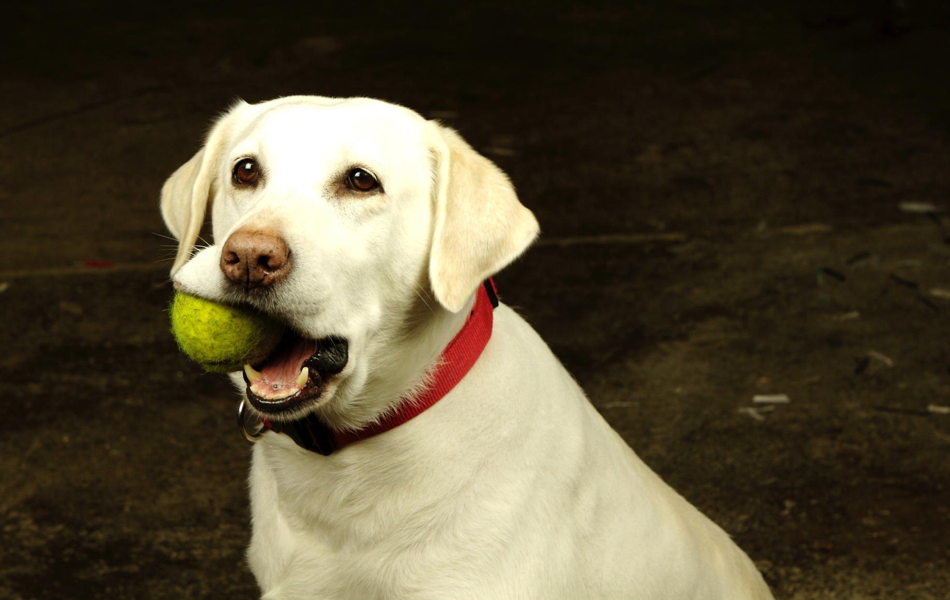
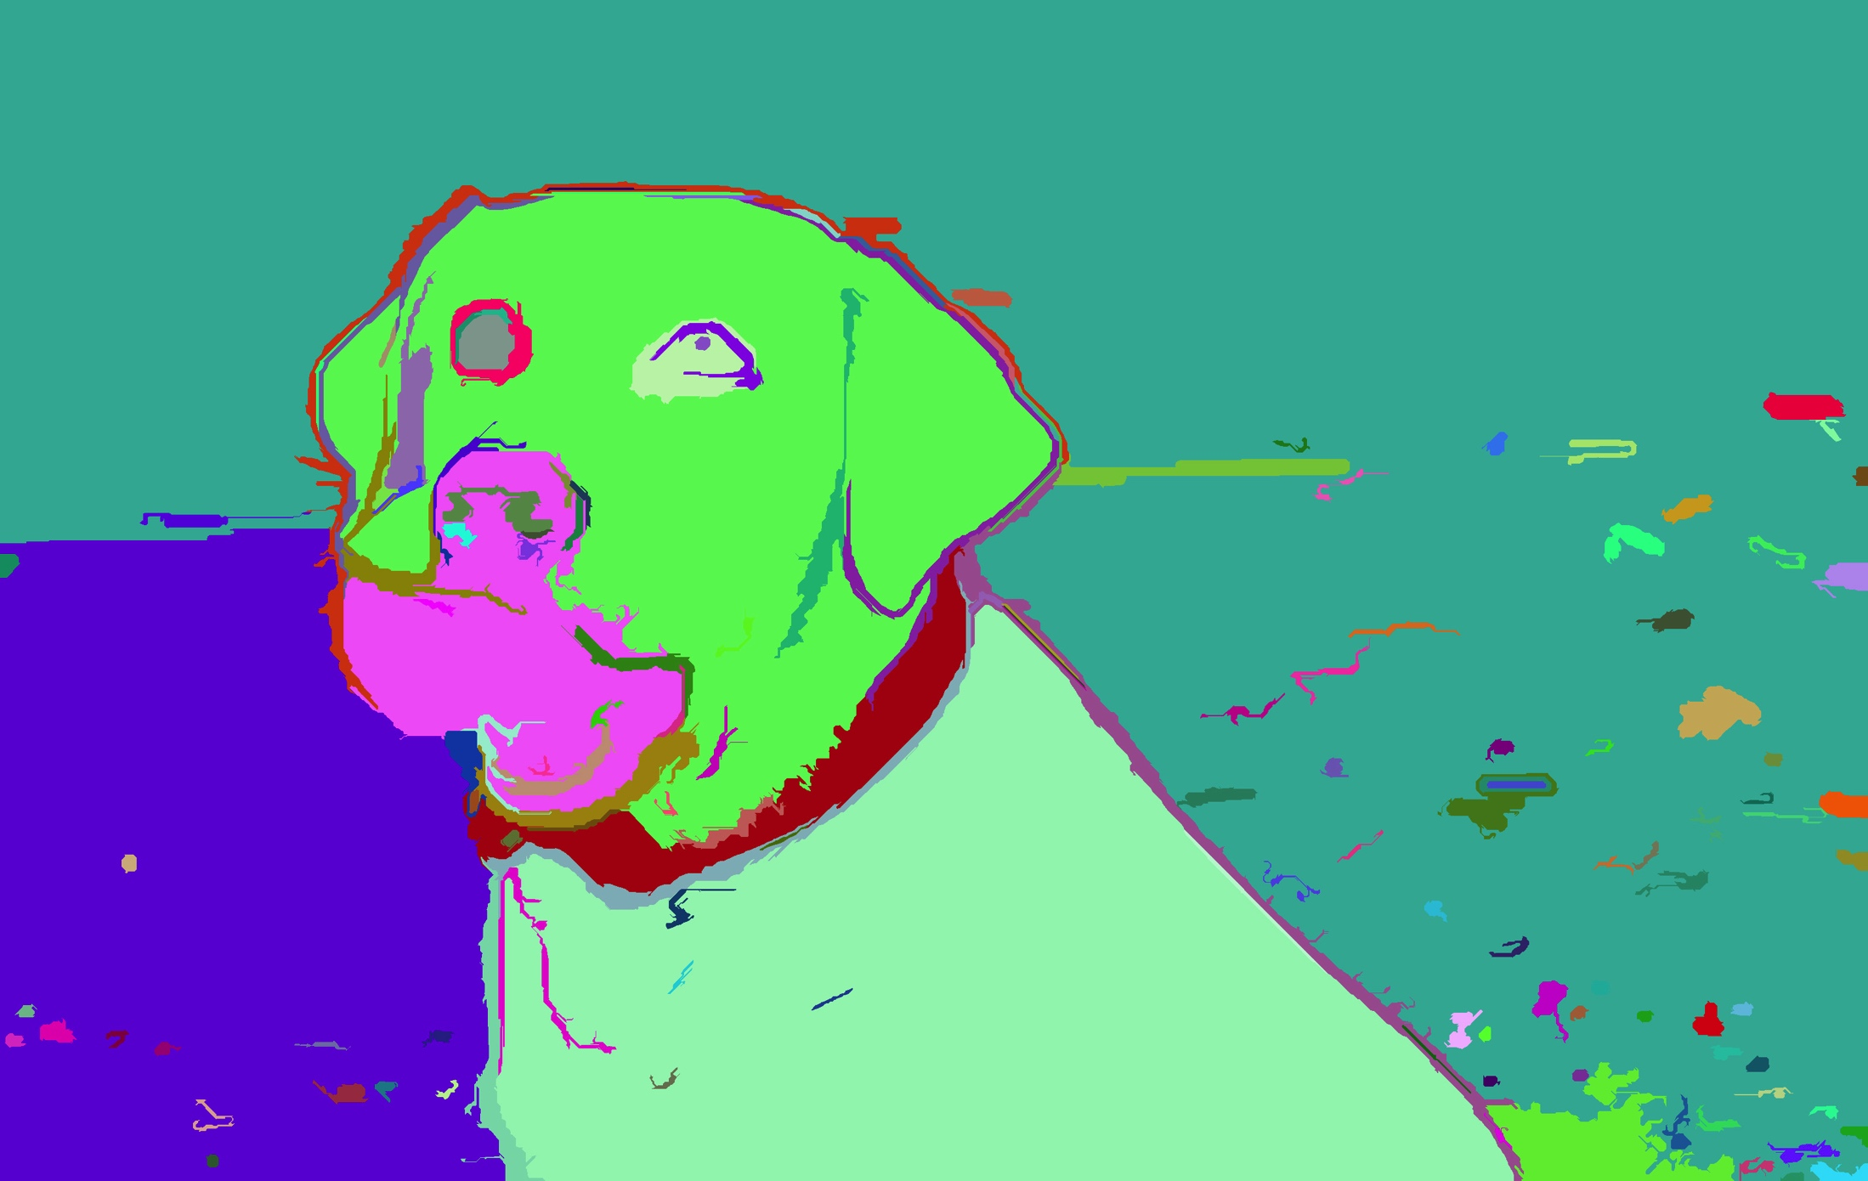
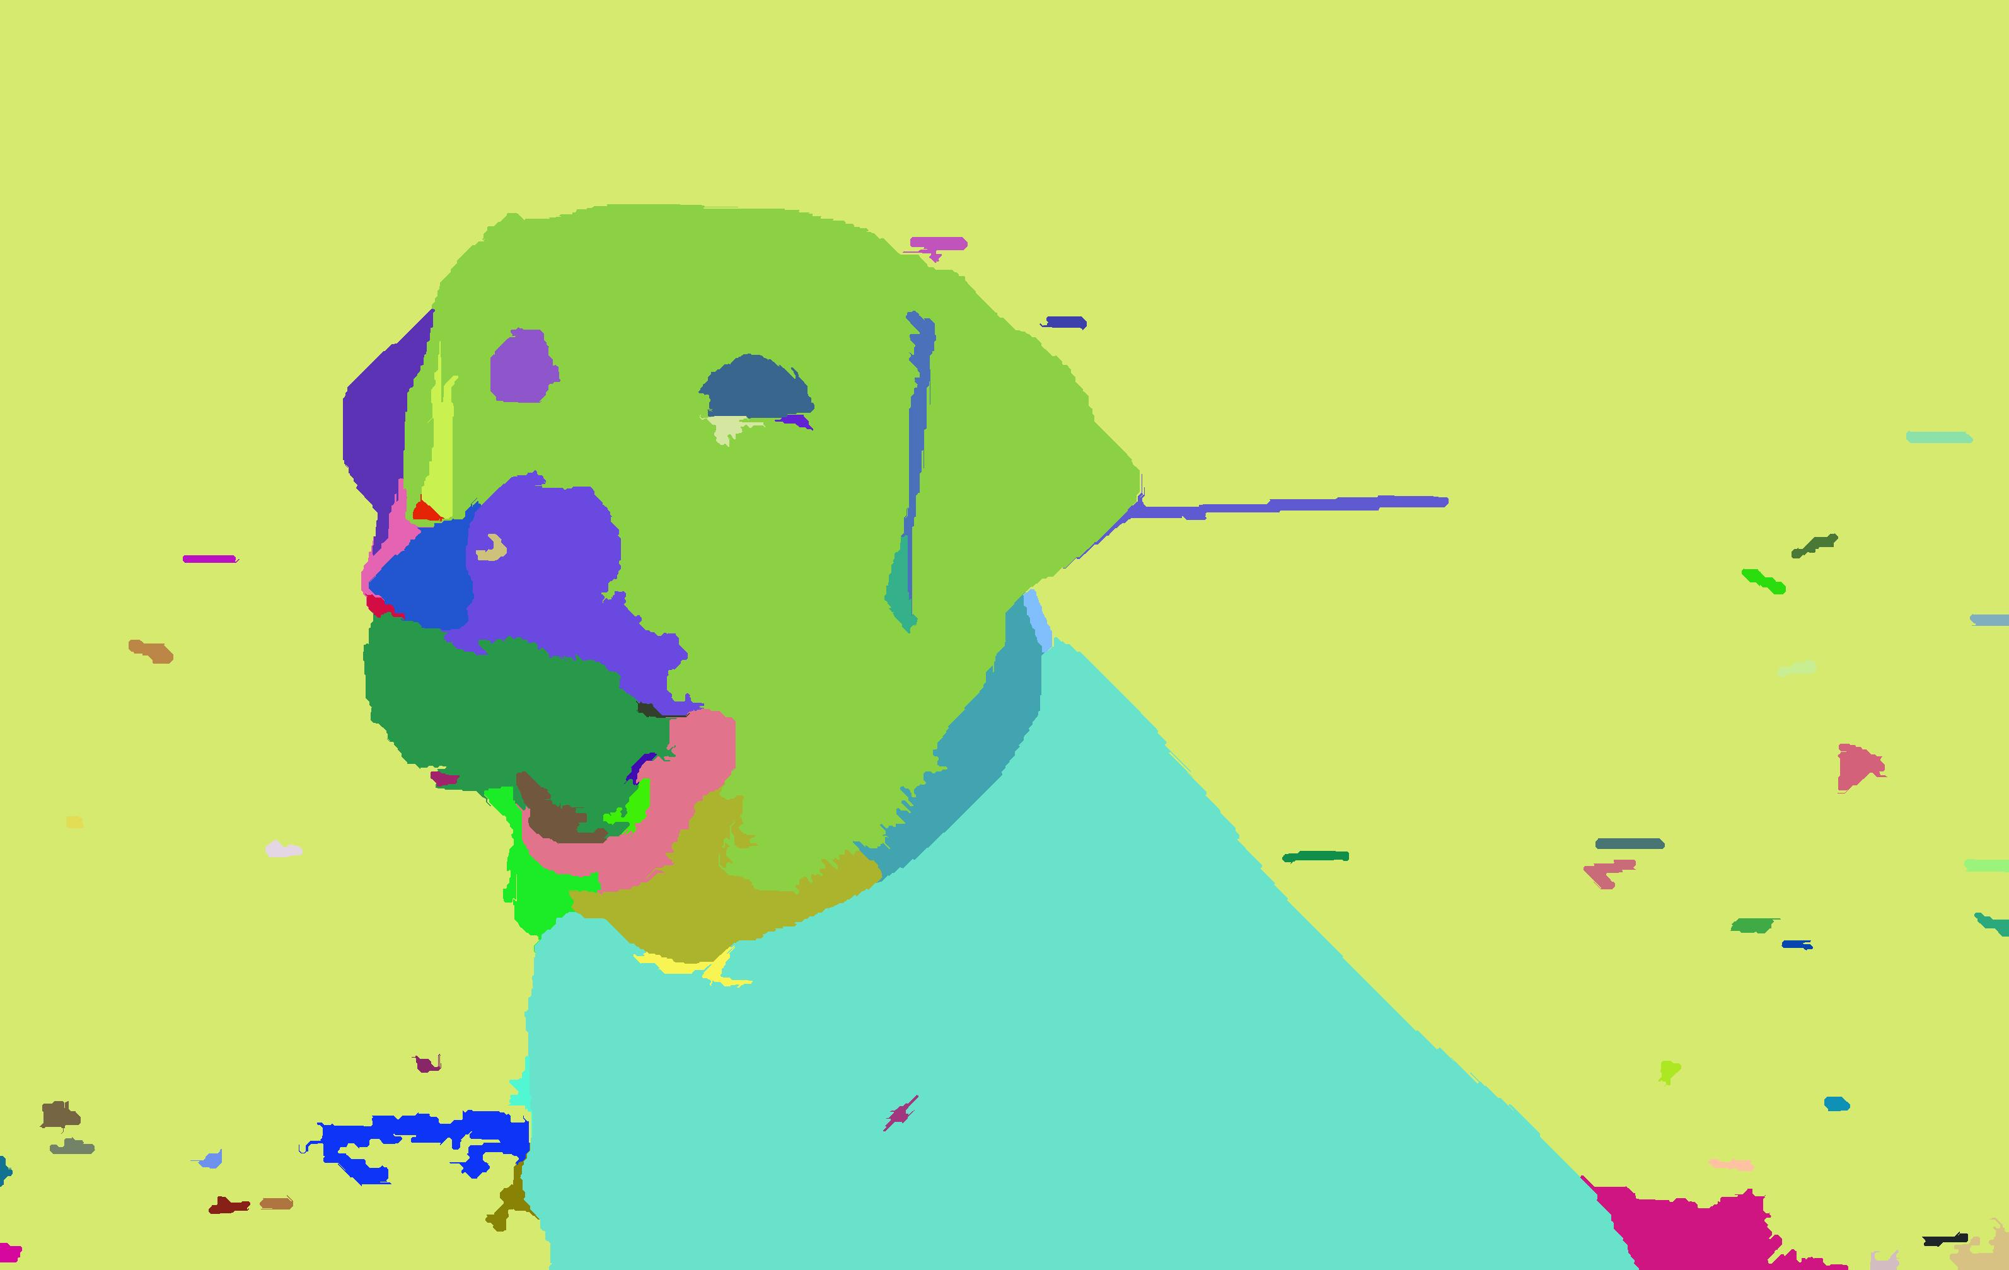
Mex results
Original dog
Their Result
Our Result
ECE 278
Winter 2015
Graph-Based Segmentation

Slide 6
Android Implementation
Hardware limitations, especially regarding memory management, which require us to down sample the original input image.
Interface and some function rewritten in Java, but the core code is still in C/C++.
Takes about 5 seconds to segment the image on an average $100 phone.
ECE 278
Winter 2015
Graph-Based Segmentation

Slide 7
Multidimensional graph construct In c/c++
Graph constructed in space:
X, Y, C1, C2, C3
X, Y are pixel coordinates
C1,C2, and C3 are components of different color space.
We tried different color space (RGB, HSV, YCrCb, Lab) for best segmentation result.
ECE 278
Winter 2015
Graph-Based Segmentation

Slide 8



Multidimensional graph construct
Original Lena
x,y,Y,Cr,Cb space
x,y,H,S,V space
x,y,L,A,B space
ECE 278
Winter 2015
Graph-Based Segmentation

Slide 9
MultiDim. Implementation
Distance between pixels is measured by L2 distance in 5-D space.
However, component in the 5D feature doesn’t have the same range! X, Y is based on image size and C1,C2,C3 is different for different color space
Thus, normalization is needed for comparison’s sake.
ECE 278
Winter 2015
Graph-Based Segmentation

Slide 10

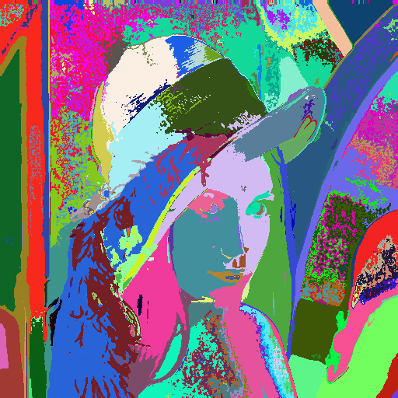

Multidimensional graph construct
Original Lena
x,y,Y,Cr,Cb space
x,y,H,S,V space
x,y,L,A,B space
ECE 278
Winter 2015
Graph-Based Segmentation

Slide 11
MultiDim. Implementation
Exact k-nearest neighbor for every pixel runs too slowly (~30 minutes for 512x512 image).
Approximate k-nearest neighbor runs in 2 or 3 minutes for image of the same size.
KNN implemented with Boost library.
ANN implemented with FLANN library.
ECE 278
Winter 2015
Graph-Based Segmentation

Slide 12
Performance
 | Time in Seconds
Pure MATLAB | 30 (4-neighborhood)
Mex MATLAB | 9.9
C/C++ Only | 18
Authors’ (C/C++) | 7
Performance is measured on dog image, 3187 × 2015 pixels on my laptop.
ECE 278
Winter 2015
Graph-Based Segmentation

Slide 13
References
Pedro F. Felzenzwalb, Daniel P. Huttenlocher. International Journal of Computer Vision September 2003. Efficient Graph-Based Image Segmentation.
ECE 278
Winter 2015
Graph-Based Segmentation

