Slide 1
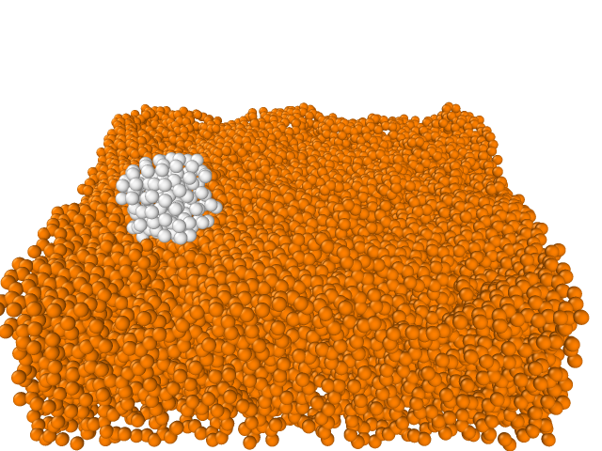
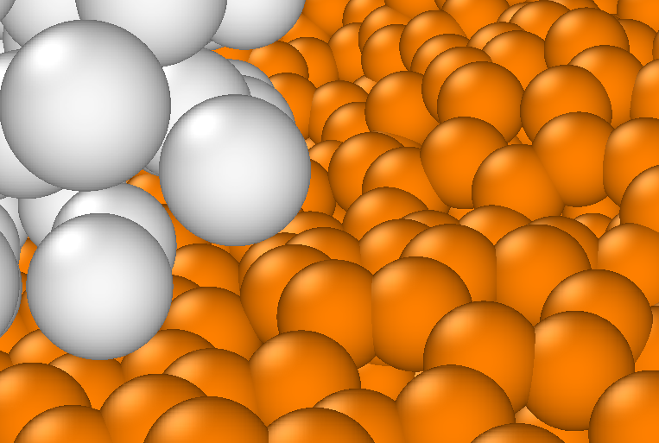
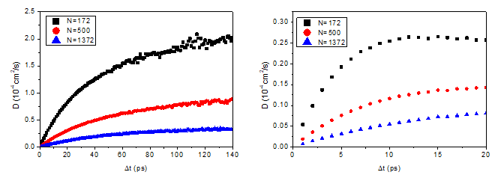
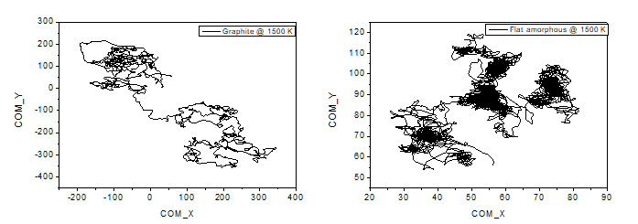
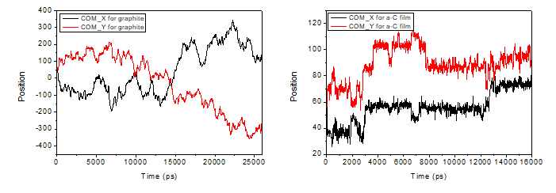
Diffusion of Cu nanodroplet on amorphous carbon film
Input
script
Molecular Dynamics simulation
Cu cluster
EAM
L-J
Tersoff
Amorphous
carbon film
Measurements
Dependences :
Diffusion coefficient
Roughness
Size
Temperature
Diffusion
Path
Transition
Time
Energy
Barrier

