Slide 1


Don’t Laugh at Me

Slide 2

Не смійся з мене

Slide 3
Group Agreement

Slide 4
Four-Fold Approach
Show up and be present
Pay attention to what has heart and meaning to you
Tell the truth to each other without blame or judgment
Be open to new ideas

Slide 5
Agenda

Slide 6
Group Agreement
Introduction and Gathering
Watch Voice of America News Clip
Introduction of the Teachers Guide
Torn Heart Activity
Caring Being Activity
Listen to “Don’t Laugh at Me”
Active Listening Activity
Power Shuffle Activity
Next Steps
Closing and Evaluation

Slide 7
Gathering

Slide 8
What are you seeing?
What would be your last lesson to children?

Slide 9
Great
News!

Slide 10
Peter Yarrow
talking about his trip to Ukraine in December of 2010…
“This is my first visit to Ukraine, but I feel a strong connection because my parents came from Ukraine. My mother came from the part that was Russia and my father - from what was Poland. If I was born here, my name would be Peter Yaroshewych and my mother’s Virochka Bortko. So this trip is also special for me for personal reasons.”

Slide 11
Your thoughts about the video

Slide 12
TEACHER’S
GUIDE

Slide 13


Slide 14


Slide 15
TEACHER’S GUIDE
A healthy expression of feelings
Caring, compassion, and cooperation
The creative resolution of conflicts
An appreciation of differences

Slide 16
Expressing Feelings
In this section, we help children learn feelings-related vocabulary, identify feelings, acknowledge and respect the feelings of others, appreciate the range of human emotions, and empathize with others

Slide 17
Caring, Compassion, and Cooperation
In this section, we help children explore helping others, taking responsibility for one’s actions, and working together for a shared goal.

Slide 18
Resolving Conflict
Creatively
In this section, we help children develop some skills such as resolving conflict without saying or doing hurtful things, understanding how conflict escalates, using I- messages to share feelings and de-escalate conflict, being aware of different points of view in a conflict.

Slide 19
Celebrating Diversity
This section deals with identifying differences and
similarities in a nonjudgmental way, appreciating
differences, and becoming sensitive to acts of
prejudice and bias.

Slide 20
TORN
HEART

Slide 21
CARING BEING

Slide 22
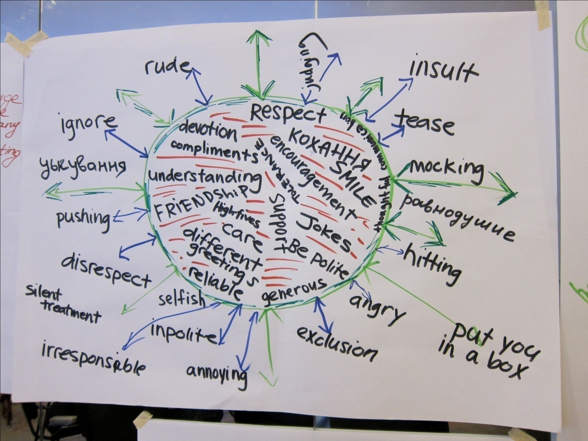

Slide 23
Put on
Display

Slide 24
DON’T LAUGH AT ME

Slide 25
НЕ СМІЙСЯ
З МЕНЕ

Slide 26
BREAK

Slide 27
Active Listening

Slide 28
Power
Shuffle

Slide 29
Closing Circle

Slide 30
MATERIALS
ORUkraine.org
Lesson Plans
Videos and Music
all@orukraine.org
OR Contacts

Slide 31
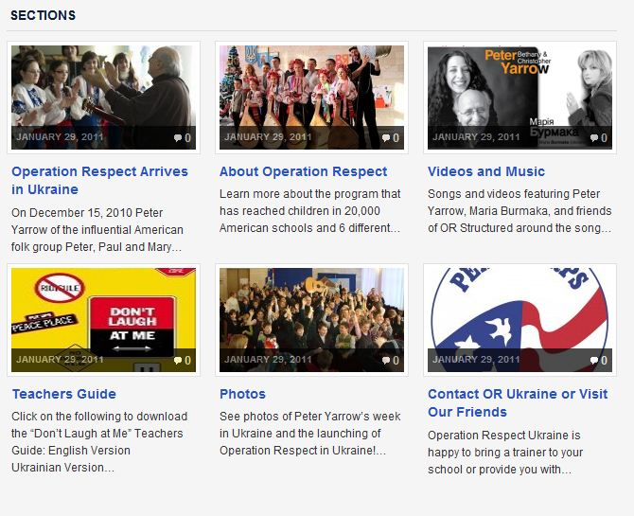
ORUKRAINE.ORG

Slide 32
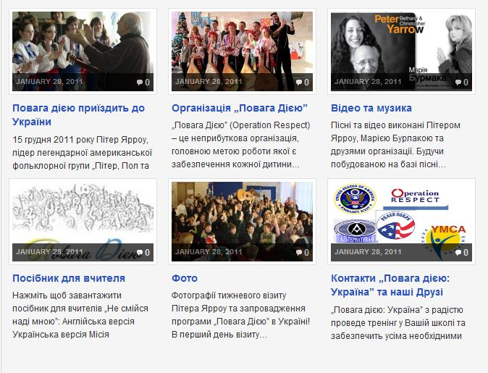
ORUKRAINE.ORG/UA

Slide 33
NEXT
STEPS

Slide 34
How difficult/easy will it be to incorporate this curriculum into your classroom/school?
What are some of the obstacles that you face?
What supports/resources do you need to help the implementation of this curriculum happen?

Slide 35
What is something that you can commit to personally to further this work?
What is something that you can commit to professionally to further this work?

Slide 36
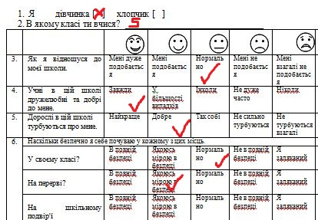
SURVEY

Slide 37
LESSON PLANS
ART AND MUSIC
SURVEY (send results to all@orukraine.org)

Slide 38
Don’t Laugh at Me Workshop Evaluation
Place:__________________________________________
Date:___________________________________________
Presenter:_______________________________________
Please evaluate this session by circling the appropriate rating. Thank you.
5 = Outstanding/Fair
4 = Very Good
3 = Good
2 = Fair
1 = Poor
Useful information 5 4 3 2 1
Presented practical skills 5 4 3 2 1
Effectiveness of presenter (OR Trainer only) 5 4 3 2 1
Overall evaluation of workshop 5 4 3 2 1
Your input is greatly appreciated and will help us improve and enrich our future
activities. Please respond to the following:
1. What was your favorite part of the workshop?
2. What could we do to make this workshop better?
3. Would you recommend this workshop to others?
4. What is one thing you will remember that you are taking with you from this
experience?
any additional comments you may have…
*Or Trainers only need to show this slide

Slide 39
THE
END

