Slide 1
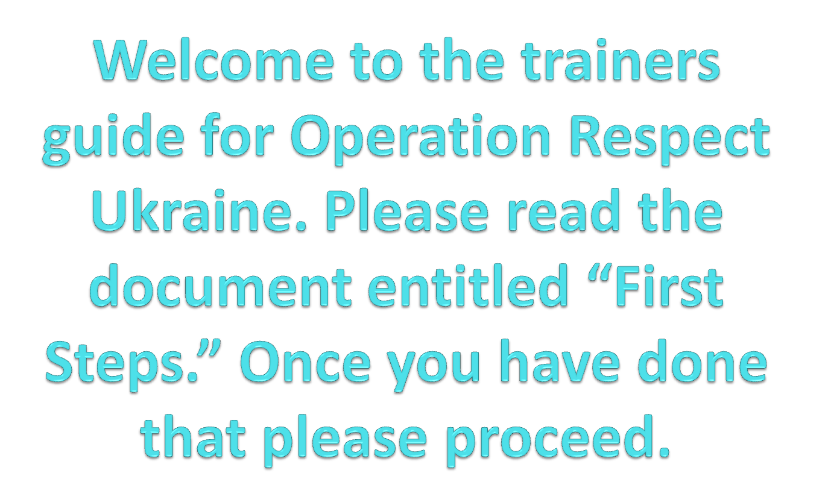

Slide 2
The training is to introduce the program as well as have community members engage in conversation about their communities. The training takes roughly four hours, but can easily be tweaked to last longer or shorter. The slides with the OR logo on the bottom right corner will be the slides shown during the actual training. Locate the Powerpoint “Training Slides” for just those slides.

Slide 3


Don’t Laugh at Me

Slide 4

Не смійся з мене

Slide 5
Introduction
Introduce yourself to the group, share a personal story about why this is an issue important to you. Think about a time when you were bullied, or called a mean name, or felt disrespected. Do you believe that it is still a problem and there is enough being done to stop it from happening? The point of today is to discuss the problem and offer tools that teachers can use to help them create safe learning environments.

Slide 6
Next you want to explain the purpose of the
training:
• To explore the issues around bullying, ridicule, teasing. Regardless of what
happens after the training it at least serves as a gathering tool for teachers to
talk in a group.
• Operation Respect serves as a tool to help teachers and students achieve
peace and respect within their community, school, and classroom. The
lessons can help reach that goal, but the ultimate work will be done by the
community itself
• The training is very interactive and shows teachers what each lesson will look
like. The teachers not only see how the activities work but also have an
opportunity to explore their own emotions and engage them in discussing
issues in their lives and community.
Finally, the training will end with participants talking about action plans on
how they can address the issues of bullying, respect, caring, and
communicating within their own communities.

Slide 7
Group Agreement

Slide 8
First you will ask the group to form a “group agreement” or “community practices” for the group to follow during the presentation, showing how important it is for all to respect one another at any age. We use the four fold way to describe “how we want to be with each other.” Additional guidelines may be: please leave the room if you need to make a phone call, please speak one person at a time, etc. This builds a group relationship from the get go and at the end can be pointed back to show what a safe and caring environment looks like.

Slide 9
Four-Fold Approach
Show up and be present
Pay attention to what has heart and meaning to you
Tell the truth to each other without blame or judgment
Be open to new ideas

Slide 10
Agenda

Slide 11
You want to show everyone the agenda for the day so everyone knows exactly what to expect from the time together and feels that it responds to their needs.
Ask them to approve the agenda…

Slide 12
Group Agreement
Introduction and Gathering
Watch Voice of America News Clip
Introduction of the Teachers Guide
Torn Heart Activity
Caring Being Activity
Listen to “Don’t Laugh at Me”
Active Listening Activity
Power Shuffle Activity
Next Steps
Closing and Evaluation

Slide 13
Gathering (sometimes called “icebreaker”):
Have everyone go around and say their name and their job title. Also have them share one thing about them that no one would know by just looking at them. This is an easy question to answer and serves as a good icebreaker for the group. It is very important to build a safe and healthy training environment.

Slide 14
Gathering

Slide 15
First activity
Have everyone in the class find a partner. Stress that they try to meet someone new in the room. Really push for all to know each other and feel comfortable talking with new people. Have the pairs discuss two issues for 3-5 minutes total.
1) What have you been hearing, seeing, noticing, or experiencing in your school around issues of ridicule, inclusion/exclusion, prejudice, and bullying?
2) Have teachers imagine the following; Tomorrow when you go into school, you will be able to teach one thing to your children that they will learn, internalize, and use for the rest of their lives. But you only get to choose one thing. What is that one thing? Remember, the promise is for one thing that you will teach your children tomorrow that they will learn and internalize for the rest of their lives. What would that be?

Slide 16
What are you seeing?
What would be your last lesson to children?

Slide 17
Bring everyone back together. Ask: what is the one thing you would teach deeply: list the answers on chart paper to show everyone. The summary of this list is how it points to “emotional intelligence” as something we need to teach: self-awareness and social awareness. There are competencies, just like academic competencies, that all of us can learn and you may see a commonality of a desire for respect and caring.
Then ask: what are you noticing about how kids treat each other. Lead a discussion to clarify and understand what is happening: are there boy/girl differences, is there cyber-bullying, is there more or less bullying since you went to school?

Slide 18
Great
News!

Slide 19
Now show the video entitled OR Ukraine Starts (voice of America) The video from Ukrainian channel, Voice of America, introduces Peter Yarrow and the broad idea of Operation Respect. It is meant to spark initial conversation about the problem at a broad base. Allow the room to carry the discussion where they want. Have them talk about gender differences and age differences in regards to the children. Also, let them touch on disrespect being a problem between adults as well. This will build upon the discussion that was held prior to the video. Show the Peter Yarrow quote and then the slide that leads to-
Ask: what came up for you as you watched the video along with the slide, “your thoughts about the video.”

Slide 20
Translation of video:
He participated in the civil rights march in Washington [March on Washington for Jobs and Freedom] in 1963. He stood on the stage with Martin Luther King, when he delivered his "I have a dream" historic speech. He sang in the most popular American folk-band of the sixties, "Peter, Paul and Mary", and holds five Grammy Awards. And his song about the magic dragon knows every child in America. Famous singer Peter Yarrow recently visited Ukraine, where his parents originated. He brought the program here, which he is engaged in the last 10 years - teaching students tolerance and mutual respect through music.
American celebrity Peter Yarrow traveled with concerts all over the world. And now he came to Ukraine. Legendary folk musician was singing for students, parents and teachers in Volodarsk-Volynskiy Secondary School № 1 in Zhytomyr oblast. He brought the local kids a musical message, which he already has sent to the students in Hong Kong and Croatia, South Africa and Canada, Israel and Palestine. "Don’t Laugh At Me." That’s the name of a program aimed at aggression in schools, which the singer created 10 years ago. It is now working in over 22,000 schools in the United States.

Slide 21
Adult violence starts with child abuse: bullying, mockery and violence that children suffer from their peers, says Peter. This adult violence includes racial prejudice, hate, wars and the Holocaust. He believes one can build a just world through tolerance in children. And music can do that. Peter is sure the song has a great unifying force. When people stand and sing together, it is very difficult to drive a neighbor away.
Program song, a sort of an anthem of the movement is called "Don’t Laugh At Me":
I'm a little boy with glasses
The one they call the geek
A little girl who never smiles
'Cause I've got braces on my teeth
And I know how it feels
To cry myself to sleep
Don't laugh at me
Don't call me names
Don't get your pleasure from my pain
In God's eyes we're all the same
Someday we'll all have perfect wings
Don't laugh at me

Slide 22
It looks like the viewers got the message. The grandmother of one of the students of this school, Tatyana Semeniy, says:
"It is a cruel world now we have, cruel children. And it unites them, we need to have more initiatives like this. One’s soul reveals and the heart begins to sing.”
Student of the 9th grade Nastia Pavytska agrees: "Songs by Peter Yarrow united us, and have created such a warm and friendly atmosphere. After singing we gave each other a hug, I really enjoyed it.”
The idea of inviting a famous artist to Ukraine belongs to the U.S. Peace Corps Volunteer - Bob Schlehuber:
"I learned online that Peter’s parents were from Ukraine, and thought that we should invite him to come home.”
U.S. Peace Corps in Ukraine’s Depyty Director Thomas Ross said the organization gladly supported the idea of Peter to present his program against violence in schools in Ukraine.
In Ukraine, Peter Yarrow gave several concerts and recorded a CD with Maria Burmaka. The singer has promised to return again to offer his program to Ukrainian schools:
“my program against bullying in schools, which I promote throughout the world. Children see violence in real life and on television. Children are just imitating adults. But children can break this cycle of fear and hatred. And this is my hope. That's why I'm here.“

Slide 23
Peter Yarrow
talking about his trip to Ukraine in December of 2010…
“This is my first visit to Ukraine, but I feel a strong connection because my parents came from Ukraine. My mother came from the part that was Russia and my father - from what was Poland. If I was born here, my name would be Peter Yaroshewych and my mother’s Virochka Bortko. So this trip is also special for me for personal reasons.”

Slide 24
Your thoughts about the video

Slide 25
The focus here is to get the people in the room talking about the problem and getting them emotionally invested. The reach of Operation Respect is to be a catalyst to help teachers work with their students, schools, and communities to address a large scale problem. The conversation and the people are what create change, allow there to be long discussion.

Slide 26
Next you will introduce the teachers guide that incorporates interactive lessons and music to reach children. The teacher’s guide is broken into four parts. Go over the overview of each section and how they flow together, explain that ideally that you cover two lessons a week and that they follow a logical order. Show the book covers and then briefly talk about each section. You will then do activities from each section, not only for the teachers to see how the activities look but also for them to learn a little themselves.

Slide 27
TEACHER’S
GUIDE

Slide 28


Slide 29


Slide 30
TEACHER’S GUIDE
A healthy expression of feelings
Caring, compassion, and cooperation
The creative resolution of conflicts
An appreciation of differences

Slide 31
Expressing Feelings
In this section, we help children learn feelings-related vocabulary, identify feelings, acknowledge and respect the feelings of others, appreciate the range of human emotions, and empathize with others

Slide 32
Caring, Compassion, and Cooperation
In this section, we help children explore helping others, taking responsibility for one’s actions, and working together for a shared goal.

Slide 33
Resolving Conflict
Creatively
In this section, we help children develop some skills such as resolving conflict without saying or doing hurtful things, understanding how conflict escalates, using I- messages to share feelings and de-escalate conflict, being aware of different points of view in a conflict.

Slide 34
Celebrating Diversity
This section deals with identifying differences and
similarities in a nonjudgmental way, appreciating
differences, and becoming sensitive to acts of
prejudice and bias.

Slide 35
Now you will read over the broken heart lesson plan. Read the lesson plan and do the activity. Facilitate a discussion afterwards. Ask the group what they thought of the lesson.

Slide 36
TORN
HEART

Slide 37
Ask: what is a “put down.” When someone says or does something that hurts your feelings. You will be reading the story of the Torn Heart. Ask participants to assume the role of 4th grade students. Hold a cut out heart. Have participants do a “thumbs down” when they hear a “put down” in the story. Tear a piece of the heart with each “put down” in the story. When you are finished ask:
How do you think Pedro is feeling right now? Why is he feeling that way? What might be the effect on him of being treated this way?
Now retell the story and each time it comes to someone being negative to Pedro, ask for something else that could have been said instead. Just thinking about how we talk to people is a great first step.
Introduce to the group the idea of an “Assertive Messages”: they are a way that you can give a strong message to someone without being disrespectful or mean.

Slide 38
During the recap take focus on the part of the day the teacher’s play. Teachers play a central role in children’s lives and are the main role model for the class to follow.

Slide 39
When finished with the torn heart ask the group the following question:
Think about yourself or someone you know who been hurt by put-downs…(you can do a paired share with the person next to them to get the conversation going.)
Questions like these get the group to share and build upon their own emotions. It is a self learning moment for them as well.

Slide 40
Now you will read over the caring being lesson plan. Read the lesson plan and do the activity. Facilitate a discussion afterwards.

Slide 41
CARING BEING

Slide 42
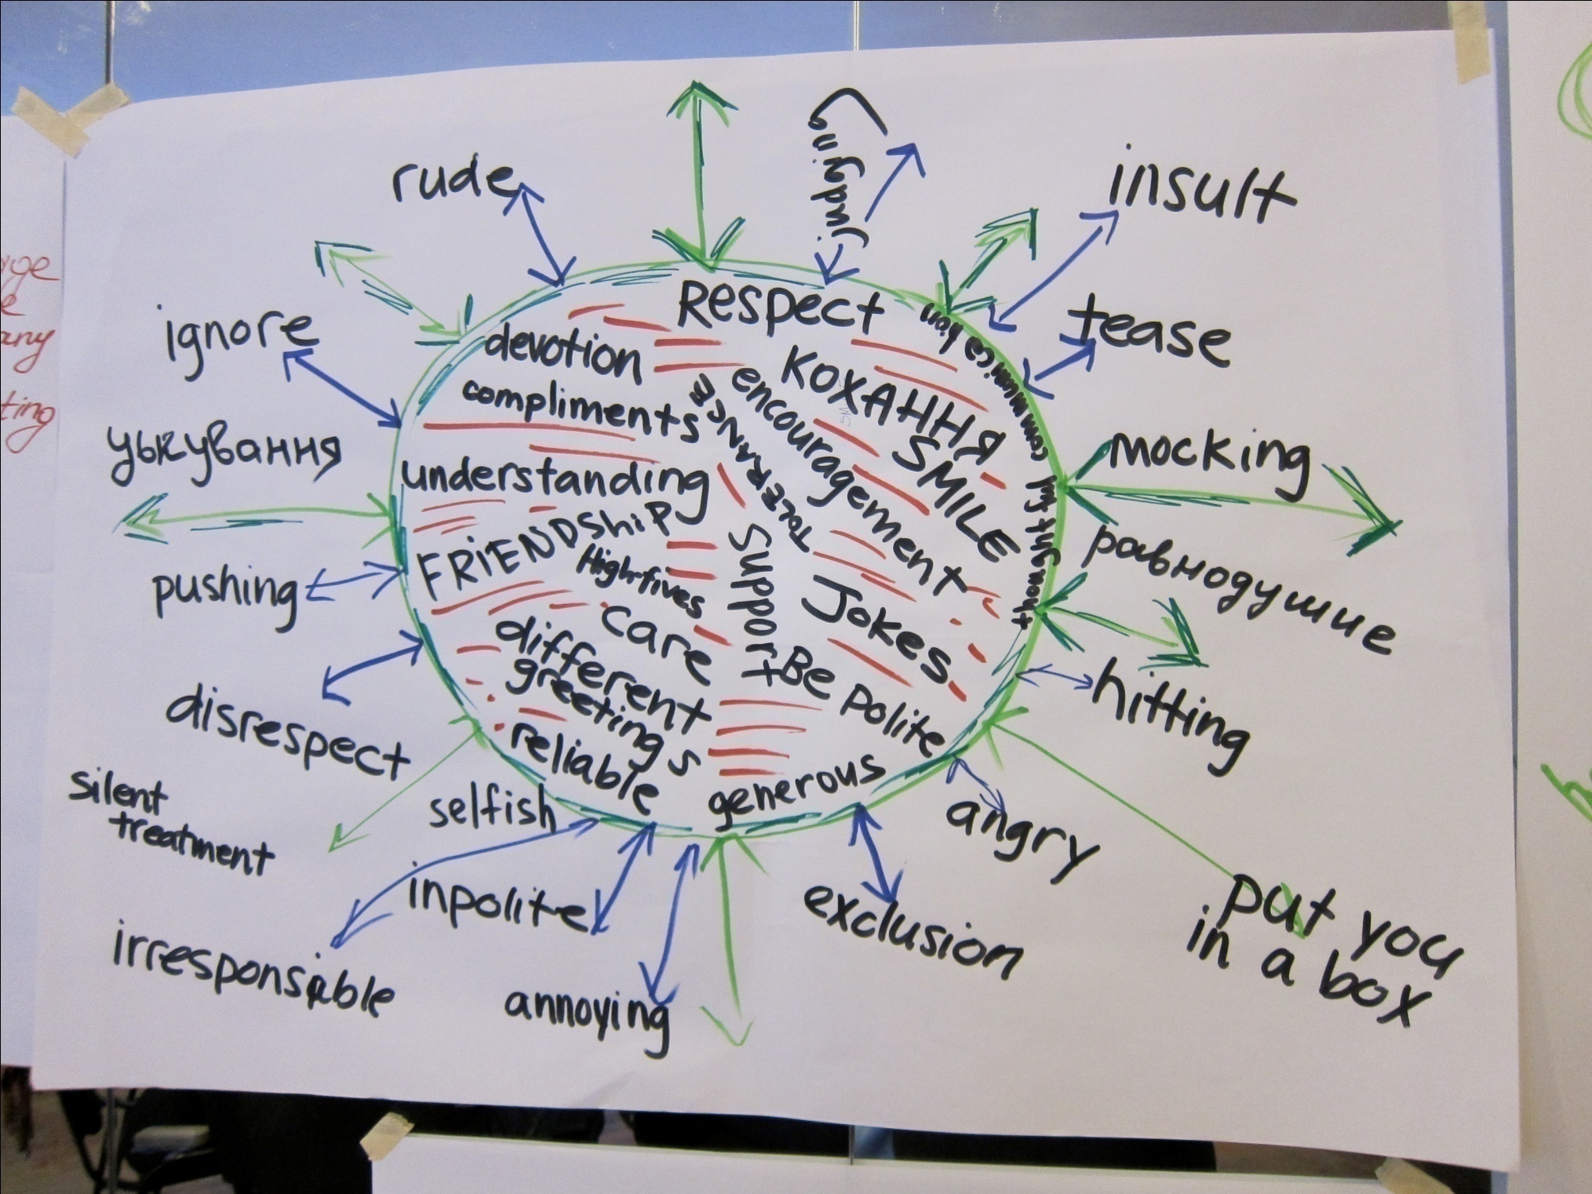

Slide 43
The caring being activity at an outer level is to show teachers how interactive the lessons are and how visuals are used to work with kids. The activity gets the teachers up and working together to design their own “caring being.” Explain to teachers that they need to draw any shape they want, a human body, a heart, a circle, an arrow, etc...
Within the being, they should write:
What behaviors or attitudes would you like to see more
of in your classroom?
You can write things you want to see or hear, or write
how you want people to behave
On the outside they should write:
What behaviors or attitudes would you like to reduce or
eliminate in your classroom?

Slide 44
When done have each group present there work and tape it to the wall so everyone can see what they have worked on.
Explain, that theme 2 of Operation Respect is to build caring, compassion, and cooperation. The caring being is a representation of what the children would like to keep out of their own classroom. You want the students to make their own caring beings and agree to commit to positive actions. The caring being gets the students to create their own classroom agreement.

Slide 45
Put on
Display

Slide 46
This is the easiest part of the presentation. Ask for people to close their eyes and listen to the Ukrainian version of Don’t Laugh at Me by Maria Burmaka. Have everyone listen to the song and then ask them what they thought. This is what they will do with their children in class. You simply need to facilitate the discussion, each person will have a different emotion or connection with the song. Play the song before or after a break.
(Maria Burmaka recorded 5 songs for Operation Respect Ukraine. Music plays a large role in the lesson plans and the overall approach of Operation Respect.)

Slide 47
DON’T LAUGH AT ME

Slide 48
НЕ СМІЙСЯ
З МЕНЕ

Slide 49
BREAK

Slide 50
Active Listening

Slide 51
Once again have the trainees pair off. This activity simply shows the importance of listening and explores what it feels like when people do not listen to you one minute each. Have the first partner tell their partner about something that happened in the last week that was exciting for them. The first time they tell the story have their partner not listen. Have them pretend they do not know what listening is (overtly ignore them, look at their phone, talk with others, etc.) Then have the second person tell about something important that happened to them, once again the person does not listen. Then do the opposite. Repeat the same conversations, but instead each time engage in active listening. Where the partner listens closely and cares. Each exchange should last one minute. (Four minutes total)

Slide 52
Have the teachers return to their seats and now share about their emotions throughout the activity. Ask: how did it feel to be “not listened to.” Then: how did it feel “to be listened to.” (Chart this list on a large sheet of paper.) Try to make sure they really focus on how good it felt to be heard and how it felt to be ignored. Explore how strong these feelings were in a matter of just one minute. The goal is for teachers to realize how important it is for all to listen to someone else, even if it is for a very short amount of time. Inversely, how hurtful one minute of not being listened is to someone.

Slide 53
Power
Shuffle

Slide 54
The power shuffle activity is to show that we each have our own experiences through life and that different people experience different things. You will read several situations and ask the participants to stand when it applies to them. When they stand take a mental note of who stands and who sits. The power shuffle is to get people to think about times they or someone they know have been treated with disrespect. It then shows that they are not alone, that other people have also experienced these things. It also shows that everyone has different experiences with disrespect and that we have different reference points.

Slide 55
Have each person stand when it applies to them. Stand up if…
You have a pet
You have a brother
You or anyone of your family members or close friends have a disability you can see or can’t see
If you have ever been called a name or put down or made fun of or whistled at or harassed or told you couldn’t do something you wanted to do
If you’ve ever been picked last in games or sports or felt left out or excluded from any activity all together
If you remember witnessing someone being bullied, but felt helpless or too fearful to do anything about it
If you have ever disrespected someone else or called someone a bad name
If you were told you are stupid or not smart

Slide 56
First ask if people stood up every time, get people to notice that they may have different experiences. Instead of getting too deep into emotions here, instead ask for questions and comments about how it would feel doing this with students. After debriefing the experience for the participants, debrief how you would approach doing this activity with youth. Ask the group for some of their observations or suggestions.
Explain in the course book the questions are very similar but are changed for younger ages and that teachers can do what they want with the activity. The book asks for the students to cross a line if it applies to them, but as you can see you can also stand and sit. All the lessons are meant to be adapted to each teachers’ preferences.

Slide 57
Closing Circle

Slide 58
Thank everyone for their participation and willingness to share and let them know that this closing circle will be followed by some planning time for next steps and a written evaluation of this training so that we can respond to their needs.
Ask the group to from a standing circle and ask participants to express some appreciation or awareness or learning that they experienced during your time together. Use any item to pass from one person to the next to show whose turn it is to talk, give each person up to 30 seconds.

Slide 59
One of the best of Operation Respect Ukraine is that there is large support to be had from Operation Respect in America, Peace Corps volunteers that are involved with Operation Respect, Peace Corps staff and most importantly Ukrainian NGOs. See the contact list that is included in the folder. You can request materials from Operation Respect Ukraine, as well as receive all of the materials online. Share with the group all of the materials they will have access to, this will help them have a better understanding of their next steps.

Slide 60
MATERIALS
ORUkraine.org
Lesson Plans
Videos and Music
all@orukraine.org
OR Contacts

Slide 61
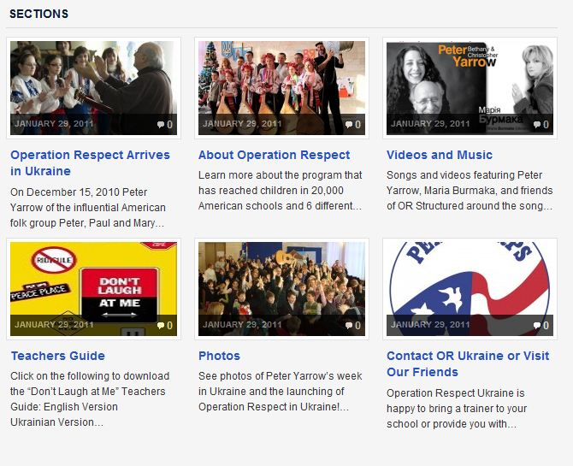
ORUKRAINE.ORG

Slide 62
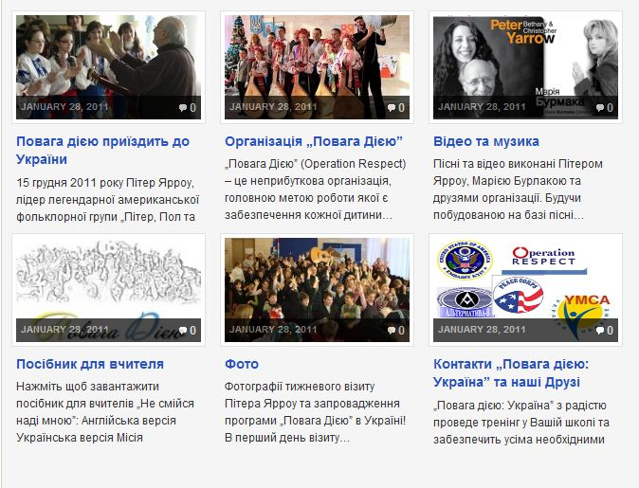
ORUKRAINE.ORG/UA

Slide 63
NEXT
STEPS

Slide 64
Go over the following questions. You may want to aim for solid commitment between the trainers or you may want to give them time to process what they have learned and let them come up with their own plans. Try to leave the room with a concrete next step plan.

Slide 65
How difficult/easy will it be to incorporate this curriculum into your classroom/school?
What are some of the obstacles that you face?
What supports/resources do you need to help the implementation of this curriculum happen?

Slide 66
What is something that you can commit to personally to further this work?
What is something that you can commit to professionally to further this work?

Slide 67
The goal of Operation Respect Ukraine is to supply a tool for the teachers to best use in their school and community. Each school, community, and teacher will use the program differently and this is to be encouraged. We have a “best scenario” plan for the teachers to use the lessons, but encourage them to make their own plan. The following are ideas of what can be used or done

Slide 68
Select one or two classes (more if you want) that you could introduce the project to. Ask for 15-20 minutes of class time. With the help of the teacher ask the students to tell you what they know of respect, bullying, and of treating others kindly. Let the students take the conversation where they want to. Next, have the students listen to Maria Burmaka’s version of “Don’t Laugh At Me.” Lead a small discussion about what the students heard, do not worry about getting too deep but simply let the students explore their thoughts (if the child simply express that they like the sound of the guitar, this is wonderful). Finally share the story of the broken heart with the students. You simply need to read the story that is included and a large heart paper.

Slide 69
If you do the above option you may take several next steps depending on the level of which the school and children would like to engage. If there seems to be a desire for large involvement introduce the other twenty lesson plans that have been translated into Ukrainian. Try to develop a schedule and plan to cover the materials, remember one or two lessons are better than none!

Slide 70
If the school would like to be involved in another way that is great. Maybe the school would like to reproduce the music from the program, develop an art project that relates to Operation Respect’s mission, maybe a school assembly to talk about the issue in a large group, or maybe they want to show the children videos from the project. Maybe someone in your school would like to train more teachers, parents, or community members. Brainstorm other options as well.

Slide 71
No matter what route you decide to take please try to have students complete a simple pre survey to help us collect data. If there is engagement in the project we also ask you to complete the same survey at the end of your time with the project. We hope to bring this project to the Minister of Education and these numbers are critical. We hope you gain a lot from the presentation and through working with the teachers. This is a great program to build basic relationships with all of your teachers.

Slide 72
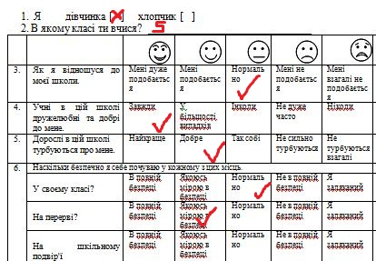

SURVEY

Slide 73
LESSON PLANS
ART AND MUSIC
SURVEY (send results to all@orukraine.org)

Slide 74
Don’t Laugh at Me Workshop Evaluation
Place:__________________________________________
Date:___________________________________________
Presenter:_______________________________________
Please evaluate this session by circling the appropriate rating. Thank you.
5 = Outstanding/Fair
4 = Very Good
3 = Good
2 = Fair
1 = Poor
Useful information 5 4 3 2 1
Presented practical skills 5 4 3 2 1
Effectiveness of presenter (OR Trainer only) 5 4 3 2 1
Overall evaluation of workshop 5 4 3 2 1
Your input is greatly appreciated and will help us improve and enrich our future
activities. Please respond to the following:
1. What was your favorite part of the workshop?
2. What could we do to make this workshop better?
3. Would you recommend this workshop to others?
4. What is one thing you will remember that you are taking with you from this
experience?
any additional comments you may have…
*Or Trainers only need to show this slide

Slide 75
Please have all participants at the training write down their name, job position, where they work, how many children they work with weekly and email address (if they would like to receive more information from Operation Respect). Please send this information to all@orukraine.org

Slide 76
THE
END

