Slide 1
Research Report
Monday 11/25/2013
Happy Holidays!
Wei Wang

Slide 2
review of the issues to solve/What I needed to do
Needed to reconstruct loops and array accesses from the trace only
Needed to write script to post process NLR outputs
Needed to test with different programs (traces)
Others
  Lulesh (using INRIA PPCG)
  PNNL benchmark

Slide 3
Progress & Problems
Reconstruct from the trace
  Looks like NLR works on simple (perfect) loop nest and simple loop iterators (lower =0, upper = N) but not (yet) imperfect loop or more complex loop bounds
  gemver.c and gemm.c (perfect loop version) successfully constructed and analyzed
  Imperfect loop nests (e.g. gemm.c and covariance.c) or complex loop bounds (covariance.c) failed
  Example (both success and failed cases) in next slides

Slide 4
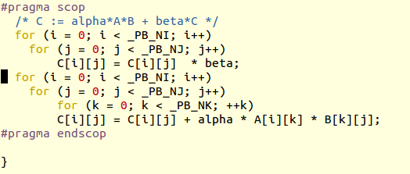
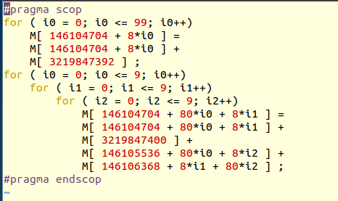
success program other than gemver.c (i.e. gemm.c)
Above: original scop
>>>Right: constructed from trace (Loop Boundary set to 10), note that the constructed scop did not recover the first nested loop but the code is correct.

Slide 5
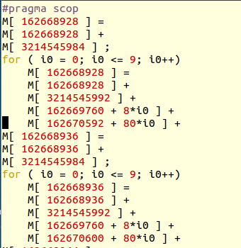
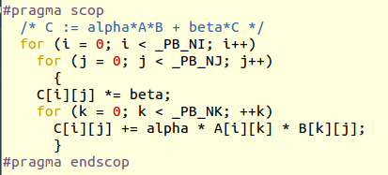
failed program: gemm.c with imperfect loop nest
Above: original scop
>>>Right: constructed from trace (loop boundary set to 10), the code is not correctly reconstructed because the first 9 lines of code got repeated 100 times, where in reality it should be a loop (or a loop nest)

Slide 6
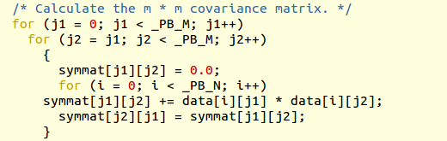
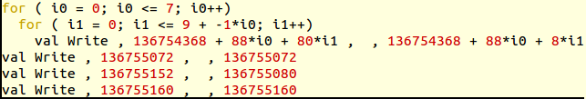
failed program: covariance.c with complex loop bounds
Right: part of the original scop
Above: part of the reconstructed code. The original code is not correctly reconstructed from trace (loop boundary still set to 10). As you can see from above, the loop bounds are not correctly calculated.

Slide 7
The plan
Discuss with Prof. Ketterlin about the two issues 1) imperfect loop nest 2) complex boundary
Migrate NLR to Windows Platform
Integrate NLR to PoCC (adding one more source code to the Collection)
Any possibility of doing dependency analysis without candl?
Energy Tuning Project
  Lulesh benchmark using PPCG
  PNNL benchmark

