Slide 1
Introduction to the Model I forest planning framework

Slide 2
Model I
In forest planning, Model I is one of the foundational formulations used for scheduling and managing timber harvests to meet specific management objectives and achieve desired forest conditions.
The goal is to determine an optimal harvest schedule for a forest over a fixed planning horizon.
Its unique feature is to use a large set of pre-identified prescriptions to build a LP model.

Slide 3
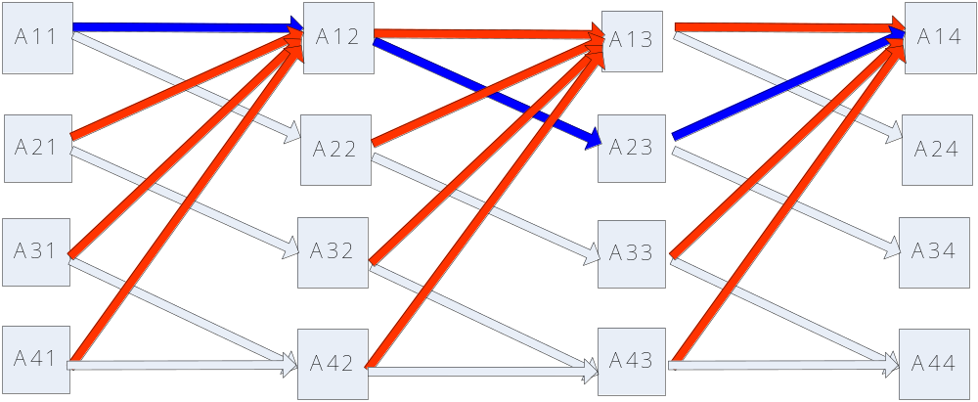
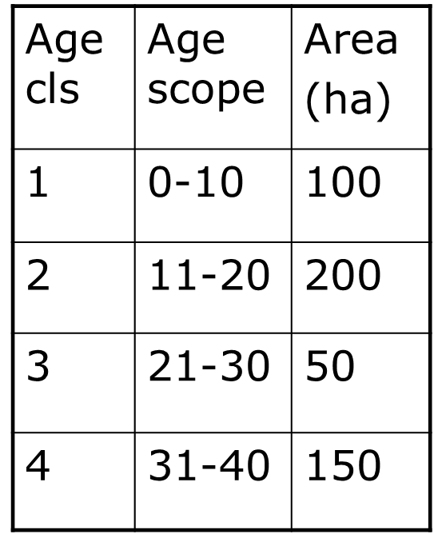
Diagram for the original dynamic model
J=1
J=2
J=3
i=1
i=2
i=3
i=4

Slide 4
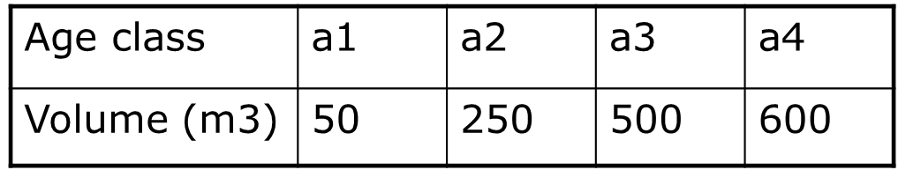
All model I prescriptions
Prescription ID | P1 | P2 | P3 | Volume harvested per ha in each period from forest with different initial age classes
 |  |  |  | Initial Age 1 |  |  | Initial Age 2 |  |  | Initial Age 3 |  |  | Initial Age 4
 |  |  |  | P1 | P2 | P3 | P1 | P2 | P3 | P1 | P2 | P3 | P1 | P2 | P3
1 | N | N | N | 0 | 0 | 0 | 0 | 0 | 0 | 0 | 0 | 0 | 0 | 0 | 0
2 | N | N | C | 0 | 0 | 500 | 0 | 0 | 600 | 0 | 0 | 600 | 0 | 0 | 600
3 | N | C | N | 0 | 250 | 0 | 0 | 500 | 0 | 0 | 600 | 0 | 0 | 600 | 0
4 | N | C | C | 0 | 250 | 50 | 0 | 500 | 50 | 0 | 600 | 50 | 0 | 600 | 50
5 | C | N | N | 50 | 0 | 0 | 250 | 0 | 0 | 500 | 0 | 0 | 600 | 0 | 0
6 | C | N | C | 50 | 0 | 250 | 250 | 0 | 250 | 500 | 0 | 250 | 600 | 0 | 250
7 | C | C | N | 50 | 50 | 0 | 250 | 50 | 0 | 500 | 50 | 0 | 600 | 50 | 0
8 | C | C | C | 50 | 50 | 50 | 250 | 50 | 50 | 500 | 50 | 50 | 600 | 50 | 50

Slide 5
All model I prescriptions
Prescription ID | P1 | P2 | P3 | Total volume/ha harvested within the planning horizon from forest of different initial age class
 |  |  |  | Age 1 | Age 2 | Age 3 | Age 4
1 | N | N | N | 0 | 0 | 0 | 0
2 | N | N | C | 500 | 600 | 600 | 600
3 | N | C | N | 250 | 500 | 600 | 600
4 | N | C | C | 300 | 550 | 650 | 650
5 | C | N | N | ? | ? | ? | ?
6 | C | N | C | ? | ? | ? | ?
7 | C | C | N | ? | ? | ? | ?
8 | C | C | C | 150 | ? | ? | ?
C: clearcut;
N: “do nothing”

Slide 6
Model I decision variables
For age class 1:
  X11, X12, X13, X14, X15, X16, X17, X18
For age class 2:
  X21, X22, X23, X24, X25, X26, X27, X28
For age class 3:
  X31, X32, X33, X34, X35, X36, X37, X38
For age class 4:
  X41, X42, X43, X44, X45, X46, X47, X48

Slide 7
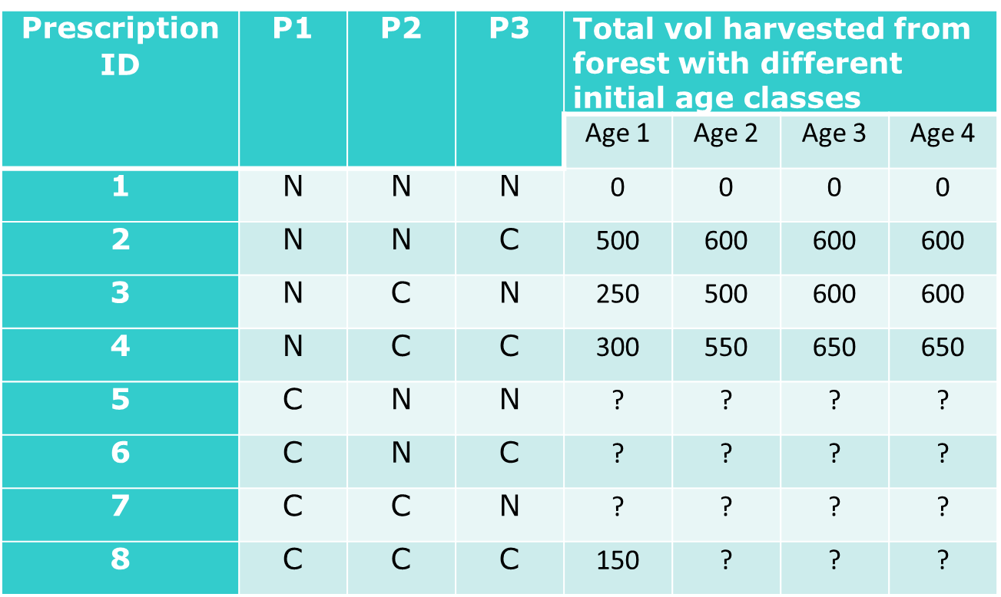
Reformulate the dynamic model
Objective to maximize total timber production during the 3-decade:
  Max Z = 0X11+500X12+250X13+300X14 …… +150X18 + …… 0X21+ … + ( )X48

Slide 8
Other constraints
X11+X12+X13+X14+X15+X16+X17+X18=100
X21+X22+X23+X24+X25+X26+X27+X28=200
X31+X32+X33+X34+X35+X36+X37+X38=50
X41+X42+X43+X44+X45+X46+X47+X48=150

Slide 9
How to formulate even timber flow constraint?
H1=???
H2=???
H3=???
H1<=H2
H2<=H3

Slide 10
The basic structure of Model I
Management units: i.e., stand, stratum, …
Many candidate silviculture prescriptions designed for each unit depending on:
  Min/max rotation ages
  Thinning options
  Length of planning periods and planning horizons
Each prescription represents a sequence of mgmt. activities across time, which can cross multiple rotations.
  i.e., thin from bellow to BA 40 at decade 10, prescribed fire at decade 11, clearcut at decade 15, thin again at decade 19 and clearcut again at decade 25.
Forest planning becomes an optimal assignment problem: how many acres of each forest stratum should be managed by following each prescription?

Slide 11
An example used for homework 4
Consider two forest types in a forest;
  1000 acres of 40-year old poorly stocked mixed pine/fir forest.
  2000 acres of 10-year old fully stocked pine forest,
Each planning period is 10-year
Both forest types would be regenerated as fully stocked pine forest after a clearcut.
Use a discount rate of 0%.
The timber stumpage price is $25/cord from both forest types.
Minimum harvest age:
  40-year for poorly stocked pine/fir forest
  30-year for fully stocked pine forest.
  No upper limit for either forest type.
All harvesting activities occur at the beginning of each 10-year period.
Age | Yield for poorly stocked mixed pine/fire forest (cords/acre) | Yield for fully stocked pine forest (cords/acre)
30 | 5 | 11
40 | 9 | 18
50 | 13 | 21
60 | 16 | 24
70 | 19 | 27
80 | 22 | 29
90 | 25 | 30
Table 1: Yield table for poorly stocked pine/fir and fully stocked pine forest based on age.

Slide 12
Prescriptions built for the forest
 | Poorly Stocked pine/fir, currently at age 40 |  |  |  |  |  |  |  | Fully Stocked pine, currently at age 10
Prescription Sequence # | Yield in Period (cords/acre) |  |  |  |  |  | Net Revenue ($/acre) | Prescription Sequence # | Yield in Period (cords/acre) |  |  |  |  |  | Net Revenue ($/acre)
 | 1 | 2 | 3 | 4 | 5 | 6 |  |  | 1 | 2 | 3 | 4 | 5 | 6
1 | 0 | 0 | 0 | 0 | 0 | 0 | 0 | 1 | 0 | 0 | 0 | 0 | 0 | 0 | 0
2 | 9 | 0 | 0 | 0 | 0 | 0 |  | 2 | 0 | 0 | 11 | 0 | 0 | 0 | 275
3 | 9 | 0 | 0 | 11 | 0 | 0 | 500 | 3 |  |  |  |  |  | 11
4 |  |  |  |  | 18 |  |  | 4 |  |  |  | 18
5 |  |  |  |  |  | 21 |  | 5 |  |  |  |  | 21
6 | 0 | 13 | 0 | 0 | 0 | 0 |  | 6 | 0 | 0 | 0 | 0 | 0 | 24 | 600
7 |  | 13 |  |  |  |  | 600 | N/A
8 |  | 13 |  |  |  |  | 775
9 | 0 | 0 | 16 | 0 | 0 | 0 | 400
10 | 0 | 0 | 16 | 0 | 0 | 11
11 | 0 | 0 | 0 | 19 | 0 | 0
12 |  |  |  |  | 22
13 | 0 | 0 | 0 | 0 | 0 | 25

Slide 13
Mathematical formulations
Define all decision variables including the definition of subscripts and write out the Model I’s mathematical formulation using Table 2. The landowner’s objective is to maximize the total net revenue from managing the entire forest during the next 60 years. This Model I formulation should include the following components.
  the objective function
  constraints for initial available areas of each forest type
  bookkeeping constraint to track the volume harvested during each decade
  non-declining even-flow constraints for timber harvesting
  non-negativity constraints for all decision variables

Slide 14
Let’s look at the Excel together

Slide 15
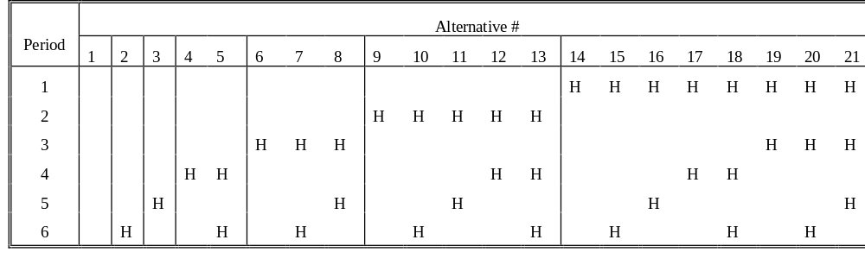
Characteristics of Model I
1. Decision variables for each land management unit each represent a management option for the unit over the entire planning horizon.
2. Decision variables for the formulation take the form:
X_{ij}= # of land units of management unit i assigned to jth prescription for stand i.
3. If rotation lengths can be short and the planning horizon is long, the number of decision variables for a single management unit can be quite large. Some systematic way of specifying the options is needed.
4. Tables like the following are often used to describe the decision variables. In this example the minimum rotation length is two periods. Each "H" in the table represents a final harvest or the end of one rotation. Thinning options are not considered in this example.

Slide 16
X1,1
X1,5
X1,7
X1,21
X2,1
X2,5
X2,7
X2,21

Slide 17
A Model I example
Suppose we have two forest management units a and b in a ponderosa pine forest.
Stand a is currently at age class 3 (median age 25) and poorly stocked; b is fully stocked and at age class 4 (median age 35).
Clearcut will be scheduled at middle of a period followed by immediate regeneration.
Forest age will be tallied at the end of a period
A 60-year planning horizon was divided into six 10-yr planning periods.
For unit a: the youngest (oldest) age to cut during the planning horizon is 40 (60) years; do nothing option is also available.
For unit b: the youngest (oldest) age to cut during the planning horizon is 40 (50) years; do nothing option is also available.
Both stands will be managed under a 50-year rotation after the last cut within the planning horizon.

Slide 18
25
5
15
25
35
45
55
5
15
25
35
45
55
5
15
25
35
45
55
5
15
25
35
45
55

Slide 19
35
5
15
25
35
45
55
5
15
25
35
45
55
5
15
25
35
45
55
5
15
25
35
45
55

Slide 20
Model I prescriptions, assumptions and objectives
Assume:
  200 acres of forest type A and 300 acres of forest type B
  For simplicity, timber yield per acre is equal to (Age Class*10)
  Formulate a Model I based system to plan the management of a forest for six decades to:
  achieve even flow of timber across decades;
  try to maximize total timber production.

Slide 21
 | Decade 1 | Decade 2 | Decade 3 | Decade 4 | Decade 5 | Decade 6 | Comments
Forest a (age tallied at the end of each period)
Alt 1 | Age 35 | Age 45 | Age 55 | Age 65 | Age 75 | Age 85
Alt 2 | Age 35 | Age 5 | Age 15 | Age 25 | Age 35 | Age 45
Alt 3 | Age 35 | Age 5 | Age 15 | Age 25 | Age 35 | Age 5
Alt 4 | Age 35 | Age 45 | Age 5 | Age 15 | Age 25 | Age 35
Alt 5 | Age 35 | Age 45 | Age 55 | Age 5 | Age 15 | Age 25
Forest b (age tallied at the end of each period)
Alt 1 | Age 45 | Age 55 | Age 65 | Age 75 | Age 85 | Age 95
Alt 2 | Age 5 | Age 15 | Age 25 | Age 35 | Age 5 | Age 15
Alt 3 | Age 5 | Age 15 | Age 25 | Age 35 | Age 45 | Age 5
Alt 4 | Age 45 | Age 5 | Age 15 | Age 25 | Age 35 | Age 45
Alt 5 | Age 45 | Age 5 | Age 15 | Age 25 | Age 35 | Age 5

Slide 22
Constraints dealing with other management require­ments are also easily incorporated. Some of the more common ones include
budget limitations
non-timber resource requirements
ending inventory requirement

