Slide 1
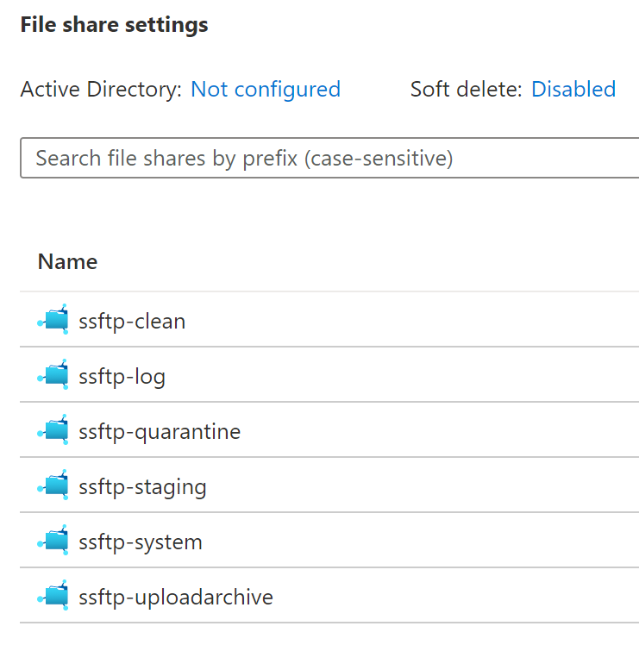

Slide 2
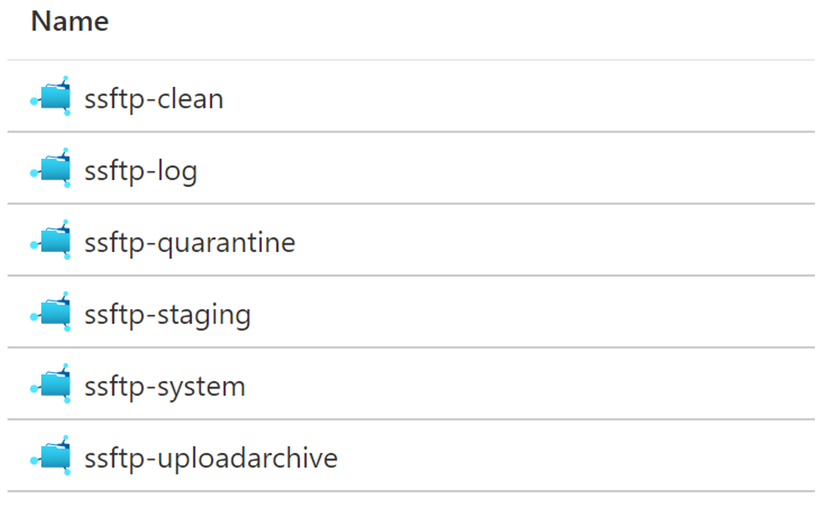
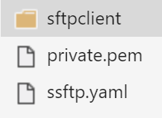
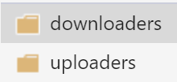

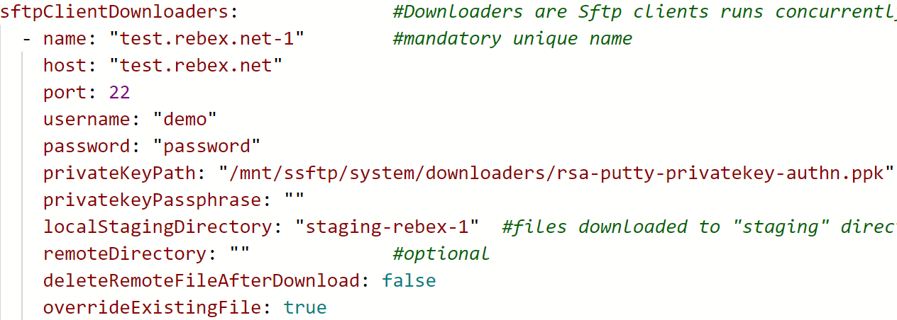
Contains files with No virus detected
A directory where Uploaders pick up files to upload to remote Sftp servers
optional, sSFTP log directory
Contains files with virus detected by ClamAV
Main upload directory, contains unscanned files
A directory where Downloaders save download files from remote Sftp servers
Contains sSFTP app files
Uploaders archive uploaded files to this folder
Recommended folder structure to store RSA PrivateKey files
for Uploaders and Downloaders to authn with remote Sftp servers
SSH private key for built-in Sftp server,
sSFTP will manage this cert
sSFTP config file
uploaded files are moved here for archival

Slide 3
