Slide 1






Google Map
browser
WWW
Portal
API
Food Truck Junkie

Slide 2
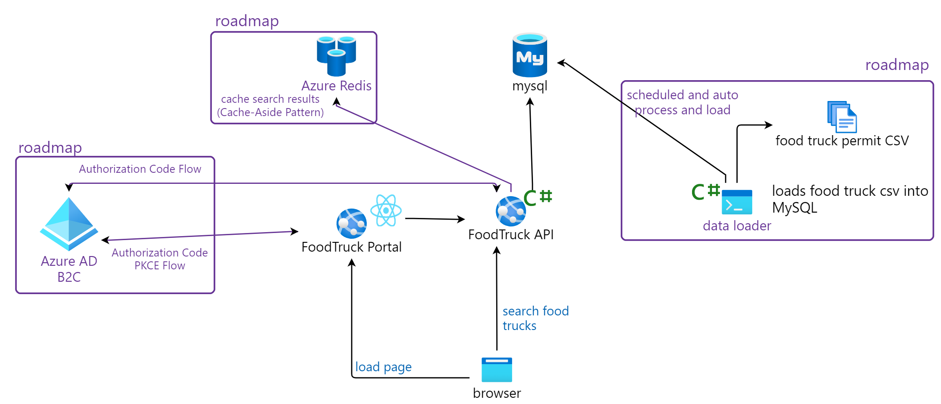

Slide 3
MySQL
Repository Layer
App config loader and injection
Service Layer
Models
Logging
constructor
dependency injection
Web API Controller Layer
Input validation
SPA

