Slide 1
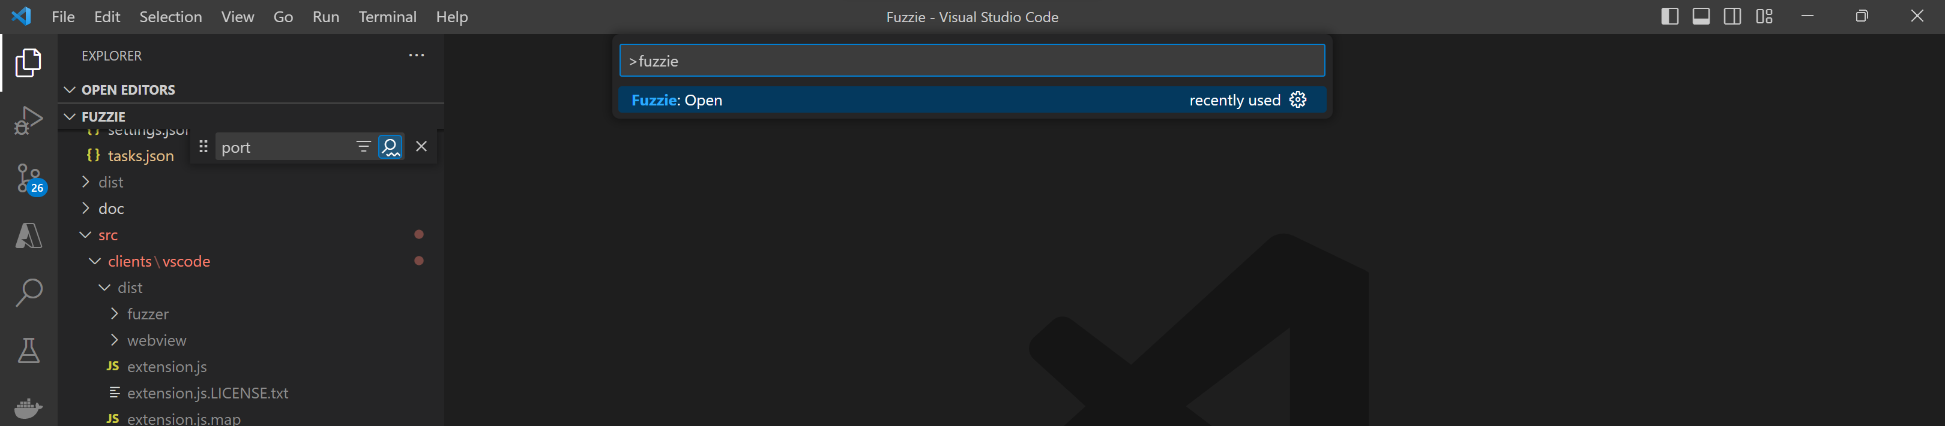

Slide 2
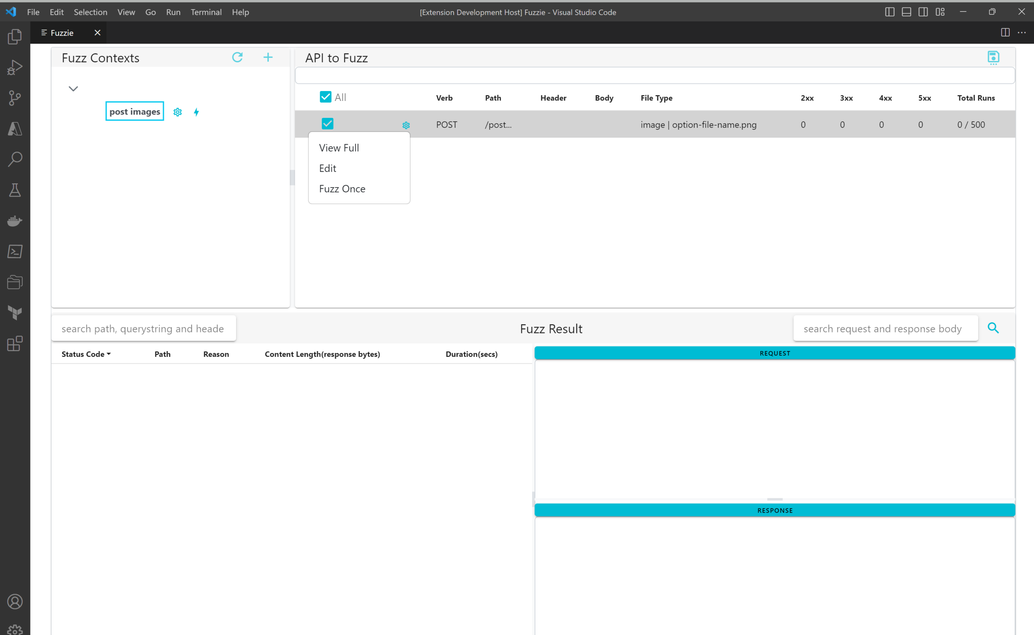
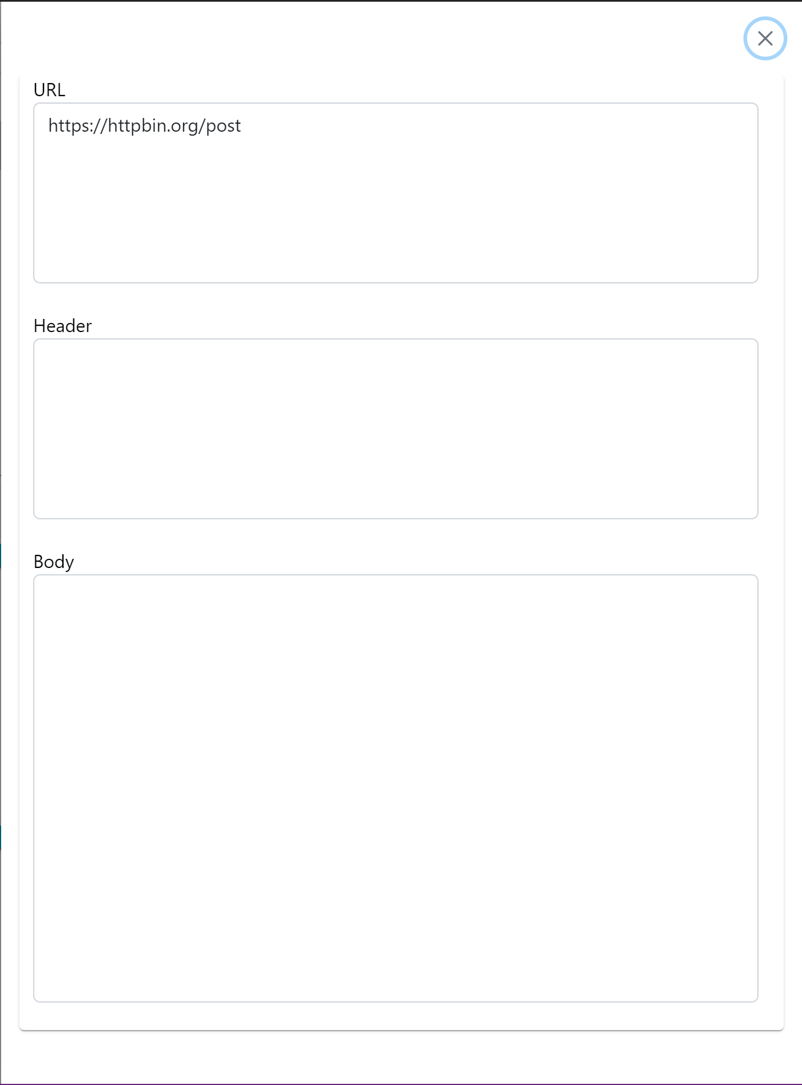
Begin fuzzing
View parsed URL, querystring, headers and body from Request Message
Edit request message
Run fuzzing once only, usually use for testing request message correctness

Slide 4
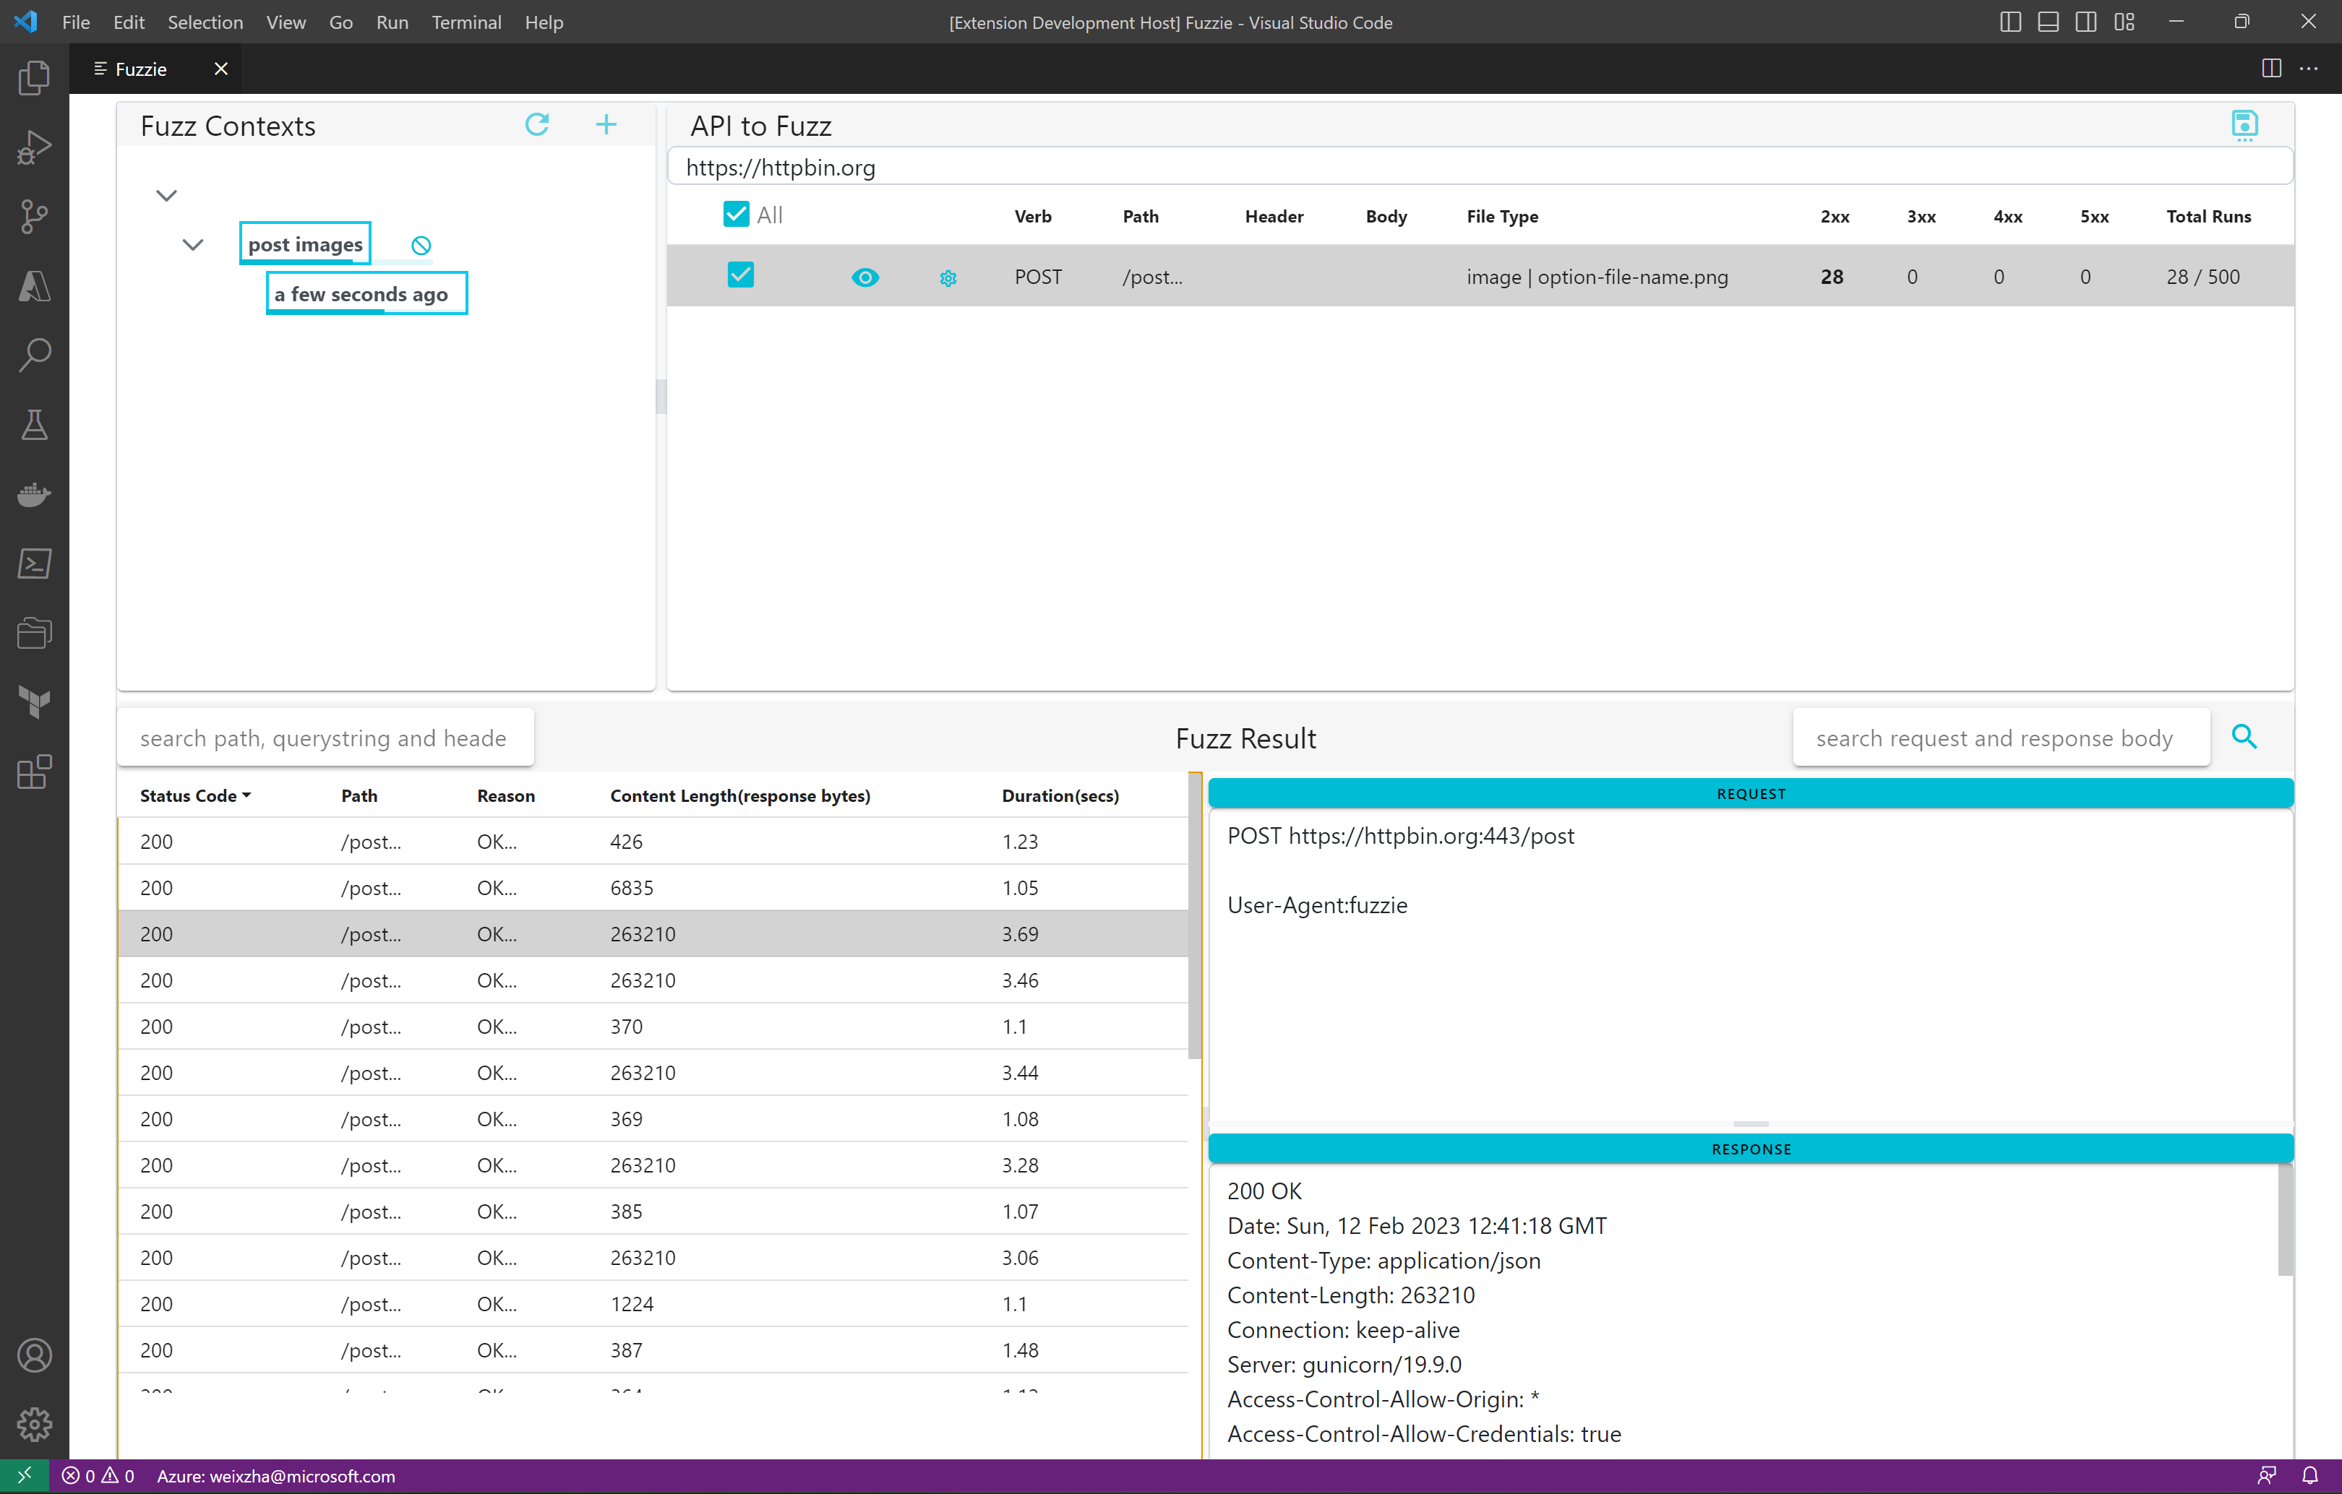

Slide 5
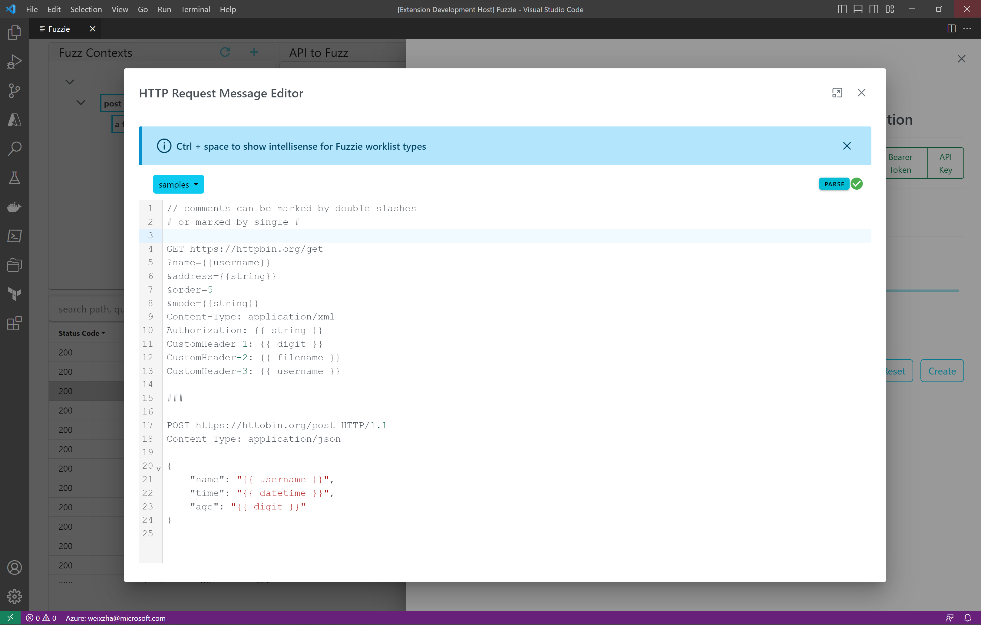
comments
all wordlist are inside a double curly braces {{ … }}
Request message divider, there are 2 request messages in here

Slide 6
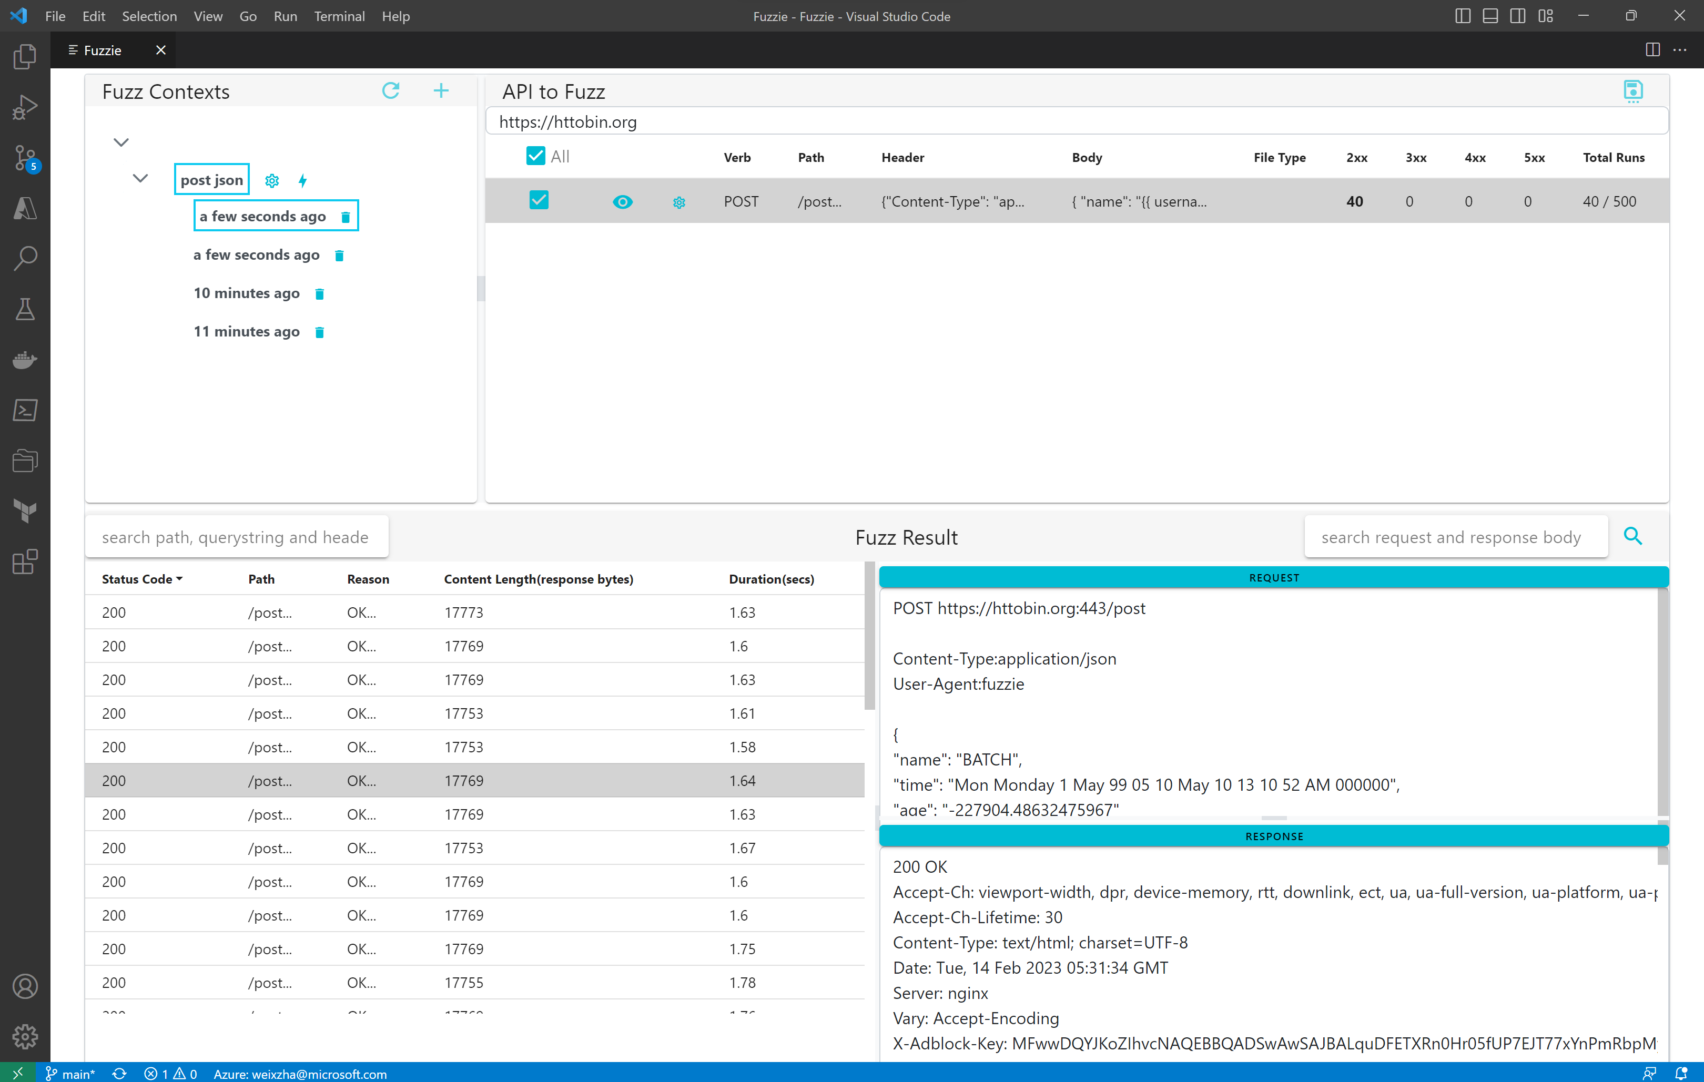
click to see
load fuzz cases
start
fuzzing
click to see
number of fuzzing runs
view
fuzzing
result
Fuzz once only
Edit request message per API
View request details
Click row to view individual
HTTP Request and Response
View response details

