Slide 1



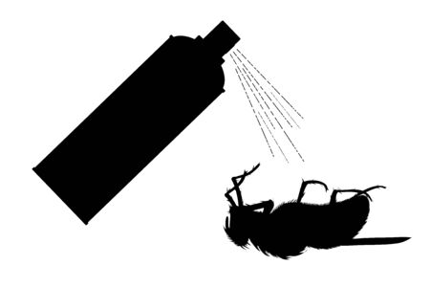
p
F u z z I e
Fuzzie
Fuzzie
Fuzzie
sadsaaswwbvsasaalpoppp0402

