Slide 1



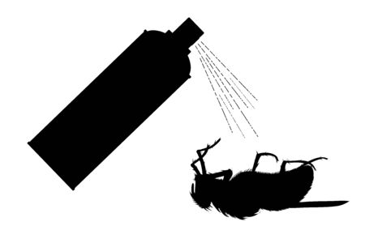
s
fuzzie
fuzzie
Fuzzie
Fuzzie
Fuzzie
sadsaaswwbvsasaalpoppp0402

