Slide 1
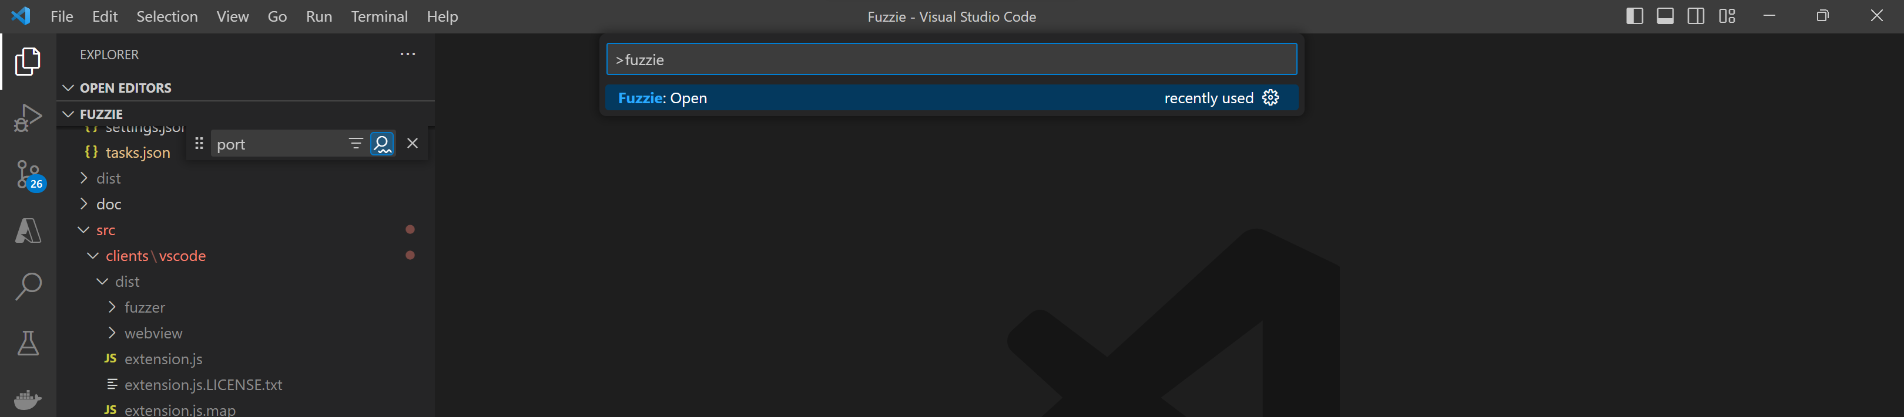

Slide 2
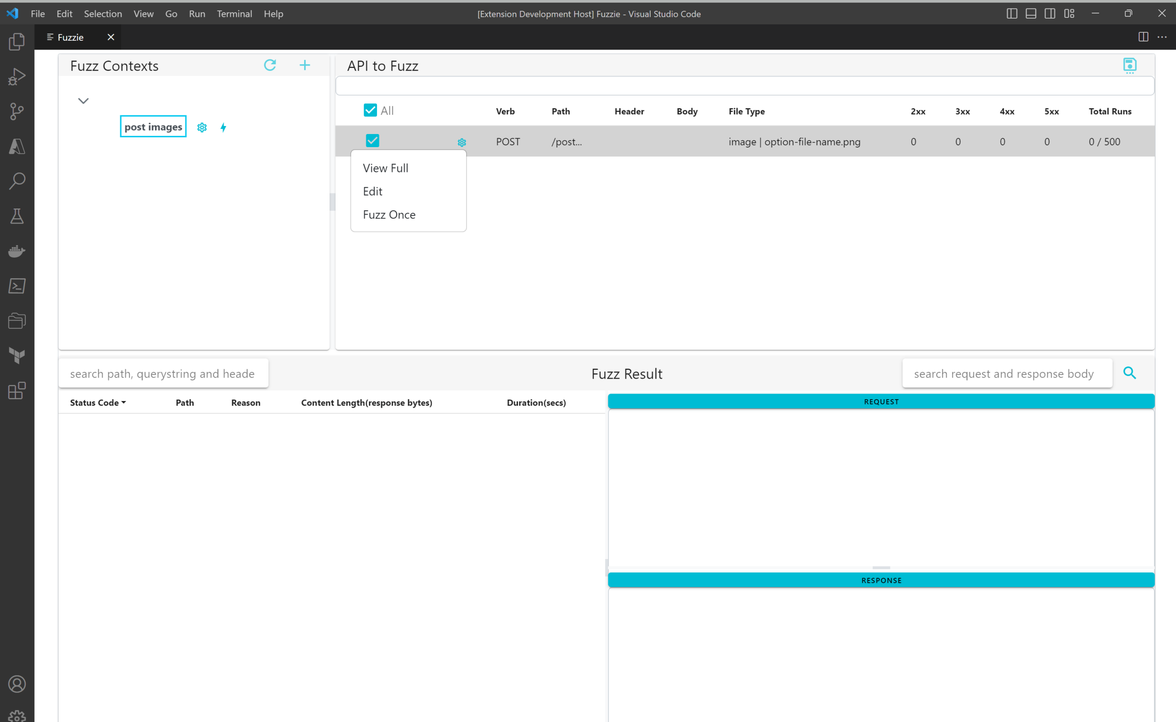
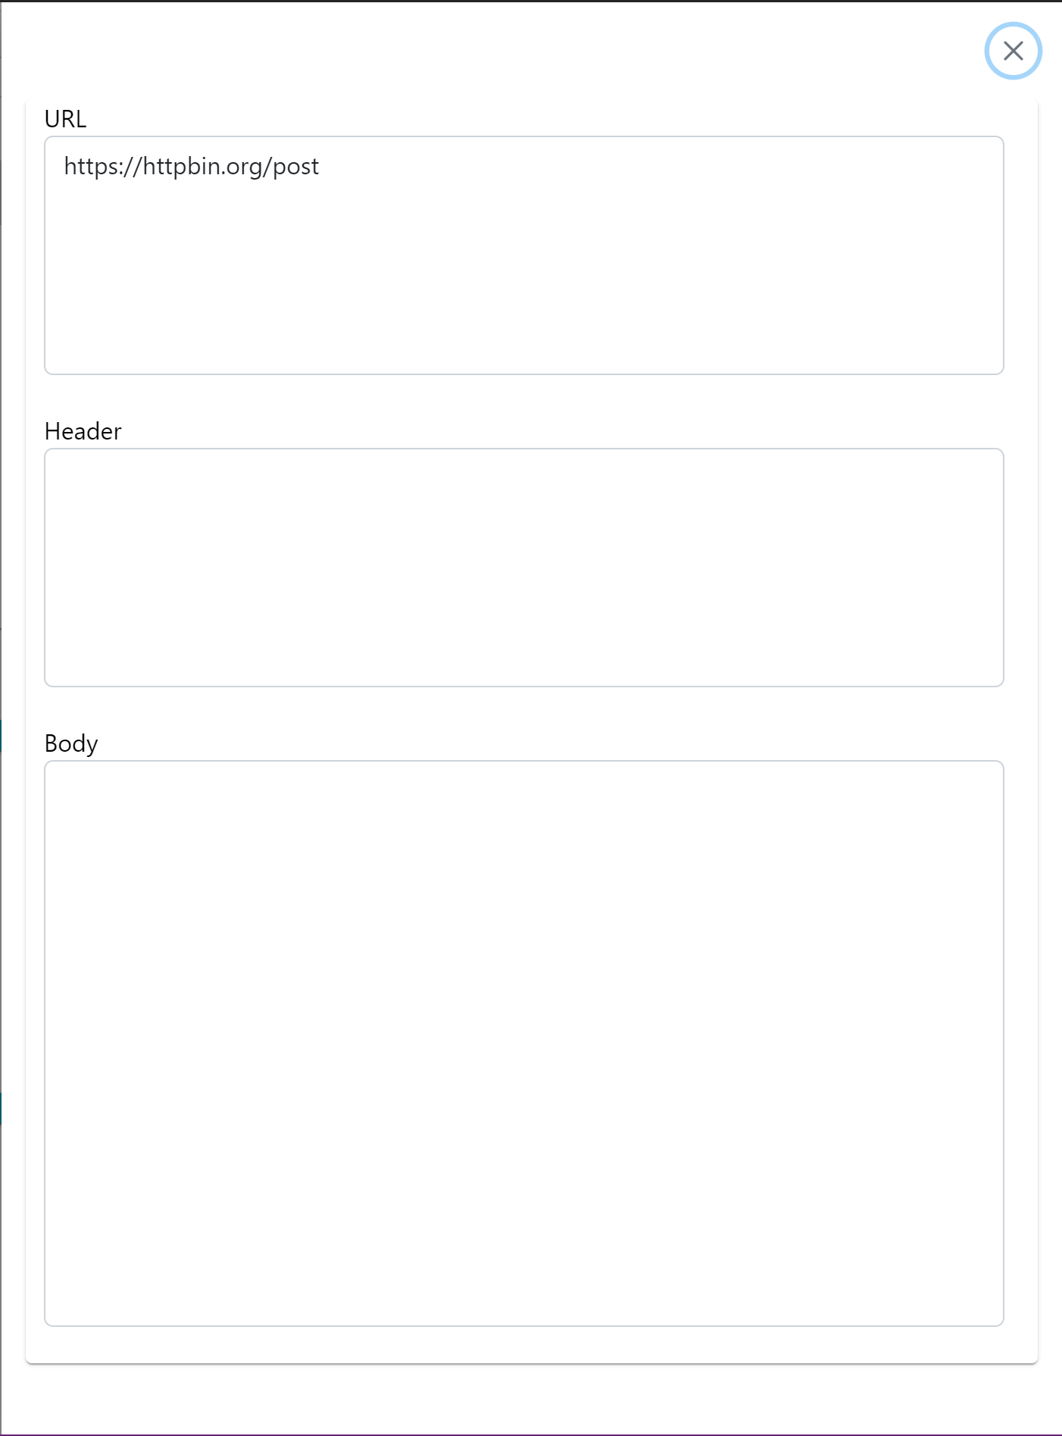
Begin fuzzing
View parsed URL, querystring, headers and body from Request Message
Edit request message
Run fuzzing once only, usually use for testing request message correctness

Slide 4
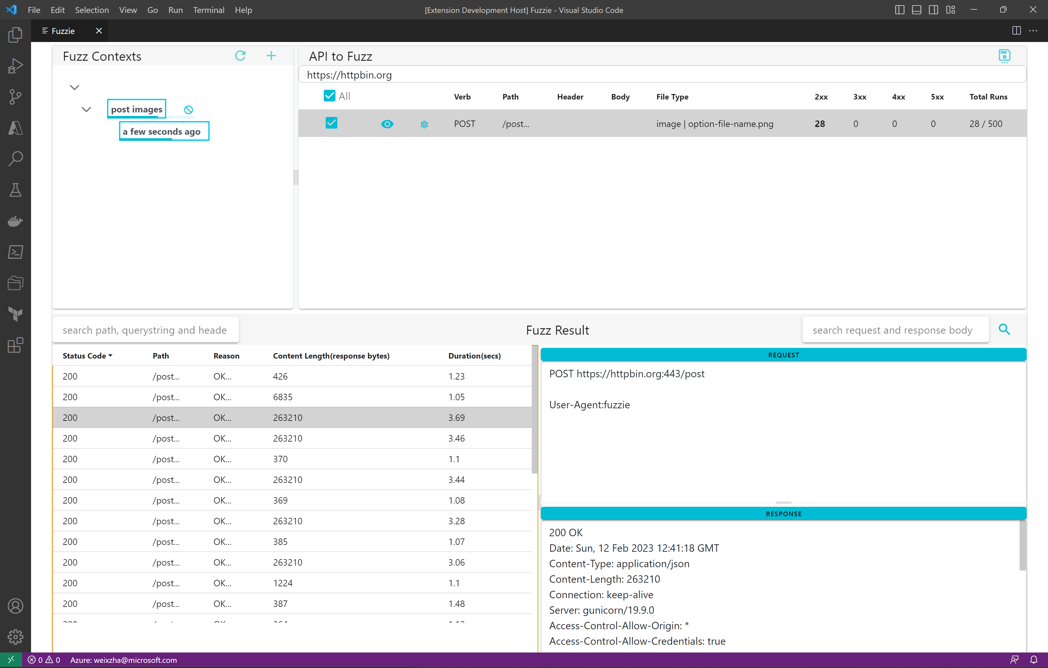

Slide 5
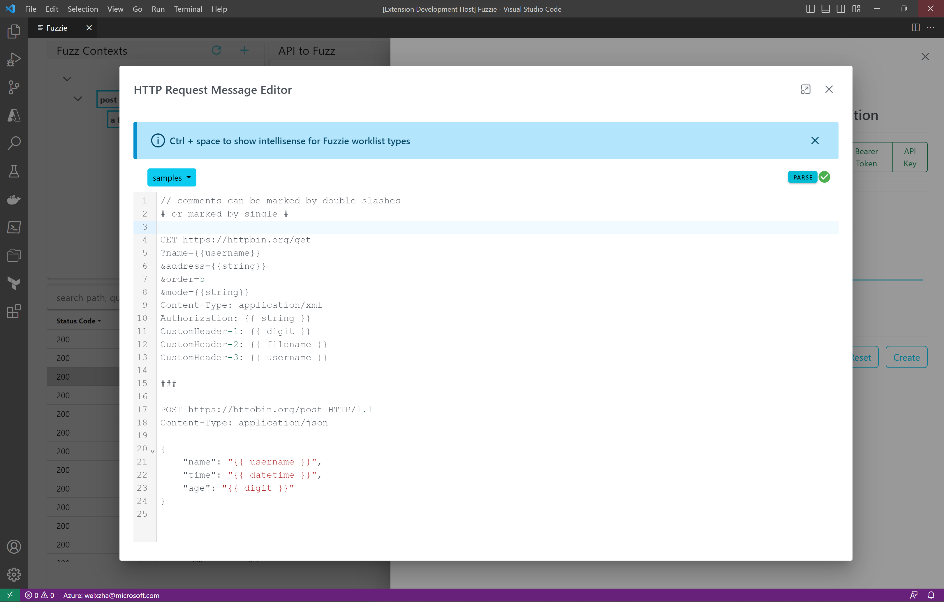
comments
all wordlist are inside a double curly braces {{ … }}
Request message divider, there are 2 request messages in here

