Slide 1
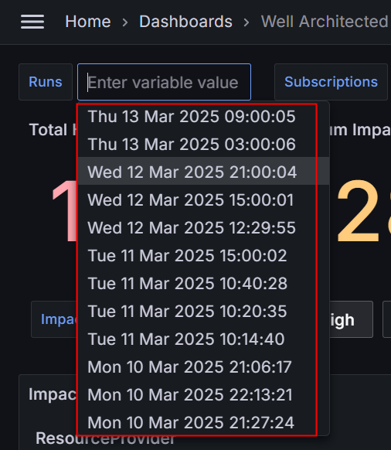
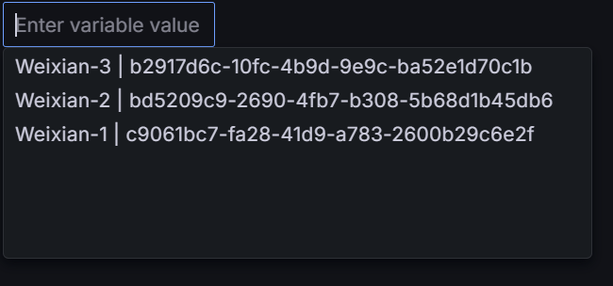

Slide 2
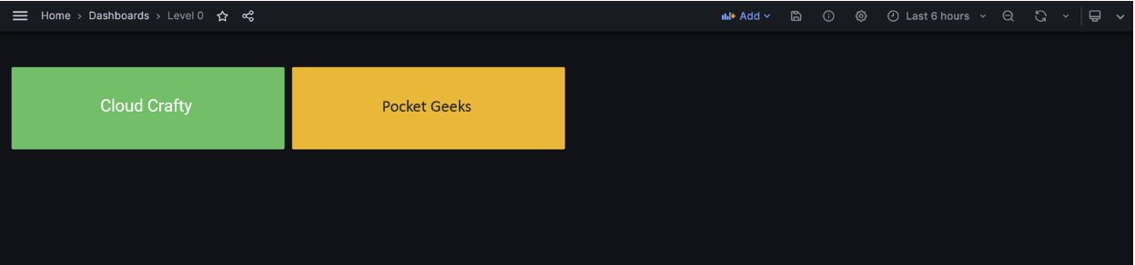
Enigma Hub

Slide 3
Cloud Crafty
Pocket Geek
Enigma Hub
Tier 0
(summary of Tier 1)
Red > Amber
Tier 1 Cloud Crafty
Tier 1 Pocket Geek
Tier 1 Enigma Hub
VM 1
VM 2
APIM
VM
Storage
VM 3
CPU>90
Event Hub
Redis
VM
Memory>90
Firewall
Storage
IoT Hub
Firewall
Bastion
Function
App Gateway
AKV

Slide 4
Pocket Geek
system
Cloud Crafty
system
Enigma Hub
system
Tier 0
(summary of Tier 1)
VM
Storage
APIM
Firewall
Tier 1 Pocket Geek system

Slide 5
Pocket Geek
system
Cloud Crafty
system
Enigma Hub
system
Tier 0
(summary of Tier 1)
VM 1
VM 2
VM 3
CPU>90
Firewall
Storage
IoT Hub
Tier 2 Cloud Crafty system
Tier 1 Cloud Crafty

Slide 6
Pocket Geek
system
Cloud Crafty
system
Enigma Hub
system
Tier 0
(summary of Tier 1)
Red > Amber
Event Hub
Redis
VM
Memory>90
Bastion
Function
App Gateway
AKV
Tier 1 Enigma Hub system

Slide 7
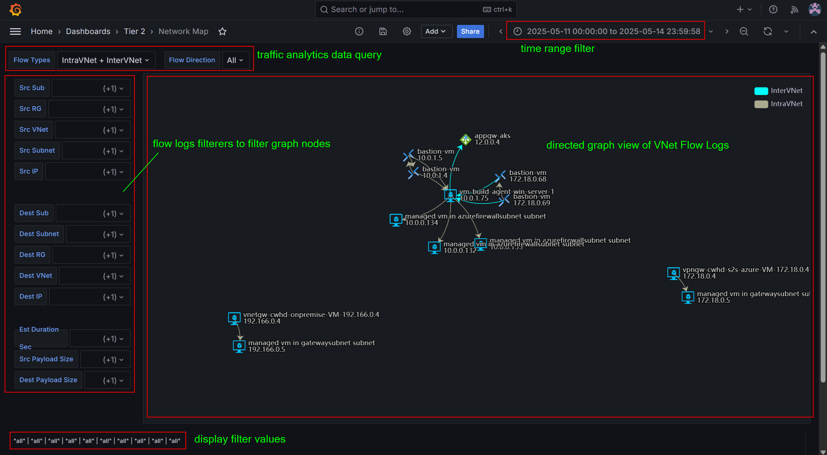
panning: hold Left mouse and move
zoom in/out: mouse scroll up/down

