Slide 1
Base configurations
project structure supports multiple environments like Dev, SIT, UAT, Production
All resource will have at least 2 instances
All AZ supporting resources will have AZ enabled

Slide 2
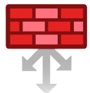





















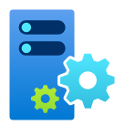




Internet Ingress
Internet Egress
AzureFirewallSubnet
AzureFirewallSubnet
Internet Compartment
Web
Daemon
App
IT
Private Endpoints
DB
Redis Cache
Bastion Compartment / AzureBastionSubnet
DevOps Compartment
Management Compartment
ADDNS
DNS Private Resolver Inbound Endpoint
DNS Private Resolver Outbound Endpoint
backup
Data
Collection
Rule
Automanage
Automation
Hybrid
Runbook
worker

