Slide 1
SwiftCloud Policy Controller Goals
The goal of SwiftCloud Policy Controller is to continuously assess tenant environments to:
Create mandatory services or re-create missing services on each tenant subscription
Assess and enable security features on selected services. i.e: ATP integrates with ASC if switched on.
Enable Azure Diagnostics Logging on all PaaS services
Collect selected log types from all tenant environments for long term storage.
Possible future integration with 3rd-party SIEM
(*KIV) Ensure “marked” environment is AIAS compliant.
Controller Manager can assess and remediate environments to make sure the posture fits the stated model
(i.e I-Model, U@Db, H-Model).

Slide 2
Policy Controller Responsibilities
Default Services Assessment Plan | Security Hygiene Assessment Plan | Log Enabler Assessment Plan | Archive Tenant Logs | Visualize/Search Logs | Other Features provided in Policy Controller Portal
Always create 1 default LA workspace Measure: ToAssess, ToRemediate Associate ASC to default LA workspace Upgrade ASC to Standard Enable “Auto Provisioning” ASC to auto-install MMA agent Enable Az Backup on VMs that has missing backup | Az Storage ATP not enabled. measure: assess, remediate Is Secure Transfer enabled for Azure Storage Az SQL Audit Az SQL Advance Data Security – Vulnerability Assessment scans Az SQL Advance Data Security – ATP Az Database for PostgreSQL ATP Az Database for MySQL ATP Az Database for MariaDB ATP Is any “imported certificates” in AKV expiring soon. | All PaaS Services log to 2 destination Log to “local” LA workspace Also log to Policy Controller central event hubs Ensure VMs are connected to “default” LA workspace Ensure “Monitor for VM” is enabled for all VMs Link Azure Activity to Log Analytics Install Monitoring Solution https://dev.azure.com/swiftoffice/Elenktis/_workitems/edit/105/ | From all subscriptions to central storage VM Windows security events logged by MMA agent, from LAWrk Monitor for VM (Insights), from LAWrk VMConnection table Network NSG Flow logs, collect from storage NSG Flow Traffic Analytics, collect from LAWrk Security Az DDoS Protection Standard, from LAWrk Az Firewall logs, from LAWrk Az App Gateway WAF, from LAWrk Az Front Door WAF logs, from LAWrk Database Az SQL ATP, from storage Az SQL VA Scan result, collect from storage Storage Storage Analytics, from storage $log container Operations Azure Activity Log, from EventHub | ELK stack to visualize Activity Log AAD Signin NSG Traffics Monitor for VM – Connection Metrics for Malicious Remote IP and opened port | *AIAS compliance asserter measure: produce report NSG rule search Search VMs with Public IPs Tag multiple VMs *Tag Log Data according to Resource Tags
Discover
Assess
Remediate
Collect
Visualize

Slide 3
Policy Controller Responsibilities
Default Services Assessment Plan | Security Hygiene Assessment Plan | Log Enabler Assessment Plan | Log Collector Assessment Plan | Visualize Logs | Compliance Assessment
 | VM Disk encryption enabled Azure SQL TDE enable Azure Resource lock on measures: assess, remediate Install missing MS Antimalware on VMs measures: assess, remediate Is App Service HttpsOnly enabled App Insights Availability Test measures: assess, notify Missing NSG at subnet measures: assess, notify No rules in NSG measures: assess, notify DDoS Protection Standard not enabled when PIP present measures: assess, remediate Remote Debugging of Az Func measures: assess, remediate Remote Debugging of App Service Measures: assess, remediate Check VM connected to LA workspace
Notes:
Gging

Slide 4















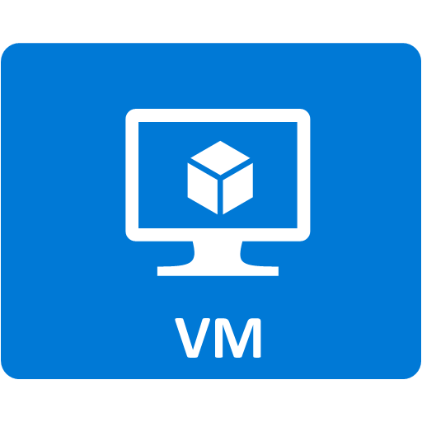








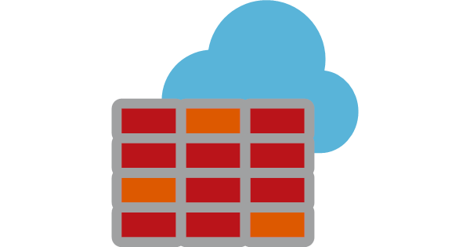


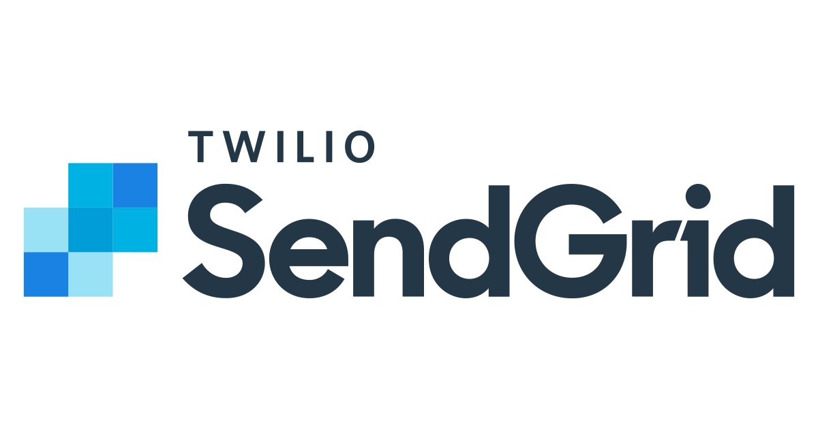

SwiftCloud Policy Controller - Azure Architecture
Policy Controller Subscription
Tenant Subscription
Event Bus
Public IP
create default services
AppGw WAF
Azure Log Analytics
Azure Security Center
Standard
Antimalware
on VMs
ACR
AKV
Discover subscriptions
create mandatory services
foreach subscription
switch on security features
enable diagnostics logging
Az Service Bus
(prod:premium)
get secrets
enable logs
Azure Cosmos Db
Mongo API
inter-controller
comms
Az NLB
Activity Log
export event hub
All PaaS Diag
to log analytics
Flow Logs on NSG
to blob storage+LA workspace
Stores all Controllers
app logs
event store
Policy Controller
Azure SQL Audit
to blob storage
Azure SQL ADS-VA Scans
to blob storage
Azure SQL
SecurityAuditEvent
to event hub
Portal
Policy Admin view/update policies
Az DB MariaDb ATP
Az DB MySQL ATP
Az DB PostgreSQL ATP
Event Hub x5
receive logs from
API
Storage ATP
AKS x3 nodes
Policy Controller’s
command line tool for automation
(TBD)
collect
Log Storage
MMA events
In LogAnalytics
NSG Traffic Analytics Log
In log anaytics
Az SQL Diag-SeccurityAuditEvents
in event hub
All logs to
ASC
all subscriptions
Azure Data Lake
Cloud Admins view
dashboard & search logs via ELK
ASC for all subscriptions
Az Firewall Logs
In event hub
AppGw Firewall Logs
In event hub
DDOS Protection Standard
Firewall Logs
in event hub
Notifier
NSG Flow Logs
In blob storage
Az SQL VA Scan Result
In blob storage
Activity Log
export event hub
Azure AD P1
diagsettings
Azure Log Analytics

Slide 5

SwiftPolicy Policy Controller – Process View
Policy Controller
between spies & fixers
spies & fixers
to chassis
controller bus
chassis framework
controller bus
to chassis
collectors
Portal
update policy changes
API
update policy changes
Watch for policy changes
Azure Cosmos Etcd (ConfigStore)

Slide 6









SwiftCloud Policy Controller - Inside AKS
Tenant Subscriptions
SwiftCloud Policy Controller
ingress controller
EventHub
EventHub
EventHub
EventHub
EventHub
Az SQL Security Audit Event
collector
DDoS Standard
log collector
AppGW WAF
log collector
AzFW
log collector
Activity
log collector
kube svc
kube svc
Portal
API
update configs
log domain events &
send notifications
Azure Log Analytics
(customer tenant)
Azure Log Analytics
(customer tenant)
Az Storage
event bus
Az Storage
Spies & Fixers
spies & fixers comms
VM log collector
NSG Traffic Analytics
log collector
NSG Flow
log collector
Az SQL VA Scan Result
log collector
Default
Service
Spy
Default
Service
Fixer
Security
Hygiene
Spy
security
hygiene
Fixer
LogEnable
Spy
chassis framework
ELK Log Ingester
Event
Logger
Notifer
Recce
LogEnable
Fixer
collectors
create plans &
policies
get configs
event bus (powered by ASB)
App DB
log events
Policy Store
Log Storage (all tenant logs)
default
service
command
queue
security
hygiene
command
queue
Log Enabler
command
queue
Notifier
command
queue
ActivityLog
command
queue
Azure Cosmos MongoDB
Azure Cosmos Etcd (ConfigStore)
Azure Data Lake
all event logs and app logs store in cosmos

Slide 7


Tenant Subscription
discover subscriptions
remediate
update policies
assess subscription
collect logs
Portal
Fixers
Policy Controller API
Recce
Log
Collectors
Spy
update policies
Discover new subscriptions
& create assessment plans & policies for new subscriptions
controller bus
get assessment plans & policies
at per subscription
chassis framework
ConfigStore
(Cosmos Etcd)
Stores
Controller app logs
controller activity result
PolicyController DB
(Cosmos MongoDB)

Slide 8
Policy Store
Types of Policy Keys | Example Key | Example Values
Subscription Key | 231dASDA2DW123 | {“subscriptionid”: “231dASDA2DW123”, “subscriptionName”: “project curious”}
Policy Key | /plan/231dASDA2DW123/defaultservicesplan/ASCAutoRegisterVMEnabledPolicy/ToAssess | true/false
“AIAS” design config Key | HModel-SharedGUTIT, HModel-WithoutGUTIT, IModel, UDB, UAPP | { “tiers”: { “internet”:{ “web”: true, “app”:true, “db”: true, “gut”:true, “it”: true }, “intranet”:{ “web”: true, “app”:true, “db”: true, } } “trafficFlow”: {…} }

Slide 9
SwiftCloud Policy Controller Portal Requirements
Assessment Plan Configuration
For each tenant subscription
Able to configure Spies and Fixers to turn on/off assessment and remediation for each policy in each assessment plan type: DefaultServicePlan, SecurityHygienePlan and LogEnablePlan
View VA scan result

Slide 10




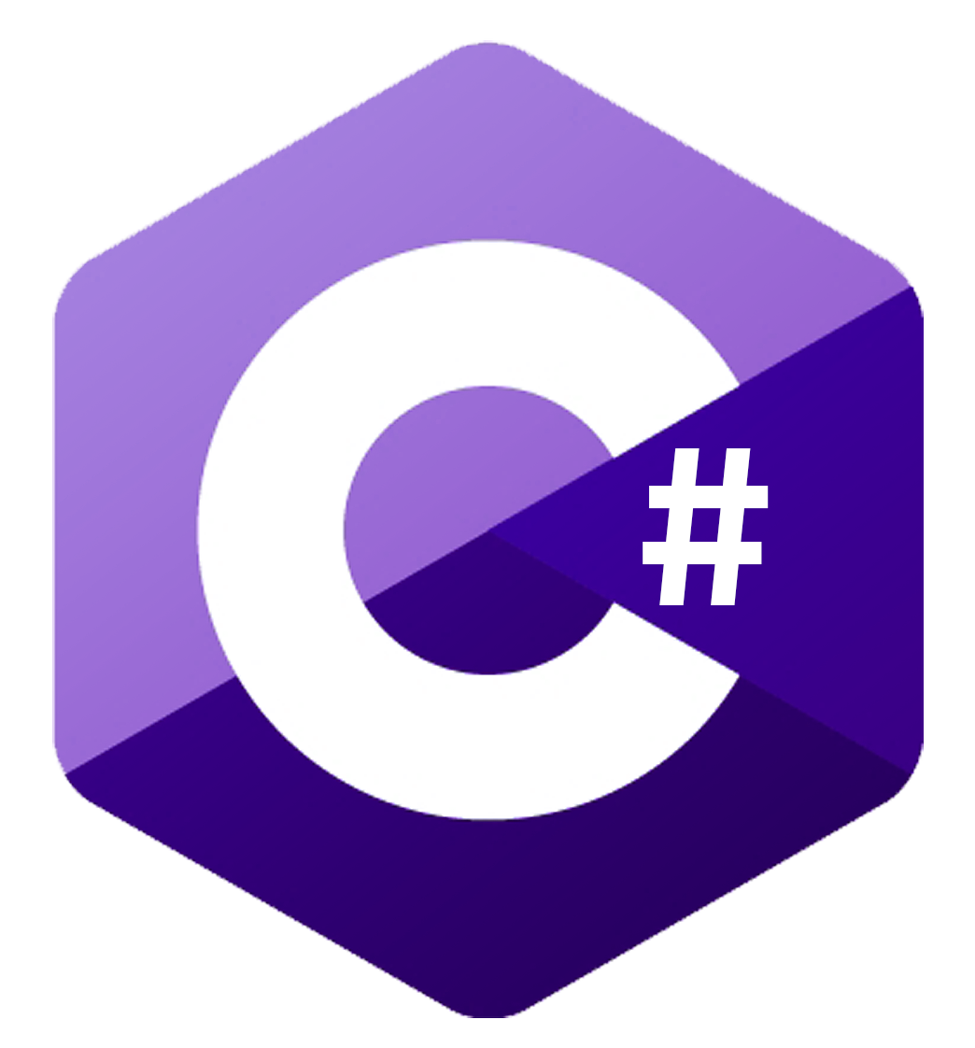


Central Services Architecture: Inside AKS
MMA
Tenant Subscription
traffic analytics
flow logs
Azure Log Analytics
Azure Activity Log
Storage
NSG Flow Logs
Storage
SQL VA Scans
export
Controller Manager Subscription
AzSQL SecurityEvent Logs
Az EH
DDos Logs
Az EH
AzFW Logs
Az EH
AppGw Logs
Az EH
ActivityLog
Az EH
NSG Flow Log
Az EG Topic
AzSQL VA Scan
Az EG Topic
if diagsettings missing
send msg
kusto
Diagnostics
Settings
Informer
kusto
AppGw WAF Log
Collecor
if feature missing
send msg
receive
SecurityHygiene
Informer
Portal
NSGTrafficAna
Collector
DDoS Log
Collecor
ActivityLog
Collector
AzSQL
VAScan
Collector
Default
Service
Informer
Mandate
Service
Fixer
VM Log
Collector
AzSQLSecurityEvent
Collector
AzFW Log
Collecor
NSG Flow
Log
Collector
Security
Hygiene
Fixer
logstash event hub
plugin
if services missing
send msg
Diagnostic
Settings
Fixer
Visualize & search
enable Security
Features
set diagnostic
settings
load data
logstash blob storage
plugin
service
fixer
queue
security
hygiene
queue
diagnostic
fixer
queue
save all tenant logs
OR
app logs
Azure Data Explorer
Azure Blob Storage
Azure Data Lake
Azure Cosmos Db Mongo API

Slide 11
Objective | Use Cases | Azure Services
Administrator and Privileged User Track | New Administrator / Privileged user creation Abnormal login attempts and login failures | Azure Security Center Just In Time Access Azure Active Directory Privileged Identity Management (PIM)
Network Traffic Logs monitoring | Firewall event monitoring Abuse and exploitation attempts monitoring Alert generation for successful access to or from external IPs identified as malicious | Azure Firewall (with Threat Intelligence turned on in alert and deny mode) 3rd Party NGFW Network Watcher and Open Source tools (for investigation)
Data | Monitor data leakages such as exfiltration of data Monitor access of sensitive table – authorized / unauthorized | Azure Security Center Vulnerability Assessment for Azure SQL
24x7 monitoring | Cloud native SIEM | Azure Sentinel (Preview)

Slide 12
Sources that inspire Policies
GCCI
IM8
Azure Secure DevOps Kit - https://azsk.azurewebsites.net/README.html
Azure CIS
Azure BluePrint – ISO 27001

