Slide 1
NTHU CS5553 Data Science for Digital Health Homework 3
Deadline: JUN. 11, 23:59

Slide 2
Predicting Mortality of Pulmonary Embolism Patients in the ICU
Model Development

Slide 3
Introduction
Pulmonary embolism (PE), the 3rd leading cause of cardiovascular-related mortality worldwide^{[1]}, causes about 300,000 deaths annually in the U.S.^{[2]}
Machine learning (ML) offers a promising approach for identifying low-risk PE patients, aiding in early ICU discharge, reducing resource use, and improving outcomes for critically ill patients^{[3]}.
What are the important predictors of mortality
in patients with PE admitted to the ICU?
[1] Raskob GE et al. Thrombosis: a major contributor to global disease burden. (2014)
[2] Wendelboe AM et al. Global burden of thrombosis: epidemiologic aspects. (2016)
[3] Schulman S et al. Post-thrombotic syndrome, recurrence, and death 10 years after the first episode of venous thromboembolism treated with warfarin for 6 weeks or 6 months. (2006)

Slide 4
Cohort Selection
Inclusion
Exclusion
Patients whose age >= 21
Patients in ICU with pulmonary embolism*¹
Include only the last ICU admission record in which the patient was diagnosed with PE
Include only patients who have admission record*²
*1 pulmonary embolism → ICD-9 code: 415.1, ICD-10 code: I26
*2 include patients whose hadm_id is valid in mimiciv_hosp.admission

Slide 5
Outcome
Mortality (in-hospital) in the last ICU admission for the patient with pulmonary embolism (patients diagnosed with PE within that hospital admission).

Slide 6
Todo
Build machine learning models for mortality prediction
You should use features extracted from your HW2
Model evaluation

Slide 7
Assignment:
Code (40%):
Implementation (25%)
Reproducibility (15%)
Key inclusions in your report (60%):
Data pre-processing (5%)
e.g.: dealing with outlier and missing data, encoding, normalization, etc.
Details of model setup (10%)
e.g.: model architecture, training process, hyperparameter tuning, etc.
Tables or plots for performance evaluation metrics (10%)
e.g.: AUC, accuracy, sensitivity, specificity, F1-score, etc.
ROC curve (4%), Confusion matrix (3%), Calibration plot (3%)
Feature importance (5%)
Fairness analysis (report model performance evaluation metrics in different gender groups) (10%)
Findings, discussion or conclusion of your results (10%)
Bonus:
Ablation study (i.e., How do you improve performance of your predictions?)

Slide 8
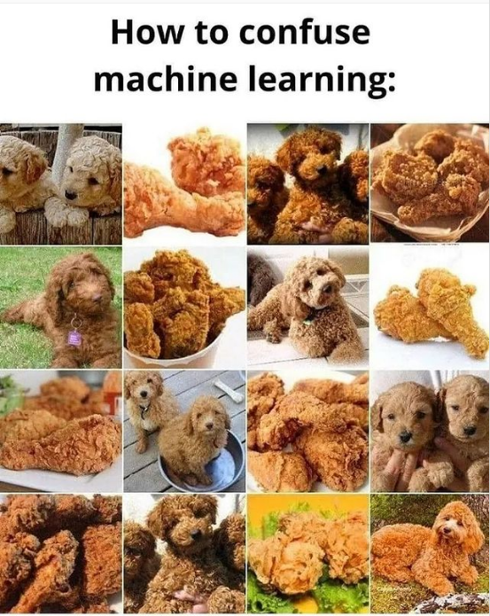
Questions?
TA: Yueh-Chun Liu (劉岳濬)
Email: eugeneliu1998@gmail.com
Lab: EECS 639

