Slide 1
NTHU CS5553 Data Science for Digital Health Homework 2
Deadline: May. 21, 23:59

Slide 2
Predicting Mortality of Pulmonary Embolism Patients in the ICU
Feature Extraction

Slide 3
Introduction
Pulmonary embolism (PE), the 3rd leading cause of cardiovascular-related mortality worldwide^{[1]}, causes about 300,000 deaths annually in the U.S.^{[2]}
Machine learning (ML) offers a promising approach for identifying low-risk PE patients, aiding in early ICU discharge, reducing resource use, and improving outcomes for critically ill patients^{[3]}.
What are the important predictors of mortality
in patients with PE admitted to the ICU?
[1] Raskob GE et al. Thrombosis: a major contributor to global disease burden. (2014)
[2] Wendelboe AM et al. Global burden of thrombosis: epidemiologic aspects. (2016)
[3] Schulman S et al. Post-thrombotic syndrome, recurrence, and death 10 years after the first episode of venous thromboembolism treated with warfarin for 6 weeks or 6 months. (2006)

Slide 4
Cohort Selection
Inclusion
Exclusion
Patients whose age >= 21
Patients in ICU with pulmonary embolism*¹
Include only the last ICU admission record in which the patient was diagnosed with PE
Include only patients who have admission record*²
*1 pulmonary embolism → ICD-9 code: 415.1, ICD-10 code: I26
*2 include patients whose hadm_id is valid in mimiciv_hosp.admission

Slide 5
Outcome
Mortality (in-hospital) in the last ICU admission for the patient with pulmonary embolism (patients diagnosed with PE within that hospital admission).

Slide 6
Features Table
*Note: all feature values related to time would be taken from between 6 hours before the target patient admitted to the ICU to 24 hours after the target patient admitted to the ICU.
 |  | Missing Data | Outcome |  | P-value
 |  |  | Alive | Die
Number of Patients |  | 0 | 1445 | 291
Urine output (mean)
Vasopressin usage during ICU stay (number of patients) | 0
vasopressin, n (%) | 1
Gender (number of patients) | Male
vasopressin, n (%) | Female
Age (mean, std)
hemoglobin_min (mean, std)
hemoglobin_max (mean, std)
resp_rate_mean (mean, std)
glucose_max (mean, std)
heart_rate_max (mean, std)
glucose_avg (mean, std)

Slide 7
Additional Features (Optional)
self-reported race, insurance
congestive heart failure, diabetes, hypertension, history of MI, history of cancer
vital sign at admission
ventilation status
lab values (max, min, avg): creatinine, hemoglobin, INR/PT/PTT, glucose, lactate
pressor requirement
…etc.

Slide 8
Todo
Extract the features shown on slide p.6 (and on slide p.7 for option)
Preprocess the extracted data
e.g.: deal with outliers, impute missing data, etc.
Perform exploratory data analysis (EDA) to see the difference between 2 subgroups w.r.t. in-hospital mortality
e.g.: T-SNE, PCA, histogram, pair plot, heatmaps, etc.
You should show at least 2 EDA results for the features in your report

Slide 9
Assignment: A Report (with your code)
Your report should include at least:
Features Table: show “Features Table” on slide p.6 (and on slide p.7 for option).
Data Preprocessing Description: include the data preprocessing steps taken.
Effective Feature Representation: show at least 2 EDA results for the features.
Preprocessing Impact: include representative examples that illustrate the impact of data preprocessing. These examples should clearly show the differences observed before and after the preprocessing phase.
Feature Relevance Analysis: based on “Features Table” and EDA results, the report should show whether there are features whose distribution in subgroups is correlated with distinguishing in-hospital mortality in PE patients. Explain the methodology you used to identify these highly correlated features.
Code: include your reproducible code.

Slide 10
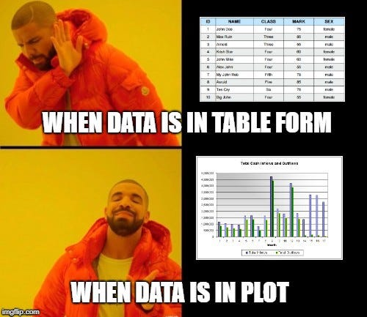
Questions?
TA: Yueh-Chun Liu (劉岳濬)
Email: eugeneliu1998@gmail.com
Lab: EECS 639

