Slide 1
Lab4
Neural Network
Chia-Suan Yu
Po-Chih Kuo

Slide 2
Introduction
In this lab, you will apply neural networks to three tasks:
Regression: Approximate a mathematical function.
Binary Classification: Classify OCT retinal images as either normal or affected by Choroidal Neovascularization (CNV), a condition that can cause vision loss.
Multi-Class Classification: Classify OCT retinal images into four categories:
CNV: Abnormal blood vessel growth in the eye
DME: Swelling of the macula due to diabetes
Drusen: Yellow deposits under the retina, potential sign of age-related macular degeneration
Normal: Healthy retina

Slide 3
Goal
Build your own deep neural network step by step
Implement all the functions required to build a deep neural network
Understanding forward propagation, backward propagation and update
Implement Binary Cross-Entropy loss and Categorical Cross-Entropy loss
Implement regression (basic part), binary classifier (basic part) and multi-class classifier (advanced part)

Slide 4
Grading Policy
Item | Score
Basic Implementation | 65%
Advanced Implementation | 30%
Basic & Advanced Report | 5%

Slide 5
Overview
Layer with parameters
Layer without parameters
Dense layer
Activation function layer
initialize_parameters
forward
forward
backward
backward
update

Slide 6
Overview
Model
Dense layer
model_initialize_parameters
Activation function layer
model_forward
Dense layer
compute_loss
Activation function layer
…
model_backward
Dense layer
model_update_parameters
Activation function layer

Slide 7
Basic Implementation (65%)
Section 1: Neural network implementation (30%)
Part 1: Linear layer (10%)
Step 1: Linear Initialize parameters (0%)
Step 2: Linear forward (4%)
Step 3: Linear backward (4%)
Step 4: Linear update parameters (2%)
Part 2: Activation function layer (10%)
Step 1: Activation forward (5%)
Step 2: Activation backward (5%)
Part 3: Build model (10%)
Step 1: Model Initialize parameters (0%)
Step 2: Model forward (4%)
Step 3: Model backward (4%)
Step 4: Model update parameters (2%)

Slide 8
Basic Implementation (65%)
Section 2: Loss function (10%)
Part 1: Binary cross-entropy loss (5%)
Part 2: Categorical cross-entropy loss (5%)
Part 3: Mean square error (0%)
Section 3: Training and prediction (25%)
Part 1: Training function & batch function (5%)
Part 2: Regression (10%)
Baseline : MAE <= 0.05 (5%)
Submit “Lab4_basic_regression.gif” (5%)
Part 3: Binary classification (10%)
Baseline : Public f1 score >= 0.8 (5%)
Baseline : Private f1 score >= 0.8 (5%)

Slide 9
Advanced Implementation (30%)
Multi-class classification
Baseline : Public f1 score >= 0.6 (5%)
Baseline : Private f1 score >= 0.6 (10%)
Private Ranking (15%)

Slide 10
Loss function and Activation function
Warning: only the following 3 combinations are allowed!
1. Regression : linear + mse
2. Binary classification: sigmoid + cross_entropy
3. Multi-class classification: softmax + cross_entropy

Slide 11
Data (Simulation data)
Regression: Math function approximation
The target function to approximate is:
y = sin(2 * sin(2 * sin(2 * sin(x))))
where x is in the range [0.01, 11]

Slide 12
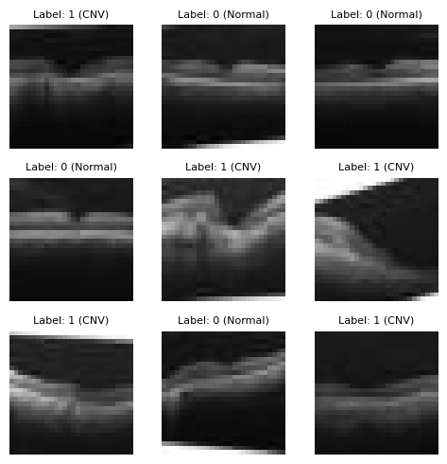
Data (OCT scans)
Binary classification: OCT scan images of retina The dataset consists of 28x28 pixels grayscale OCT scan images of the retina, focusing on two classes: CNV (Choroidal Neovascularization) and Normal. Details of the dataset:
shape of x_train: (20000, 28, 28)
shape of y_train: (20000, 1)
shape of x_test: (5000, 28, 28)
Classes:
CNV: label = 1
Normal: label = 0

Slide 13
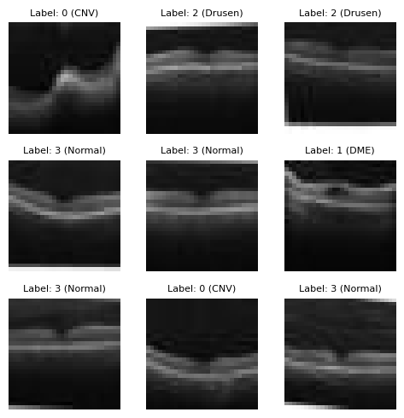
Data (OCT scans)
Multi-class classification: OCT scan images of retina The dataset consists of 28x28 pixels grayscale OCT scan images of the retina, categorized into four classes: CNV (Choroidal Neovascularization), DME (Diabetic Macular Edema), Drusen, and Normal.
Details of the dataset:
shape of x_train: (37754, 28, 28)
shape of y_train: (37754,)
shape of x_test: (3000, 28, 28)
Classes:
CNV: label = 0
DME: label = 1
Drusen: label = 2
Normal: label = 3

Slide 14
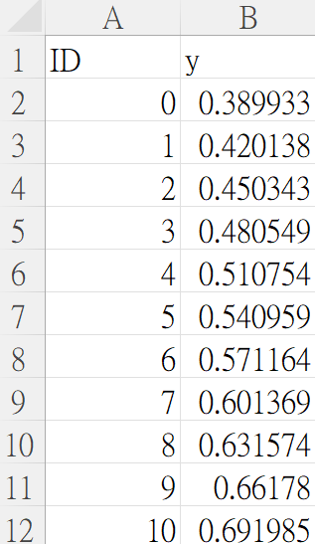
Output .csv file format
Basic Part : regression
There should be (1000+1) rows in your csv file
First row is the header [‘ID’, ’y’]
ID starts from 0, and y is the predicted y value
Please make sure that your output format is correct
Submit the answer (Lab4_basic_regression.csv) to Kaggle
ML2024-Lab4-BasicPart-Reg

Slide 15
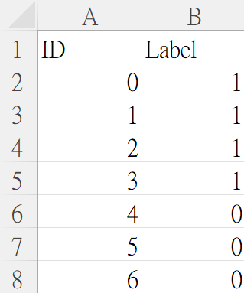
Output .csv file format
Basic Part : binary classifier
There should be (5000+1) rows in your csv file
First row is the header [‘ID’, 'Label']
Your prediction answer should be either 0 or 1
ID starts from 0, and Label is the predicted answer
Please make sure that your output format is correct
Submit the answer (Lab4_basic.csv) to Kaggle
ML2024-Lab4-BasicPart-B.C.

Slide 16
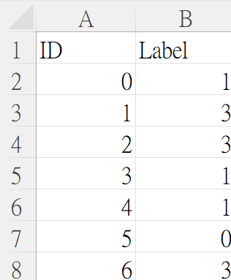
Output .csv file format
Advanced Part : multi-class classifier
There should be (3000+1) rows in your csv file
First row is the header [‘ID’, 'Label']
Your prediction answer should be (0~3)
ID starts from 0, and Label is the predicted answer
Please make sure that your output format is correct
Submit the answer (Lab4_advanced.csv) to Kaggle
ML2024-Lab4-AdvancedPart

Slide 17
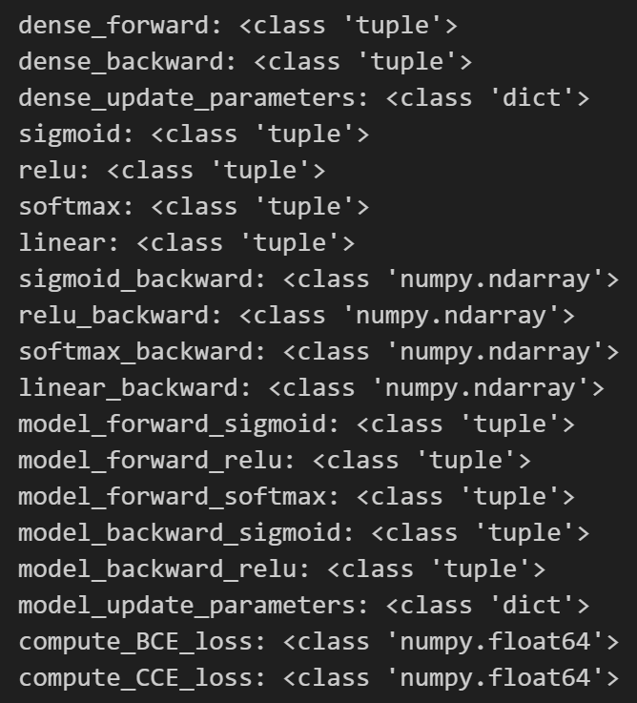
Output .npy File Format
Named as “Lab4_output.npy”
This file is a dictionary that stores your output for each function.
We will test your ”Lab4_output.npy” to verify the correctness of your neural networks.

Slide 18
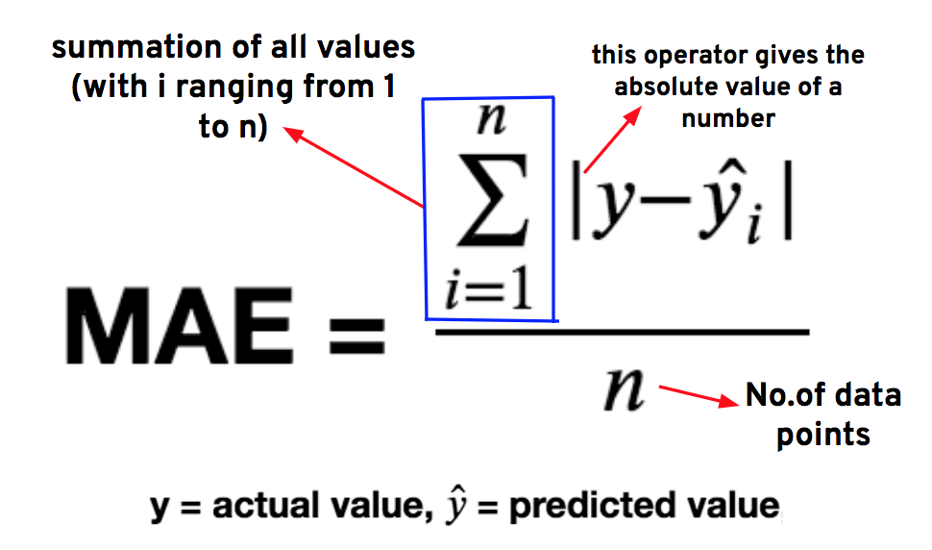
Evaluation Metric
Regression
MAE (mean absolute error)

Slide 19
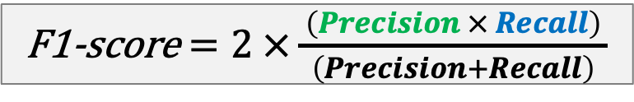
Evaluation Metric
Classification
F1-score
 |  | Actual/True value
 |  | positive | negative
Predicted value | positive | TP | FP
 | negative | FN | TN

Slide 20
Given Items
Template: Lab4_template.ipynb
Basic data (binary classifier): basic_data.npz
Advanced data: advanced_data.npz

Slide 21
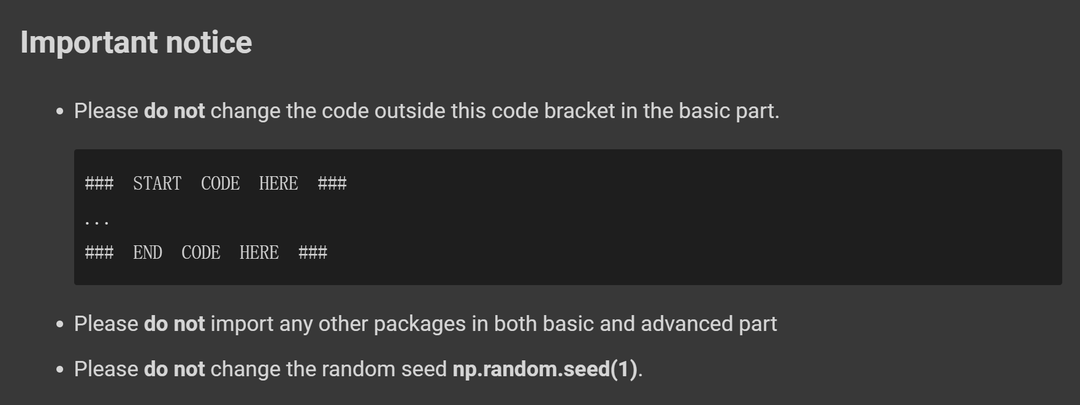
Template
Remember to save the code file to Lab4.ipynb

Slide 22
Kaggle
We’ve created competitions for 3 tasks respectively.
Basic regression link:
https://www.kaggle.com/competitions/ml-2024-lab-4-basic-part-fa
Basic binary classification link:
https://www.kaggle.com/competitions/ml-2024-lab-4-basic-part-bc
Advanced link:
https://www.kaggle.com/competitions/ml-2024-lab-4-advanced-part
For regression, only public data are provided.
For both binary and multi-class classification tasks, we split the testing data randomly into public (50%) and private (50%) parts, maintaining the same class distribution ratio.
Only the public score will be visible on Kaggle.

Slide 23
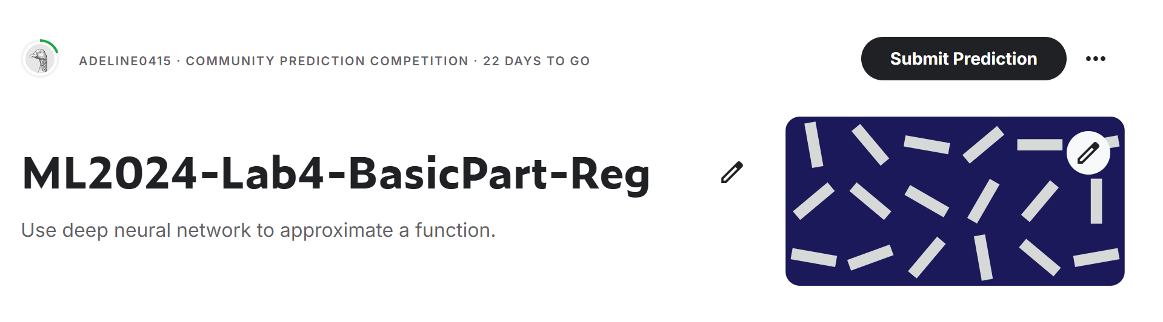
Kaggle
Please register your account.
Click the ‘Join competition’ button to join.

Slide 24
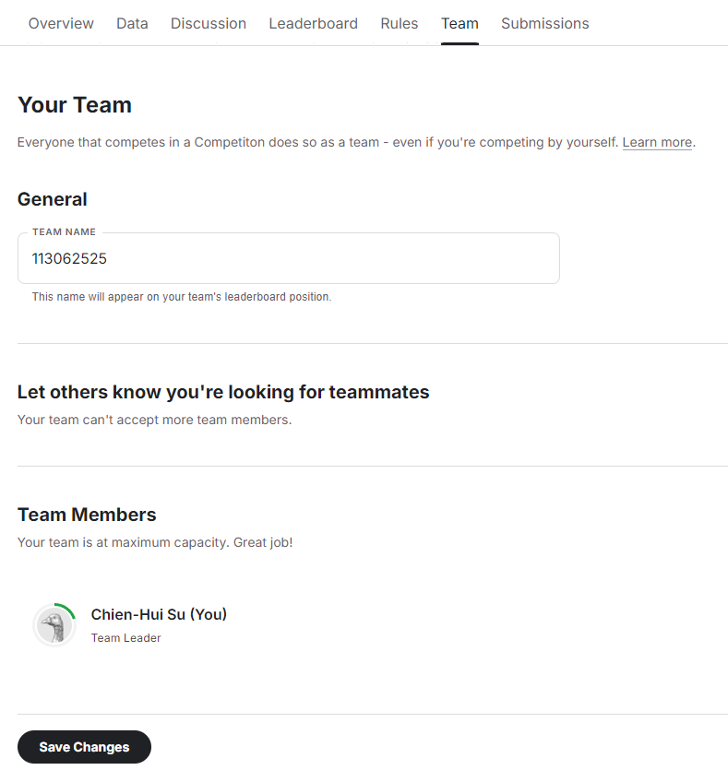
Kaggle
After joining the competition, you should change your team name (each student is a team) to your student ID.
Please remember to SAVE CHANGES
You can submit 50 times per day.
Notes: Please verify your team name on the leaderboard - changing profile name does not change team name.

Slide 25
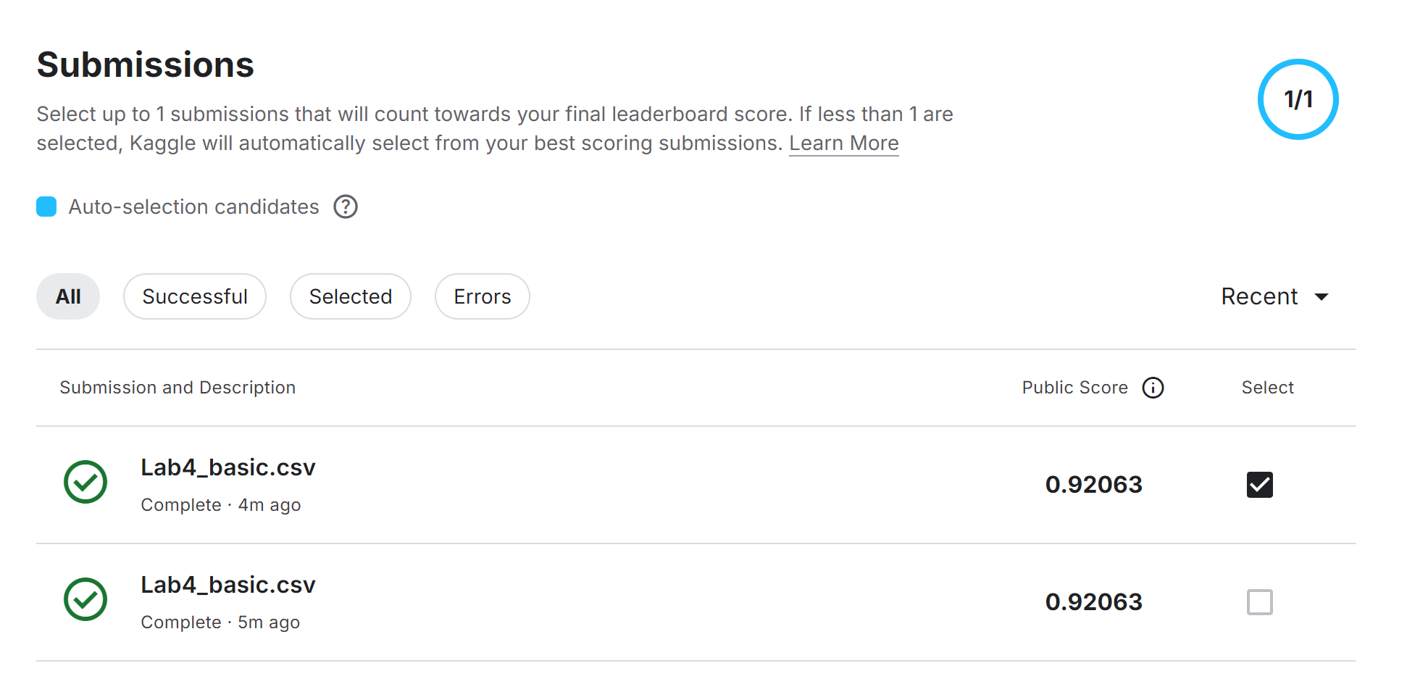
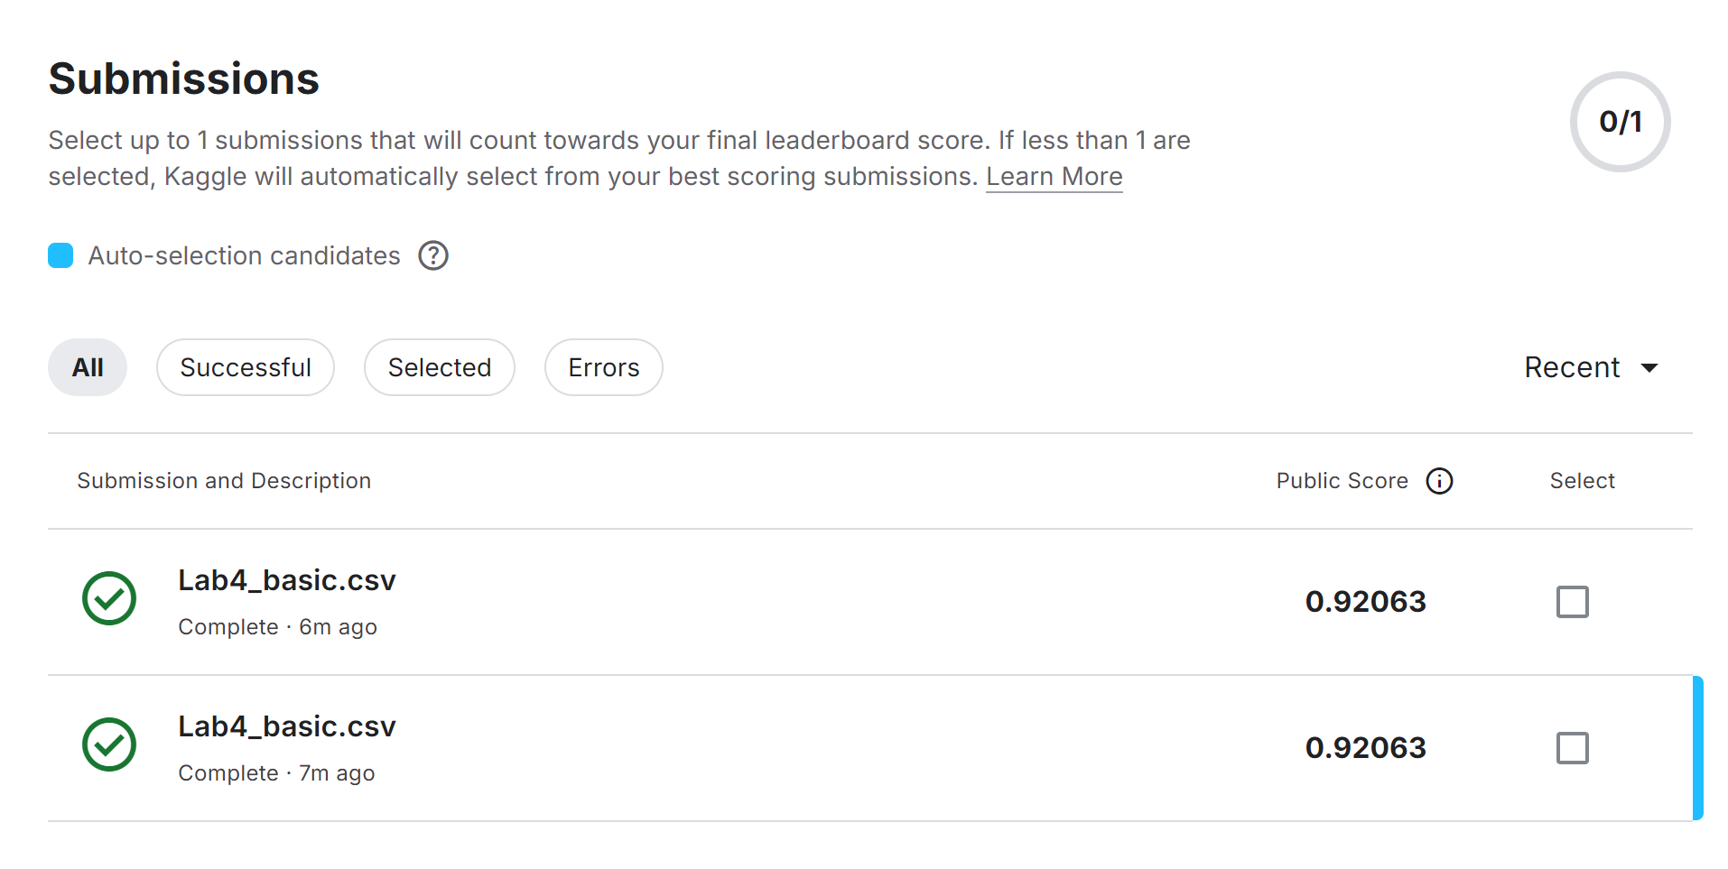
Kaggle
You can manually select up to 1 submission that will count towards your final leaderboard score. If no submission is selected, Kaggle will automatically select your submission with the best public score.
Manual-selection
Auto-selection

Slide 26
Basic & Advanced Report (5%)
What are the key differences between sigmoid and softmax activation functions, and why did we choose them for binary and multi-class classification respectively? (1%)
Why does the loss oscillate during model training? (list at least 2 reasons) (2%)
How does changing the learning rate and batch size affect model training time? (1%)
Put your regression results (lab4_basic_regression.jpg) on report. (1%)
Notes:
Do not exceed 1 page!
Name your report file as “Lab4_report.pdf”.

Slide 27
Requirement
Do it individually! Not as a team! (team is for final project)
Announce date: 2024/10/31
Deadline: 2024/11/12 23:59 (Late submission is not allowed!)
Submit the answers (csv) to corresponding Kaggle competition.
ML2024-Lab4-BasicPart-Reg
ML2024-Lab4-BasicPart-B.C.
ML2024-Lab4-AdvancedPart
Hand in following files to eeclass in the following format (Do not compressed!)
Lab4.ipynb
Lab4_report.pdf
Lab4_basic_regression.gif
Lab4_output.npy

Slide 28
Penalty
0 points if any of the following conditions happened
Plagiarism
Late submission
Not using a template or importing any other packages
No submission record on Kaggle (we cannot identify who you are)
Wrong team name on Kaggle (we cannot identify who you are)
No code(“Lab4.ipynb”) submission on eeclass
Your submission was not generated by your code
5 Points would be deducted if your submission format is incorrect
0 Points will be given in the Basic section 1&2 if you don’t submit “Lab4_output.npy”

Slide 29
Questions?
TA: Chia-Suan Yu 余佳軒 (adeline041503@gmail.com)
No debugging service

