Slide 1
Lab 5
Convolutional Neural Network
Pin-Shun Wang, Fen-Yu Hsieh
Po-Chih Kuo

Slide 2
Goal
Build your own convolutional neural network step by step.
Extend your previous NN to CNN.
Implement certain functions required to build a convolutional neural network.
Understand how the convolution layer and max pooling layer work, including forward propagation, backward propagation and update.
Build a convolutional neural network to predict the pulmonary disease of patients from their chest X-ray images.

Slide 3
Grading Policy
Item | Score
Basic Implementation | 65%
Advanced Implementation | 30%
Report | 5%

Slide 4
Overview
Layer with parameters
Layer without parameters
Convolution layer
Max pooling layer, flatten layer
forward
forward
backward
backward
update

Slide 5
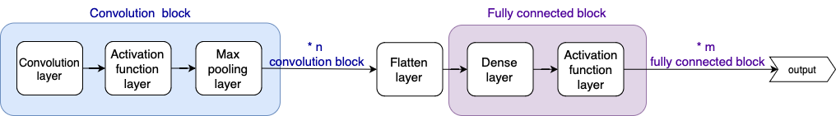
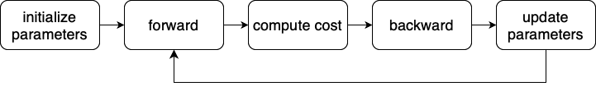
Overview
CNN model structure (suggestion)
Training process

Slide 6
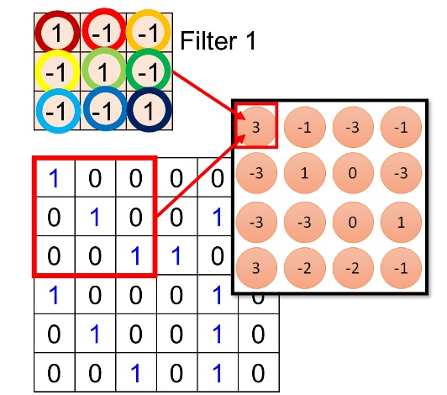
Basic Implementation (65%)
Convolution layer (30%)
Implement zero_pad function (3%)
Implement convolution single step (5%)
Implement forward pass (10%)
Implement backward pass (10%)
Implement convolution update parameters (2%)

Slide 7
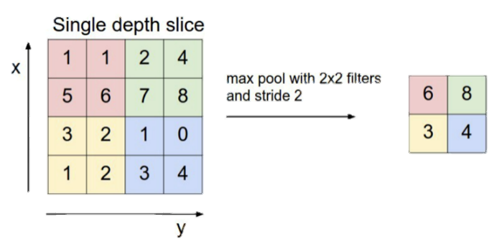
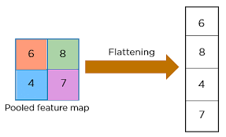
Basic Implementation (65%)
Max pooling layer (20%)
Implement forward pass (10%)
Implement backward pass (10%)
Flatten layer (10%)
Implement forward pass (5%)
Implement backward pass (5%)
Model (5%)
Implement forward pass, backward pass, update parameters (5%)

Slide 8
Advanced Implementation (30%)
Designing a CNN Model for Binary Classification
Implement a CNN binary classifier and try to get a good performance.
You can only use the functions you implement in the basic part.
We will use accuracy to evaluate your model.
Baseline: Accuracy > 0.65 (10%)
Baseline: Accuracy > 0.75 (10%)
Ranking (10%)

Slide 9
Data
Binary classification: Chest X-rays images
You will receive 600 samples as training data (300 normal and 300 abnormal), 300 samples as public testing data, and 300 samples as private testing data.
Use the training data to predict whether the patient in test data is normal or not.
0: normal / 1: abnormal
The shape of X_train is (600, 32, 32, 1) and the value of each pixel is between 0 and 1.

Slide 10
Lab5_output.npy File Format
Named as “Lab5_output.npy”
This file is a dictionary that stores the output for each function. You can use the provided sanity check in the notebook to ensure nothing is missing. The dictionary should include the following 18 keys:
'zero_padding’,
'conv_single_step’,
'conv_forward_1’,
'conv_forward_2’,
'conv_forward_3’,
'conv_backward_1’,
'conv_backward_2’,
'conv_backward_3’,
'conv_update_1’,
'conv_update_2’,
'maxpool_forward’,
'maxpool_backward’,
'flatten_forward’,
'flatten_backward’,
'model_1’,
'model_2’,
'model_3’,
'model_4’

Slide 11
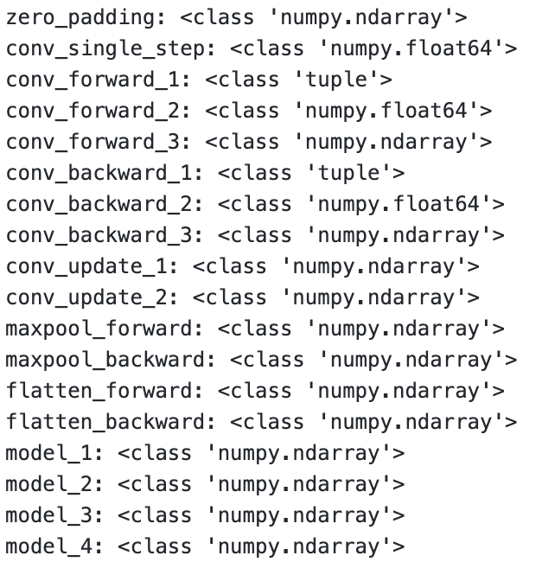
Lab5_output.npy File Format
We will test your ”Lab5_output.npy” to verify the correctness of your basic implementation.
Submit this file to eeclass.

Slide 12
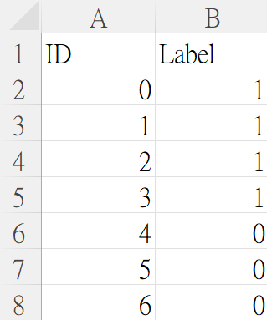
Lab5_prediction.csv file format
There should be (600+1) rows in your csv file
First row is the header [ID, Label]
Your prediction answer should be either 0 or 1
ID starts from 0, and Label is the predicted answer
Please make sure that your output format is correct
Submit the answer (Lab5_prediction.csv) to Kaggle

Slide 13
Items for you
Template: Lab5_template.ipynb
Some files: Dense.py, Activation.py, Loss.py (You can paste the code you wrote in Lab4 into these files). Additionally, a helper function file, Predict.py, is provided to assist with model predictions (you don’t need to modify this file).
Data(including training and testing data): data.npz
Sample submission csv file: Sample_submission.csv

Slide 14
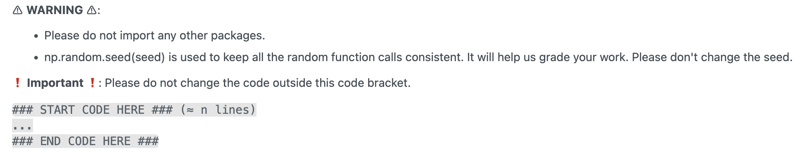
Template
Except for the imported packages in the template, you cannot use any other packages (ex: tqdm).
Remember to save the code file to Lab5.ipynb and submit it to eeclass.

Slide 15
Kaggle
We’ve created competitions for the advanced part.
Kaggle link: https://www.kaggle.com/t/3c1c6515bc5941b1a9bf6cda1642827c
The testing set is divided, with 50% designated as public and the remaining 50% as private.
Only the public score will be visible on Kaggle.
All final scores will be based on the private score.

Slide 16
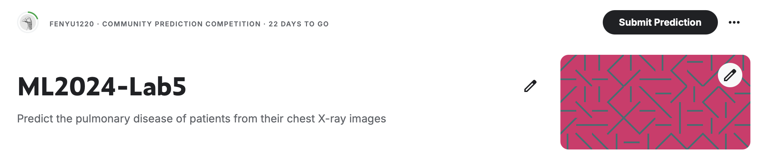
Kaggle
Please register your account.
Click the ‘Join competition’ button to join.

Slide 17
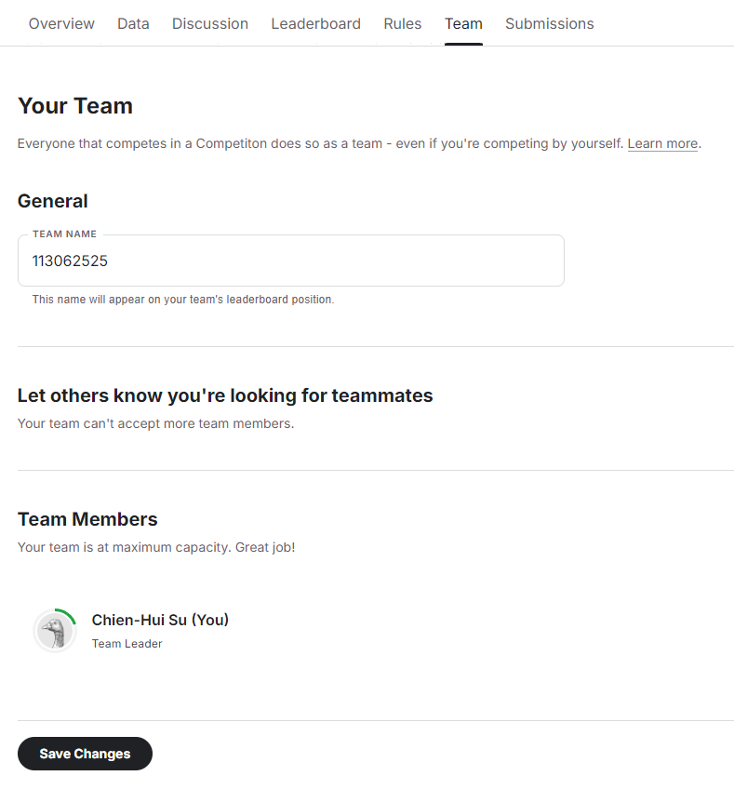
Kaggle
After joining the competition, you should change your team's name (each student is a team) to your student ID.
Please remember to SAVE CHANGES
You can submit 50 times per day.
Notes: Please verify your team's name on the leaderboard - changing profile name does not change team name.

Slide 18
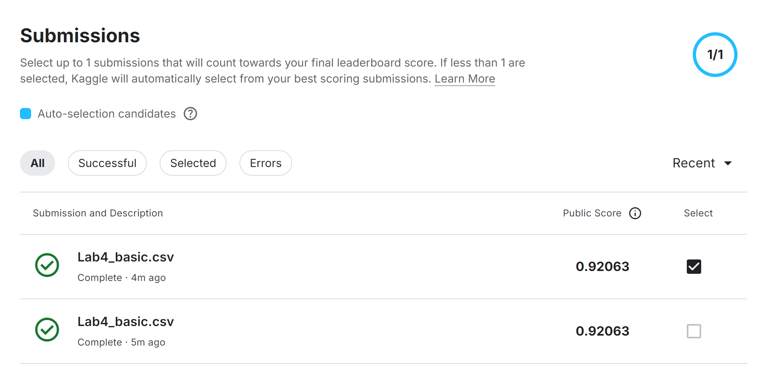
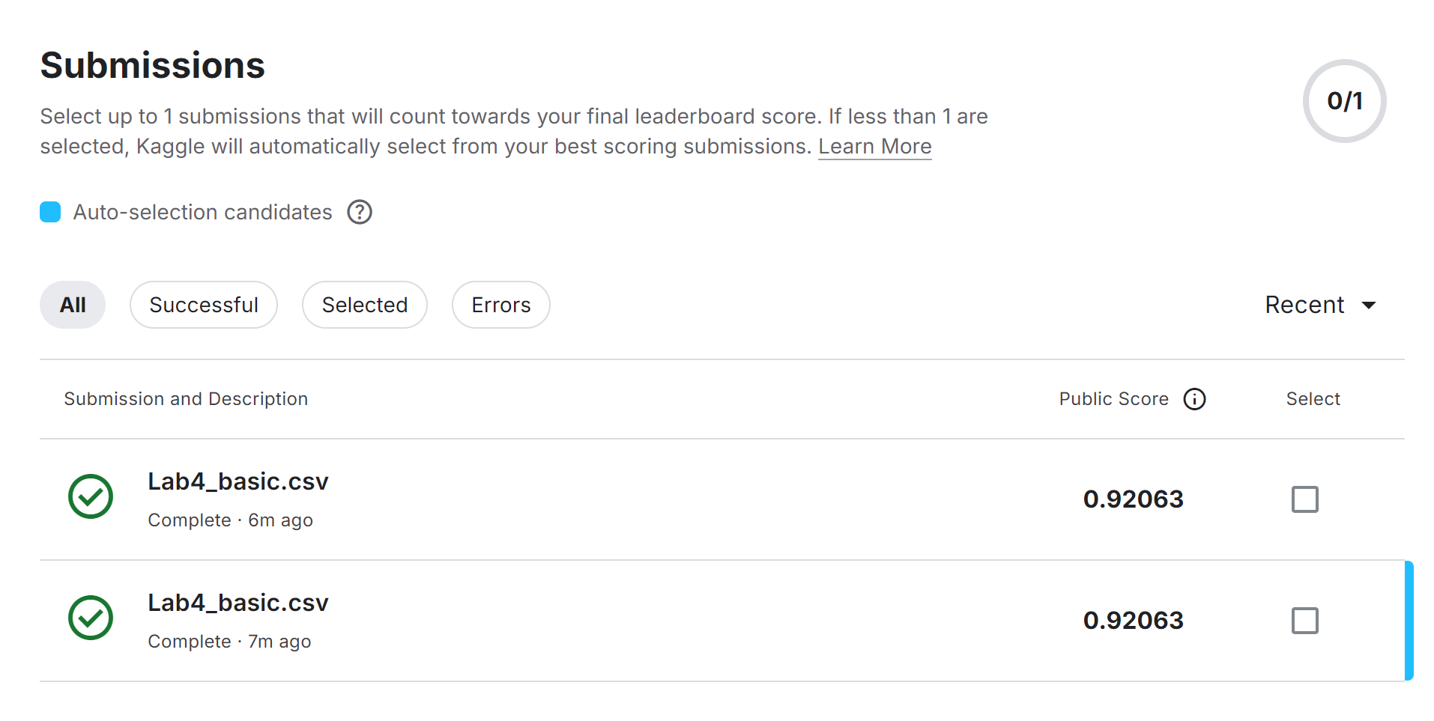
Kaggle
You can manually select up to 1 submission that will count towards your final leaderboard score. If no submission is selected, Kaggle will automatically select your submission with the best public score.
Manual-selection
Auto-selection

Slide 19
Report
Explain why ReLU is typically preferred over Sigmoid as the activation function in the convolutional block? (1%)
Describe how you design the CNN architecture and your findings in choosing parameters such as filter_size and pool_size for each layer? (2%)
Calculate and compare the number of learnable parameters between the CNN model and the NN model you designed for binary classification in Lab4. For simplicity, omit the bias parameters and calculate only the weights. (2%)
Notes:
Do not exceed 2 pages!
Name your report file as “Lab5_report.pdf”.

Slide 20
Requirement
Do it individually! Not as a team! (team is for final project)
Announce date: 2024/11/12
Deadline: 2024/11/26 23:59 (Late submission is not allowed!)
Submit the answers (Lab5_prediction.csv) to the Kaggle competition (Ensure that your leaderboard team name matches your student ID)
Advanced: https://www.kaggle.com/t/3c1c6515bc5941b1a9bf6cda1642827c
Hand in your files in the following format (Do not zip the files!)
Lab5.ipynb (Please keep your execution output)
Lab5_output.npy
Lab5_report.pdf
Lab 5 will be covered on the next exam.

Slide 21
Penalty
0 points if any of the following conditions happened:
Plagiarism
Late submission
Not using a template or importing any other packages
Incorrect input/output format
No submission record on Kaggle
Wrong team name on Kaggle (the team name is not your student id)
No code(“Lab5.ipynb”) submission on eeclass
Your submission was not generated by your code
5 Points would be deducted if your submission format is incorrect
0 Points will be given in the Basic implementation if you don’t submit “Lab5_output.npy”

Slide 22
Questions?
TA:
Pin-Shun Wang (wangpinshun@gmail.com)
Fen-Yu Hsieh (fenyu9867@gmail.com)
No debugging service

