Slide 1
Lab 6
Recurrent neural network
Yu-Chieh Lin
Po-Chih Kuo

Slide 2
Goal
Build your own recurrent neural network (RNN) by extending the previous Lab (Dense layer).
Implement certain functions required to build a RNN.
Understand how the forward propagation, backward propagation work in RNN.
Build a model using RNN layer to (1)model a Sinusoidal wave and (2)classify human activity.

Slide 3
Grading Policy
Item | Score
Basic Part RNN layer (30%) Model class (10%) Sinusoidal wave data (20%) | 60%
Advanced Part (human activity classification) | 35%
Report | 5%

Slide 4
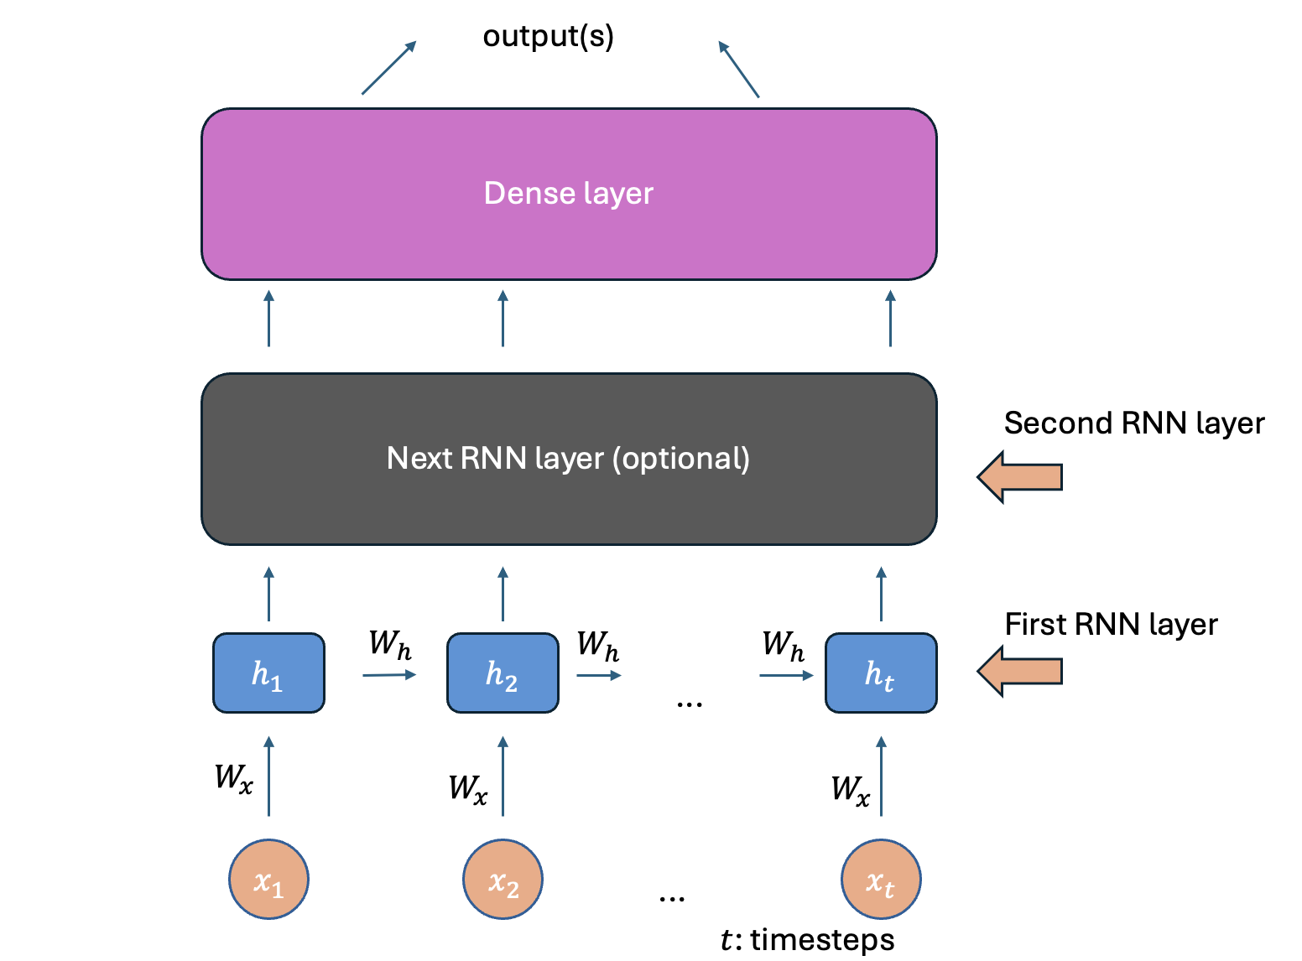
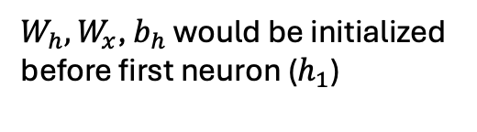
Overview
RNN layer

Slide 5
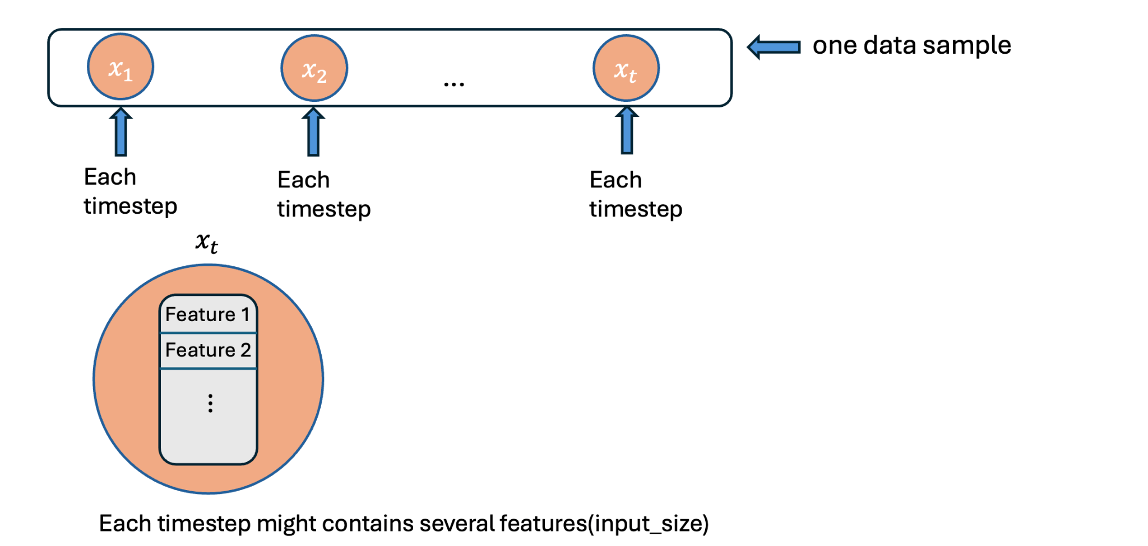
Overview
RNN layer (Cont’d)

Slide 6
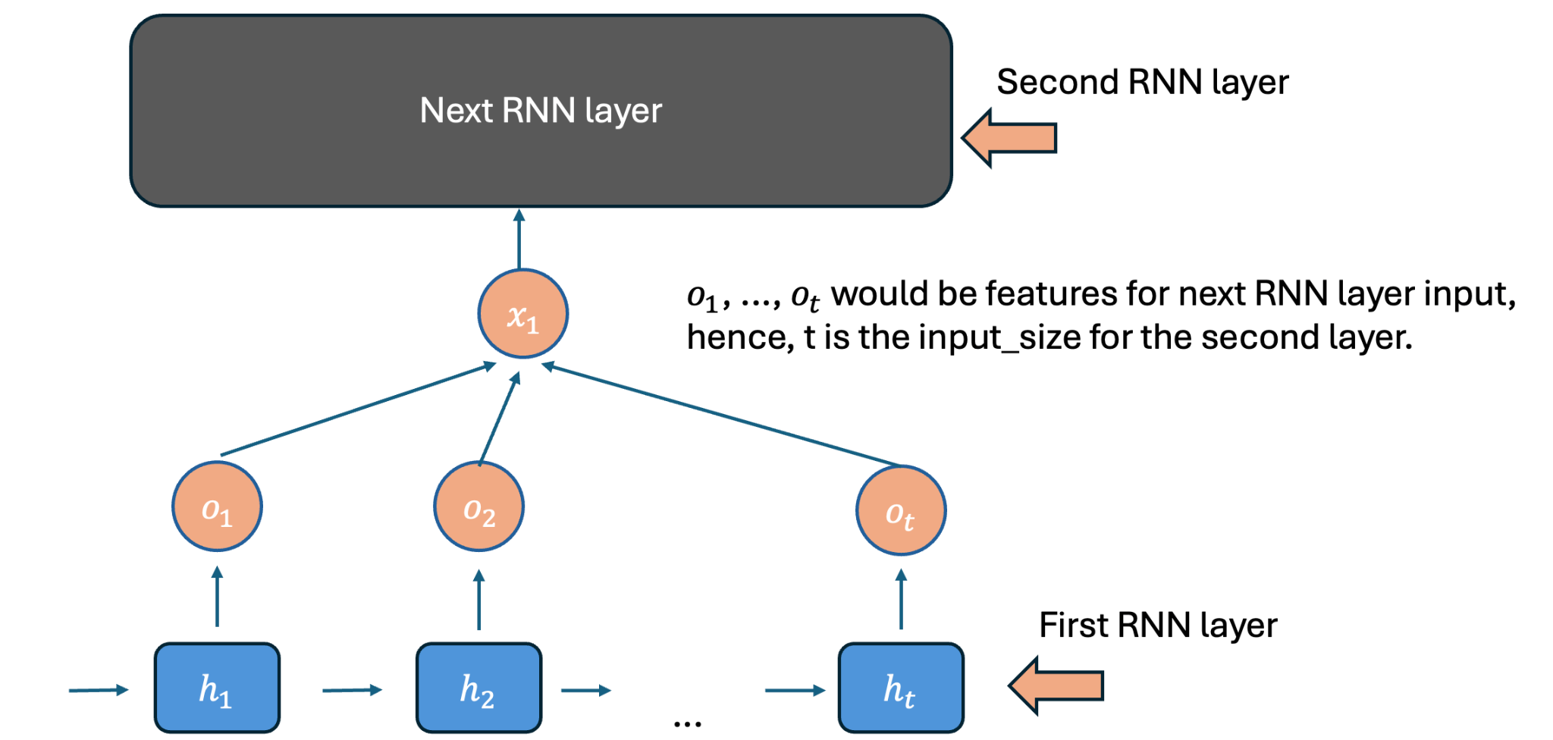
Overview
RNN layer connection

Slide 7
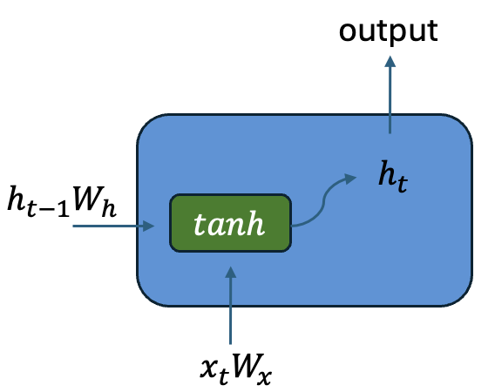
Overview
Each neuron in RNN

Slide 8
Basic Part (60%)
RNN layer (30%)
Implement initialize_parameters function (3%)
Implement forward pass (12%)
Implement backward pass (15%)
Back propagation of RNN: https://www.pycodemates.com/2023/08/backpropagation-through-time-explained-with-derivations.html

Slide 9
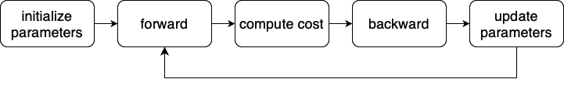
Basic Part (60%)
Model class (10%)
Implement forward pass, backward pass, update parameters and training function.
Training process

Slide 10
Output .npy File Format
Named as “Lab6_outputs.npy”.
This file is a dictionary that stores the output for each testing function. You can use the provided sanity check and expected output in the notebook to ensure nothing is missing.

Slide 11
Output .npy File Format
We will test your ”Lab6_outputs.npy” to verify the correctness of your basic implementation.
Submit this file to eeclass.
'RNN_backward’:
'dH shape',
'dH',
'dL_dX shape',
'dL_dX',
'dL_dWx shape',
'dL_dWx',
'dL_dWh shape',
'dL_dWh',
'dL_dbh shape'
'dL_dbh'
'Model_class':
'AL',
'dA_prev',
'Wx of RNN',
'Wh of RNN',
'bh of RNN'
'RNN_initialization':
'Wx_shape',
'Wh_shape',
'bh_shape',
'RNN_forward':
'X shape',
'X',
'Output shape',
'Output',

Slide 12
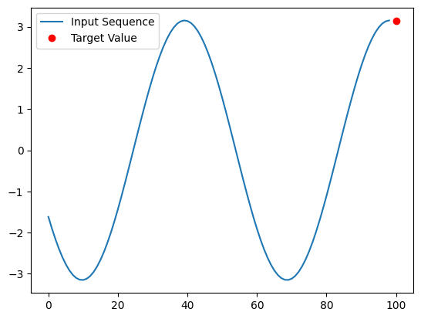
Basic Part (60%)
Sinusoidal wave data (20%)
In this dataset, we want you to build your model to predict the last value of given Sine wave data (sequential data).
We provided a function generate_sine_wave_data that you can generate your own training data with custom frequency and amplitude.
There are 500 samples with each 99 timesteps in testing data.

Slide 13
Basic Part (60%)
Sinusoidal wave data (20%)
1. You have to create your own training dataset by the given function in Lab6_template.ipynb.
2. First, try to construct the model without using RNN layer, that is, just using Dense layers to build the model. Then build another model with RNN layer to compare their performance.
3. Download the testing data(X_test.csv) from Kaggle to generate the prediction y_pred_basic.csv. Submit the y_pred_basic.csv to Kaggle for evaluation.

Slide 14
Basic Part (60%)
Sinusoidal wave data (20%)
4. Kaggle link: 2024ML-Lab6-Sinusoidal wave
5. We will use MAPE for evaluation. (On public leaderboard)
Baseline 1: MAPE <= 17 (%) (10%)
Baseline 2: MAPE <= 14 (%) (10%)
6. There is only public score (no private testing data) on Kaggle in this part!

Slide 15
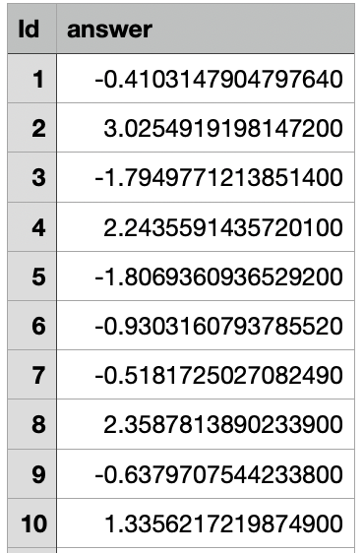
Output .csv file format (Basic part)
Here are some output format:
First row is the header [Id, answer].
Your prediction answer should be value in y_pred_basic.csv.
There should be 500 rows output.
Don’t change the output cell in template so that the format would be correct!
Submit the answer (y_pred_basic.csv) to Kaggle .
y_pred_basic.csv

Slide 16
Advanced Part (35%)
Designing a RNN Model for Categorical Classification
Design your RNN model with the given sequential data of Accelerometer and Gyroscope and predict the user’s activity type. (There are 3 kinds of activity in this task)
You can only use the functions you implement in the basic part.
We will use accuracy to evaluate your model.
Baseline 1: Accuracy >= 0.65 (10%)
Baseline 2: Accuracy >= 0.7 (10%)
Baseline 3: Accuracy >= 0.75 (10%)
Ranking (5%)
We’ve splitted the testing data to 60% for public score & 40% for private score.

Slide 17
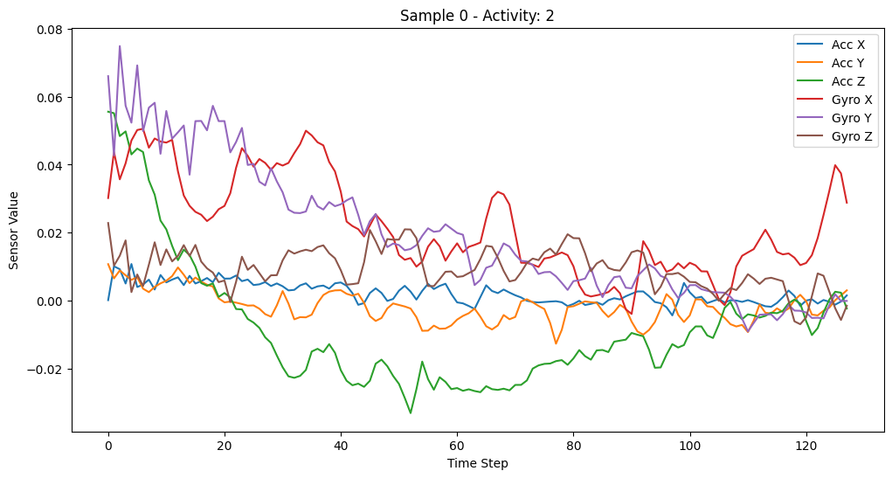
Data in Advanced Part
Categorical classification: Accelerometer and Gyroscope data
You will receive time-series (sequential) data of Accelerometer and Gyroscope each has 3-axial(x, y, z) data. For each record, there will be 128 timesteps.
Please download the training(X_train, y_train) and X_test from Kaggle.
X_train would contains 7352 samples.

Slide 18
Data in Advanced Part
Categorical classification: Accelerometer and Gyroscope data
3. Use the training data to classify 3 Human activities.
4. Submit the y_pred_advanced.csv to Kaggle, link: ML2024-Lab6-Activity classification
5. For y_train.npy, you should one-hot encode the labels before training the model

Slide 19
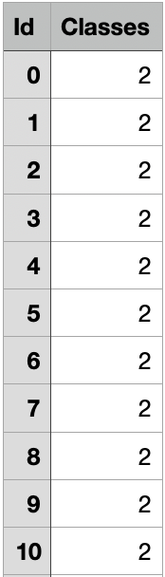
Output .csv file format (Advanced Part)
Here are some output format:
First row is the header [Id, Classes].
Your prediction answer should be class 0, 1, 2 in y_pred_advanced.csv
There should be 2947 row outputs.
Don’t change the output cell in template so that the format would be correct!
Submit the answer (y_pred_advanced.csv) to Kaggle .
y_pred_advanced.csv

Slide 20
Items for you
Template: Lab6_template.ipynb
Some files: Dense.py, Activation.py, Loss.py & Flatten.py (You can paste the code you wrote in Lab4 & Lab5 into these files).

Slide 21
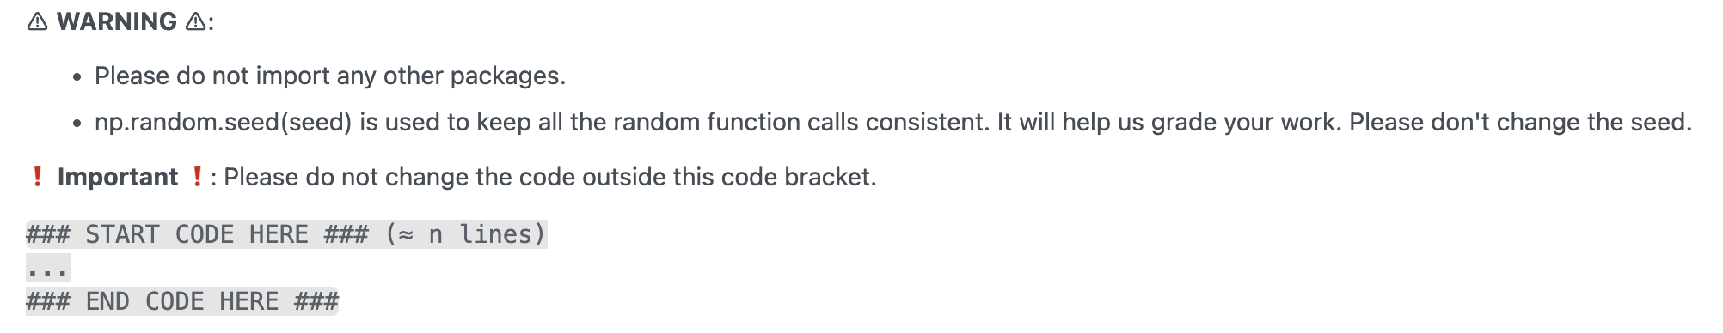
Template
Except for the imported packages in the template, you cannot use any other packages.
Remember to save the code file to Lab6.ipynb

Slide 22
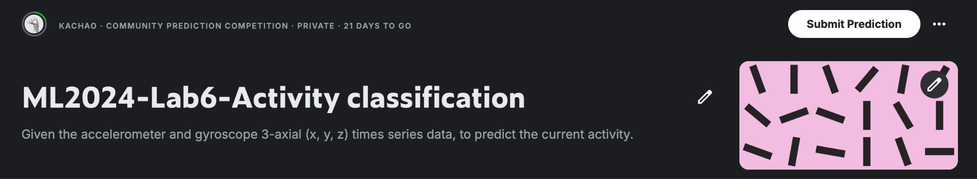
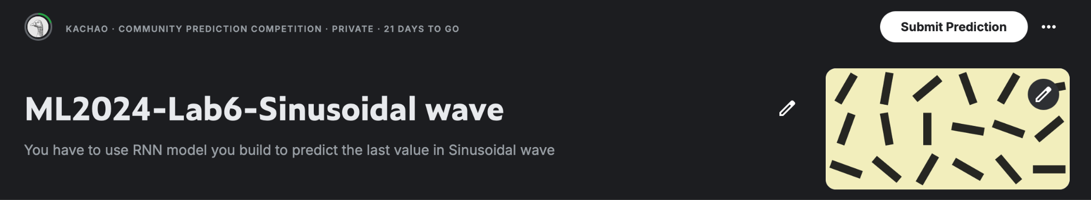
Kaggle
Please register your account.
Click the ‘Join competition’ button to join.

Slide 23
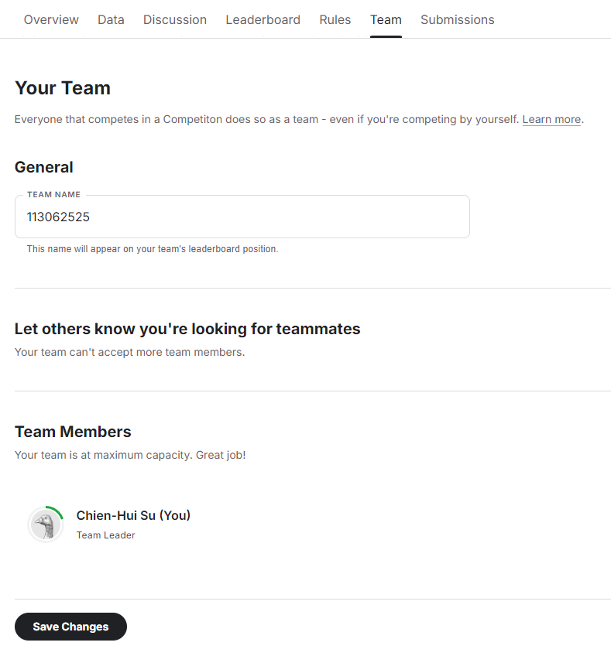
Kaggle
After joining the competition, you should change your team's name (each student is a team) to your student ID.
Please remember to SAVE CHANGES
You can submit 100 times per day.
Notes: Please verify your team's name on the leaderboard - changing profile name does not change team name.

Slide 24
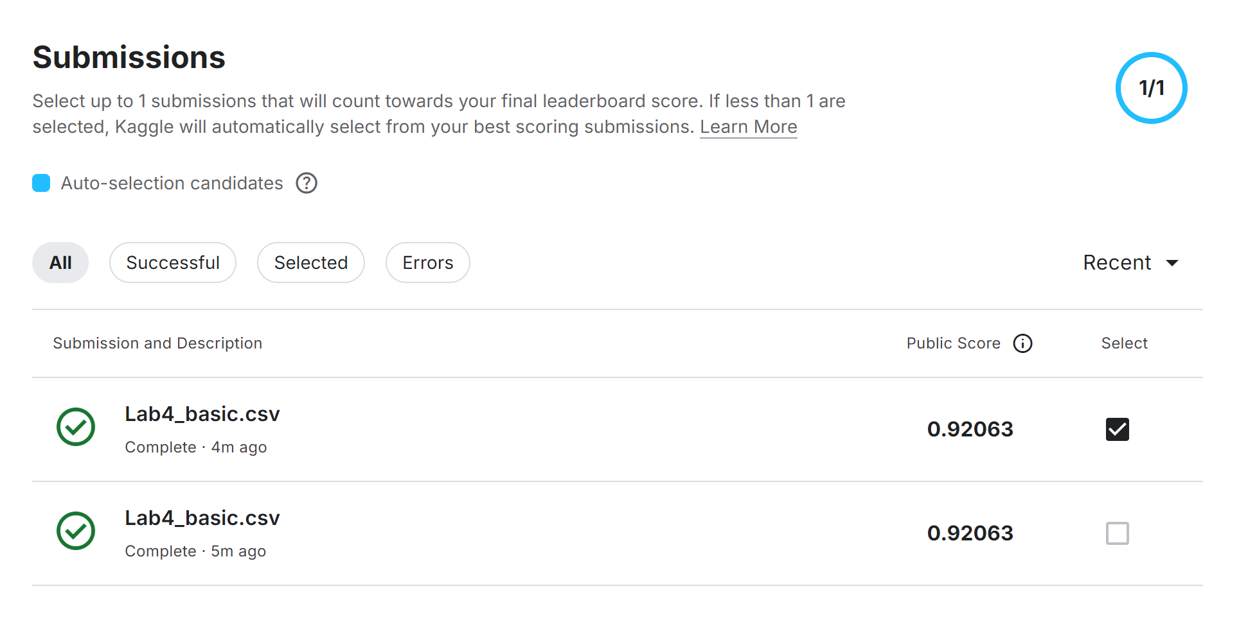
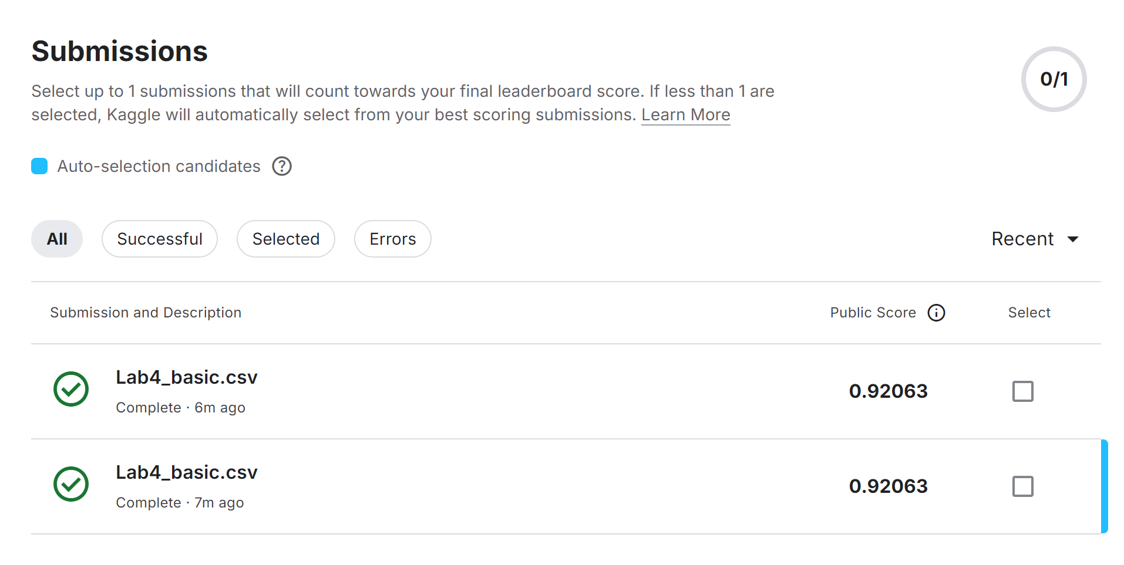
Kaggle
You can manually select up to 1 submission that will count towards your final leaderboard score. If no submission is selected, Kaggle will automatically select your submission with the best public score.
Manual-selection
Auto-selection

Slide 25
Report
When predicting values using sine wave data, is there a performance difference between the model that only contains Dense layers and one that includes an RNN layer? Which performs better? (1%)
Have you tried stacking two consecutive RNN layers in the model? How would you configure the parameters for the second RNN layer if the first RNN layer is defined as RNN(1, 16)? Briefly explain your reasoning.(2%)
What would be the effects with the larger size of hidden units in RNN layer? (2%)
Notes:
Do not exceed 1 page!
Name your report file as “Lab6_report.pdf”.

Slide 26
Requirement
Do it individually! Not as a team! (team is for final project)
Announce date: 2024/11/28
Deadline: 2024/12/19 23:59 (Late submission is not allowed!)
Submit the answers (.csv) to corresponding Kaggle competition (Ensure that your leaderboard team name matches your student ID)
Basic (Sinewave): ML2024-Lab6-Sinusoidal wave
Advance (Activity prediction): 2024ML-Lab6-Activity classification
Hand in your files in the following format (Do not zip the files!)
Lab6.ipynb (Please keep your execution output)
Lab6_outputs.npy
Lab6_report.pdf

Slide 27
Penalty
0 points if any of the following conditions happened:
Plagiarism
Late submission
Not using a template or importing any other packages
Incorrect input/output format
No submission record on Kaggle
Wrong team name on Kaggle (the team should be your student ID)
No code(“Lab6.ipynb”) submission on eeclass
Your submission on Kaggle was not generated by your code
5 Points would be deducted if your submission format or file name is incorrect
0 Points will be given in the Basic implementation if you don’t submit “Lab6_outputs.npy”

Slide 28
Questions?
TA:
Yu-Chieh Lin (ss113062537@gapp.nthu.edu.tw)
TA time: Thursday 17:00~18:00 at EECS 638
TA time reservation sheet: TA reservation
No debugging service

