Slide 1
NTHU Introduction to ML 2024
Lab 2
Mortality Prediction using Decision Tree and Random Forest
Ya-Ting Lin
Po-Chih Kuo

Slide 2
Introduction
Machine learning is playing an increasingly important role in healthcare, where its ability to analyze vast amounts of data can directly impact human lives.
By implementing predictive models on ICU patient data, you'll explore how machine learning can be used to support critical healthcare decisions. Whether it's identifying at-risk patients or improving care outcomes, these techniques offer the potential to transform patient care and save lives.
By the end of this lab, you will have a deeper understanding of how machine learning can be applied to healthcare scenarios, where every decision can make a difference.

Slide 3
Dataset
Real Data
A database containing a large amount of critical care data from many different intensive care units (ICUs) worldwide
Basic Part: We extracted 40 cases with 10 attributes and 1 label (‘hospital_death’)
Advanced Part: We extracted 8500 cases with 29 attributes and 1 label (‘hospital_death’)

Slide 4
Goal
Be familiar with the concepts of building a decision tree
Implement a decision tree
Implement a random forest
Make predictions on patients’ survival (‘hospital_death’) from real data
Fine-tune the model for better performance

Slide 5
You will have the following items
Template : lab2.ipynb
Input file :
lab2_basic_input.csv
lab2_advanced_training.csv
lab2_advanced_testing.csv (without label ‘hospital_death’)

Slide 6
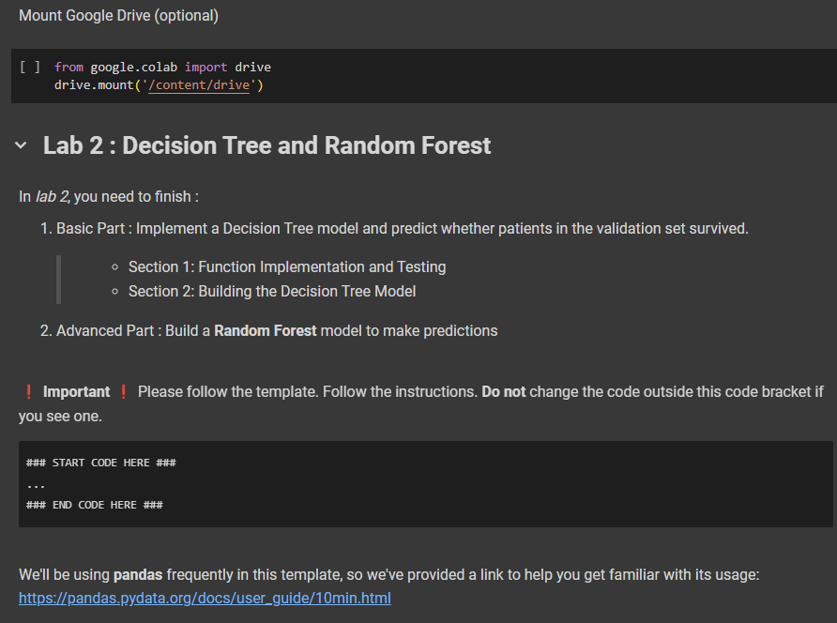
Template
You must use the given file lab2.ipynb to build the model
Except for the imported packages in the template, you cannot use any other packages
Please follow the template, and only modify the content where we specifically indicate you can.

Slide 7
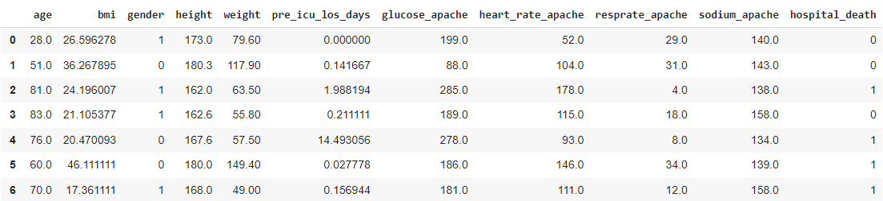
Basic Input File Format
Named “lab2_basic_input.csv”
40 instances in total
Each instance has 10 features and 1 class label
10 features
Class label

Slide 8
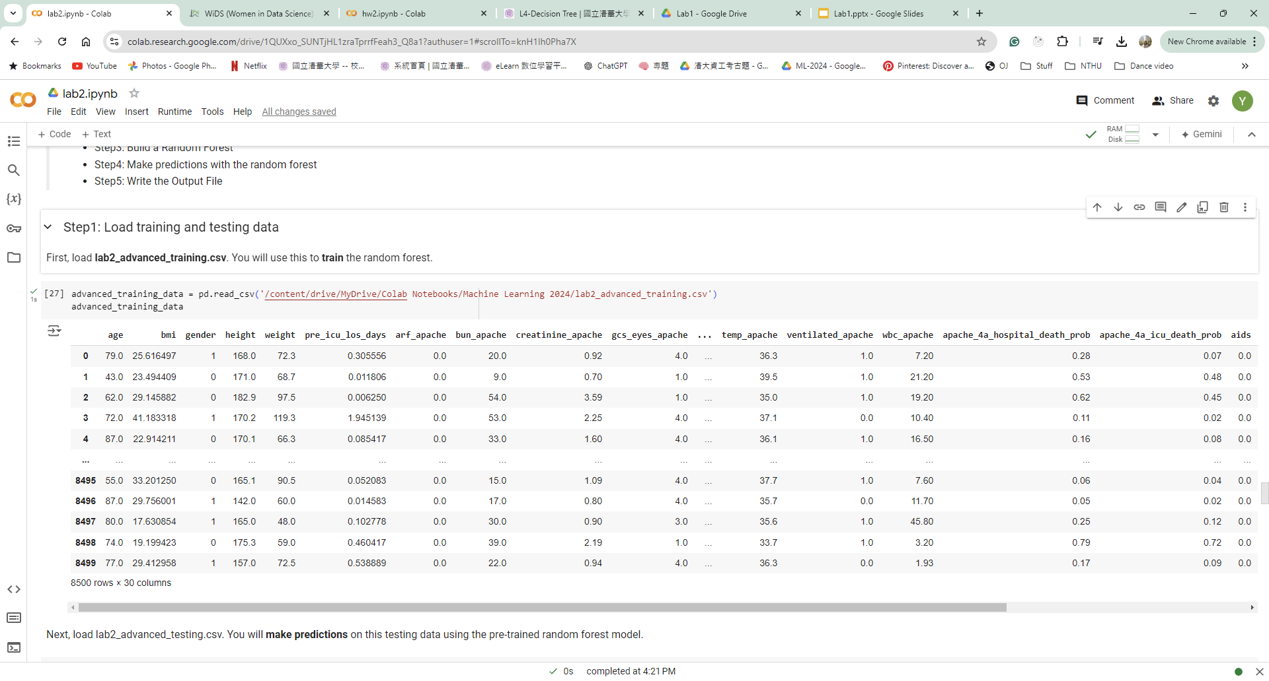
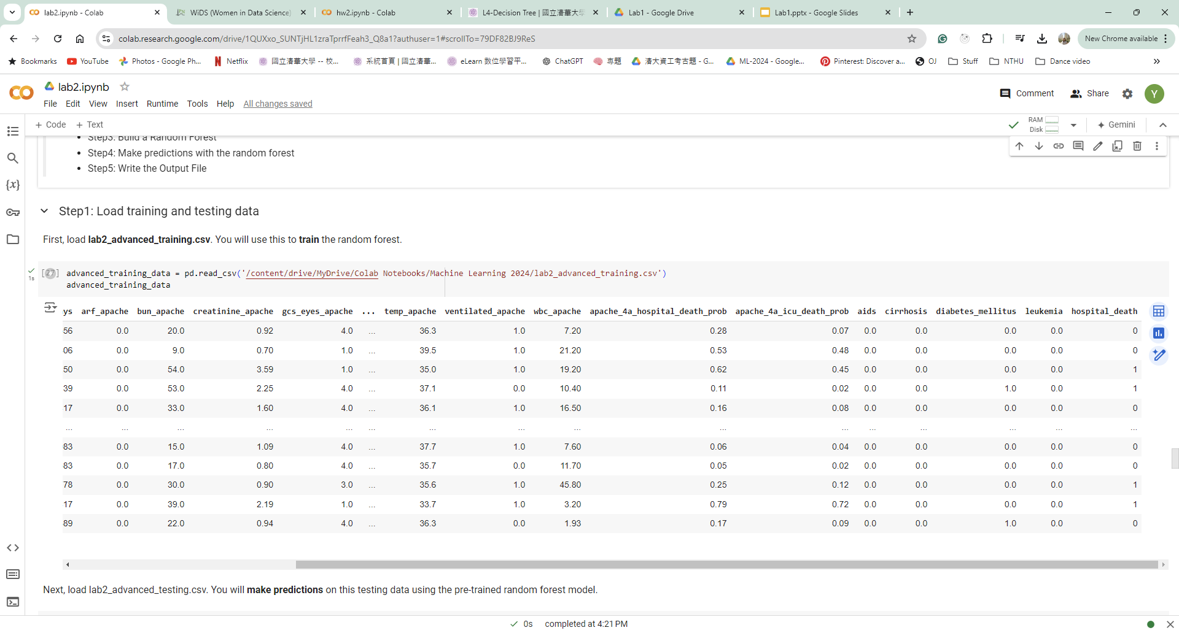
Advanced Training File Format
Named “lab2_advanced_training.csv”
8500 instances in total
Each instance has 29 features and 1 class label
29 features
Class label

Slide 9
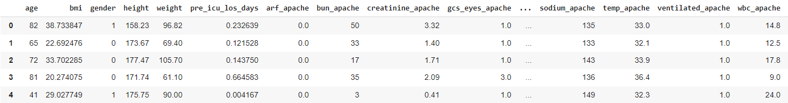
Advanced Testing File Format
Named “lab2_advanced_testing.csv”
900 instances in total
Each instance has 29 features
Without class label
29 features

Slide 10
Grading Policy
Item | Score
Basic Implementation (Decision Tree) | 30%
Advanced Implementation (Random Forest) | 65%
Report | 5%

Slide 11
Basic Implementation (30%)
Section 1: Function Implementation and Testing
Implement 5 functions that are necessary for building a decision tree model.
After implementing each function, you must run it with the given input variables to verify its correctness.
Section 2: Build a Decision Tree Model and make Predictions
Use the functions from section 1 to build a decision tree model and make predictions.
Please use lab2_basic_input.csv as your input data

Slide 12
Basic Grading Policy
Given information on 40 patients and whether they survived
Section 1: Function Implementation and Testing
Step 1 : Calculate the Entropy (5%)
Step 2 : Calculate the Information Gain (5%)
Step 3 : Find the Best Split (5%)
Step 4 : Split the data into two branches (5%)
Step 5 : Build the decision tree (5%)
Step 6: Save answers
Section 2: Build a Decision Tree Model and make Predictions
Step 1: Split the data into training set and validation set
Step 2: Train a decision tree model with the training set
Step 3: Predict the cases in the validation set by using the model trained in Step 2
Step 4: Calculate the f1-score of your predictions in Step 3 (5%)
Step 5: Save answer

Slide 13
Basic Output File Format
Please save your answers into lab2_basic.csv
Submit the file to eeclass
There should be 7 rows in your csv file:
row number | description | variable
Row 1 | Header | [‘Id’, ‘Ans’]
Row 2 | entropy | ‘ans_entropy’
Row 3 | information gain | ‘ans_informationGain’
Row 4 | best split information gain, value, feature | [‘ans_ig’, ‘ans_value’, ‘ans_name’]
Row 5 | number of instances in the left subtree | ‘ans_left’
Row 6 | n features and the threshold corresponding to each feature | ‘ans_features’ + ‘ans_thresholds‘
Row 7 | F1-score | ‘ans_f1score’

Slide 14
Advanced Implementation (65%)
Build a random forest
Please use lab2_advanced_training.csv as the training data
Make predictions with the Random Forest on the testing data lab2_advanced_testing.csv

Slide 15
Advanced Grading Policy
Baseline – 55%
F1-Score >= 0.65 (25%)
F1-Score >= 0.68 (15%)
F1-Score >= 0.7 (15%)
Ranking – 10%
Compete your F1-Score with the whole class

Slide 16
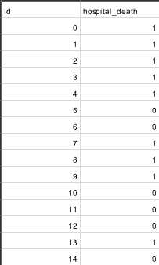
Advanced Output File Format
There should be (900+1) rows in your csv file
First row is the header [‘Id’, ‘hospital_death’]
Your prediction answer should be either 0 or 1
Id starts from 0, and hospital_death is the predicted answer
Please make sure that your output format is correct
Submit the answer (.csv) to Kaggle ML2024-Lab2-AdvancedPart

Slide 17
Kaggle
We’ve created a competition for the Advanced part
link: https://www.kaggle.com/t/f429abd0842e414e9685155f9bcb21ce
In the advanced part, we split the testing data into public & private parts.
The score you see on kaggle after submission is your public score
You can directly check if you have passed the three baselines
Private score is for ranking.
The private score will be revealed after the deadline.

Slide 18
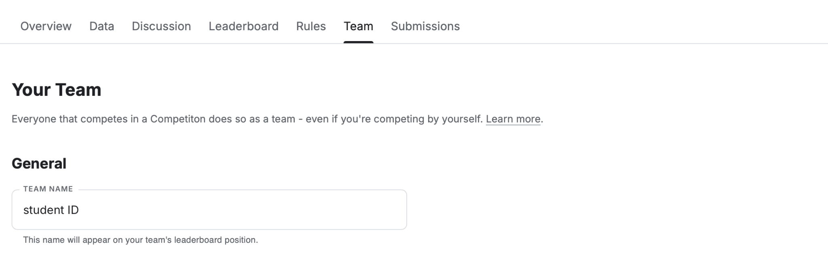
Kaggle
After joining the competition, you should change your team name (each student is a team) to your student ID.

Slide 19
Report
Named as “lab2_report.pdf”
Briefly describe the attributes setting of the random forest model , including:
The number of trees you used (1%)
The number of features you used (1%)
The number of instances you used to build each tree (1%)
(optional) any other settings
Briefly describe the difficulty you encountered (1%)
Summarize how you solved the difficulty and your reflections (1%)
No more than one page

Slide 20
Lab 2 Requirements
Do it individually! Not as a team! (The team is for the final project)
Announce date: 2024/10/1
Deadline: 2024/10/15 23:59 (Late submission is not allowed!)
Hand in your files in the following format (Do not compress!)
lab2.ipynb
lab2_report.pdf
lab2_basic.csv

Slide 21
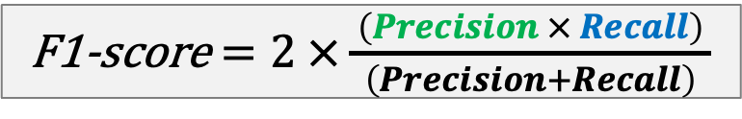
The Evaluation Metric
F1-score
For example
The class you predicted:
ŷ = [1, 1, 0, 0, 0, 0, 1]
Actual values:
y = [0, 0, 0, 0, 0, 1, 1]
F1-score = 0.4
 |  | Actual/True value
 |  | positive | negative
Predicted value | positive | TP | FP
 | negative | FN | TN
 |  | Actual/True value
 |  | positive | negative
Predicted value | positive | TP | FP
 | negative | FN | TN

Slide 22
Penalty
0 points if any of the following conditions happened
Plagiarism
Late submission
Not using a template or importing any other packages in this assignment
No submission record on Kaggle
Your submission was not generated by your code
Not following the instructions to print certain answers in the template
Kaggle’s team name is not your student ID(we cannot identify who you are)

Slide 23

Questions?
TA: Ya-Ting Lin (ivylin752@gmail.com)
Do not ask for debugging.
TA time for 10/3 and 10/9 will be moved to 17:30~18:30

