Slide 1
Lab 3 Linear Classification
Chien-Hui Su
Po-Chih Kuo

Slide 2
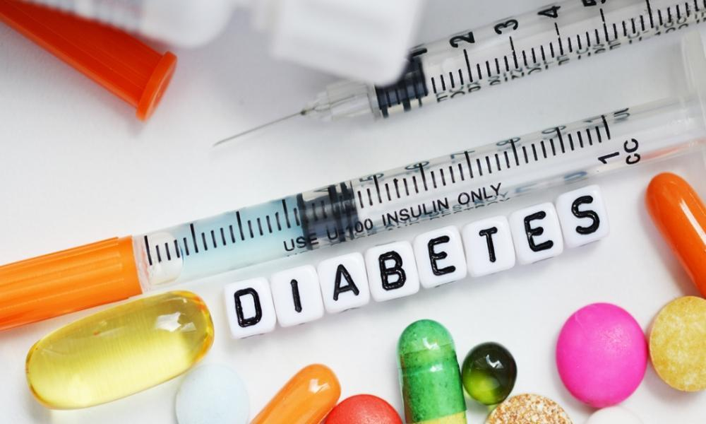
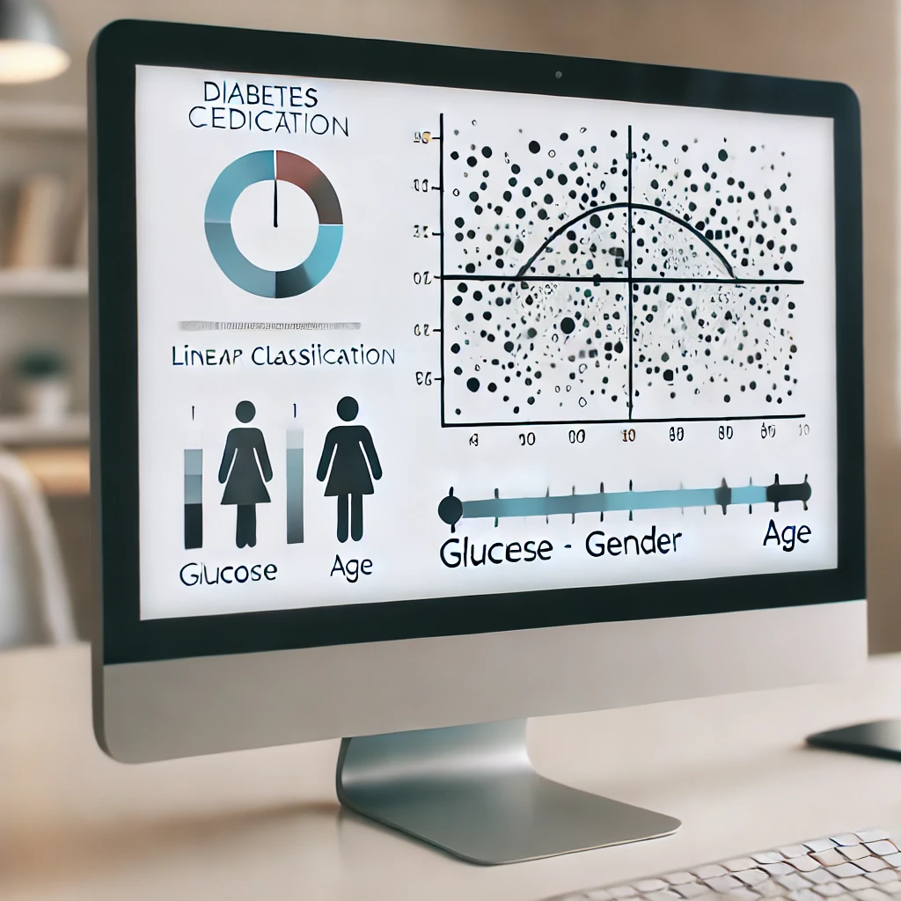
Introduction
In this lab, students will need to implement classification methods to accurately classify whether the patient has diabetes (1) or not (0) based on their Age, BMI, and Glucose.

Slide 3
Dataset
Given 25000 records for training/validation, 5000 for testing
The data used in this lab has 3 features of patients.
Age, BMI, and Glucose(血糖)
Classes
2 classes: no diabetes(0), diabetes(1)

Slide 4
Goal
Predict if the patients have diabetes
Implement the Perceptron
Implement Fisher’s Linear Discriminant Analysis (LDA)
Implement LDA classifier using Gaussian distributions and MAP estimation

Slide 5
Grading Policy
Item | Score
Part 1: Perceptron | 35%
Part 2: Fisher’s LDA | 35%
Part 3: LDA + MAP | 25%
Report | 5%

Slide 6
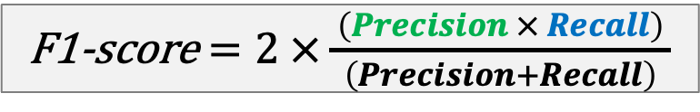
The Evaluation Metric
F1-score
For example
The class you predicted:
ŷ = [1, 1, 0, 0, 0, 0, 1]
Actual values:
y = [0, 0, 0, 0, 0, 1, 1]
F1-score = 0.4
 |  | Actual/True value
 |  | positive | negative
Predicted value | positive | TP | FP
 | negative | FN | TN
 |  | Actual/True value
 |  | positive | negative
Predicted value | positive | TP | FP
 | negative | FN | TN

Slide 7
Grading Policy-Part 1: Perceptron (35%)
Implement key functions of a Perceptron
Submit the answer (.csv) to Kaggle ML2024-Lab3-Perceptron
Get all if F1 score >= 0.5

Slide 8
Grading Policy-Part 2: LDA (35%)
Implement key functions of Linear Discriminant Analysis (LDA)
Submit the answer (.csv) to Kaggle ML2024-Lab3-LDA
Get all if F1 score >= 0.6

Slide 9
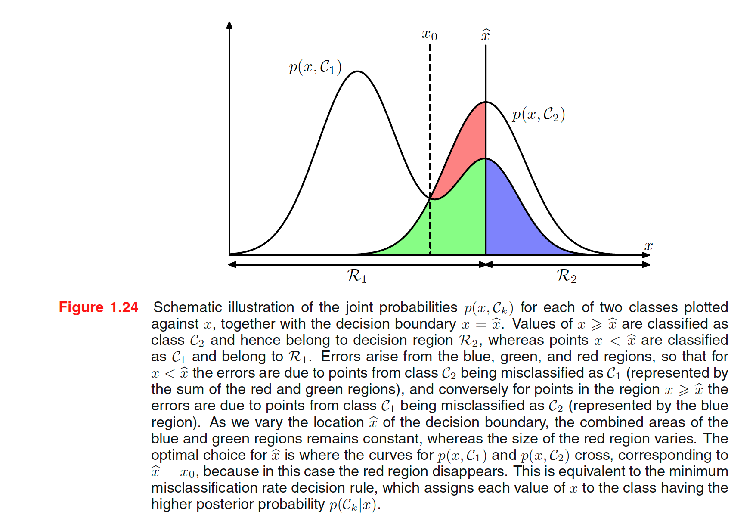
Part 3 - LDA with MAP
(Chapter 4.5.1 of Pattern Recognition and Machine Learning. Book by Christopher Bishop)

Slide 10
Part 3 - LDA with MAP
LDA projects the data onto a lower-dimensional space that maximizes class separability
After projection, we assume each class follows a Gaussian distribution in this new space. Computes the means, variances, and priors of each class in the LDA-projected space.
Implement the Gaussian density function.
Use MAP estimation
For each test point, calculate its likelihood of belonging to each class using the likelihood function.
Multiply these likelihoods by the class priors to get quantities proportional to the posterior probabilities.
Predict based on the highest posterior probability.

Slide 11
Grading Policy-Part 3: LDA with MAP (25%)
Implement key functions of Linear Discriminant Analysis (LDA) using Gaussian distributions and Maximum A Posterior (MAP) estimation.
Submit the answer (.csv) to Kaggle ML2024-Lab3-LDAMAP
Get all if F1 score >= 0.6

Slide 12
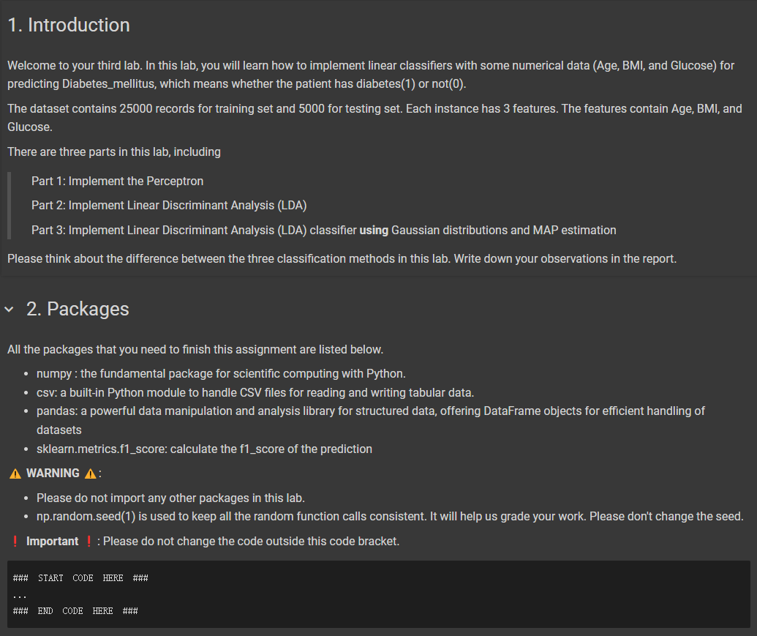
Template
You must use the given file “Lab3_template.ipynb” to build the model
Except for the imported packages in the template, you cannot use any other packages in this lab

Slide 13
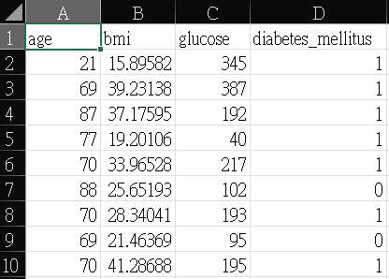
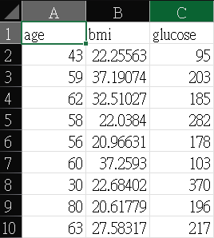
Input File Format
lab3_training.csv
There will be two input files:
“lab3_training.csv”
Label 0, 1
Each row has 3 features
Contains 25000 rows
“lab3_testing.csv”
Contains 5000 rows
label
lab3_testing.csv

Slide 14
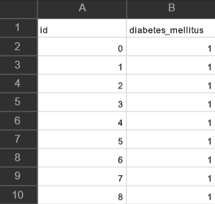
Output File Format
There should be (5000+1) rows in your csv file
First row is the header [‘id’, ‘diabetes_mellitus’]
Your prediction answer should be either 0 or 1
Id starts from 0, and diabetes_mellitus is the predicted answer
Please make sure that your output format is correct
Submit the answer (.csv) to Kaggle ML2024-Lab3-Perceptron, ML2024-Lab3-LDA, ML2024-Lab3-LDAMAP respectively

Slide 15
Kaggle
We’ve created three competitions for each part respectively.
Part 1 link: https://www.kaggle.com/t/45991d6a368e12568344cae35a1e4d9b
Part 2 link: https://www.kaggle.com/t/2a4ed439f6bd997affa01473fd9f0b32
Part 3 link: https://www.kaggle.com/t/6d62fd46fbb3421ea893761f77317c31
For each part of the lab, only a public score is provided. You can check if you pass the baseline directly.

Slide 16
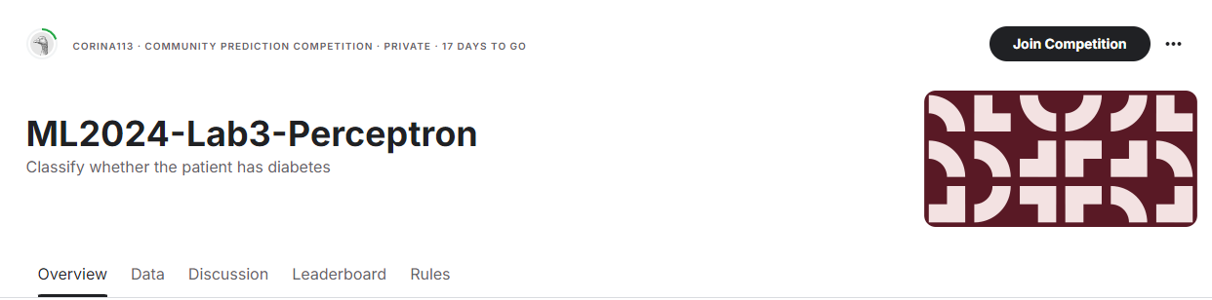
Kaggle
Please register your account.
Click the ‘Join competition’ button to join.

Slide 17
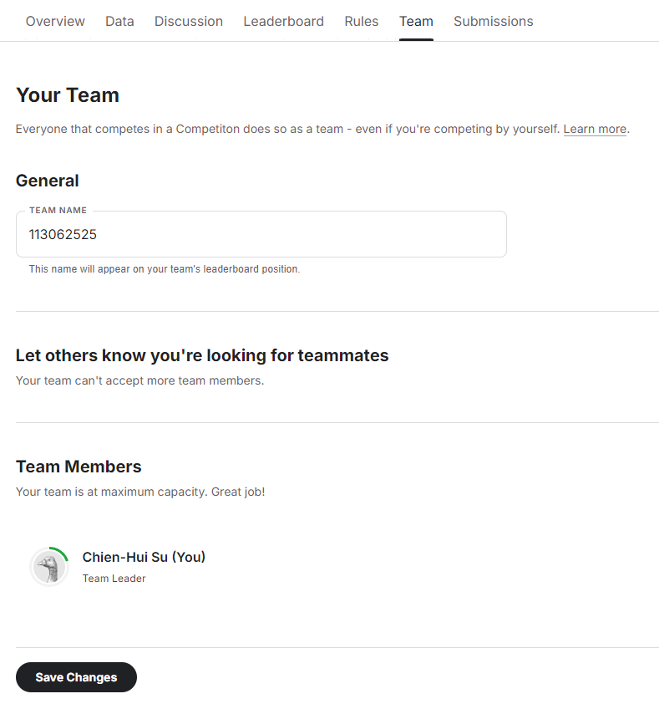
Kaggle
After joining the competition, you should change your team name (each student is a team) to your student ID.
Please remember to SAVE CHANGES
You can submit 50 times per day.

Slide 18
Report
Named as “Lab3_report.pdf”
State the possible reason why the accuracy or F1-score change between Perceptron and LDA? (2%)
Does MAP help? Why?(2%)
Summarize how you solve the difficulty and your reflections (1%)
No more than one page

Slide 19
Lab 3 Requirement
Do it individually! Not as a team! (The team is for final project)
Announce date: 2024/10/17
Deadline: 2024/10/31 23:59 (Late submission is not allowed!)
Submit the answers (csv) to corresponding Kaggle competition.
ML2024-Lab3-Perceptron
ML2024-Lab3-LDA
ML2024-Lab3-LDAMAP
Hand in following files to eeclass in the following format (Do not compressed!)
Lab3.ipynb
Lab3_report.pdf
Lab 3 would be covered on the exam next time.

Slide 20
Penalty
0 points if any of the following conditions happened
Plagiarism
Late submission
Not using a template or importing any other packages
No submission record on Kaggle (we cannot identify who you are)
Your submission was not generated by your code
5 Points would be deducted if your submission format is incorrect

Slide 21
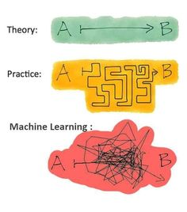
Questions?
TA: Chien-Hui Su (fabienne1023@gapp.nthu.edu.tw)
Do not ask for debugging.

