Slide 1
Solving Mine Sweeper in parallel
311551107 石偉辛 311552007 張千祐 311551131 賴俊宇

Slide 2
Outline
Introduction
Problem Statement
Related Work
Parallel Solution
Evaluation
Conclusion
Contributions

Slide 3
Introduction

Slide 4
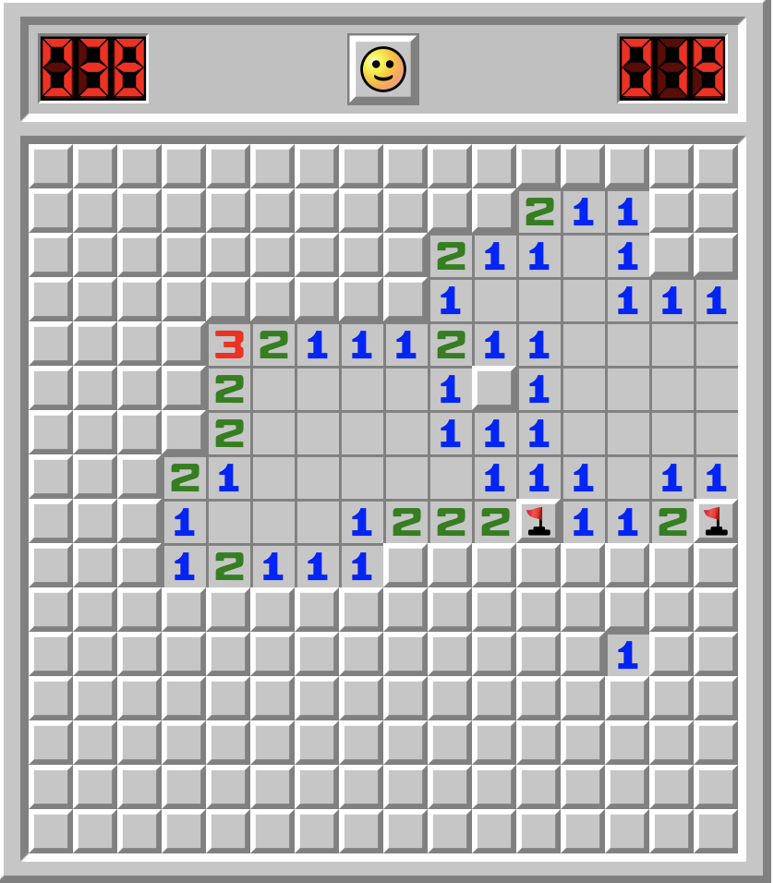
Introduction
Goal – Find out all the mines in the map.
Number in the grid means the number of mines around it.
Place a flag if you consider there’s a mine.

Slide 5
Problem Statement

Slide 6
Problem Statement
Generate Map
n<N?
False
n – Current mines found
N – Total number of mines
True
Random Select
Detect
Mines
Changed?
False
True
Compare
Map

Slide 7
Problem Statement
Generate Map
n<N?
False
True
X+F==G?
True
Random Select
False
True
F==G?
Detect
Mines
False
Open Unknown
Place
Flag
Changed?
False
True
Compare
Map

Slide 8
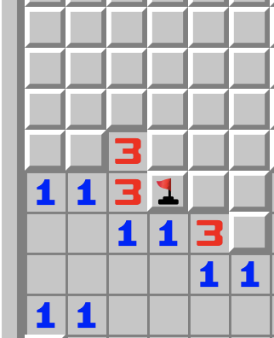
Unknown(X) + Flag(F) == Grid(G)
X+F==G?
True
False
True
F==G?
False
Open Unknown
Place
Flag

Slide 9
Flag(F) == Grid(G)
X+F==G?
True
False
True
F==G?
False
Open Unknown
Place
Flag

Slide 10


Parallelize
Generate Map
n<N?
False
True
Critical Section
Random Select
Program flow
Time
Detect
Mines
Parallel
Region
Changed?
False
True
Compare
Map

Slide 11
Related Work

Slide 12
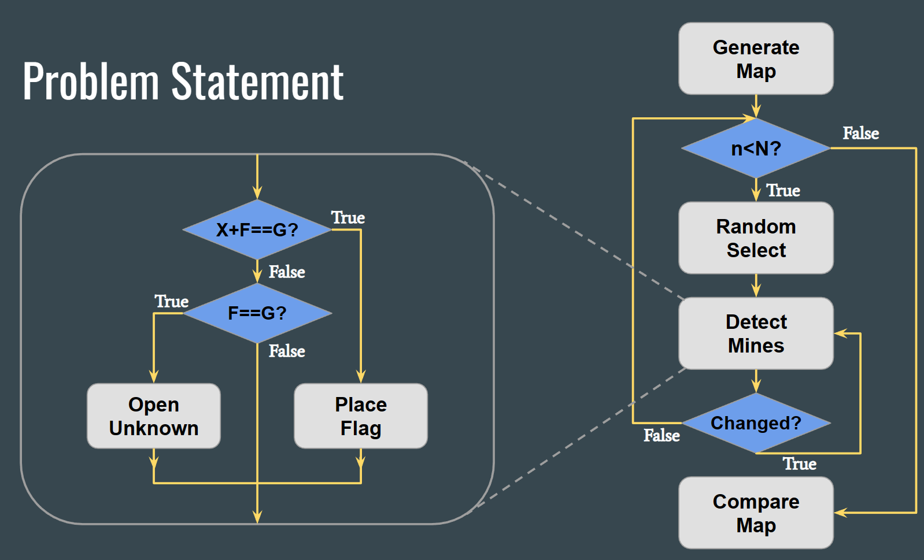
Related Work
Almost every related work we found apply same way on random select and detect mines.
Mainly difference is how they pick grid before detecting mine.

Slide 13
Go through the whole map
Go through all the grids on the map every round.
At the end of each round, check whether the map is changed or not.
Changed → loop again
Unchanged → random select

Slide 14
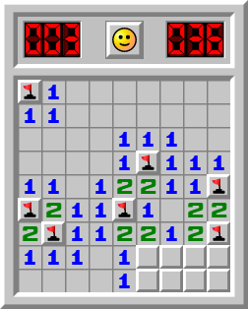
2. Update set
Maintain a set storing unfinished grids.
Pick grid from the set to detect mine.

Slide 15
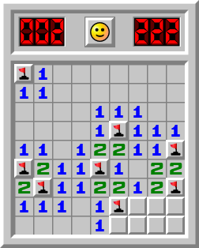
2. Update set
Situation：place flag
Set that grid flag.
Pop itself from the set.
X

Slide 16
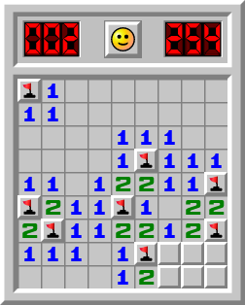
2. Update set
Situation：open unknown
Pop itself from the set
Push the unknown grid to the set.
X

Slide 17
Parallel Solution

Slide 18
Parallel Solution - Pthread
Apply the way of “go through” for picking grid in our implementation.
Devide workload by row.
Red : thread ID = 1
blue : thread ID = 2
green : thread ID = 3

Slide 19
Parallel Solution - Pthread
Create
Threads
n – Current mines found
N – Total number of mines
Random Select Once
Detect
All
Mines
Changed
True
False
n<N?
Join

Slide 20
Parallel Solution - Chanllenge
Problem 1：At first, we apply the way of “ Update Set ” for picking grid in our implementation, But the mutex overhead is too high.
Problem 2：We use the barrier to solve the problem of synchronization, but it costs more than we think.

Slide 21
Parallel Solution - Cuda
n<N?
True
False
Random Select
The flow is slightly different from pthread method.
Devide workload into blocks
Each blocks：25 x 25 threads
Each thread：Detects 4 grids
Call Cuda
Blocks
Detect All Mines
True
False
change?
Compare Map

Slide 22
Evaluation

Slide 23
Evaluation - Platform
Workstation
GPU：GeForce GTX 1060 6GB
CPU ：Intel(R) Core(TM) i5-7500 CPU @ 3.40GHz processors

Slide 24
Evaluation - Pthread vs Serial
Method \ Map Size | 50 x 50 (200) | 100 x100 (800) | 200 x 200 (2500) | 500 x 500 (4000) | 1000 x 1000 (7000)
Serial | 0.001431 | 0.00839 | 0.070506 | 0.945244 | 7.36482
2 Thread | 0.002797 | 0.010921 | 0.078682 | 1.01815 | 7.64167
4 Thread | 0.003013 | 0.012759 | 0.092178 | 1.09629 | 8.00158
8 Thread | 0.00425 | 0.014458 | 0.096284 | 1.20283 | 8.06298
(sec)

Slide 25
Evaluation - Cuda vs Serial
Method \ Map Size | 50 x 50 (200) | 100 x100 (800) | 200 x 200 (2500) | 500 x 500 (4000) | 1000 x 1000 (7000)
Serial | 0.001431 | 0.00839 | 0.070506 | 0.945244 | 7.36482
Cuda | 0.000314 | 0.000944 | 0.001627 | 0.002925 | 0.006927
(sec)

Slide 26
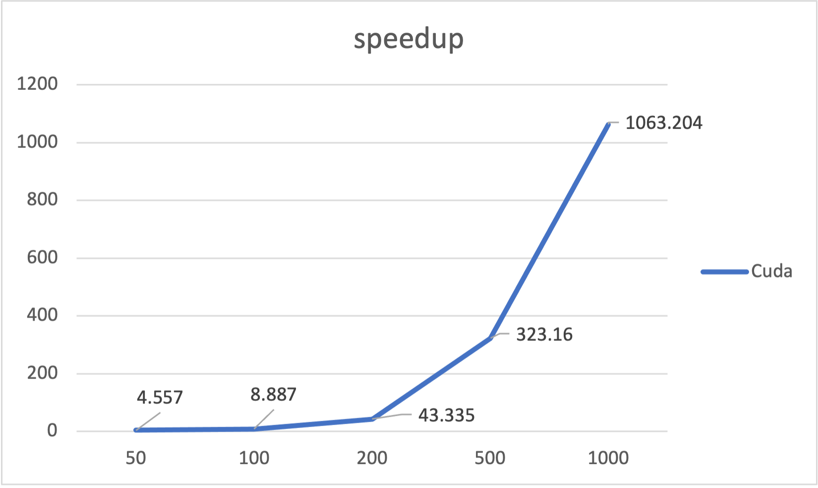
Evaluation - Speedup
Method \ Map Size | 50 x 50 (200) | 100 x100 (800) | 200 x 200 (2500) | 500 x 500 (4000) | 1000 x 1000 (7000)
Cuda | 4.55732484 | 8.88771186 | 43.3349723 | 323.160342 | 1063.20485

Slide 27
Conclusion

Slide 28
Conclusion
To accelerate the serial program, we implement two parallel methods including Pthread and Cuda.
In Pthread method, we found that synchronization overhead costs much more than the benefits from parallelization.
In Cuda method, we get well performance and have 1000x speedup when map is 1000 x 1000.

Slide 29
Contributions
石偉辛：Problem discussion、Program dessign、Presentation
張千祐：Problem discussion、Program dessign、Presentation
賴俊宇：Problem discussion、Program dessign、Presentation

Slide 30
Reference
https://github.com/meganung/minesweeper-solver
minesweeper-online-solver/Board.py at master ·h0rban/minesweeper-online-solver (github.com)

Slide 31
Create
Threads
Random Select Once
Detect
All
Mines
Changed
True
False
n<N?
Join

